Slide 1
AirPenguin
David Bright
Jordan Humphrey
Denis Le Borgne
Austin Lingenfelter
Melissa Lynch
John Nistico
Bradley Stemm
Emile Tawfik
Notes:
Austin

Slide 2

AirPenguin
A video casting alternative to
Chromecast using a Raspberry pi
Developed in Qt for cross platform capabilities, maintainability, and large support community
Notes:
Austin: So when looking for inspiration for our project, we looked at the google chrome cast and thought could this be implemented using a raspberry pi? The end result is a software designed using Qt. Our biggest reason when choosing Qt for our development was that fact that there is such a large support community surrounding the Qt Community; and also the fact that Qt offers easier access when dealing with cross platform development.

Slide 3
Development Roles
Austin: Scrum master
Denis: Network coding
Emile: Network coding
Jordan: Encryption, testing, QA
John: Video player, transcoding
Melissa: UI design, presentation
Bradley: UI & icon design, pi testing
David: UI design, UI implementation
Notes:
Austin
So as you can see from the screen when it came to developing in a larger group, a lot of us had to adapt and take on roles completely new to us.

Slide 4
Development Process
Agile Programming
Bi-weekly scrum meetings, daily open
communication during sprints
5 sprints total
Project Management through Slack & GitHub
Notes:
Austin
Throughout the development process we relied heavily on the scrum method. Being that we are all students, we did not have the time to approach our project using the waterfall method. This is another major reason as to why we went with the agile programming method. This allowed us to be able to put forth the code we had developed throughout each scrum.

Slide 5
Sprint 1
Goals:
Familiarize ourselves with Qt
Identify initial use cases, program features, requirements
Rough UI brainstorming
Socket code
Outcomes:
Identified some Qt libraries, classes to be used in network, player
Socket code completed
Early Network UML developed
Sketches of possible UI, icon development, color palette
Notes:
Melissa

Slide 6
Sprint 2
Goals:
Develop TCP connection
Media Player - QMediaPlayer
Encryption skeleton creation
UI design
Outcomes:
Working connection with client/server
Media player switched to using VLC libraries
Codec support not good in Qmediaplayer
IO problems/ memory
VLC is clean, clear, concise
Issues with Qt build on pi
Encryption plan/UML
UI wireframes completed
Notes:
Melissa

Slide 7
Sprint 3
Goals:
Encryption
Start UI Implementation
Video Playback on pi
Initial testing with Raspberry pi
Outcomes:
Encryption no longer part of development
Due to limited processing on Raspberry pi
UI started, tweaks to widget types, buttons, etc.
Notes:
Melissa

Slide 8
Sprint 4
Goals:
UI implementation/ completion
Test plan development
Final changes to network
Outcomes:
UI Completed
Fully developed test plan and framework/environment
Final network code & UML
Notes:
Melissa

Slide 9
Sprint 5
Goals:
UI Integration, Polishing
Testing
Outcomes:
UI Integrated/ Completed
Testing Completed
Built executable file
Notes:
Melissa

Slide 10
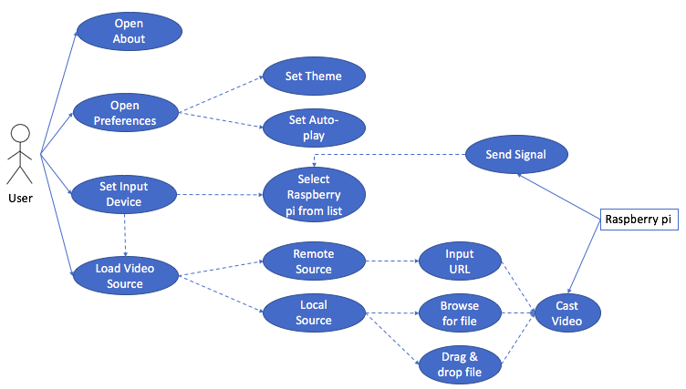
Requirements Analysis/ Use Cases
Notes:
Austin

Slide 11
Design Patterns
Network manager is a singleton
Iterator pattern used in network manager
Signals & Slots (UI) use Observer pattern
Façade structural pattern to abstract complexities of underlying code
Abstracts libVLC API calls and data structures
Notes:
John

Slide 12
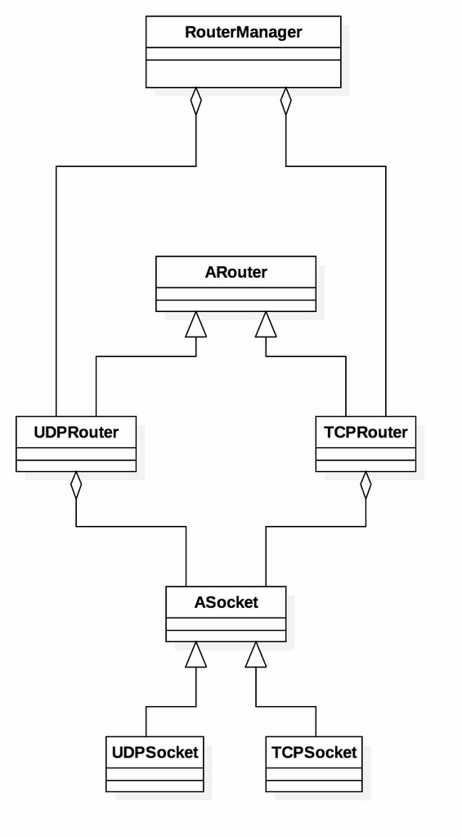
UML - Network Early Version
Notes:
Emil/ Denis

Slide 13
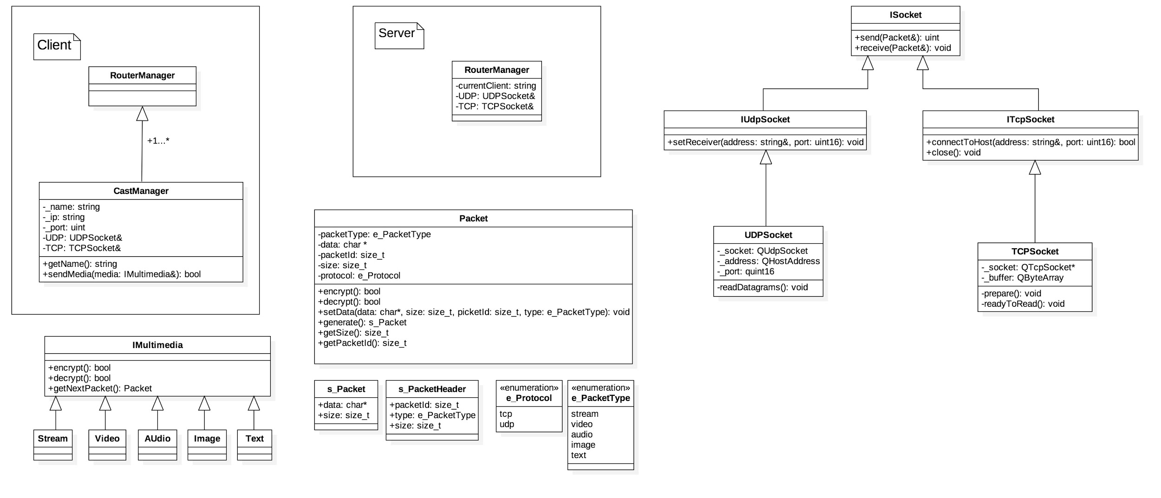
UML - Network Updated Version
Notes:
Emil/ Denis

Slide 14
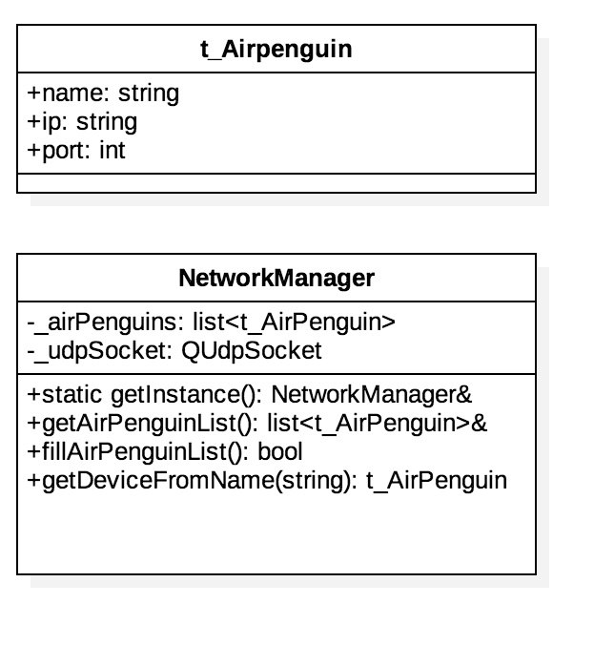
UML - Network Current Version
Notes:
Emil/ Denis

Slide 15
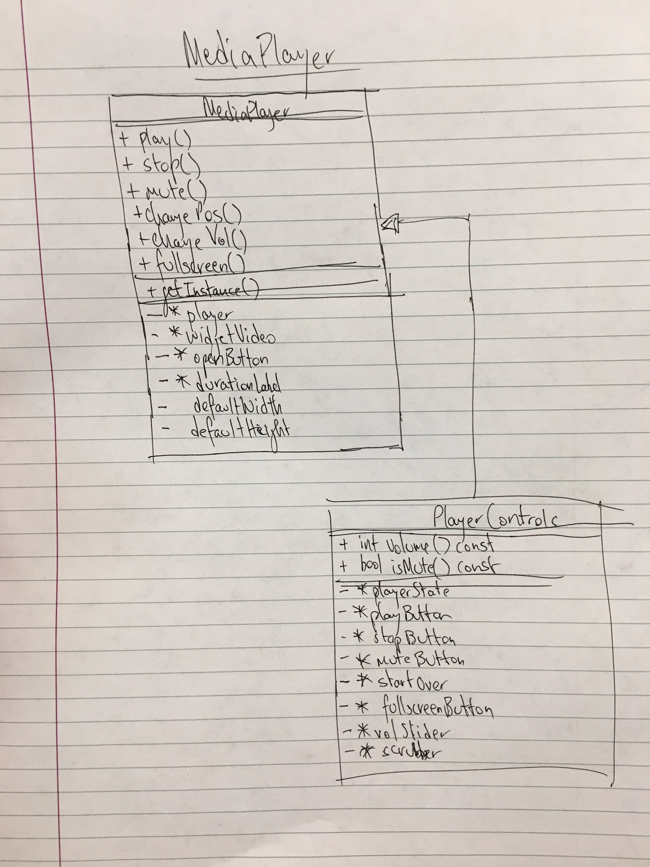
UML - Player Early Version
Notes:
John

Slide 16
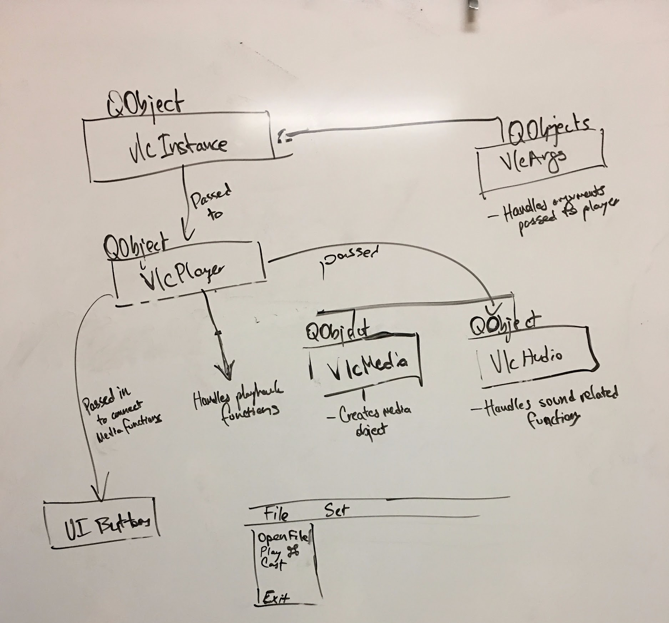
UML - Player Current Version
Notes:
John

Slide 17
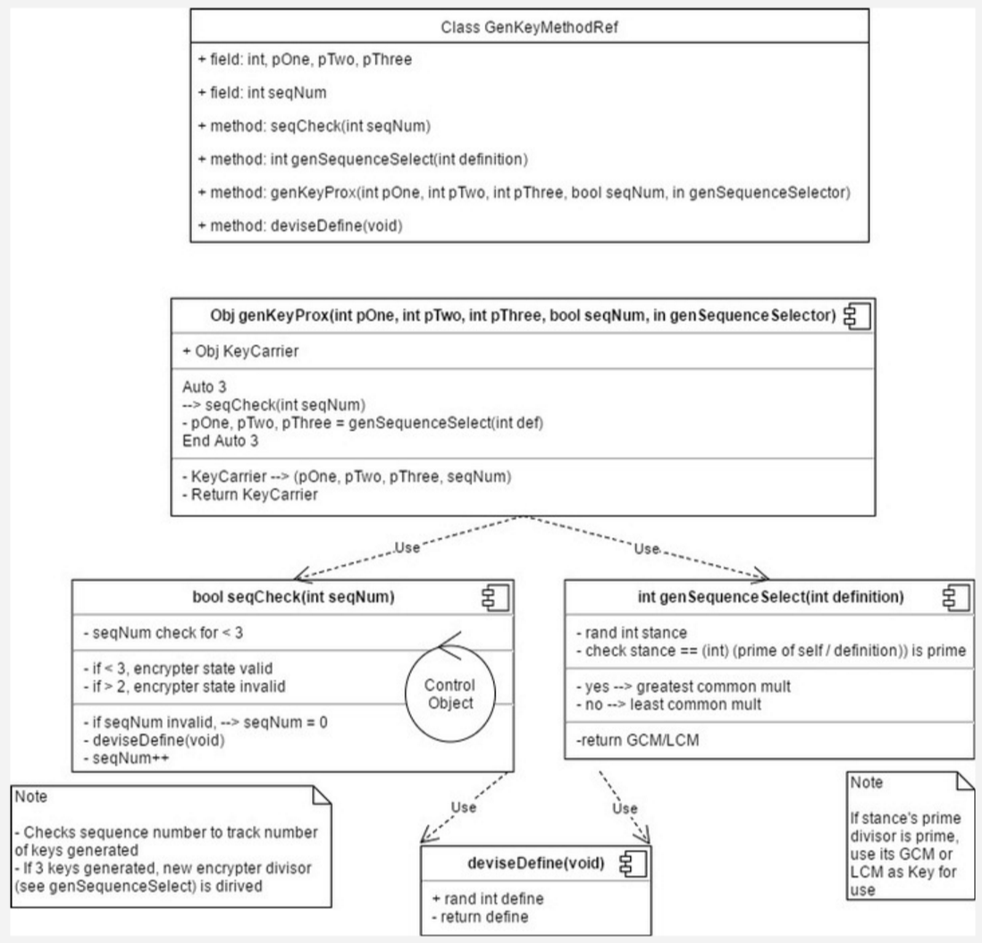
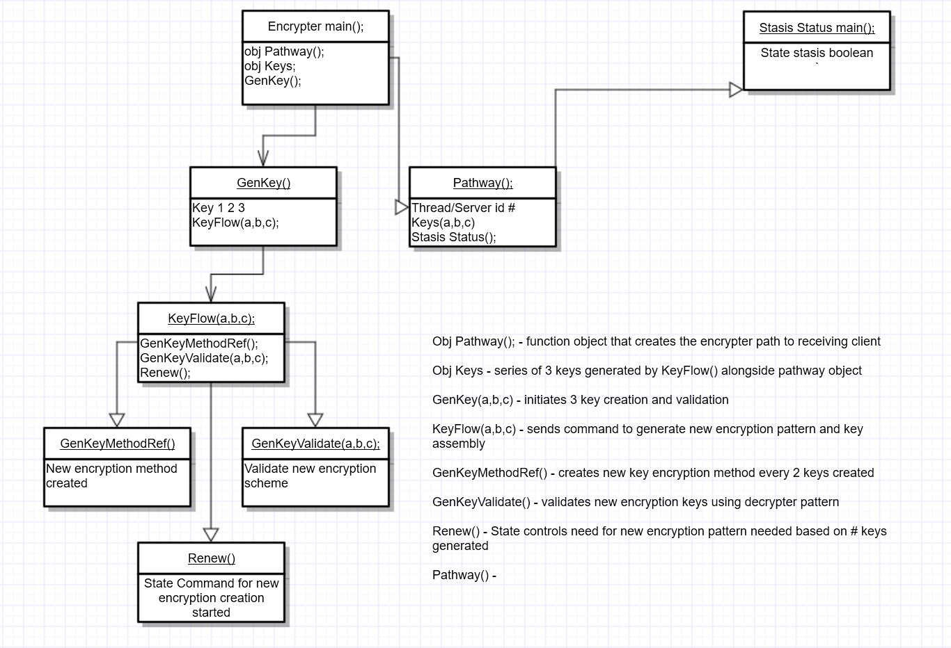
UML - Encryption Early Version
Notes:
Jordan

Slide 18
Encryption Current Version
Due to unintentional discovery of the broadcast stream being able to connect to multiple devices, stasis lock and handshake between server and device would prove too much processing for the Raspberry pi to handle
Stasis lock depended on shielding connected device from other forms of input stream
Proved to be too much to handle for the RP
Shielding of devices could not be forced due to needing access to device internet ability
Solved via only allowing modest amount of user input to modify functionality of non-critical cores of the program
Notes:
Jordan

Slide 19
Implementation - Network
/* Singleton */
static NetworkManager& getInstance() {
static NetworkManager networkManager;
return networkManager;
}
/*Iterator*/
for (std::list<t_AirPenguin>::const_iterator it = _airPenguins.begin(); it != _airPenguins.end(); ++it)
{ std::cout << name << " --- " << it->name << std::endl;
if (name.compare(it->name) == 0)
{ std::cout << "MATCH" << std::endl;
device.name = it->name;
device.ip = it->ip;
device.port = it->port;
Break; } }
Notes:
Denis/ Emil

Slide 20
Implementation - VLC
VLC code
void LocalPlayer::initQtPlayer()
{
_videoFrame = new QtVideoFrame(this);
_instance = new VlcInstance(_args->list(), this);
_player = new VlcMediaPlayer(_instance);
_posScrubber = new QtPositionScrubber(_player, this);
_volSlider = new QtVolumeSlider(_player, this);
_playButton = new QtPlayButton(_player, this);
_stopButton = new QtStopButton(_player, this);
_muteButton = new QtMuteButton(_player, this);
_media = new VlcMedia(_filePath, !_stream, _player->vlcInstance());
_player->setVideoWidget(_videoFrame);
}
Notes:
John

Slide 21
Implementation - VLC
{
_argsList << "-vvv"
<< --sout=#transcode{vcode=h264,vb=2048,acodec=mpga,ab=192,channels=2}:rtp{dst=" + _hostAddr + ",port=" + _port + ",sdp=rtsp"
"://" + _rtspAddress + ":" + RTSP_PORT + "/" + _sdpName + "}"
<< _networkSettings;
}
{
char *argv[args.count()];
for (int i = 0; i < args.count(); ++i)
argv[i] = (char *)qstrdup(args.at(i).toUtf8().data());
_vlcInstance = libvlc_new(args.count(), argv);
}

Slide 22
Implementation - VLC
Instantiating media player
_vlcInstance = instance; //passed into constructor
_vlcMediaPlayer = libvlc_media_player_new(_vlcInstance->libInst_t());
Rendering in qwidget
#if defined (Q_OS_DARWIN) //OS X
libvlc_media_player_set_nsobject(_vlcMediaPlayer, (void *)_currentWId);
#elif defined (Q_OS_UNIX) //Linux
libvlc_media_player_set_xwindow(_vlcMediaPlayer, _currentWId);
#endif
Passing media to instance of vlcMediaPlayer
_vlcMedia = libvlc_media_new_path(instance->libInst_t(), _currentLocation.toUtf8().data()); //play local
_vlcMedia = libvlc_media_new_location(instance->libInst_t(), _currentLocation.toUtf8().data()); //play remote url

Slide 23

Implementation - UI
Notes:
Tony/ Brad

Slide 24
Test Plan
What is your strategy?
Break media player before the user has potential to
Include tests in troubleshooter to ensure QA
Why do you think you have good coverage?
Unit tests designed to stress VLC and Qt functionality to protect against crashes and unexplained errors
Very little user modification available to core of program functionality, code testing and refactoring enabled this
Notes:
Jordan

Slide 25
Testing - Targets - Environment
UI themes - PASS
Stream address instances - PASS
Multiple streams
Playback - PASS
Audio/ video sync
OMX Player - PASS
Format acceptance and recovery
Server handling
Launch crashing - PASS
Handling
Troubleshooting Handlers - Removed - N/A
Built in/ external
Verification
Bandwidth usage - PASS
minimal
Memory usage - PASS
Avg +20MB/instance
Frames dropped - PASS
-(2-6) fps
CPU usage - PASS
Original plan to use Gtest
Thrown out due to time constraints
Easier to use assertions and custom testing and handling of unexpected behavior
Custom testing proved effective at forcing undefined behavior
Multiple iterations and rewrites of code forced intentional instruction throws to force logical failures
Notes:
Jordan

Slide 26
First Round Testing
First round testing showed numerous bugs and incomplete functionality, was overall acceptable but needed much work. Pi casting was more in depth and error prone, such as videos crashing, high processing usage.
Invalid file formats accepted
Video seeker not playing at point specified
Resumes playback when seeking while paused
Caster a/v out of sync
Url video load not loading, pending script/implementation
Multiple stream instances cause high cpu usage
Seeking video position crashes the video player while casting
Notes:
Jordan

Slide 27
Refactoring/Defensive Coding
Refactoring
UI: Remove unused/ underused buttons
Removed unnecessary/ unused libraries, methods, etc. (from VLC especially)
Defensive coding
Media player: Checks for VLC player instantiation before API calls
UI: Checks for empty strings for file path, URL before instantiating player
Notes:
Tony/ Brad

Slide 28
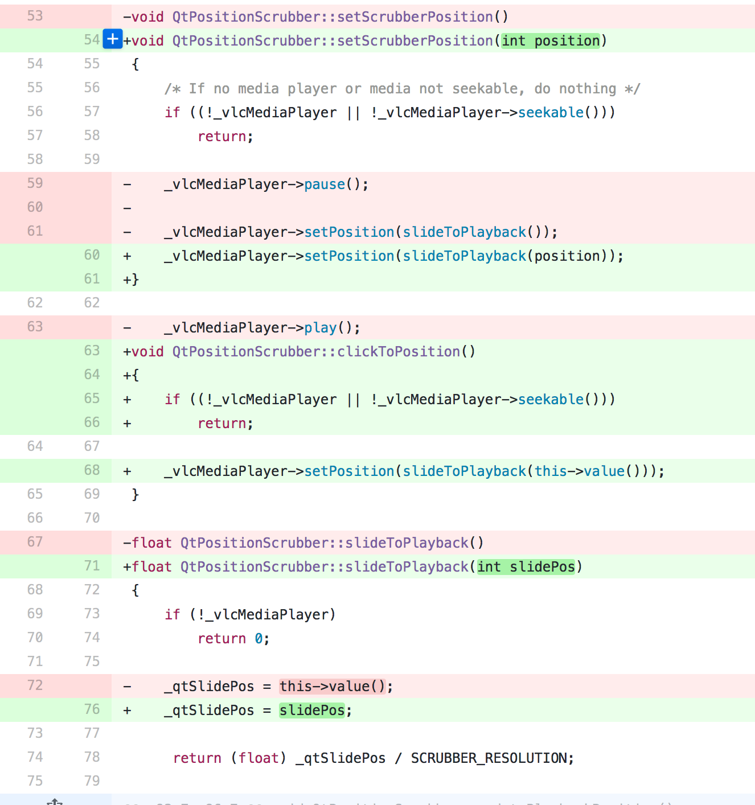
Refactored Code Example 1
Notes:
John

Slide 29
Refactored Code Example 2
QtPlayButton::QtPlayButton(VlcMediaPlayer *player, QWidget *parent)
: QPushButton(parent),
_vlcMediaPlayer(player){
initQtPlayButton();
}
QtPlayButton::QtPlayButton(QWidget *parent)
: QPushButton(parent),
_vlcMediaPlayer(0) {
initQtPlayButton();
}
QtPlayButton::~QtPlayButton() {
}
void QtPlayButton::initQtPlayButton() {
QSize buttonSize(40,40);
this->setFixedSize(buttonSize);
this->setIcon(QIcon(":/playbuttonLight.png"));
//timer for button updates
_timer = new QTimer();
_timer->start(100);
connect(_timer, SIGNAL(timeout()), this, SLOT(updateIcon()));
connect(this, SIGNAL(clicked(bool)), this, SLOT(playMedia()));
}
Notes:
Tony/ Brad: this is an example of subclassing playback button functionality

Slide 30
Refactored Code Example 2
void QtPlayButton::playMedia() {
if (!_vlcMediaPlayer->currentMedia())
{ this->setIcon(QIcon(":/playbuttonLight.png"));
return;
}
if (_vlcMediaPlayer->state() == Vlc::Paused
|| _vlcMediaPlayer->state() == Vlc::Idle
|| _vlcMediaPlayer->state() == Vlc::Stopped)
_vlcMediaPlayer->play();
else
_vlcMediaPlayer->pause();
}
void QtPlayButton::updateIcon()
{
if (_vlcMediaPlayer->state() == Vlc::Paused
|| _vlcMediaPlayer->state() == Vlc::Idle
|| _vlcMediaPlayer->state() == Vlc::Stopped)
this->setIcon(QIcon(":/playbuttonLight.png"));
else
this->setIcon(QIcon(":/pausebuttonLight.png"));
}
Notes:
Tony/ Brad: this is an example of subclassing playback button functionality

Slide 31
Defensive Coding Example 1
penguinview.cpp
selectedDevice = NetworkManager::getInstance().getDeviceFromName(_ui->listWidgetDeviceList->currentItem()->text().toStdString());
NetworkManager::getInstance().connectToAP(selectedDevice.ip);
Notes:
Tony/ Brad

Slide 32
Defensive Coding Example 2
penguinview.cpp
void PenguinView::on_playLocalButton_clicked() {
/* Check for current player object (QWidget) */
if (_playerWidget != Q_NULLPTR) {
return;
}
/* ensure file is selected */
if (_filePath.isEmpty()) {
QtError err("No file selected",this);
return;
}
_localArgs = new VlcArgs();
_playerWidget = new LocalPlayer(_filePath, _localArgs, _autoPlay, false);
_playerWidget->show();
connect(_playerWidget, SIGNAL(playerClosed()), this, SLOT(playerDeleted()));
}
Notes:
Tony/ Brad: defensive programming in our penguinview.cpp class to check for empty filepaths and a current player so we don't launch two

Slide 33
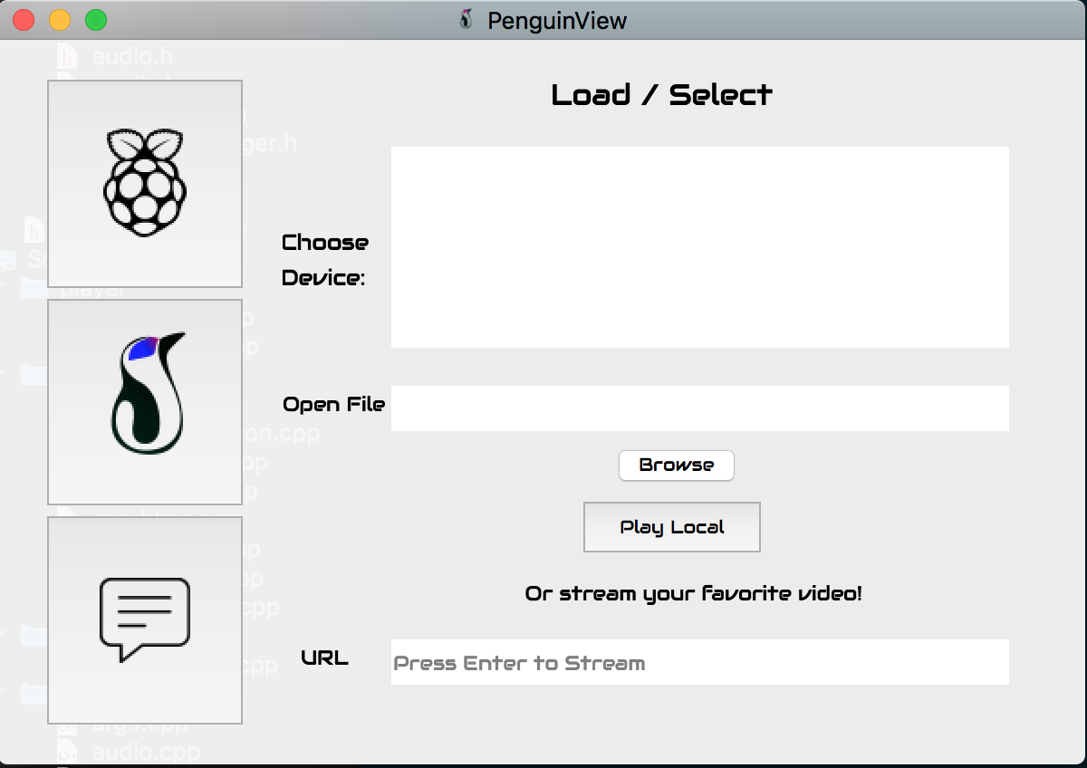
Questions?

