Slide 1
Game Pitch
By
Team P

Slide 2
Game Idea Summary:
A Stealth Action game where you play as a ninja to assassinate enemy AI in a haunted village/house at night.
The setting takes place in 15th Century Japan (Feudal Japanese Era)

Slide 3
Target Audience
For the East and Southeast Asian market

Slide 4
Genre and Style
3rd Person Stealth Game with Oriental horror-elements incorporated in
Stealth-action game
Primary Influence: Metal Gear Online (MGS4) gameplay as Raiden
Other Influences: Ninja Gaiden Black, Shinobido Series, Other Metal Gear Solid
Oriental Horror elements
Influence: Project Zero 2 (Fatal Frame2)
Blended with a Visual-Novel Story
Cutscenes compose of text boxes on bottom of screen and 2D digitally-drawn art
Cutscenes of the game is played as a visual novel
Decision making in the visual novel cutscenes affect the level branching

Slide 5
Gameplay and Controls (If needed for pitch)
In Working Progress
Design for the gameplay, controls, and camera view will need to be discussed among the team first before the actual design is finalized
Some ideas for a base to start discussion (this is NOT the final design)
Character movement through level with changing camera views (like in Fatal Frame 2)
Assassinations and attacks like Raiden gameplay in MGO
Complex ninja moves not required (but if the team likes to implement this, it is a great idea too!)

Slide 6
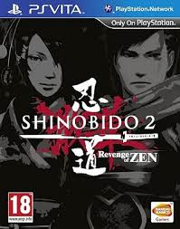
Shinobido 2: Revenge of Zen

Slide 7
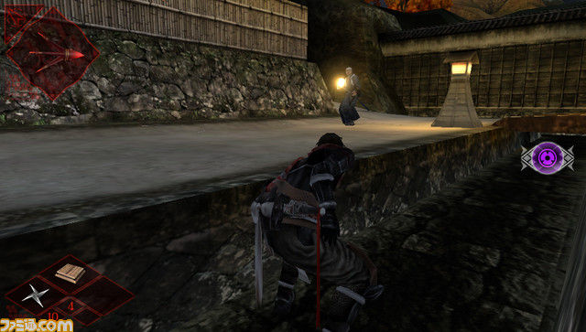
Shinobido 2- Revenge of Zen Gameplay

Slide 8
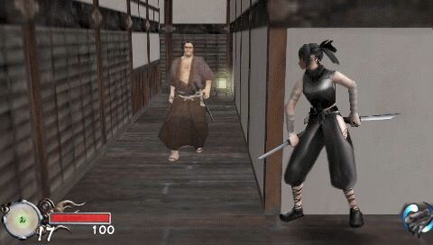
Tenchu: Shinobi Taizen Gameplay

Slide 9
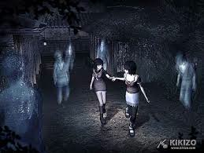
Project Zero 2

Slide 10
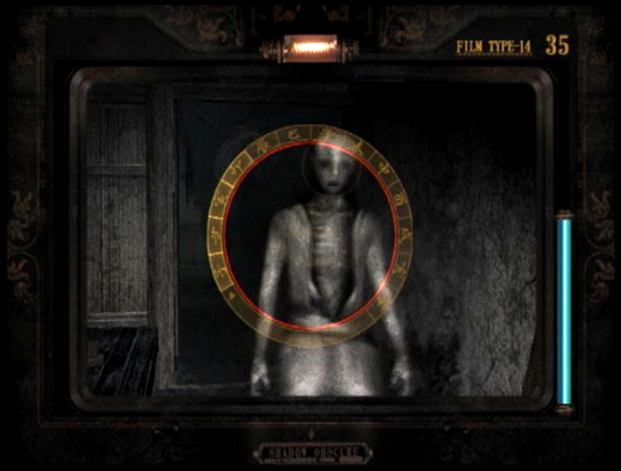
Project Zero 2

Slide 11
Game Engine
Unity3D or Source SDK. We might need school support for a Unity Pro license.

Slide 12
Team Structure
Hope to have a 3D artist and animator
Great learning opportunity!
I’ll do some
We can get models and rigs off the web
Several programmers because the game will have lots of content and levels.
Need a producer to herd the cats.

