Slide 1
Game Pitch
By
Team P

Slide 2
Please Note
Everything you see after this slide is underdeveloped and needs further discussion.
What you will see is meant to provide a base for those looking for a structure. Nothing is final. ☺

Slide 3
Game Idea Summary:
A Stealth Action game where you play as a ninja to assassinate enemy AI in a haunted village/house at night.
The setting takes place in 15th Century Japan (Feudal Japanese Era)

Slide 4
Idea
Stealthier version of Ninja Gaiden Black/Sigma/2, that is spookier
Enemies are spooky looking too and will use the fog to hide. You can either avoid them in combat or kill them.

Slide 5
Target Audience
For the East and Southeast Asian market

Slide 6
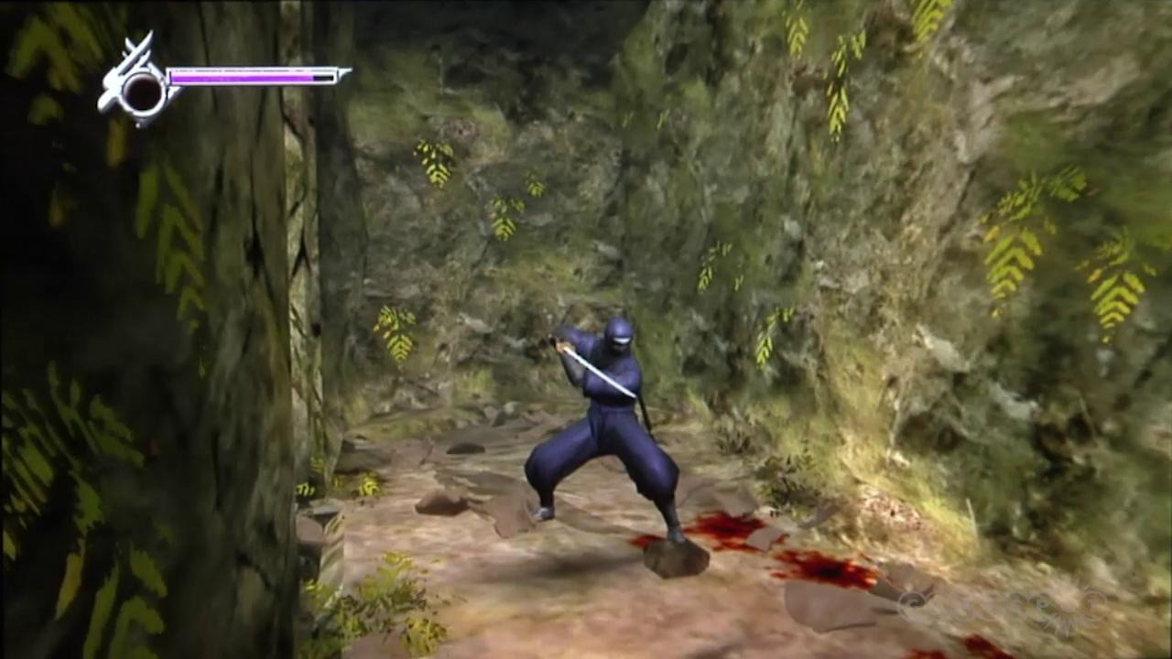
Ninja Gaiden Sigma

Slide 7
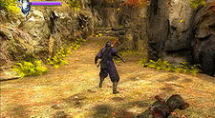
Ninja Gaiden Sigma

Slide 8
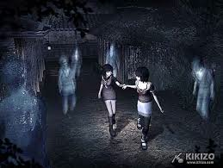
Project Zero 2

Slide 9
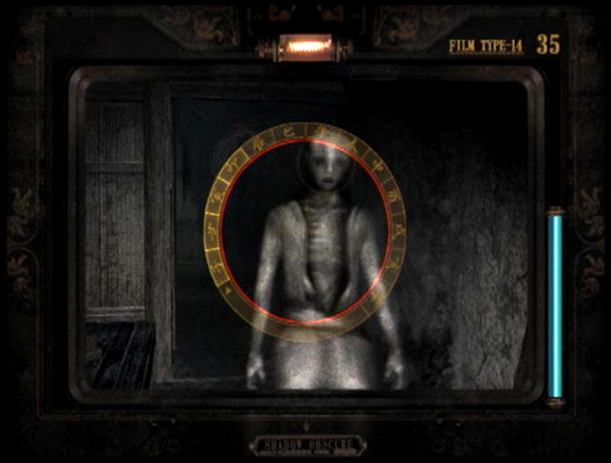
Project Zero 2

Slide 10
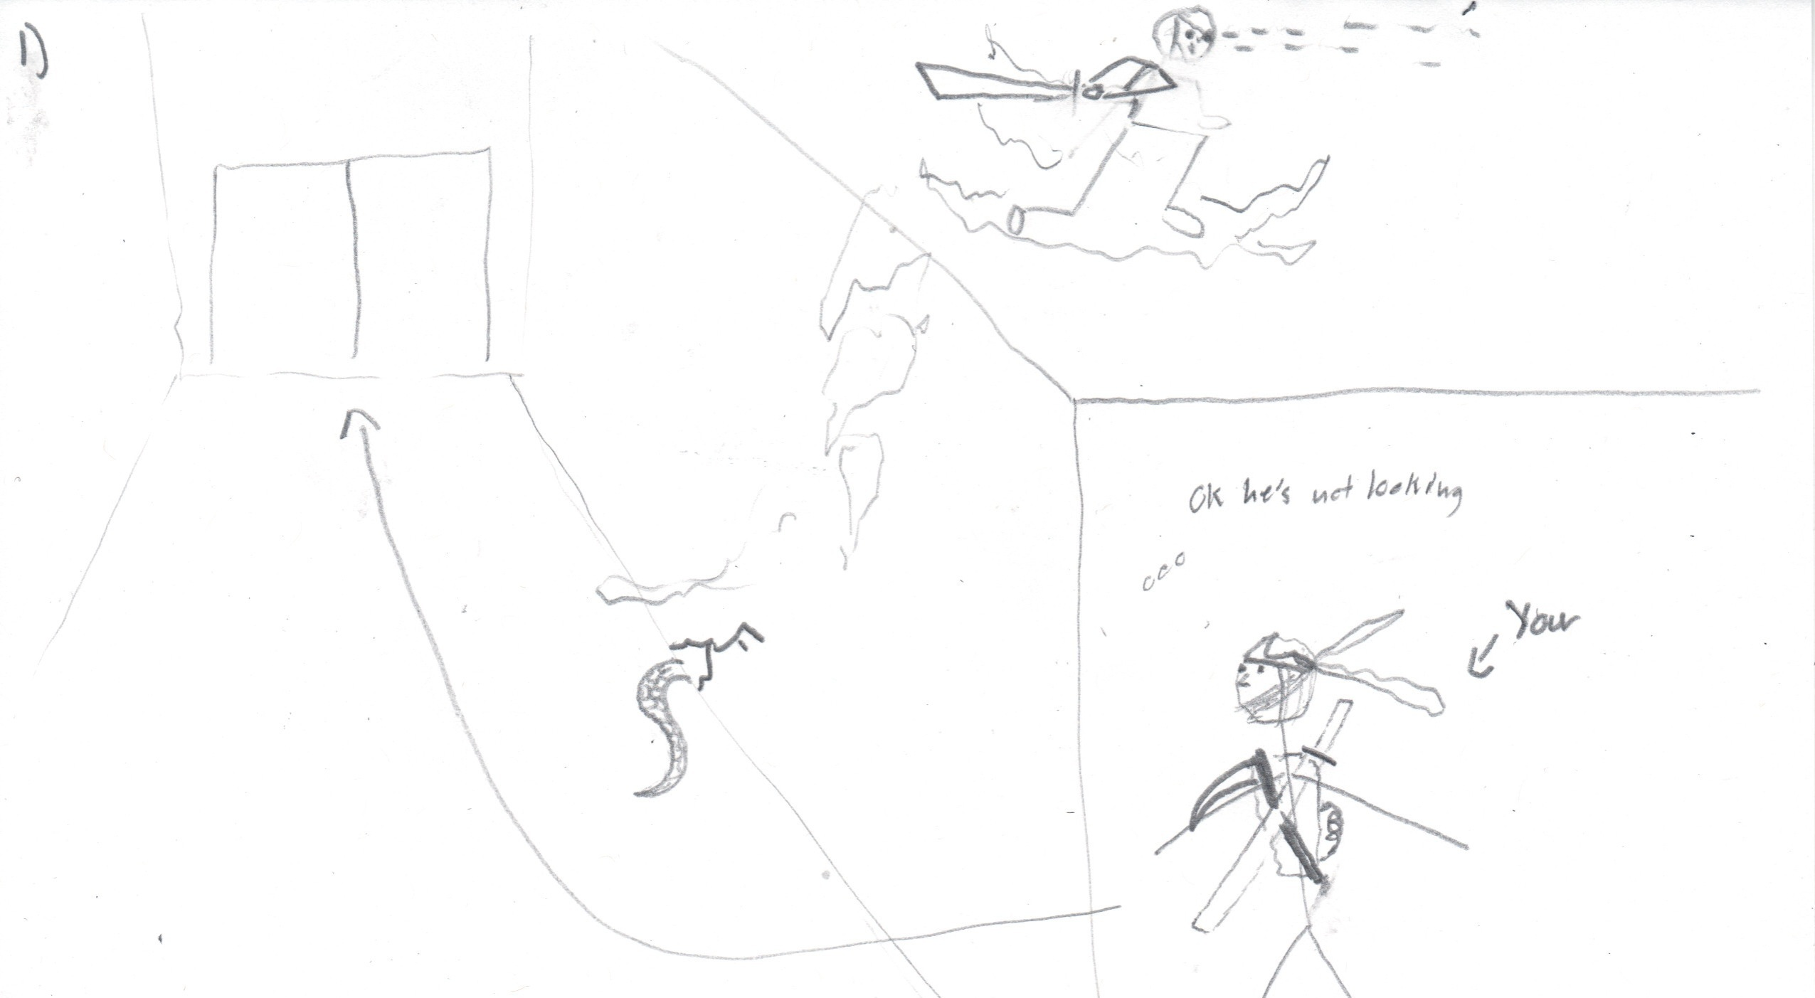

Slide 11
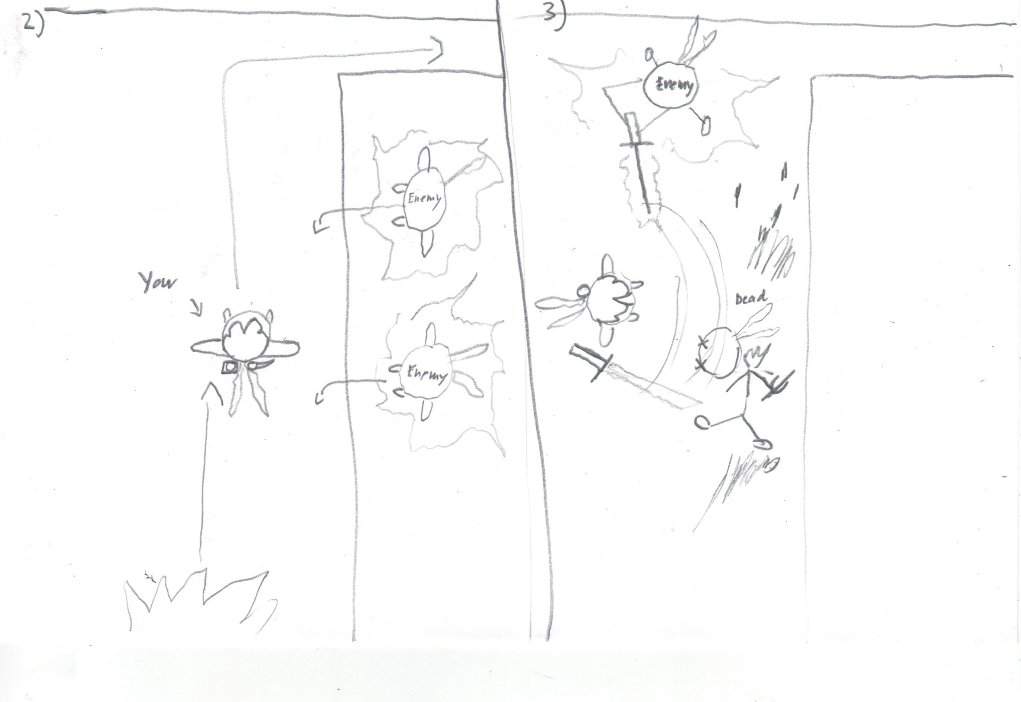

Slide 12
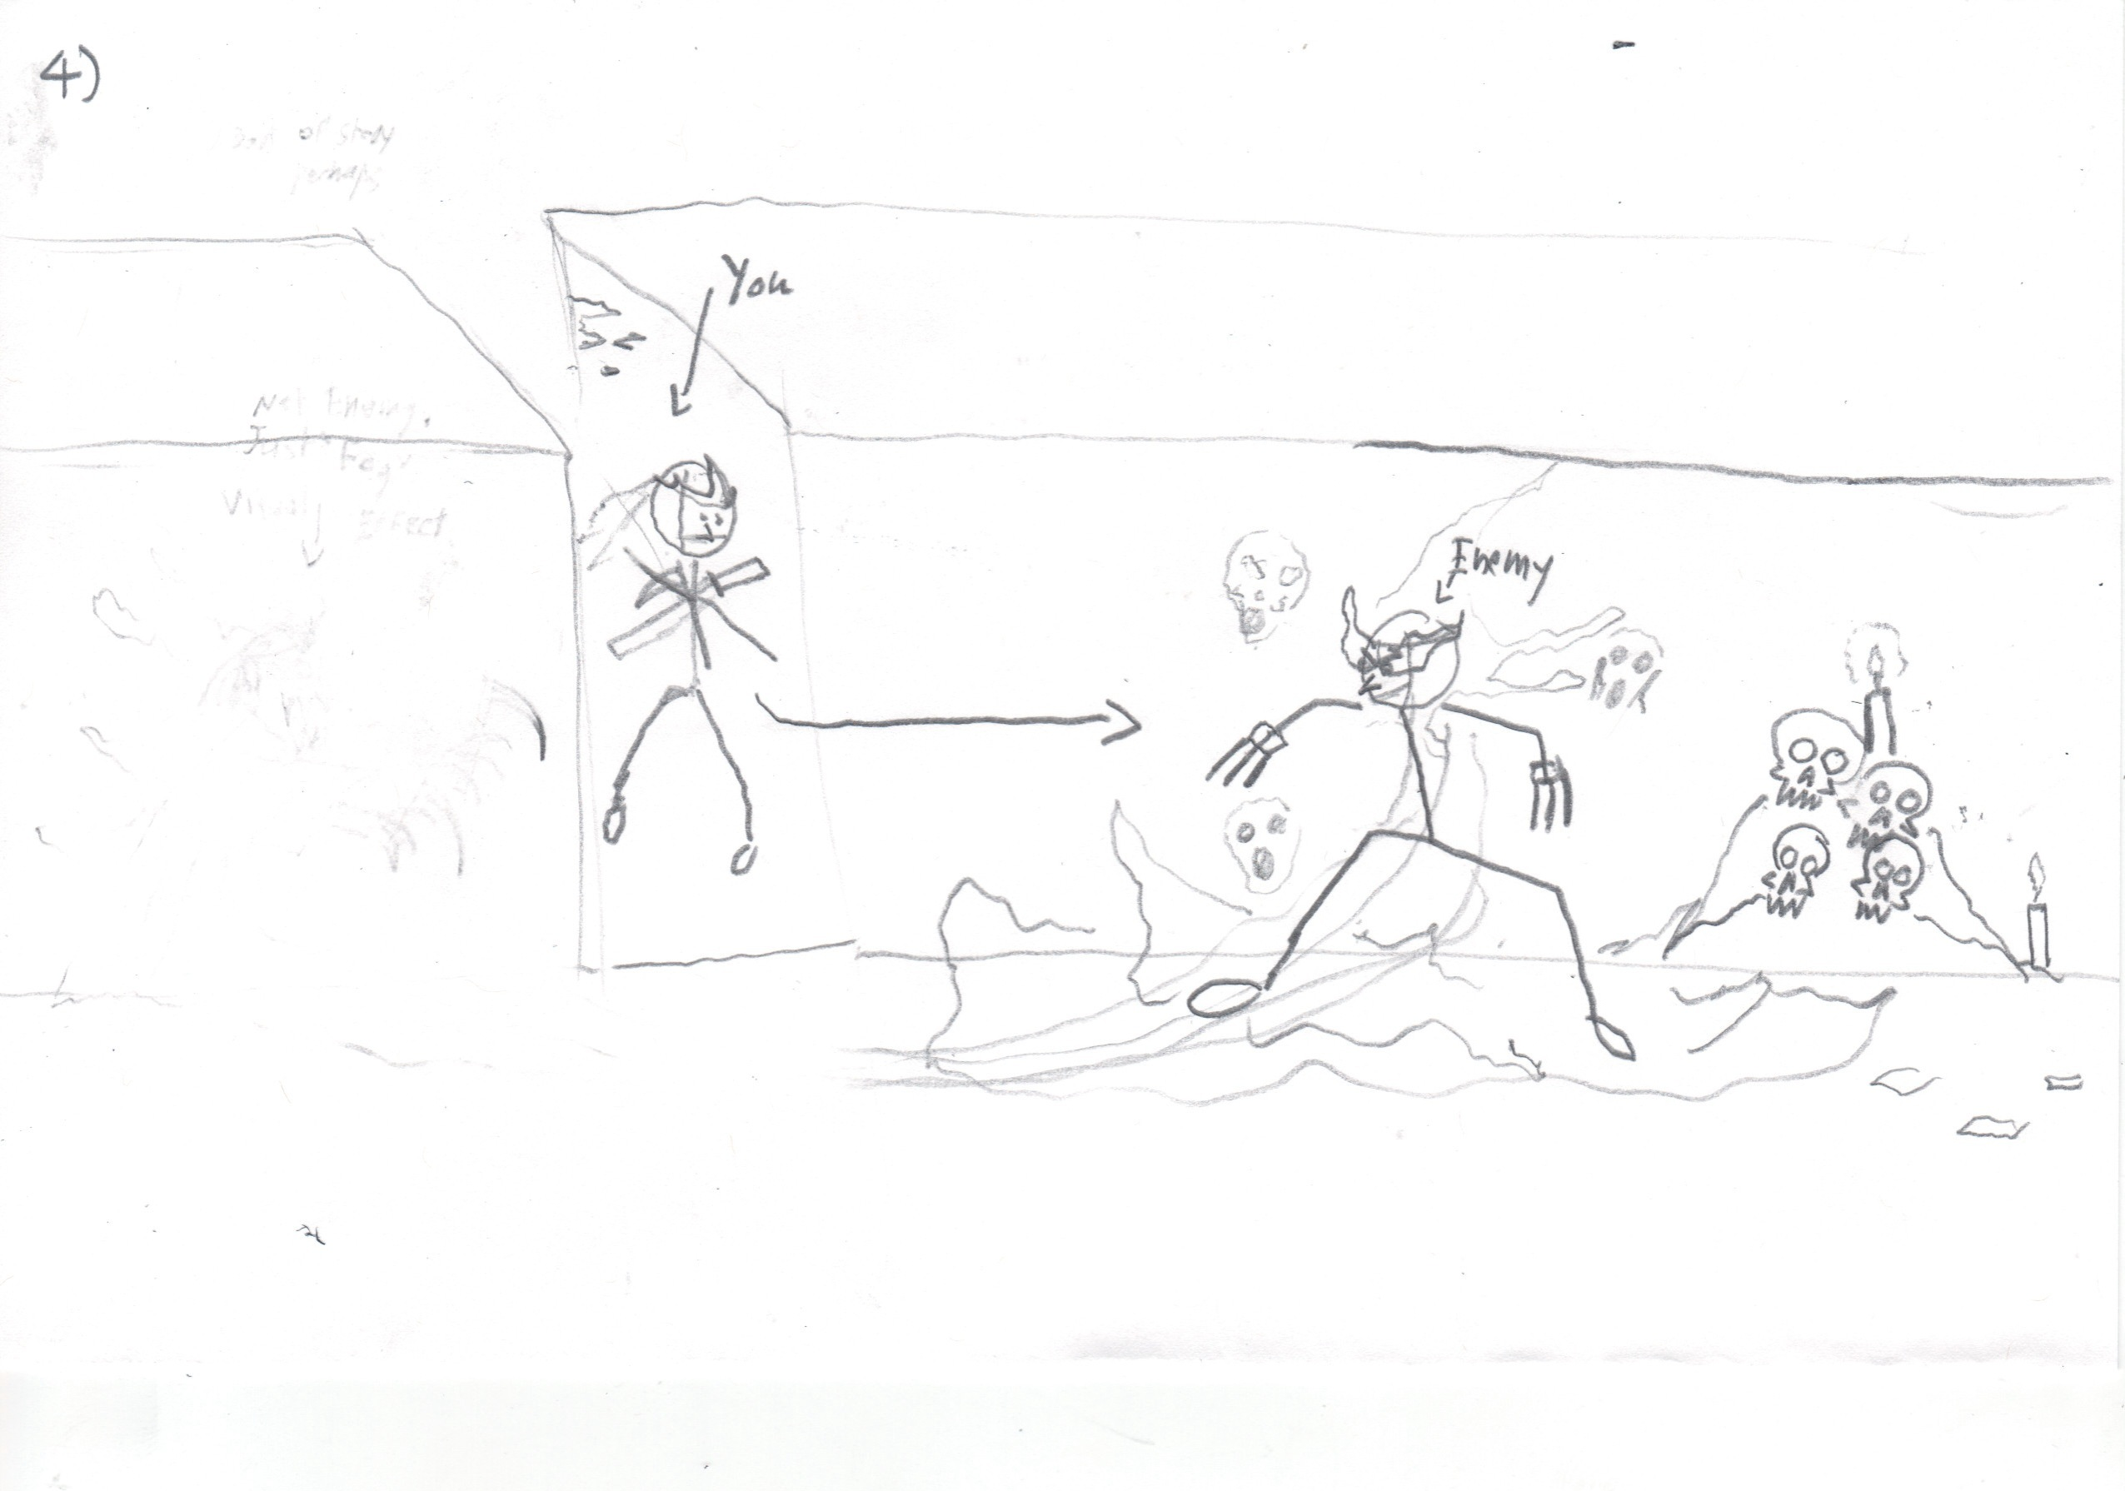

Slide 13
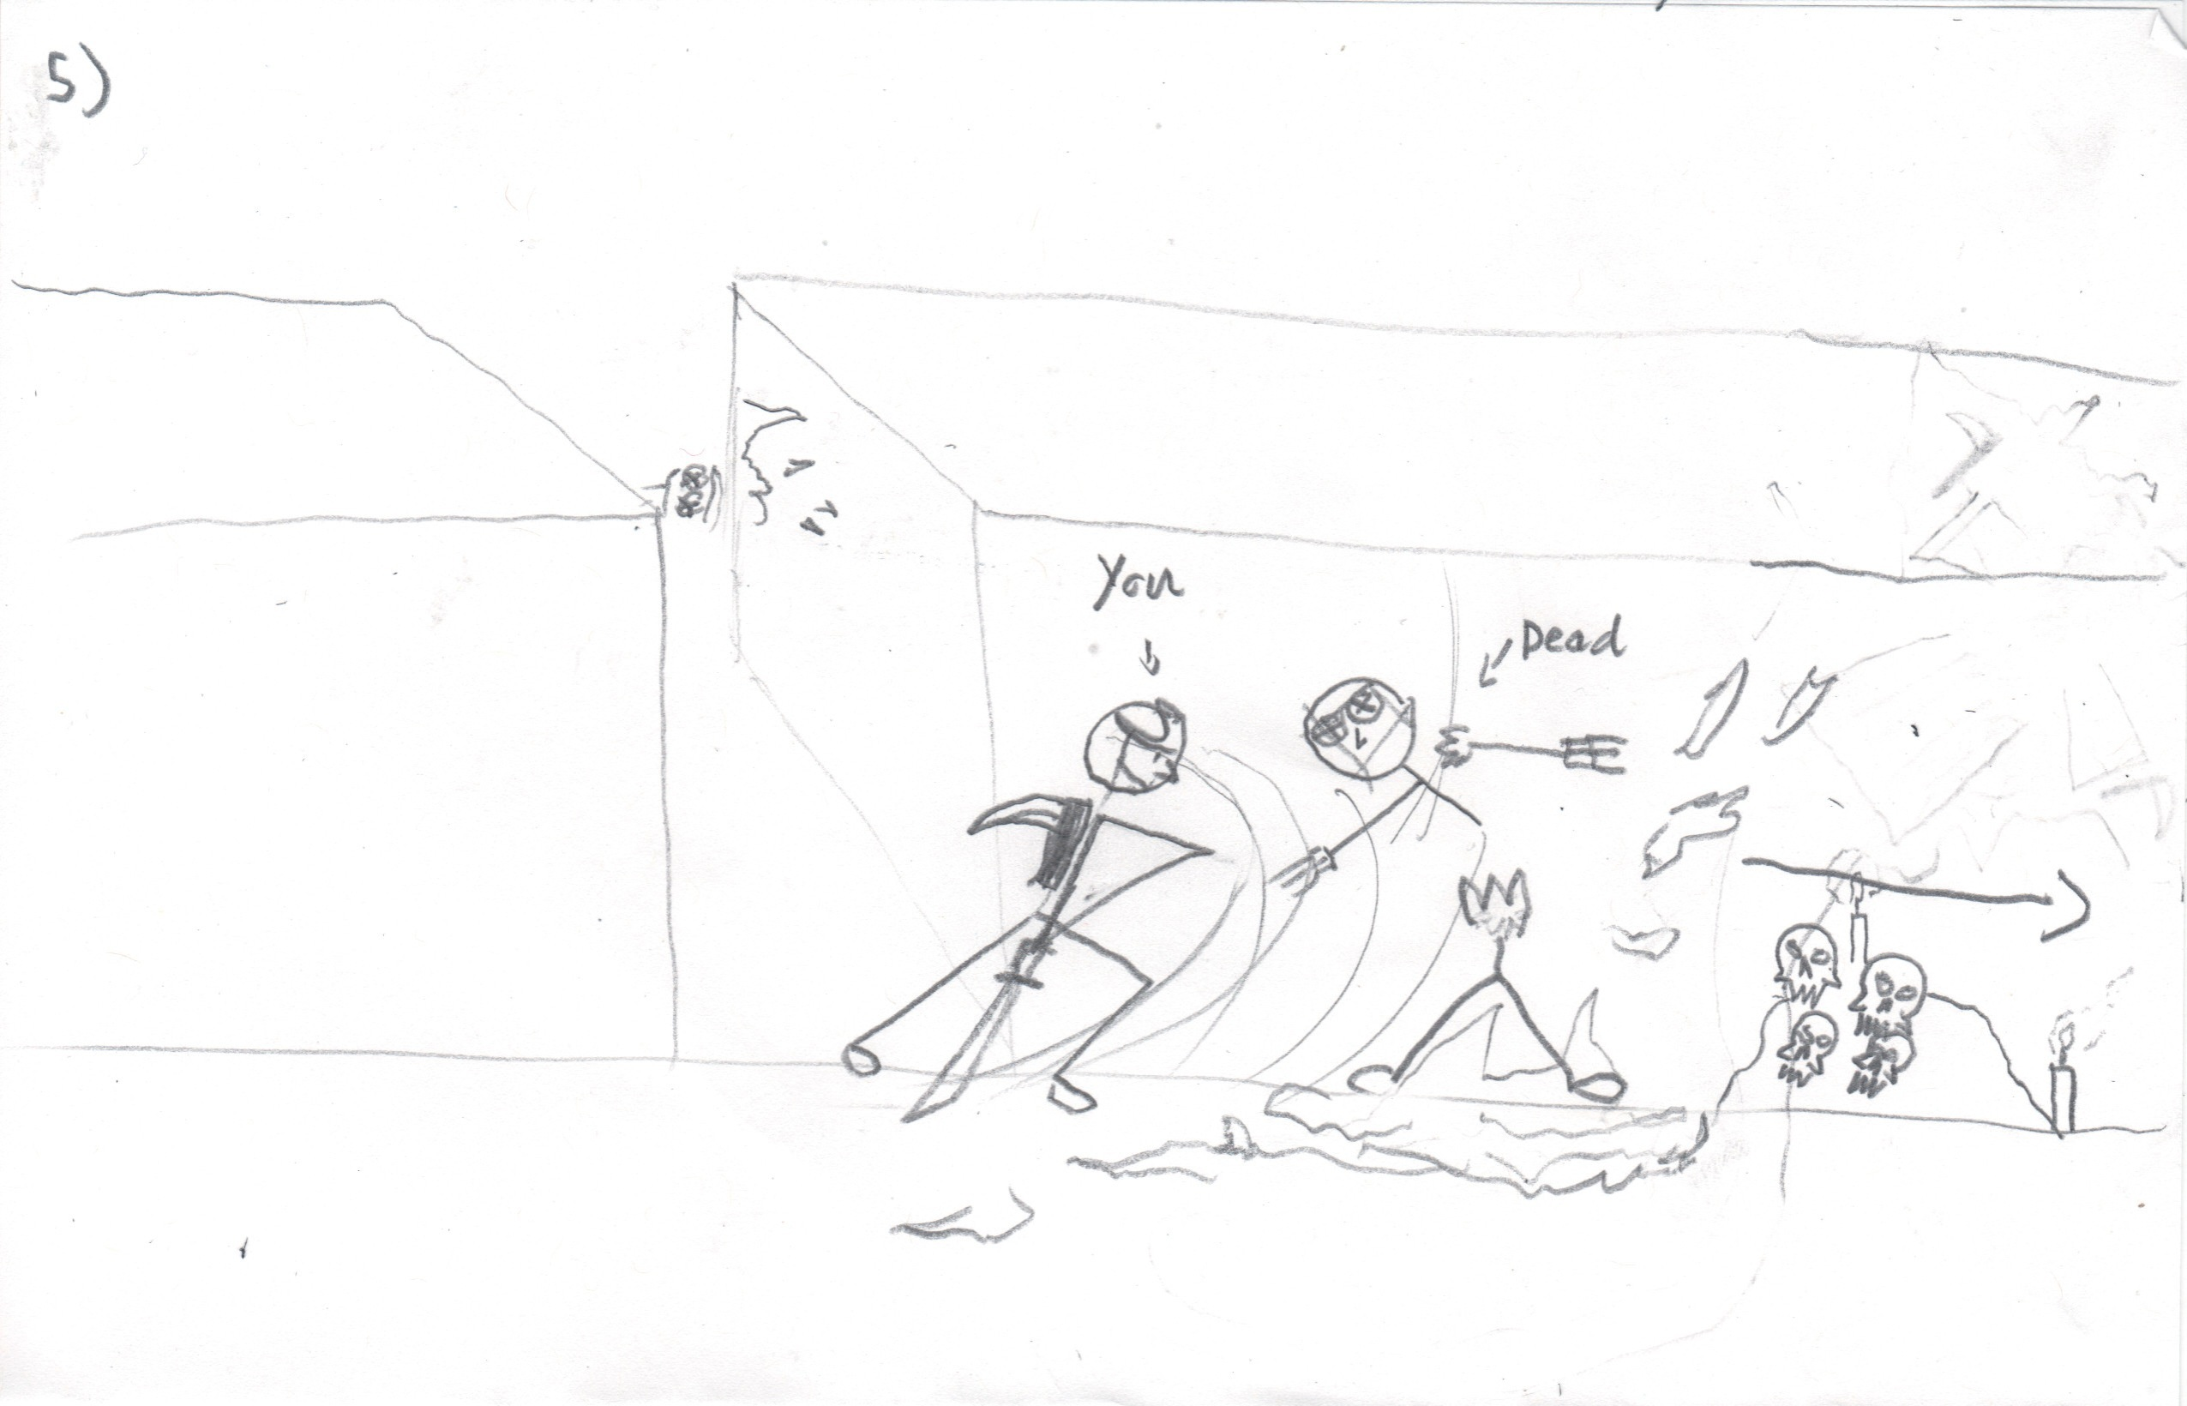

Slide 14
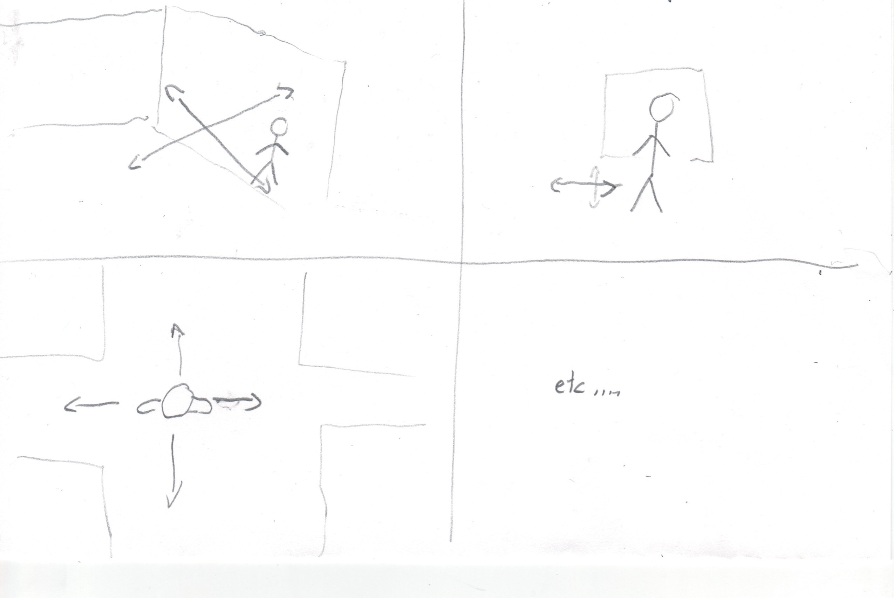

Slide 15
Game Engine
Unity3D or Source SDK. We might need school support for a Unity Pro license.

Slide 16
Team Structure
Hope to have a 3D artist and animator
Great learning opportunity!
I’ll do some
We can get models and rigs off the web
Most roles with some programming experience
1 Dedicated Programmer Role
Need a producer to herd the cats.

