Slide 1
Game Pitch
By
Team P

Slide 2
Game Idea Summary:
A Stealth Action game where you play as a ninja to assassinate enemy AI.
The objective is to reach the final checkpoint in all of the single-player levels.
Between each level is a visual-novel cutscene mechanic, and you make decisions in the cutscenes to determine the next level that you play/or how the next level will be set up for you.
The game blends stealth with a very spooky theme in:
the story, character design, level design, enemy mechanics, sound, etc.
The setting takes place in Feudal Japan
Think of it as playing Fatal Frame as a ninja.

Slide 3
Target Audience
For the Asian market, by an Asian developer team.

Slide 4
Style
Yes:
Fully genuine Japanese game
3D
Style will be more obvious as the presentation goes
No:
Non-Oriental (Western, European, American, Slavic, Latin, etc.)
Western game mimicking an Oriental game

Slide 5
Genre
3rd Person Stealth Game
Stealth-action game
Influences: Ninja Gaiden Black, Shinobido Series, Metal Gear Solid Series
Blended with a Visual-Novel Story
Cutscenes compose of text boxes on bottom of screen and 2D digitally-drawn art
Cutscenes of the game is played as a visual novel
Decision making in the visual novel cutscenes affect the level branching

Slide 6
Theme
Horror-elements incorporated into the stealth mechanic. This includes:
Dark Fog
AI Enemies stalking player’s avatar
Blood (a lot of it)
Etc.
Horror should be based off traditional Asian horror stories (not movies), such as curses and ghosts.
Should be like Project Zero (US: Fatal Frame) games.
Elements of horror that will not be included:
Jump Scares, other Western-style horror mechanics, etc.

Slide 7
Platform and Services
Yes:
PC and Unix-Based personal computers
Should run on Windows XP, 7, Mac OSX 10 and up, and all Third-Party and Custom Linux Platforms
Available for sale in Southeast Asia and East Asia only
Another possible platform could be the PSP and PS Vita
No:
Android
Micro-transactions
DRM
Online Multiplayer (At the moment)
Online requirements

Slide 8
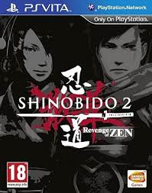
Shinobido 2: Revenge of Zen

Slide 9
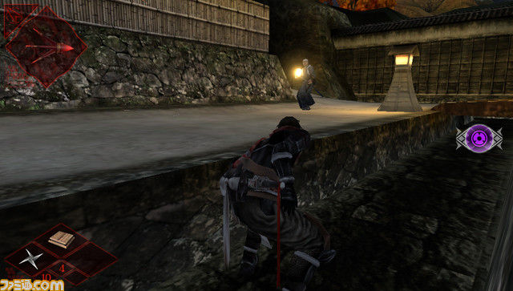
Shinobido 2- Revenge of Zen Gameplay

Slide 10
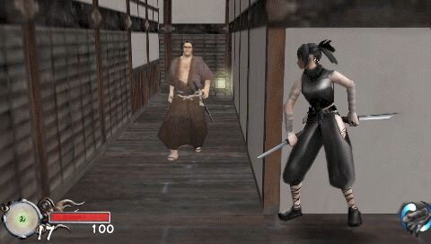
Tenchu: Shinobi Taizen Gameplay

Slide 11
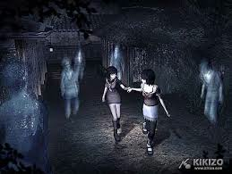
Project Zero 2

Slide 12
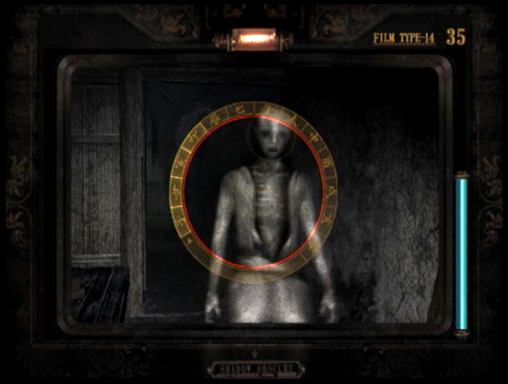
Project Zero 2

Slide 13
Project Zero 2 Gameplay (Notice the controls for player movement. Ignore the item discovery and Camera Obscura gameplay):
https://www.youtube.com/watch?v=ed_GL32xrCo
Shinobido Takumi PS2 Gameplay
NOTE: Game controls and attacks will not be implemented like this in this game. Just basic attacks like in Metal Gear Solid 4 gameplay as Raiden. Nonetheless, this is a stealth action game with ninjas in it.
https://www.youtube.com/watch?v=IyRU8xmEmpE
MGO Raiden Gameplay(Ignore the controls and camera. Focus on the Sword attacks. Game should only need basic sword attacks like here):
https://www.youtube.com/watch?v=ySCTSvkNl1w

Slide 14
Game Design
The game is a straight-up stealth action game
What makes it different from other stealth action games:
The theme and setting for the story, and the levels, should be as spooky as shown in Project Zero 2 (thick fog, ghosts)
Instead of ghosts, enemy AI ninjas from rival clans stalking you to assassinate you, and the perspective to view these ninjas are not going to require changing to a first person view, like with the Camera Obscura in Project Zero 2. The enemy AI will be like those in Metal Gear Solid games
Spooky ninja music (high pitched flute plays to warn you that you are being stalked/boss fight/danger(You are spotted), and other traditional Japanese music for other aspects of the game)
Bosses: Shogun Warlord, Rival Clan elder, an elite team of enemy Ninjas, Ghost (possibly??)
Cutscenes(Plot): Implemented as a visual novel (text box, digital 2D portrayal of characters, and decision making)
The decision making affects the next level of the game
Game objective: Get to the final checkpoint of each level without getting killed. 3 Levels are planned as of now. This game is purely single-player experience.
Levels: Most of the levels, you are going through a large house, and very occasionally outside the house. The story will focus either on 1 big house that the player’s ninja has to sneak through, or a full village of houses like in Project Zero 2. The level layout should be very much like that in Project Zero 2, except you play as an assassin of course.
Gameplay and Controls: Like everything described so far, this is subjected to tweaking and slight modification by the developer team as a whole at will. But for the sake of the pitch and a starting idea, etc. , the controls will work as follows:
3rd Person will not be like the traditional camera following of the player and camera adjusting when the character hides in a corner.
Instead, each corner, corridor, hallway, etc. of the level itself will provide an individual camera.
As the character moves through each corner, corridor, hallway, etc. , the player’s perspective should switch to the camera contained in that specific corner, corridor, hallway, etc. So basically, the 3rd person controls should be the same like in Project Zero 2 or Metal Gear Solid 1. Again, this needs more thought put into it, and I was hoping a team could help perfect the design.
Sorry if I get any of the terms mixed up, but I hope you get the idea.

Slide 15
Goals and Objectives of the Project
Any tweaks and modifications should not alter the following:
Style of Story(the spookiness, the Japanese-style theme)
Plot(the spookiness, the Japanese-style theme)
Theme
Objective
Convey of Oriental-style spookiness through character and level design
Design of the gameplay and controls must be straightforward to implement. It should not require any degree of leap over ambiguity.
This game should be purely a Japanese game for the Asian audience only, so western/European/Eastern-European/Slavic/Latin/non-Oriental influences should be avoided while engineering the entire game.

Slide 16
Implementation
Programming Languages: C#, C/C++, Python, or any scripting language for all aspects of the game.
Animation Tools: Maya/3DS Max, Mel-Scripting, or any scripting language to get the animation done
Requires 3D Animation
Game Engine: Unity3D or Source SDK. We might need school support for a Unity Pro license.

Slide 17
Team Structure
Game: There may be times when an initial design turns out that it is too difficult or too ambiguous to follow through, and therefore slight modifications may need to be done as it goes. We will try our best to avoid this scenario of course.
For the sake of having this message make sense to non-Oriental viewers of this presentation:
the game design must use stereotypical design philosophies and mindsets found Japanese/Other East/Southeast Asian developers when they made their games.
To the team though, we don’t see this as ‘stereotypical’, because it is something that we are used to.
Team itself: It truly depends on who is part of the team. Each member needs to provide a straight-forward plan on a shared google drive folder for the team in:
What he/she plans to accomplish by the end of each week
Commits to the github repository (which will store the game implementation itself)
Team Setup:
1 or more Programmers (Depending on who will join)
3D Modeler with Animator(One does the modeling and another does the animating of the model, OR One person does both the modeling and the animating)
Graphic Artist for the Visual Novel Cutscenes (if we decide to go with the visual novel style cutscenes)
Asset management (for the Unity 3D or Source SDK project)
Team Presenter
Sound
NOTE: Each member is not constrained to one role. All members can switch roles back and forth when needed, but everyone is expected to help each other out if they are stuck. Programming experience among most if not all the team members is highly appreciated

