Slide 1
Dark Vessel Detector
Gulf SAR and AIS fusion
A GULF MARITIME PICTURE | PROJECT 1 OF 3
Detecting vessels in Sentinel-1 radar imagery and flagging those absent from AIS tracking
Jordan Manoj Cheruvathoor | Stellaria technical interview | 12 November 2026
Notes:
One sentence: I detect ships in Sentinel-1 radar images and flag the ones that are not broadcasting AIS, then test it on Gulf waters the model has never seen: Khalifa Port and the Strait of Hormuz.
Project 1 of 3 in 'A Gulf Maritime Picture': who is at sea, and who is not reporting.

Slide 2
Vessels that switch off AIS disappear from tracking but stay visible to radar
THE PROBLEM
WHY IT MATTERS TO STELLARIA
AIS is self-reported: transponders can be switched off, spoofed or out of coverage
Sentinel-1 SAR images ships day or night and through cloud
Matching radar detections to AIS isolates vessels that are present but not reporting
Automated target recognition
Vessel detection in SAR is a core ATR task on the Stella platform
Maritime and port intelligence
Radar detections fused with vessel tracking, as Stella fuses sensors
AREAS OF INTEREST
Khalifa Port, Abu Dhabi ~24.8°N, 54.65°E
Dense port traffic, coastline clutter
Strait of Hormuz ~26.9°N, 56.4°E
Larak–Qeshm anchorage, chosen from AIS density
Orbion
Directly relevant to the maritime-intelligence joint venture with the Abu Dhabi Maritime Academy
Notes:
AIS is self-reported, so a ship can switch it off, spoof it or be out of coverage. Radar sees it anyway.
Matching the two gives a list of 'dark' vessels: not proof of wrongdoing, a lead for an analyst.
Hormuz: my first box in the open strait was almost empty (2 ships, confirmed by GFW's own radar), so I moved it to the Larak–Qeshm anchorage, the busiest offshore cluster in Global Fishing Watch AIS data for 15 Oct.
This mirrors Stella: fuse a sensor (SAR) with tracking data (AIS); directly relevant to Orbion.

Slide 3
Five stages take a raw Sentinel-1 scene to a dark-vessel flag
1 Ingest
2 Preprocess
3 Detect
4 Match to AIS
5 Flag
Sentinel-1 GRD scenes
OSSDD ship labels
dB scaling, VV/VH
Land and no-data mask
Overlapping tiles
CFAR baseline
Fine-tuned YOLOv8s
Associate detections with GFW AIS by time and position
Unmatched detection = dark vessel
Shown in red
TRAIN AND EVALUATE
Open SAR Ship Detection Dataset
595 / 200 / 200 Sentinel-1 VV+VH chips with ship boxes; metrics overall, land vs open water, by ship size
APPLY TO THE GULF
Copernicus Data Space + Global Fishing Watch
Calibrated Sentinel-1 over Khalifa Port and Hormuz, 15 Oct 2026; AIS presence within ~1 km and ±1 h
Notes:
Ingest: Sentinel-1 GRD, VV and VH. Preprocess: σ⁰ in dB, fixed scaling (not per-chip, which destroys absolute brightness), land mask from OpenStreetMap, 640 px tiles at native 10 m: never resized, ships are only ~13 px.
Tiles use a core + halo: each detection is kept only in the tile whose core contains it, so no duplicates across tiles.
Detect: CFAR baseline vs fine-tuned YOLOv8s. Match: Global Fishing Watch AIS presence. Flag: no AIS nearby = dark.
Training data: OSSDD, the only open, ungated Sentinel-1 dual-pol ship dataset. xView3 labels are downloaded for per-ship dark-vessel scoring as the next step (its imagery is 123 GB).

Slide 4
A pre-trained YOLOv8s, fine-tuned on Sentinel-1 ships, is measured against a CFAR baseline
Component | Choice | Alternatives considered | Reason
Baseline | Two-parameter CFAR on VH | Fixed global threshold | Classical SAR method; sets the bar the learned model must beat
Detector | YOLOv8s, pre‑trained, fine‑tuned | YOLO26s (out of memory on 4 GB GPU); training from scratch | Fast on free GPUs; reuses learned features with limited labels
Input | VV + VH in dB, overlapping tiles | Single polarisation; full scenes | Ships span few pixels; overlap avoids cutting vessels at tile edges
Dark flag | AIS presence, Global Fishing Watch | Per-ship AIS (commercial only) | Only free AIS for the Gulf; dark = no AIS within ~1 km, ±1 h
REUSE
Pre-trained YOLOv8s weights, OSSDD ship labels, GFW AIS and OSM coastlines
BUILD
SAR preprocessing, CFAR baseline, AIS cross-check and the Gulf evaluation
Notes:
Build vs reuse (asked last round): I reuse COCO-pretrained YOLOv8s. SAR looks nothing like photos, but low-level filters transfer and with ~600 chips fine-tuning beats random init.
Why YOLO: anchor-free head (no anchors tuned to COCO's big objects), fast, mature tooling.
YOLO26s was the planned comparison (small-target label assignment), but it needed 8.9 GB in one allocation on my 4 GB GTX 1650, which runs FP32 because Ultralytics disables mixed precision on GTX 16-series. I didn't change its settings, to keep the comparison fair; it runs on a 16 GB GPU next.
SAR-specific augmentation: no hue/saturation jitter (channels are physics), scale ±20 % not ±50 %, vertical flips on.

Slide 5
YOLOv8s cuts false alarms by 77 % at nearly the same recall
OSSDD TEST SET: 200 SENTINEL-1 CHIPS, 1,171 SHIPS
Metric | CFAR baseline | YOLOv8s | Change
Precision | 0.61 | 0.87 | +0.26
Recall | 0.95 | 0.94 | −0.01
F1 | 0.75 | 0.90 | +0.16
F1, chips with land | 0.55 | 0.79 | +0.24
F1, open water | 0.82 | 0.94 | +0.12
Recall, ships 40–120 m | 0.86 | 0.90 | +0.04
False alarms | 704 | 162 | −77 %
GULF SCENES (NO LABELS)
Same satellite pass, 15 Oct 2026
Khalifa Port: 13 vessels, 1 dark candidate
Hormuz anchorage: 40 vessels, 16 dark candidates
GFW's own radar: 17 of 30 unmatched at Hormuz; 30 of our 40 coincide
Dark = no AIS within ~1 km and ±1 h: a lead, not proof
Thresholds tuned on validation only. Point matching ≤ 200 m as in xView3. Source: results/metrics_*.json
Notes:
Same 200 test chips for both; CFAR's false-alarm rate and YOLO's confidence were tuned on the validation set only.
Headline: false alarms 704 → 162 (−77 %) with recall almost unchanged (0.95 → 0.94). F1 0.75 → 0.90.
Biggest gain on chips with land: F1 0.55 → 0.79, where CFAR fires on harbour structures. Same pattern as xView3, where even the winner scored much lower near shore.
CFAR still has slightly higher recall: it flags anything bright, which is also why its precision is low.
Gulf: Khalifa (regulated port) 1 of 13 dark; Hormuz anchorage 16 of 40. Global Fishing Watch's own radar pipeline independently flagged 17 of 30 as unmatched there, and 30 of our 40 detections sit next to theirs.
Not scored yet: the dark-vessel flag per ship. That needs xView3's per-ship AIS labels, which is the next step.

Slide 6
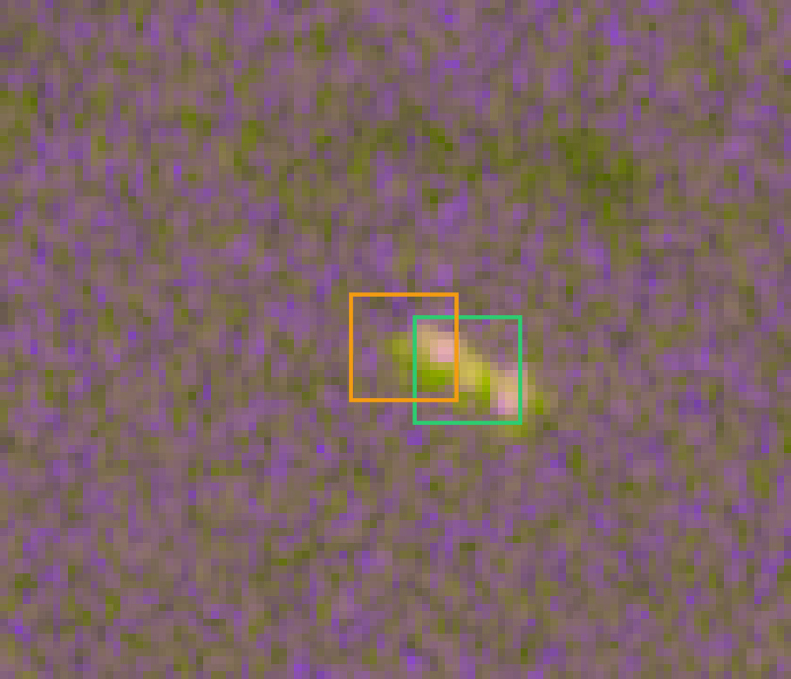
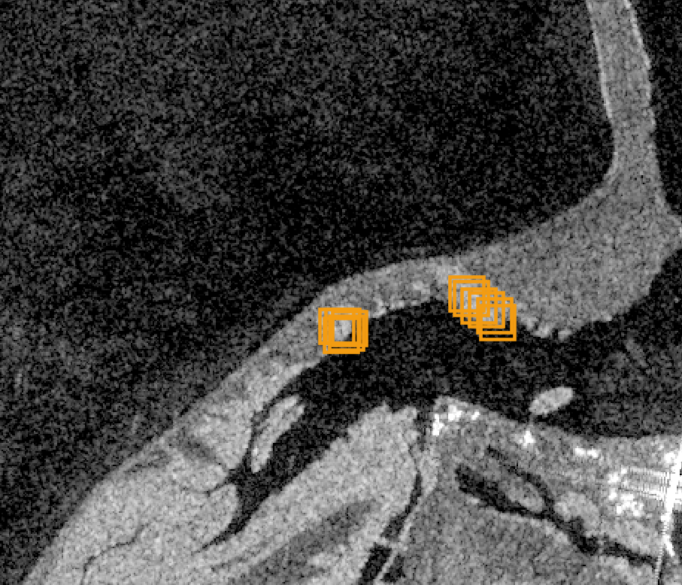
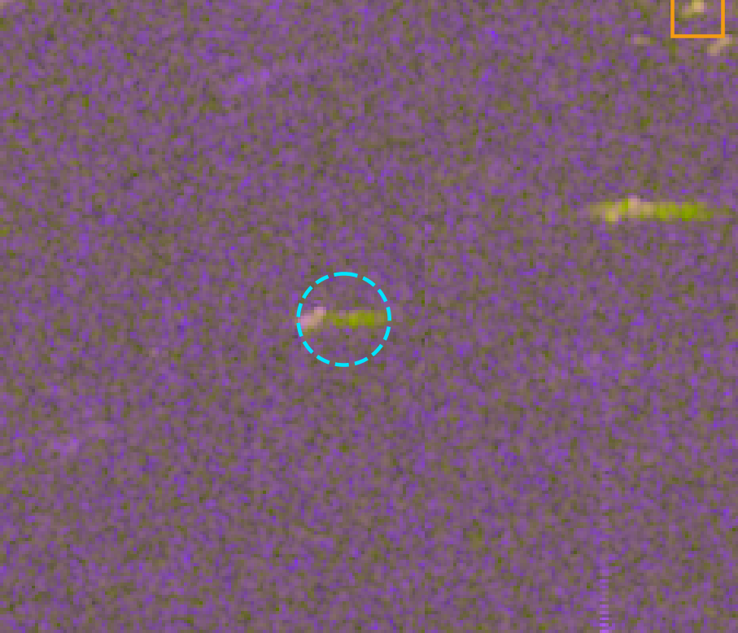
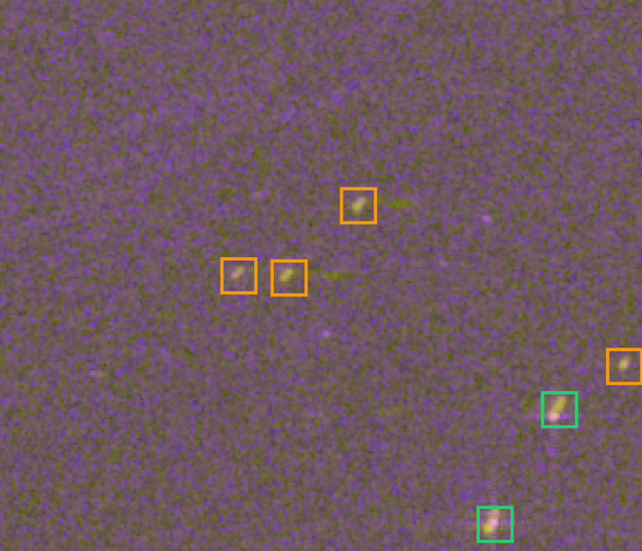
Failure cases and what they teach
CFAR
CFAR · GULF
YOLOv8s
YOLOv8s
Ship fragmentation
Coastline clutter
Faint, smeared ships
Label noise
CFAR splits one hull into two hits
CFAR fires along Gulf shorelines
Moving ships with weak returns are missed
Some “false alarms” are unlabelled ships
LESSON
Learned detector sees the whole ship
LESSON
Precise land mask plus learned context
LESSON
Small-object head and more training data
LESSON
Precision is a lower bound; inspect errors
Notes:
All four are real outputs. Green = correct, orange = false alarm, cyan dashed circle = missed ship.
1. CFAR fragmentation: bright bow and stern exceed the threshold separately, so one ship becomes two detections. Most of CFAR's open-water false alarms look like this.
2. Coastline clutter on the real Khalifa Port scene: CFAR fires in clusters where the OSM land mask meets the shore.
3. YOLO misses faint ships and moving ships smeared along-track with a wake: rare in training data.
4. Several 'false alarms' are clearly ship-shaped and missing from the labels: label noise, the same issue the xView3 winners reported. So measured precision is a lower bound.

Slide 7
Domain shift to Gulf waters is the main limitation
LIMITATIONS
NEXT STEPS
Domain shift: calm Gulf sea is up to 11 dB darker in VH than training data; fixed with a noise floor
No Gulf labels: Gulf results are qualitative
Gridded AIS: ~1 km cells, so dark counts are a lower bound
Score the dark flag per ship with xView3 AIS labels
Train YOLO26s and a small-object head on a 16 GB GPU
Label a few Gulf chips to measure the shift
A GULF MARITIME PICTURE: THREE LAYERS OF INTELLIGENCE
PROJECT 1 | THIS PROJECT
Dark Vessel Detector
Who is at sea, and who is not reporting
PROJECT 2
Super-Resolution for Port Intelligence
Sharper imagery of port activity
PROJECT 3
Abu Dhabi Coastal Bathymetry
Water depth along the coastline
Notes:
Domain shift, measured: Copernicus removes the thermal noise floor and clips at zero, so 37 % (Khalifa) to 58 % (Hormuz) of VH pixels were exactly zero. Gulf sea VH median −36 dB vs −25 dB in training.
First Gulf run: CFAR found 0 ships and YOLO missed an obvious one. Fix from physics, not tuning: clip at the training data's 1st percentile (VV −29.2, VH −31.9 dB), and never let CFAR's background std drop below speckle (2.2 dB for ~4.4 looks). The OSSDD baseline didn't change (F1 0.745 → 0.746).
AIS: Global Fishing Watch is gridded, so a dark ship anchored next to an AIS ship counts as matched.
Projects 2 and 3 add sharper port imagery (super-resolution) and water depth (bathymetry) to the same Gulf picture.

Slide 8
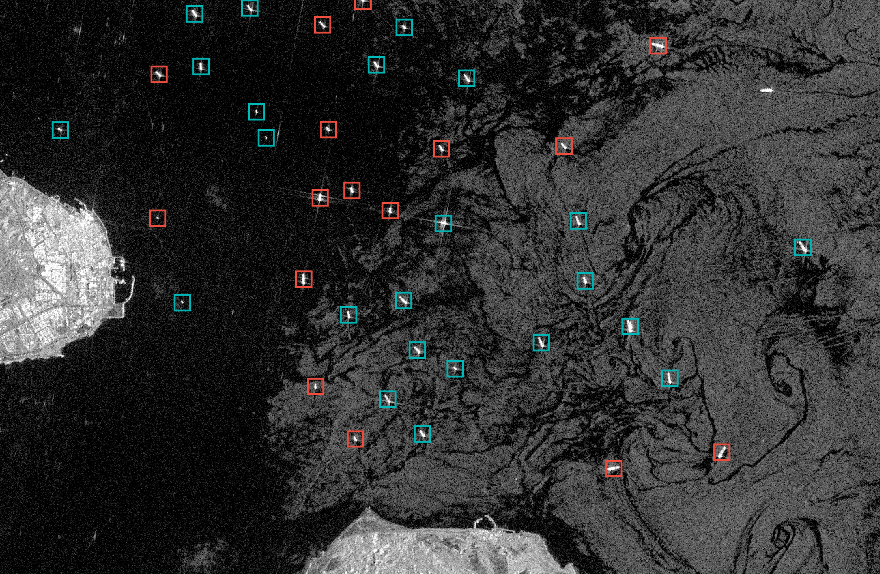
Demo and questions
READING THE DEMO
Vessel matched to AIS
Reporting its position
Dark vessel
Detected by radar, absent from AIS
Questions
Jordan Manoj Cheruvathoor
MSc Informatik, Leibniz Universität Hannover
Notes:
Strait of Hormuz, Larak–Qeshm anchorage, Sentinel-1, 15 Oct 2026 02:14 UTC. Fine-tuned YOLOv8s, never trained on Gulf data. Teal = AIS-broadcasting ship nearby, red = dark candidate.
40 vessels, 16 dark candidates. Compare Khalifa Port on the same pass: 13 vessels, 1 dark.
Live demo: streamlit run "demo app/app.py". Pick a chip, compare CFAR vs YOLO, drag the thresholds to show the precision/recall trade-off.

