Slide 1
Super-Resolution for Port Intelligence
An evaluation of whether 10 m → 2.5 m super-resolution of Sentinel-2 imagery supports the analysis of UAE ports, and where it introduces detail that does not exist
Jordan Manoj Cheruvathoor
Stellaria technical interview | 12 November 2026 | Project 2 of 3, A Gulf Maritime Picture
Notes:
This project evaluates whether super-resolution of free 10 m Sentinel-2 imagery supports the analysis of UAE ports, and measures where it introduces detail that is not present in reality.
It is the second of three projects under 'A Gulf Maritime Picture': (1) dark-vessel detection from SAR and AIS, (2) this study, and (3) coastal bathymetry.
Summary of findings: the training domain matters more than the architecture; fidelity-oriented super-resolution is reliable but yields only a small gain; GAN-based super-resolution produces realistic imagery and makes some vessels detectable, but its synthesised texture must not be treated as evidence.

Slide 2
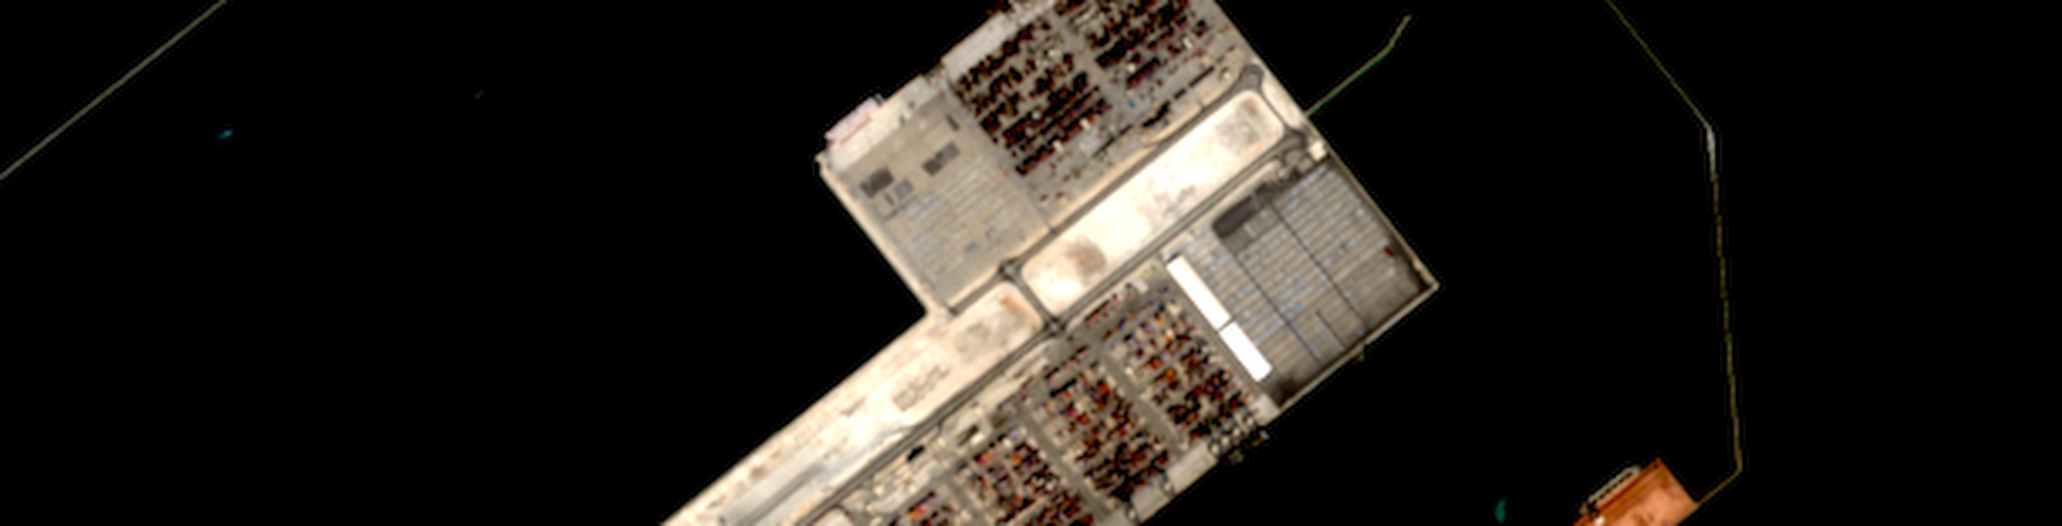
Super-resolution helps port intelligence only if the added detail is real
THE QUESTION
RELEVANCE TO STELLARIA
Sentinel-2 provides free, frequent 10 m imagery of every UAE port
At 10 m, vessels, cranes and berths cover only a few pixels
GAN-based super-resolution sharpens them, but can draw structures that do not exist
An invented vessel or berth becomes a false lead for an analyst
Super-resolution is a listed capability of the Stella platform
Port and maritime intelligence through Orbion, the joint venture with Abu Dhabi Maritime Academy
Study sites: Khalifa Port, Jebel Ali and Port Zayed
Notes:
Sentinel-2 provides a free image of every UAE port every few days, but at 10 m a container vessel spans roughly 30 pixels, and cranes or small craft are below the pixel size.
Super-resolution is a listed capability of the Stella platform, and Orbion addresses maritime and port intelligence. The risk is that GAN-based super-resolution draws structures that do not exist; in an intelligence context an invented vessel is more harmful than a blurred one, because it creates unwarranted confidence.
Image: Khalifa Port, Sentinel-2 L2A, 1 November 2025, 10 m (brightened for display).

Slide 3
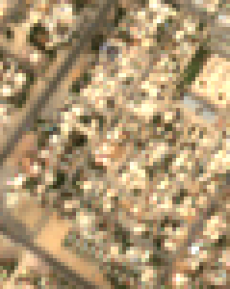
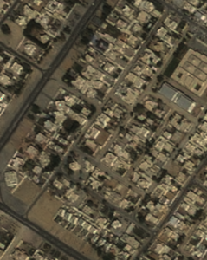
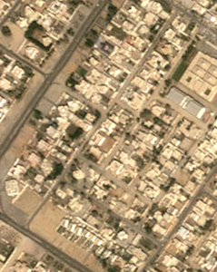
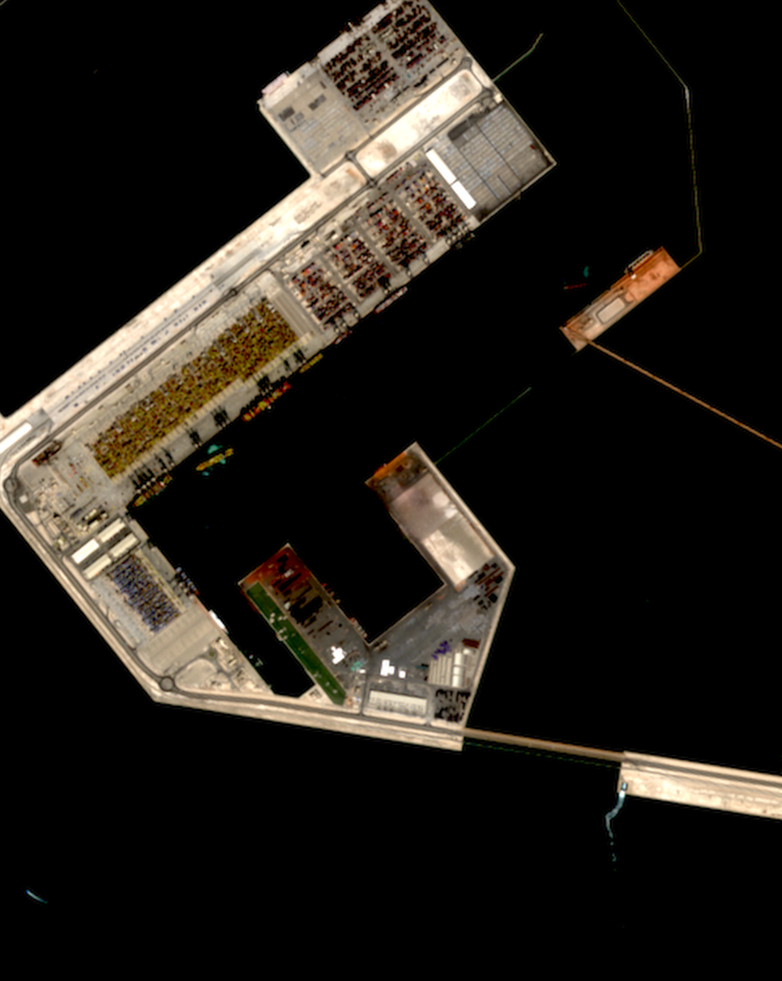
Paired imagery is aligned before any comparison is made
1 SENTINEL-2 L2A
Model input, 10 m
2 SPOT 6/7 AS DELIVERED
1.5 m, different sensor colours
3 SPOT AFTER ALIGNMENT
2.5 m, matched and registered
4 UAE PORT AREA OF INTEREST
Khalifa Port, Sentinel-2 only
Panels 1–3: WorldStrat tile Landcover-773487 (Sharjah), held out from training. The SPOT reference is resampled to 2.5 m, histogram-matched to Sentinel-2 and sub-pixel registered by phase correlation, so that metrics measure spatial detail rather than sensor calibration.
Notes:
Two data sources. WorldStrat (NeurIPS 2022) pairs real Sentinel-2 revisits with real 1.5 m SPOT imagery worldwide, including the Gulf. The full dataset is 104 GB; I read the zip index with HTTP range requests and downloaded approximately 2.5 GB: 600 training, 60 validation and 120 test tiles, plus all 13 Gulf tiles held out.
Panel 2 shows why alignment is required: SPOT colours differ strongly from Sentinel-2. Without colour matching, PSNR would primarily measure the sensor difference. I also register the images to sub-pixel accuracy, since a one-pixel offset at 2.5 m costs several dB and penalises sharp methods.
For the UAE ports themselves no free 2.5 m reference exists, so they are evaluated with reference-free checks later in the deck.

Slide 4
Five upscaling methods pass through one evaluation pipeline
1 DATA
2 SUPER-RESOLUTION
3 EVALUATION
4 OUTPUTS
WorldStrat v1.1
Sentinel-2 and SPOT 1.5 m pairs; 600 train, 60 val, 120 test, 13 Gulf tiles held out
Bicubic
Interpolation baseline
Image quality
PSNR, SSIM, LPIPS against SPOT at 2.5 m
Comparison
Five methods with bootstrap 95 % confidence intervals
Pre-trained
Real-ESRGAN (photographs) and Satlas (Sentinel-2 to US aerial)
Usefulness
Frozen YOLO11-OBB (DOTA) on SR versus on high-res
Before / after demo
Streamlit slider over UAE ports
Sentinel-2 L2A
Khalifa, Jebel Ali and Zayed Port; four cloud-free dates each
Fine-tuned on WorldStrat
L1 loss (fidelity) and L1 + VGG + GAN (realism)
Hallucination
Patch correctness, input consistency, stability across dates
Failure gallery
Where SR introduces detail
Notes:
Every method passes through the same pipeline. Data: WorldStrat for training and reference-based evaluation; Sentinel-2 L2A over the three ports from Element 84 Earth Search (AWS open data, no account required, reflectance offset of -0.1 handled).
Evaluation on three axes: image quality, usefulness for a frozen detector, and hallucination.

Slide 5
Reuse pre-trained weights, then fine-tune on real satellite pairs
Method | Build or reuse | Reason
Bicubic | Standard library | Sets the floor that every learned model must exceed
Real-ESRGAN, pre-trained | Reuse | General-purpose SR trained on degraded photographs
Satlas, pre-trained | Reuse | Same network trained on Sentinel-2 to US aerial imagery
Fine-tuned L1 | Fine-tune | Real-ESRGAN weights, 4,000 iterations, L1 loss: fidelity
Fine-tuned GAN | Fine-tune | From the L1 model, adds perceptual and GAN loss: realism
WHY NOT TRAIN FROM SCRATCH
Measured rather than assumed: with identical data, loss and 1,500 iterations, a random initialisation reaches 23.7 dB validation PSNR, against 28.8 dB from Real-ESRGAN weights.
WHY NOT DIFFUSION OR MULTI-IMAGE SR
Diffusion models exceed the 4 GB GPU budget and hallucinate more in published benchmarks. Multi-image SR fails on vessels that move between passes; it is the next step for static infrastructure.
Notes:
Both pre-trained models share exactly the same RRDBNet architecture (the ESRGAN generator: 23 blocks, 16.7 million parameters), so comparing them isolates the effect of training data. I re-implemented RRDBNet in about 100 lines only because the BasicSR package is incompatible with current torchvision, and verified that it loads both official checkpoints with strict key matching.
Training: 4,000 L1 iterations from Real-ESRGAN weights (selected by the ablation on the next slide), then 3,000 GAN iterations. Adam optimiser, cosine learning-rate decay, exponential moving average of weights, full precision because half precision produced NaN losses on the GTX 1650.

Slide 6
Pre-trained weights outperform training from scratch by 5 dB on the same budget
VALIDATION PSNR DURING TRAINING, 30 VALIDATION TILES (dB)
WHAT THE ABLATION SHOWS
Identical data, loss and 1,500 iterations; only the initial weights differ
Real-ESRGAN: 28.8 dB; starts high and continues to improve
Satlas: 24.2 dB; satellite weights, but trained on US imagery only
Random: 23.7 dB and still rising; would require far more data and compute
Decision: fine-tune from Real-ESRGAN weights
Notes:
This addresses the question from the first interview on pre-trained models. Identical data (1,607 pairs), loss and number of iterations; only the initial weights differ.
Real-ESRGAN initialisation ends at 28.79 dB, Satlas at 24.22 dB, random at 23.73 dB. Notably, the satellite-specific Satlas weights perform worse than generic photographic weights: Satlas was trained on US imagery with NAIP colours and must first unlearn that prior on Gulf scenes. Generic weights provide useful low-level features (edges, textures) without an incorrect geographic prior.
Source: results/training/ablation_l1_*/log.json.

Slide 7
Only the L1 model improves fidelity; the GAN model improves perceptual quality
Method | PSNR (dB) ↑ Gulf / global | SSIM ↑ | LPIPS ↓ | Hallucinated patches ↓
Bicubic | 20.11 / 25.46 | 0.504 | 0.653 | 0.0 %
Real-ESRGAN, pre-trained | 19.83 / 24.81 | 0.483 | 0.426 | 4.4 %
Satlas, pre-trained | 15.49 / 21.22 | 0.179 | 0.516 | 76.1 %
Fine-tuned L1 | 20.22 / 25.51 | 0.519 | 0.536 | 0.9 %
Fine-tuned GAN | 19.71 / 24.90 | 0.476 | 0.335 | 6.7 %
Image quality
Fine-tuned L1 exceeds bicubic by 0.11 dB on Gulf tiles (95 % CI 0.01 to 0.20): significant but small. All GAN models trade PSNR for LPIPS.
Usefulness
Detector agreement with SPOT is inconclusive: 42 reference objects in 120 test tiles, and all F1 intervals overlap (bicubic 0.41, GAN 0.44).
Hallucination
Satlas introduces structure in 76 % of Gulf patches. Fine-tuning reduces Real-ESRGAN's 11 % to 9 % (GAN) and 1 % (L1) on the global test set.
13 held-out Gulf tiles (never used in training) / 120 global WorldStrat test tiles. SSIM, LPIPS and hallucination on Gulf tiles. SR colours harmonised to the input before scoring; confidence intervals from 10,000 paired bootstrap resamples. Source: results/metrics/per_tile_summary.csv, bootstrap_ci.csv.
Notes:
These results describe a trade-off rather than a single ranking.
Fidelity: only the L1 fine-tuned model exceeds bicubic, by 0.11 dB on Gulf tiles. The bootstrap interval excludes zero, so the gain is genuine, but it is small. This is consistent with the literature: super-resolution between real Sentinel-2 and SPOT imagery is considerably harder than on synthetic benchmarks.
Perceptual quality: the GAN model has the best LPIPS by a wide margin but lower PSNR: the perception-distortion trade-off described by Blau and Michaeli (2018).
Hallucination: measured per patch, simplified from ESA's OpenSR-test; a patch is counted as hallucinated when the output moves away from both the input and the reference.
Usefulness: the downstream detection test is underpowered, because WorldStrat tiles contain few detectable objects.

Slide 8
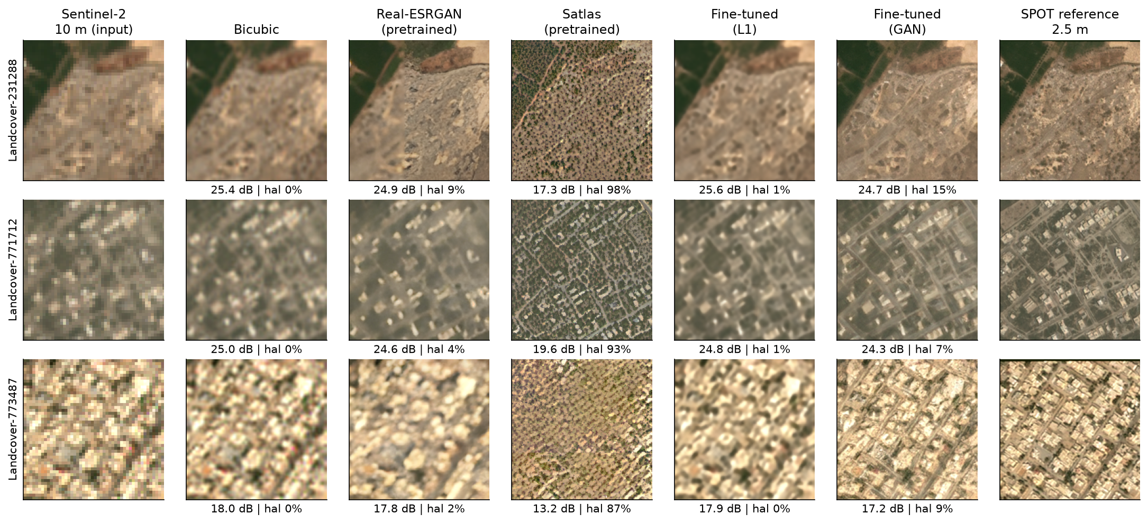
All five methods on held-out Gulf tiles, against the SPOT reference
Three of the 13 held-out Gulf tiles. Under each panel: PSNR against the reference and the share of hallucinated patches. Satlas renders vegetation typical of its US training data; the GAN model reconstructs the street layout most convincingly.
Notes:
This gallery shows every method on held-out Gulf tiles. Three observations.
First, Satlas consistently replaces Gulf scenes with vegetation and terrain typical of its US training data; this is the domain-shift failure.
Second, the L1 model is faithful but remains soft; visually it is close to bicubic.
Third, the GAN model reconstructs street grids and building outlines that resemble the reference, yet its PSNR is lower, because the individual structures are placed slightly incorrectly. Source: results/figures/examples_gulf.png.

Slide 9
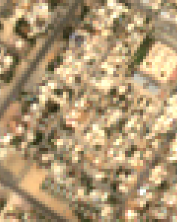
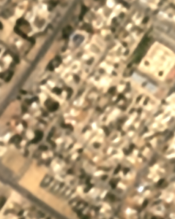
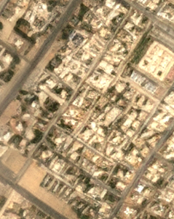
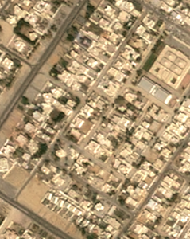
A closer view: one Sharjah tile, fidelity model versus GAN model
1 INPUT
Sentinel-2, 10 m
2 FINE-TUNED L1
17.9 dB, 0 % hallucinated
3 FINE-TUNED GAN
17.2 dB, 9 % hallucinated
4 REFERENCE
SPOT, resampled to 2.5 m
Bicubic on this tile: 18.0 dB. Sentinel-2 L2A via WorldStrat; reference: WorldStrat SPOT 6/7 (CC BY-NC 4.0). Tile Landcover-773487, never used in training. Same crop in every panel.
Notes:
A dense residential district in Sharjah that the models never saw during training.
The L1 model is faithful but soft. The GAN model produces a convincing street grid and building outlines that resemble the reference, yet its PSNR is lower, because individual roofs and walls are placed slightly incorrectly. This is the perception-distortion trade-off in a single example, and the reason an analyst should not count buildings or vehicles on GAN output.

Slide 10
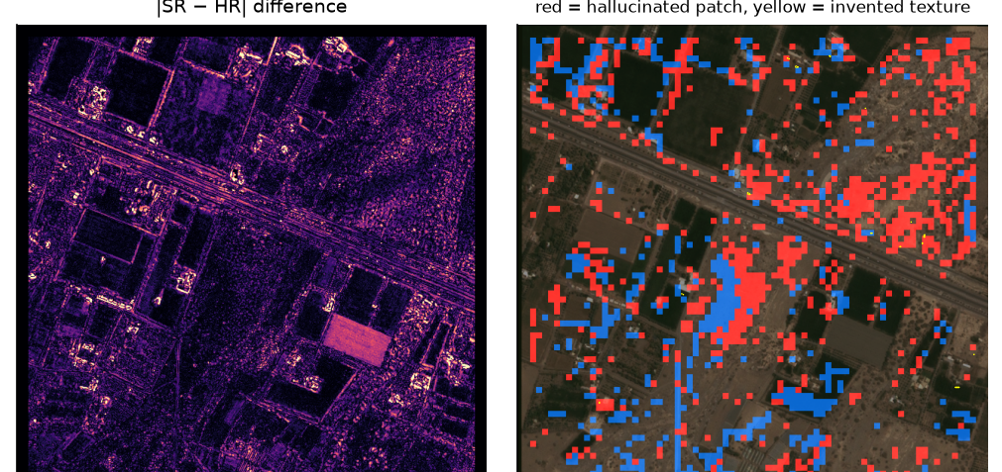
Hallucinations are identified by comparing SR with both the input and the reference
1
2
3
4
Align
Colour-match and sub-pixel register SPOT to Sentinel-2
Compare
Per 8×8 patch: distance of SR to the reference and to bicubic
Flag
Hallucinated: SR moved away from both input and reference
Review
Zoomed crops and difference maps of the worst tiles
WHAT THE FAILURE CASES SHOW
Domain shift: Satlas synthesises vegetation from its US training data (76 % of Gulf patches)
GAN texture is realistic but not accurate: roofs and walls are slightly misplaced
Some flags reflect real change between acquisition dates, such as a replanted field
Notes:
Method: after colour matching and registration, for each 8x8 patch I compute d_im = |SR - HR| / |bicubic - HR| and d_om = |SR - bicubic| / |bicubic - HR|. If the output is closer to the reference than bicubic, the patch is an improvement (blue). If it has moved away from both the input and the reference, it is a hallucination (red). This is a simplified version of the correctness metric in ESA's OpenSR-test benchmark.
Image: left, absolute difference to the reference; right, the patch classification. The bright rectangle in the difference map is a field that changed between the SPOT and Sentinel-2 acquisitions: genuine change rather than hallucination, which is the main limitation of any reference-based check.

Slide 11
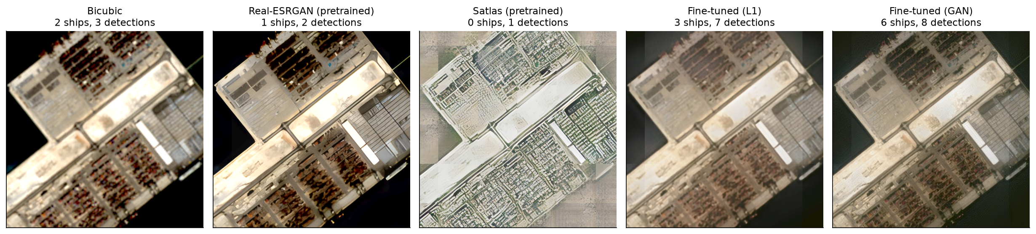
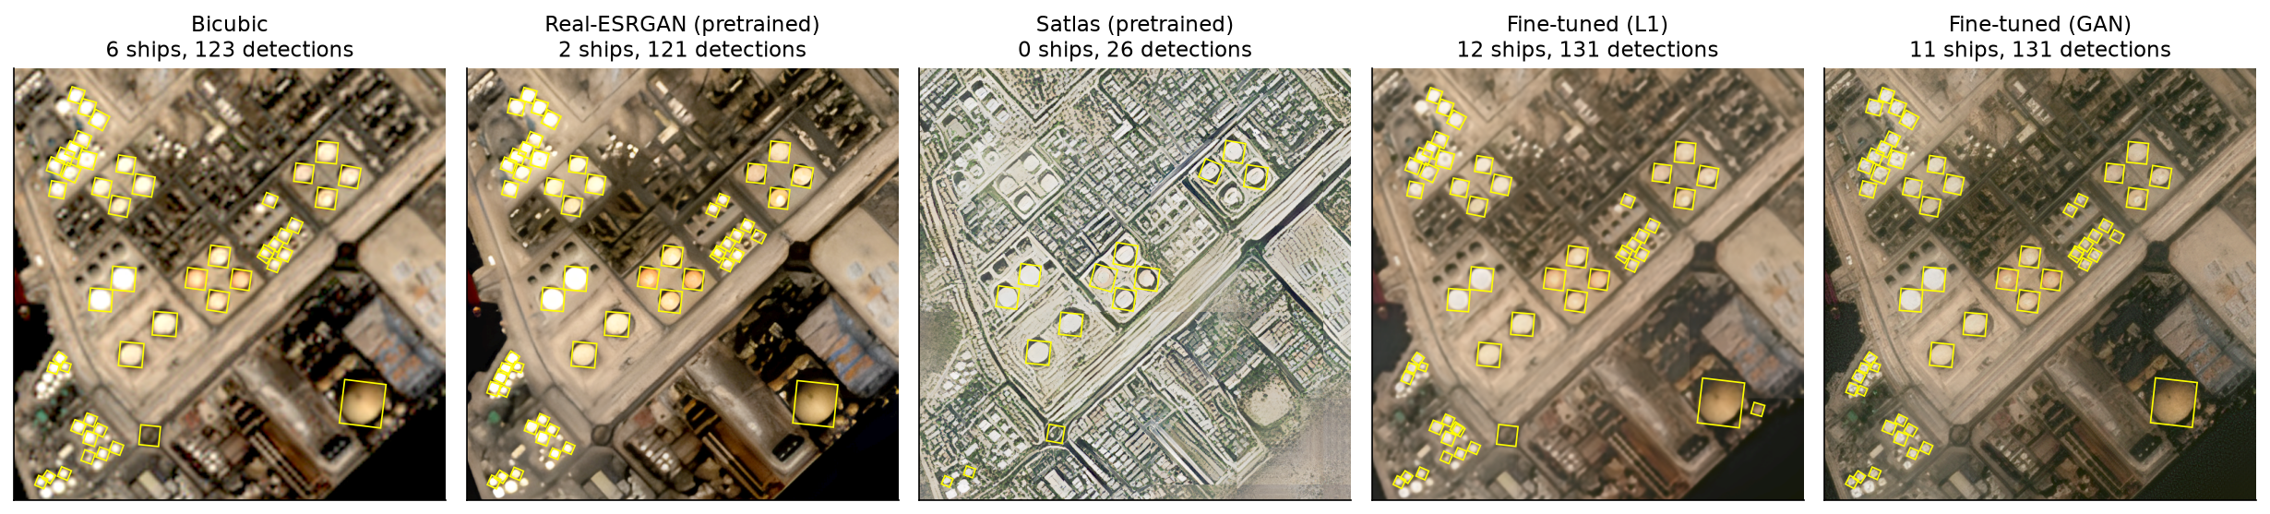
Super-resolution over the UAE ports, with detector output overlaid
Sentinel-2 L2A (Element 84 Earth Search), ×4. Boxes: frozen YOLO11-OBB trained on DOTA (cyan: ship; yellow: other classes such as storage tanks). Display brightened identically in every panel. Counts refer to the full 6 × 6 km area of interest.
Notes:
Two of the three ports, each shown with all five methods and the detector output. At Jebel Ali, the storage-tank farm is detected consistently by every method except Satlas, which converts the port into US-style terrain and suppresses most detections. The fine-tuned models retain the port structure and add sharper edges. No free 2.5 m reference exists for these dates, so the next slide uses reference-free checks.

Slide 12
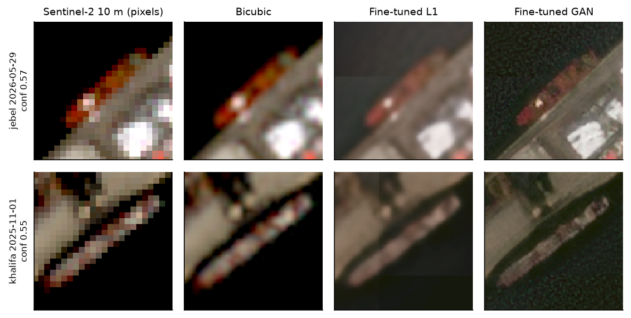
GAN super-resolution makes berthed vessels detectable, but its deck detail is not evidence
VESSELS DETECTED ONLY AFTER GAN SR ARE VISIBLE IN THE 10 M INPUT
REFERENCE-FREE CHECKS: 3 PORTS × 4 DATES
Vessels per image: bicubic 2.8, GAN 4.0, L1 3.9, Real-ESRGAN 1.9
The additional vessels are real: they are visible in the Sentinel-2 input
Satlas suppresses port structure: 3.7 detections per image, against 46 for bicubic
GAN detail varies between dates: +1.1 grey levels on pixels the input shows as unchanged
Implication: detections may be used; synthesised texture may not
Notes:
As no 2.5 m reference exists for these dates, the ports are evaluated with reference-free checks.
1) Detections: the frozen DOTA detector finds more vessels after GAN super-resolution. I inspected every vessel that appears only after GAN SR: all are genuine berthed vessels, visible in the 10 m pixels. Super-resolution therefore assists the detector. However, the containers and superstructure drawn on deck cannot be verified from 10 m data.
2) Temporal stability: between two dates, on pixels where the input is unchanged, the output should also be unchanged. The GAN output varies most, which indicates that part of its fine detail is generated rather than observed.
3) Satlas suppresses the port structure entirely.
Source: results/metrics/ports_summary.csv.

Slide 13
Limitations, next steps and the place of this project in the wider picture
LIMITATIONS
A GULF MARITIME PICTURE: THREE LAYERS
SPOT and Sentinel-2 are not acquired simultaneously, so some flags are real change
The detection test is underpowered (42 objects); labels are pseudo ground truth
A linear 8-bit stretch darkens water; WorldStrat SPOT data is CC BY-NC
Dark Vessel Detector
Gulf SAR + AIS: vessels that switch off tracking
1
Super-Resolution for Port Intelligence
Sharper views, delivered with a hallucination check
2
NEXT STEPS
Multi-image SR from repeated passes for static port infrastructure
SEN2SR (radiometrically consistent, ESA OpenSR) as a further baseline
A hallucination map delivered with every SR output
Abu Dhabi Coastal Bathymetry
Satellite-derived water depth along the coast
3
Notes:
Limitations: the acquisition gap between SPOT and Sentinel-2, the small number of detectable objects in the test tiles, and the non-commercial licence of the reference imagery, which is suitable for research but not for a product.
Position in the wider picture: project 1 identifies dark vessels from SAR and AIS; super-resolution could support an analyst inspecting optical image chips of those candidates, provided each output carries a hallucination flag. Project 3, bathymetry, should not use super-resolved imagery as input, because depth retrieval depends on the original reflectance values.

Slide 14
Conclusions
1 The training domain matters more than the architecture: US-only pretraining fails in the Gulf
2 Fidelity-oriented SR is reliable but gains only 0.11 dB; GAN SR aids vessel detection
3 SR should be used as a visual aid, with every output accompanied by a hallucination check
Demonstration: streamlit run demo/app.py | Code, data scripts and results in the project repository | Questions
Notes:
Conclude with the three findings, then switch to the live demonstration (before/after slider over Khalifa Port, Jebel Ali and Zayed Port) and take questions.

