Slide 1

ELEC4951 – Research Thesis A Seminar
Comparison and Implementation of Data Compression Methods for SoC-based Radar Systems
Jordan Mohindra
Supervisor: Beena Ahmed

Slide 2
Introduction
Problem
The rapid expansion of radar sensors in automotive systems creates significant challenges in managing the resulting surge in bandwidth requirements.
What does this matter?
Requires more expensive architecture
Higher latency
Notes:
2

Slide 3
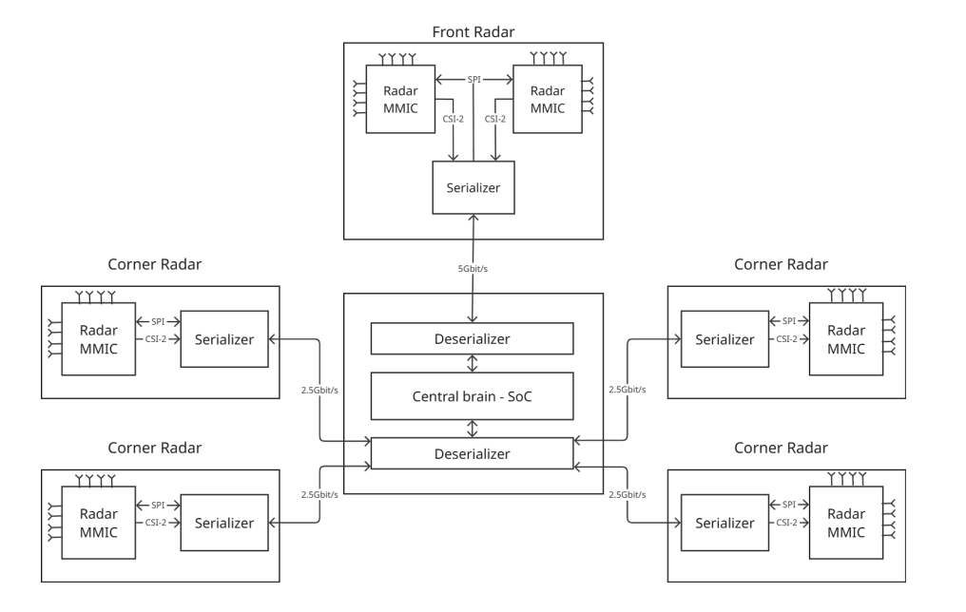
Introduction
SerDes (Serializer/Deserializer) Architecture
Notes:
3

Slide 4
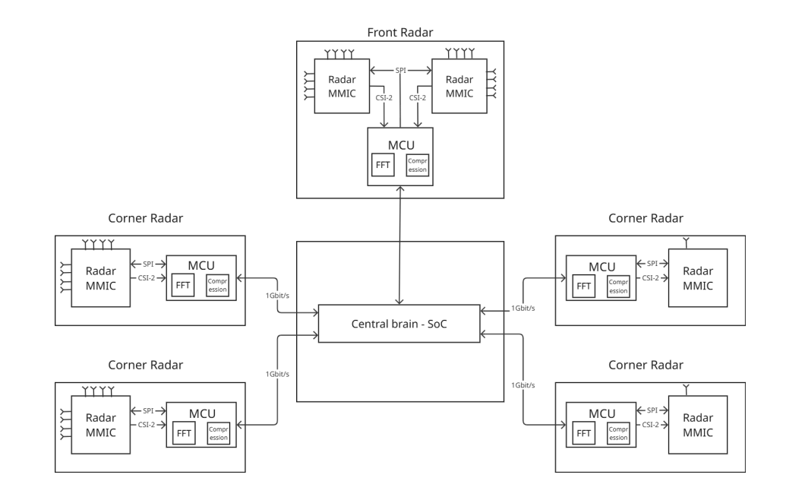
Introduction
Compression Solution
Notes:
4

Slide 5
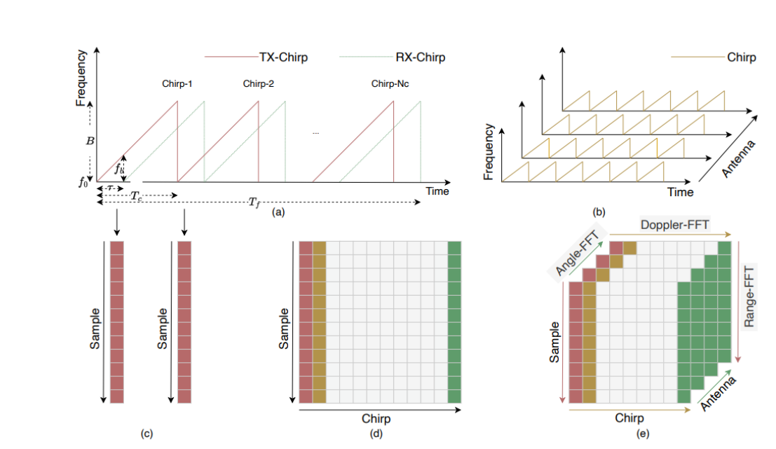
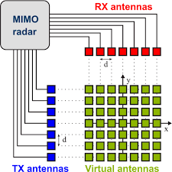
Technical Background - Radar
Notes:
5

Slide 6
Technical Background – Compression Algorithm Metrics
Compression Algorithm Metrics
Compression Ratio (CR)
False Positive (FP)
False Negative (FN)
Noise Floor
SNR
Latency
Notes:
6

Slide 7





Existing Compression Algorithms
Exponential Golomb Encoding (EGE)
CPX
[2]
CMPR
[1]
[3]
[5]
[4]
AdaRadar
DRHE
BAQ
[6]
[7]
JPEG2000
Notes:
7

Slide 8
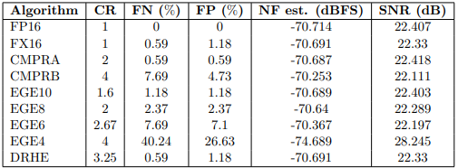
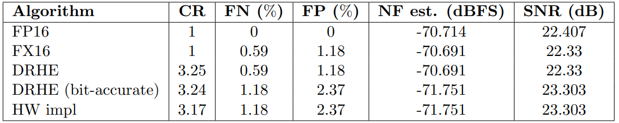
Related Work – Masters Thesis
Simulation Results
[8]
Hardware Implementation Results
[8]
Notes:
8

Slide 9
Related Work – Gaps
1. Fixed vs Float Quantization Error
2. Decompression
3. Other Compression Algorithms
[2]
CPX
[7]
JPEG
BAQ
[6]
AdaRadar
[5]
Notes:
9

Slide 10
My Thesis
1. Fixed vs Float Quantization Error
2. Decompression
3. Other Compression Algorithms
[2]
CPX
[7]
JPEG
BAQ
[6]
AdaRadar
[5]
Notes:
10

Slide 11
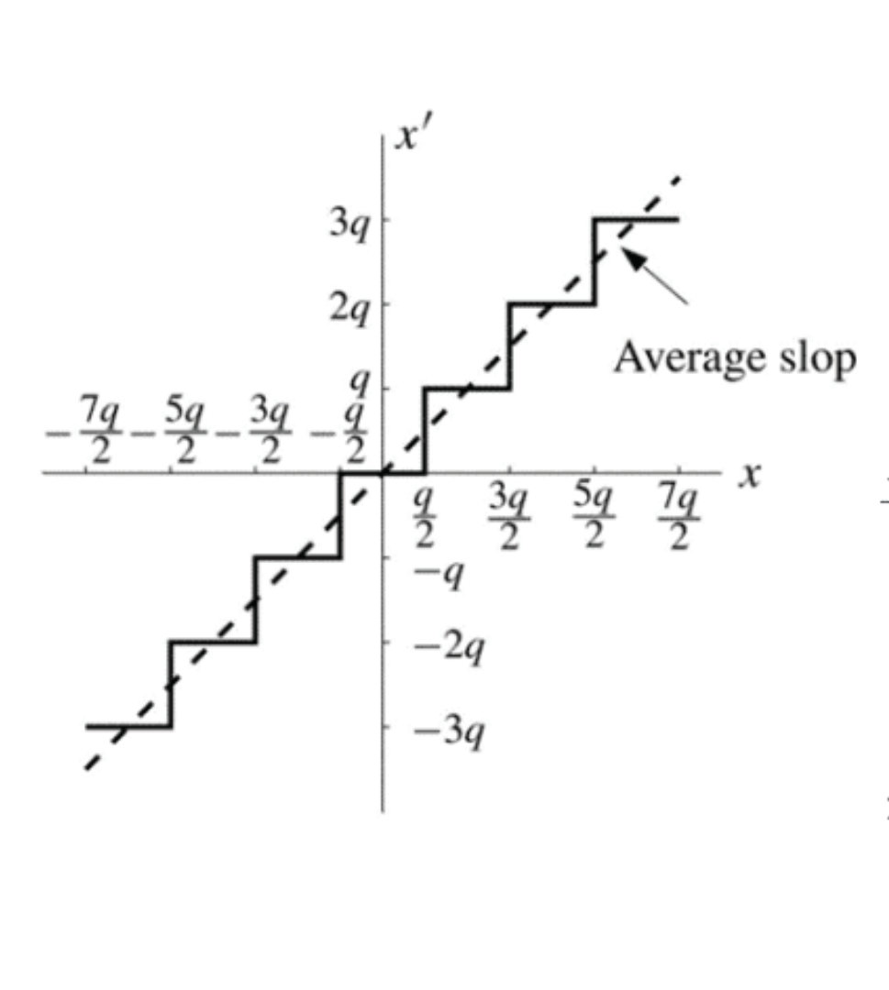
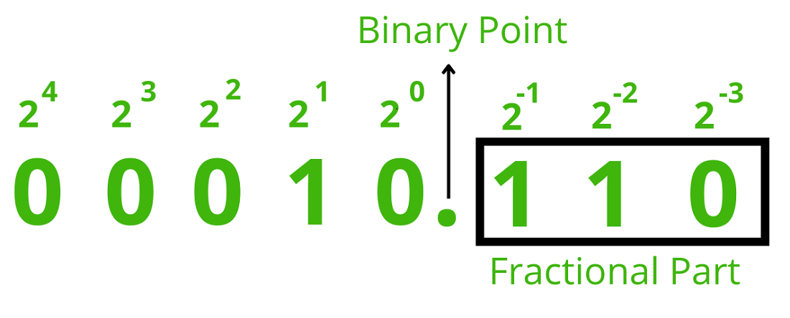
My Thesis
1. Fixed vs Float Quantization Error
Notes:
11

Slide 12
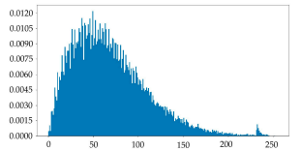


My Thesis
1. Fixed vs Float Quantization Error
Solutions?
Latency was 0.079ms – floating point implementation?
[8]
[9]
Notes:
12

Slide 13
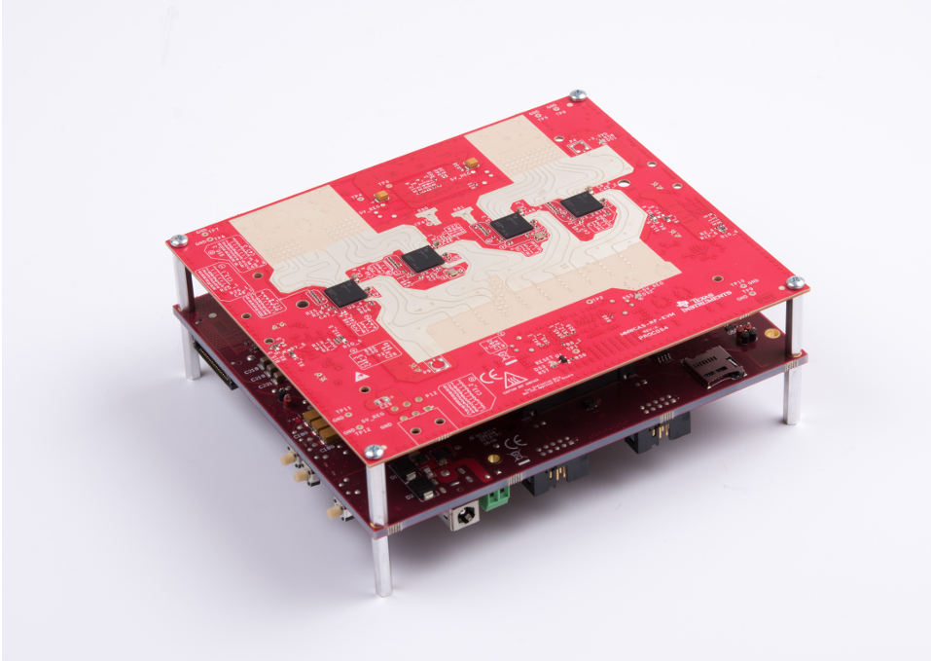

My Thesis
2. Decompression
MMWAVCAS-RF-EVM with MMWAVCAS-DSP-EVM
MATLAB
[10]
Notes:
13

Slide 14
My Thesis
3. Other Compression Algorithms (alongside DRHE)
[2]
CPX
[7]
[6]
BAQ
AdaRadar
[5]
Notes:
14

Slide 15
Project Plan & Timeline
Milestone 1: Completion of Literature Review & Algorithm Selection (Completed)
Milestone 2: Completion of MATLAB algorithm simulations and trade-off analysis.
Milestone 3: Successful Implementation of Compression Algorithm
Milestone 4: Successful raw data compression/decompression on MATLAB using the AWR2243 sensor.
Milestone 5: Final hardware benchmarking (Latency, Resource Utilization, and Data Fidelity).
Notes:
15

Slide 16
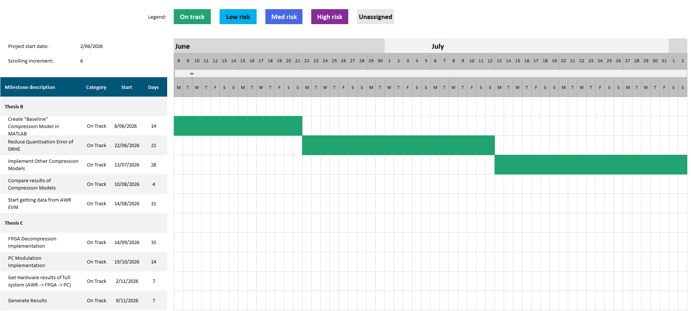
Project Plan & Timeline
Notes:
16

Slide 17
Challenges
Challenge 1: FPGA Implemenntation
Mitigation: Extensive comprehension of FPGA source management techniques
Challenge 2: Measuring performance metrics of algorithms, such as latency
Mitigation: Look into various profiling methods
Notes:
17

Slide 18
Skills
What Skills do I have?
Background in DSP and Embedded Systems
What Skills do I need?
FPGAs!
Notes:
18

Slide 19
References
[1] Texas Instruments EGE (Exponential-Golomb Encoding) Mani, A. and Yang, Z. (2019) Memory Compression and Decompression Engine for TI mmWave Radar. Application Report SWRA663. Texas Instruments.
[2] CPx NXP Algorithm NXP Semiconductors (2017) AN5375: Compression overview. Application Note Rev. 1. NXP Semiconductors.
[3] CMPR or Infineon Compression Algorithm Infineon Technologies (2026) Product Brochure AURIX™ 32-bit microcontrollers for automotive and industrial applications (March 2026 edition). Infineon Technologies.
[4] DRHE Algorithm (On-the-fly algorithm) Zivkovic, Z. and Li, L. (2015) 'On-the-fly range-velocity radar data compression exploring Doppler spectrum redundancy', 2015 16th International Radar Symposium (IRS), pp. 321-326.
[5] AdaRadar Algorithm Park, J., Chun, S.Y. and Seok, M. (2026) 'AdaRadar: Rate Adaptive Spectral Compression for Radar-based Perception', arXiv preprint arXiv:2603.17979.
[6] JPEG2000 Algorithm Taubman, D.S. and Marcellin, M.W. (2002) JPEG2000 Image Compression Fundamentals, Standards and Practice. Springer Science & Business Media.
[7] BAQ Algorithm Kwok, R. and Johnson, W.T.K. (1989) 'Block adaptive quantization of Magellan SAR data', IEEE Transactions on Geoscience and Remote Sensing, 27(4), pp. 375-383.
[8] Kiem's Design and Implementation Paper Kiem, L. (n.d.) Design and Implementation of Data Compression Methods for SoC-based Radar Systems. Graz University of Technology (TU Graz).
[9] Rayleigh Distribution Quantization Error Fix Deng, J. and Huang, L. (2024) 'Synthetic Aperture Radar Image Compression Based on Low-Frequency Rejection and Quality Map Guidance', Remote Sensing, 16(5), p. 891.
[10] Texas Instruments RF-EVM Board Texas Instruments (2019) AWRx Cascaded Radar RF Evaluation Module (MMWCAS-RF-EVM) User's Guide. Revision A. Texas Instruments.
Notes:
19

