Slide 1
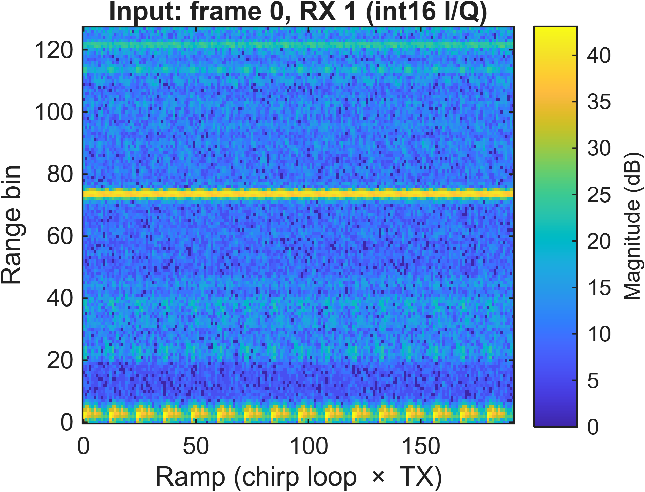
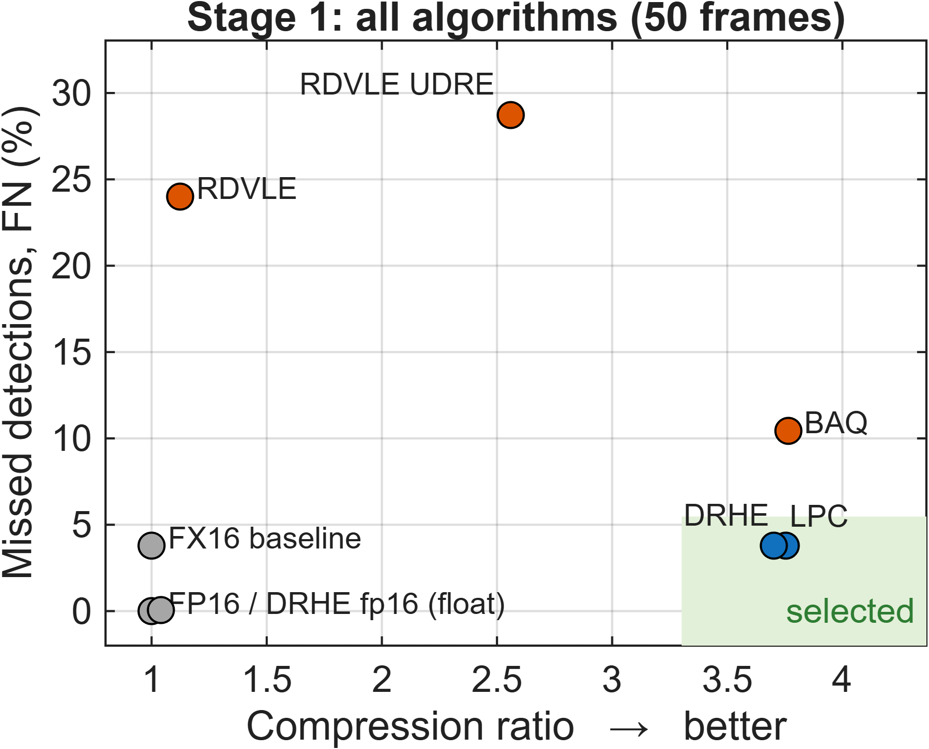
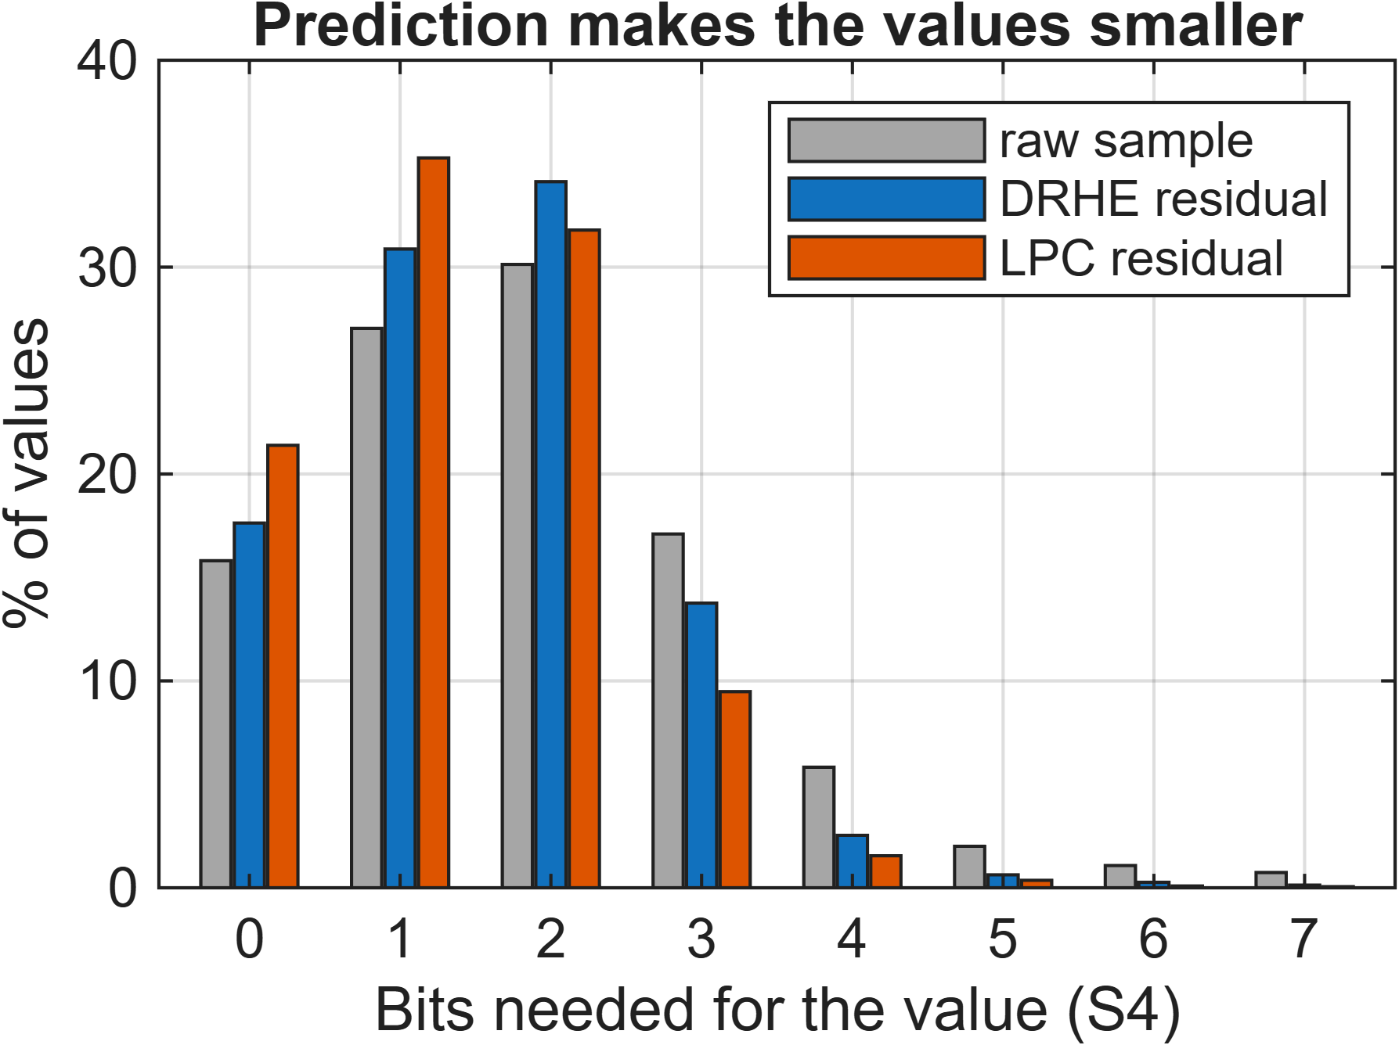
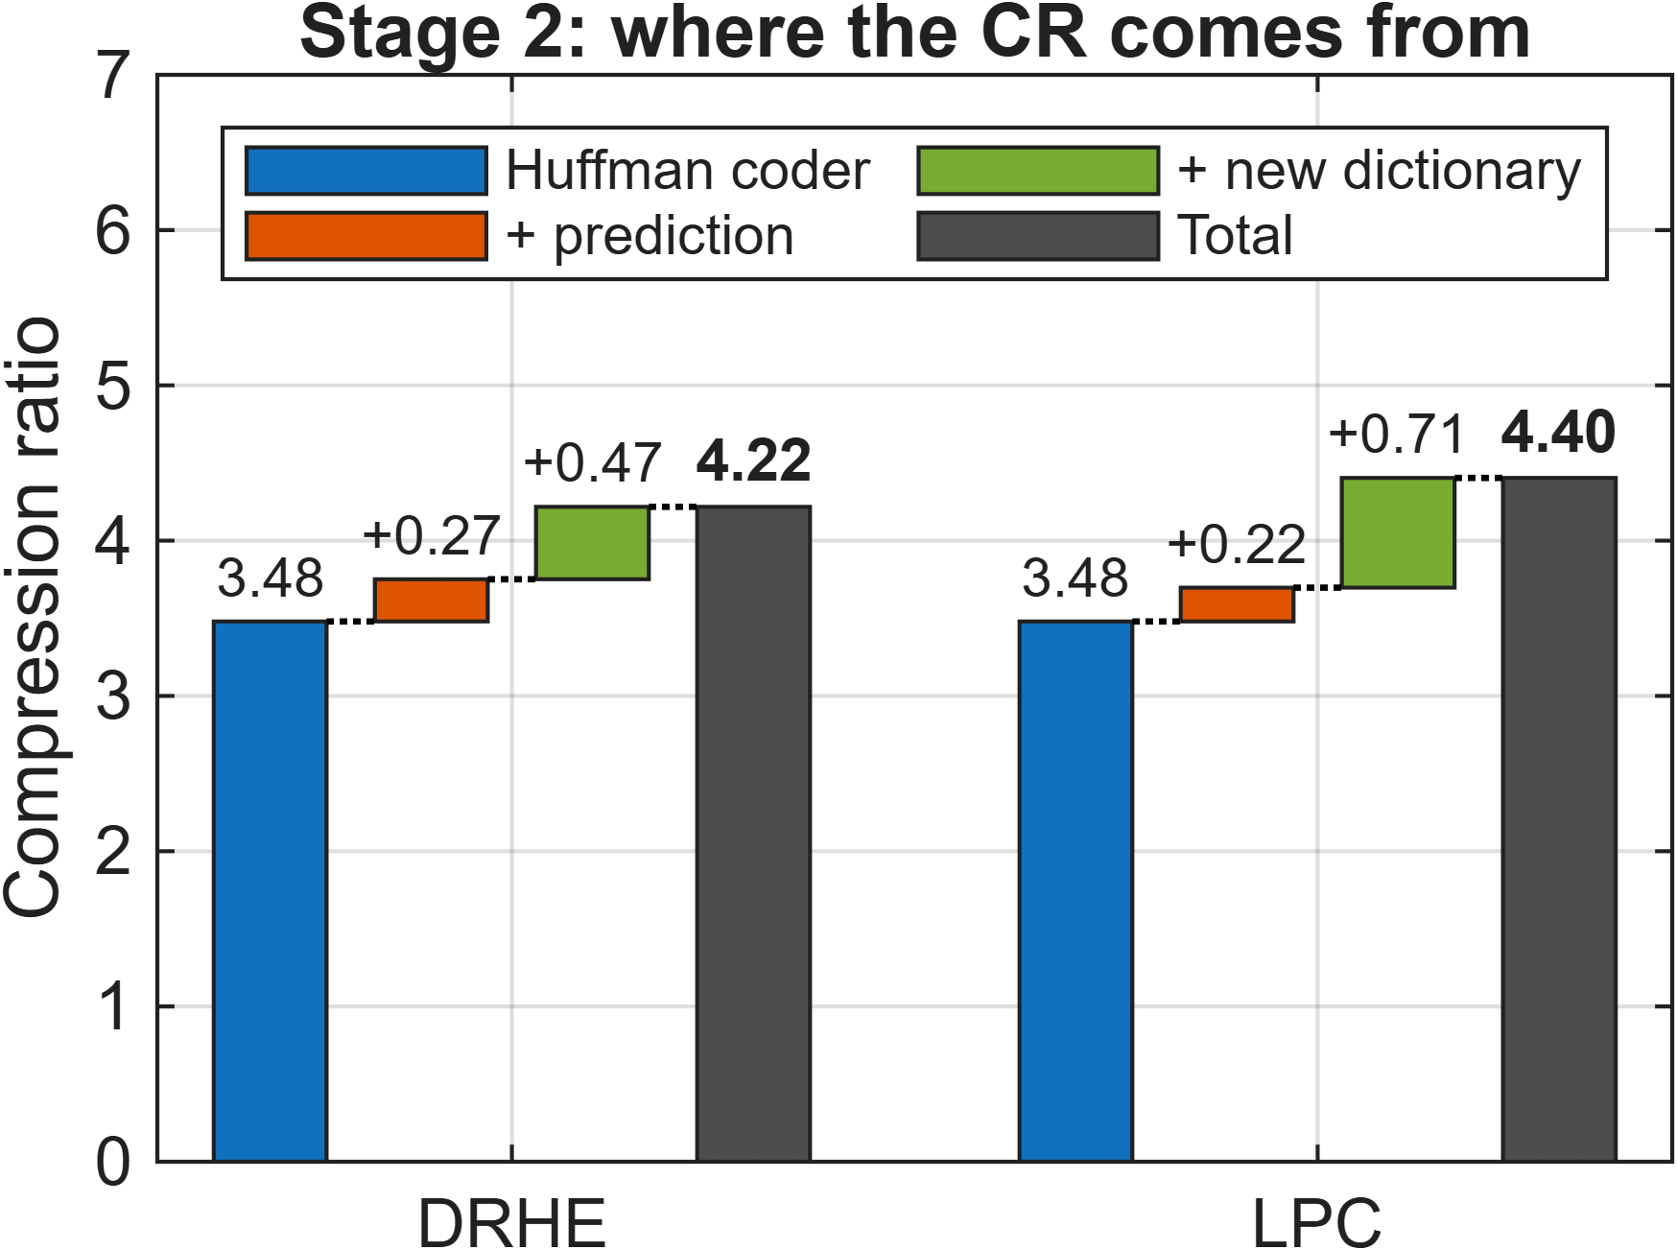
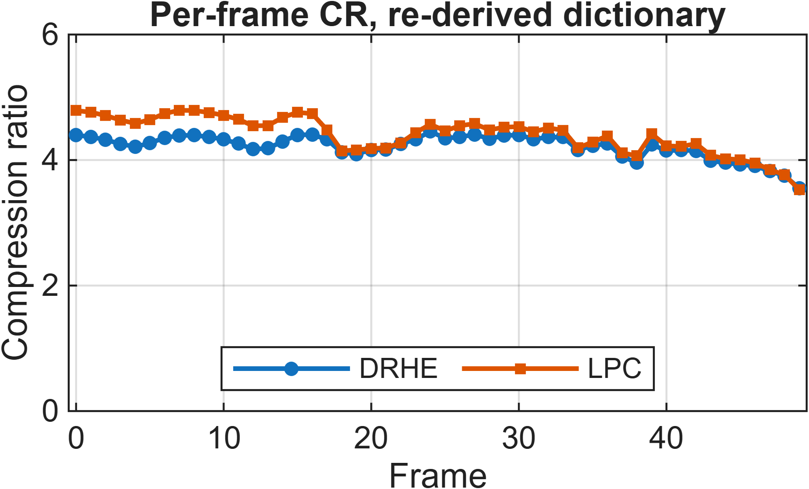
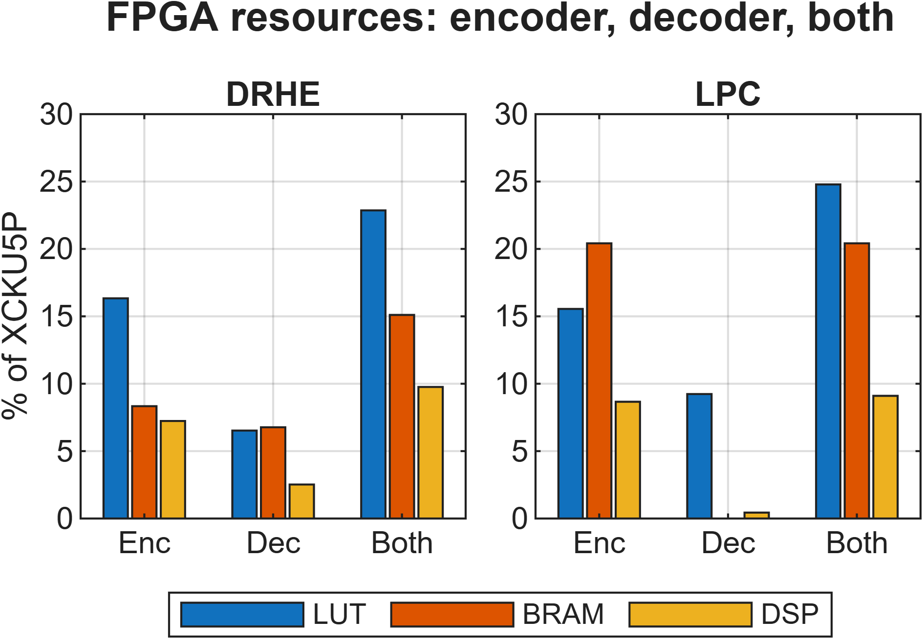
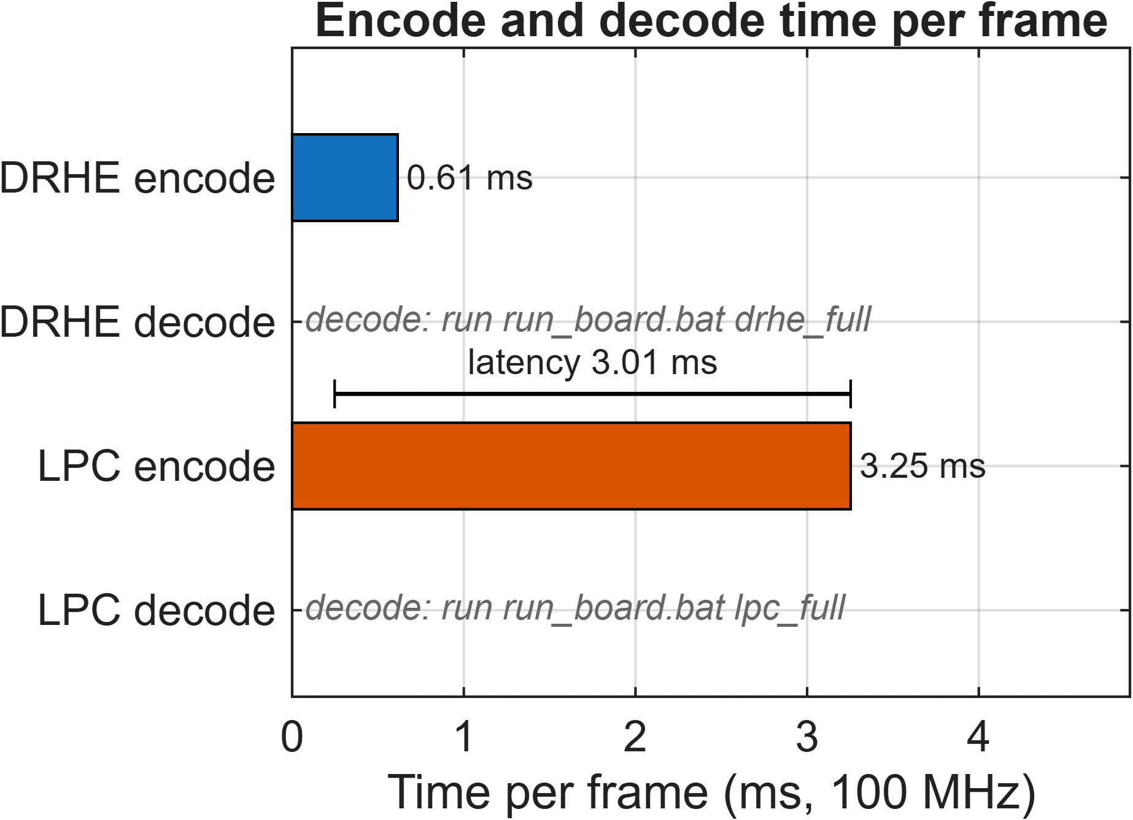
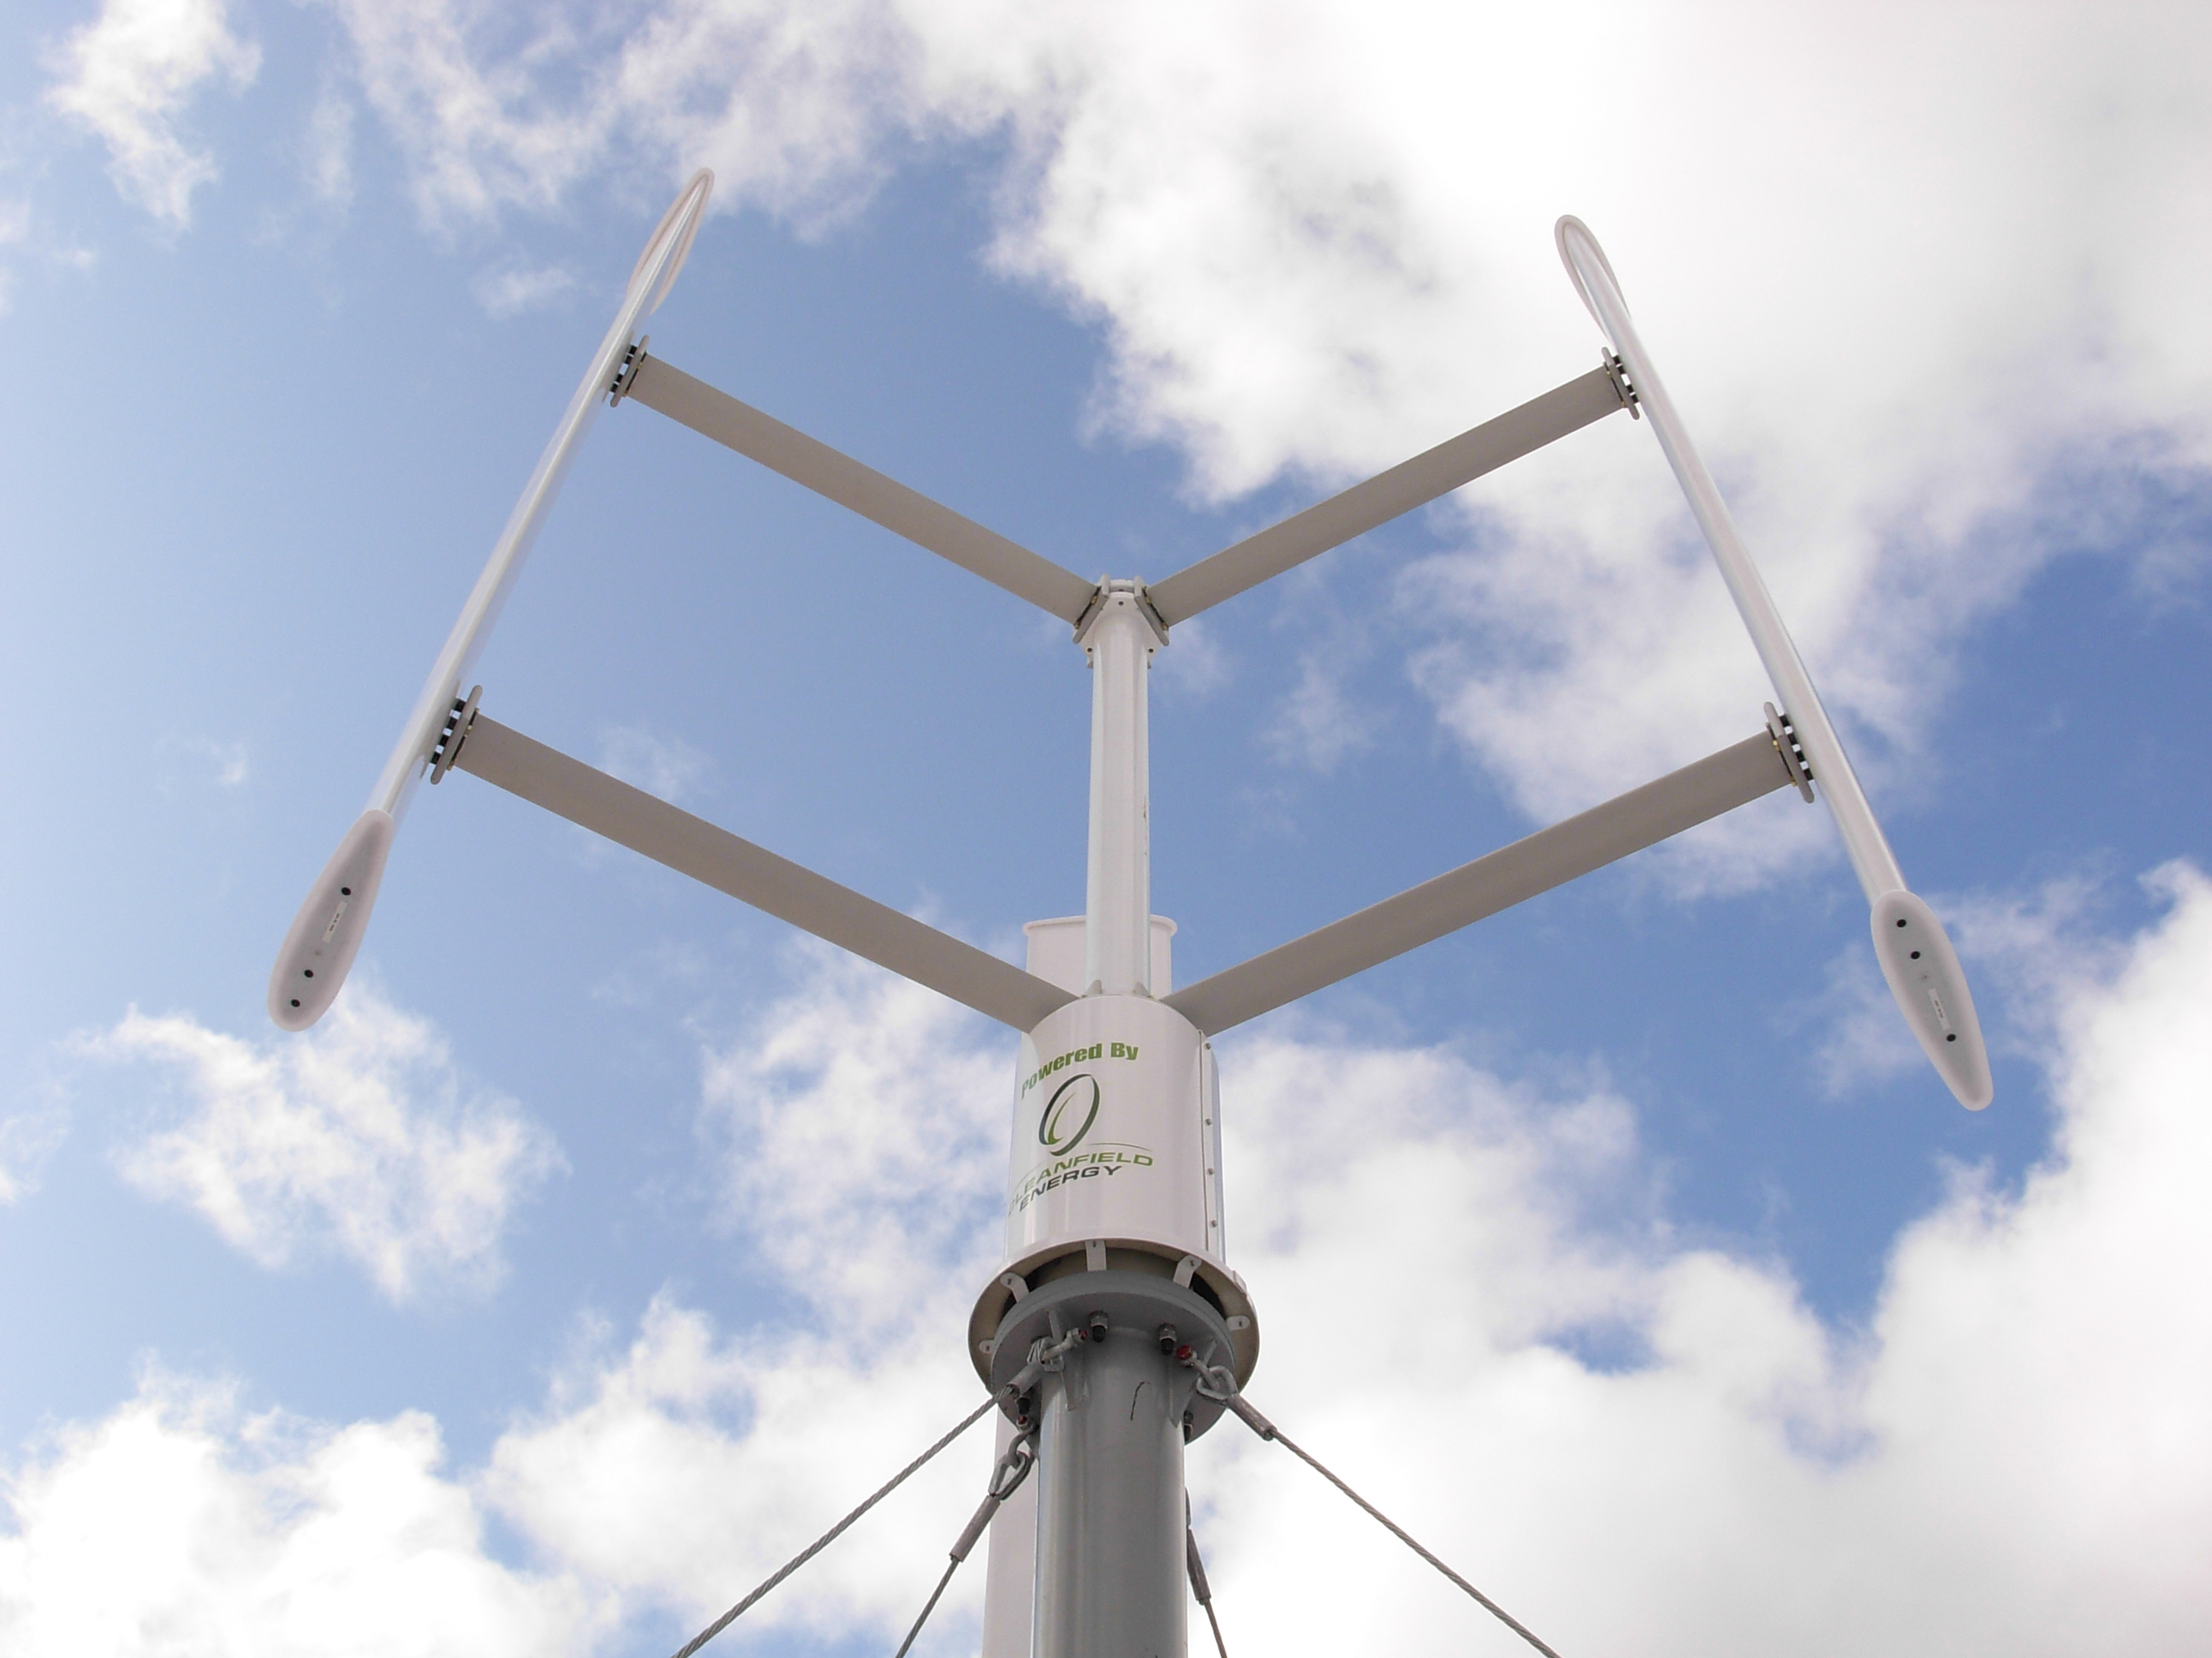
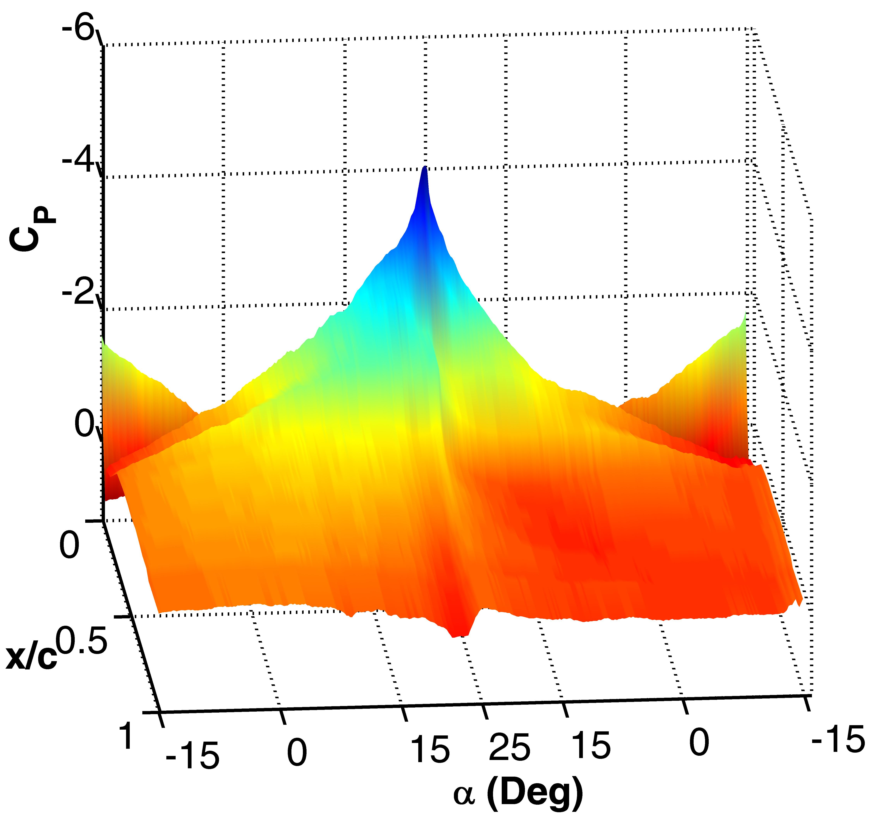
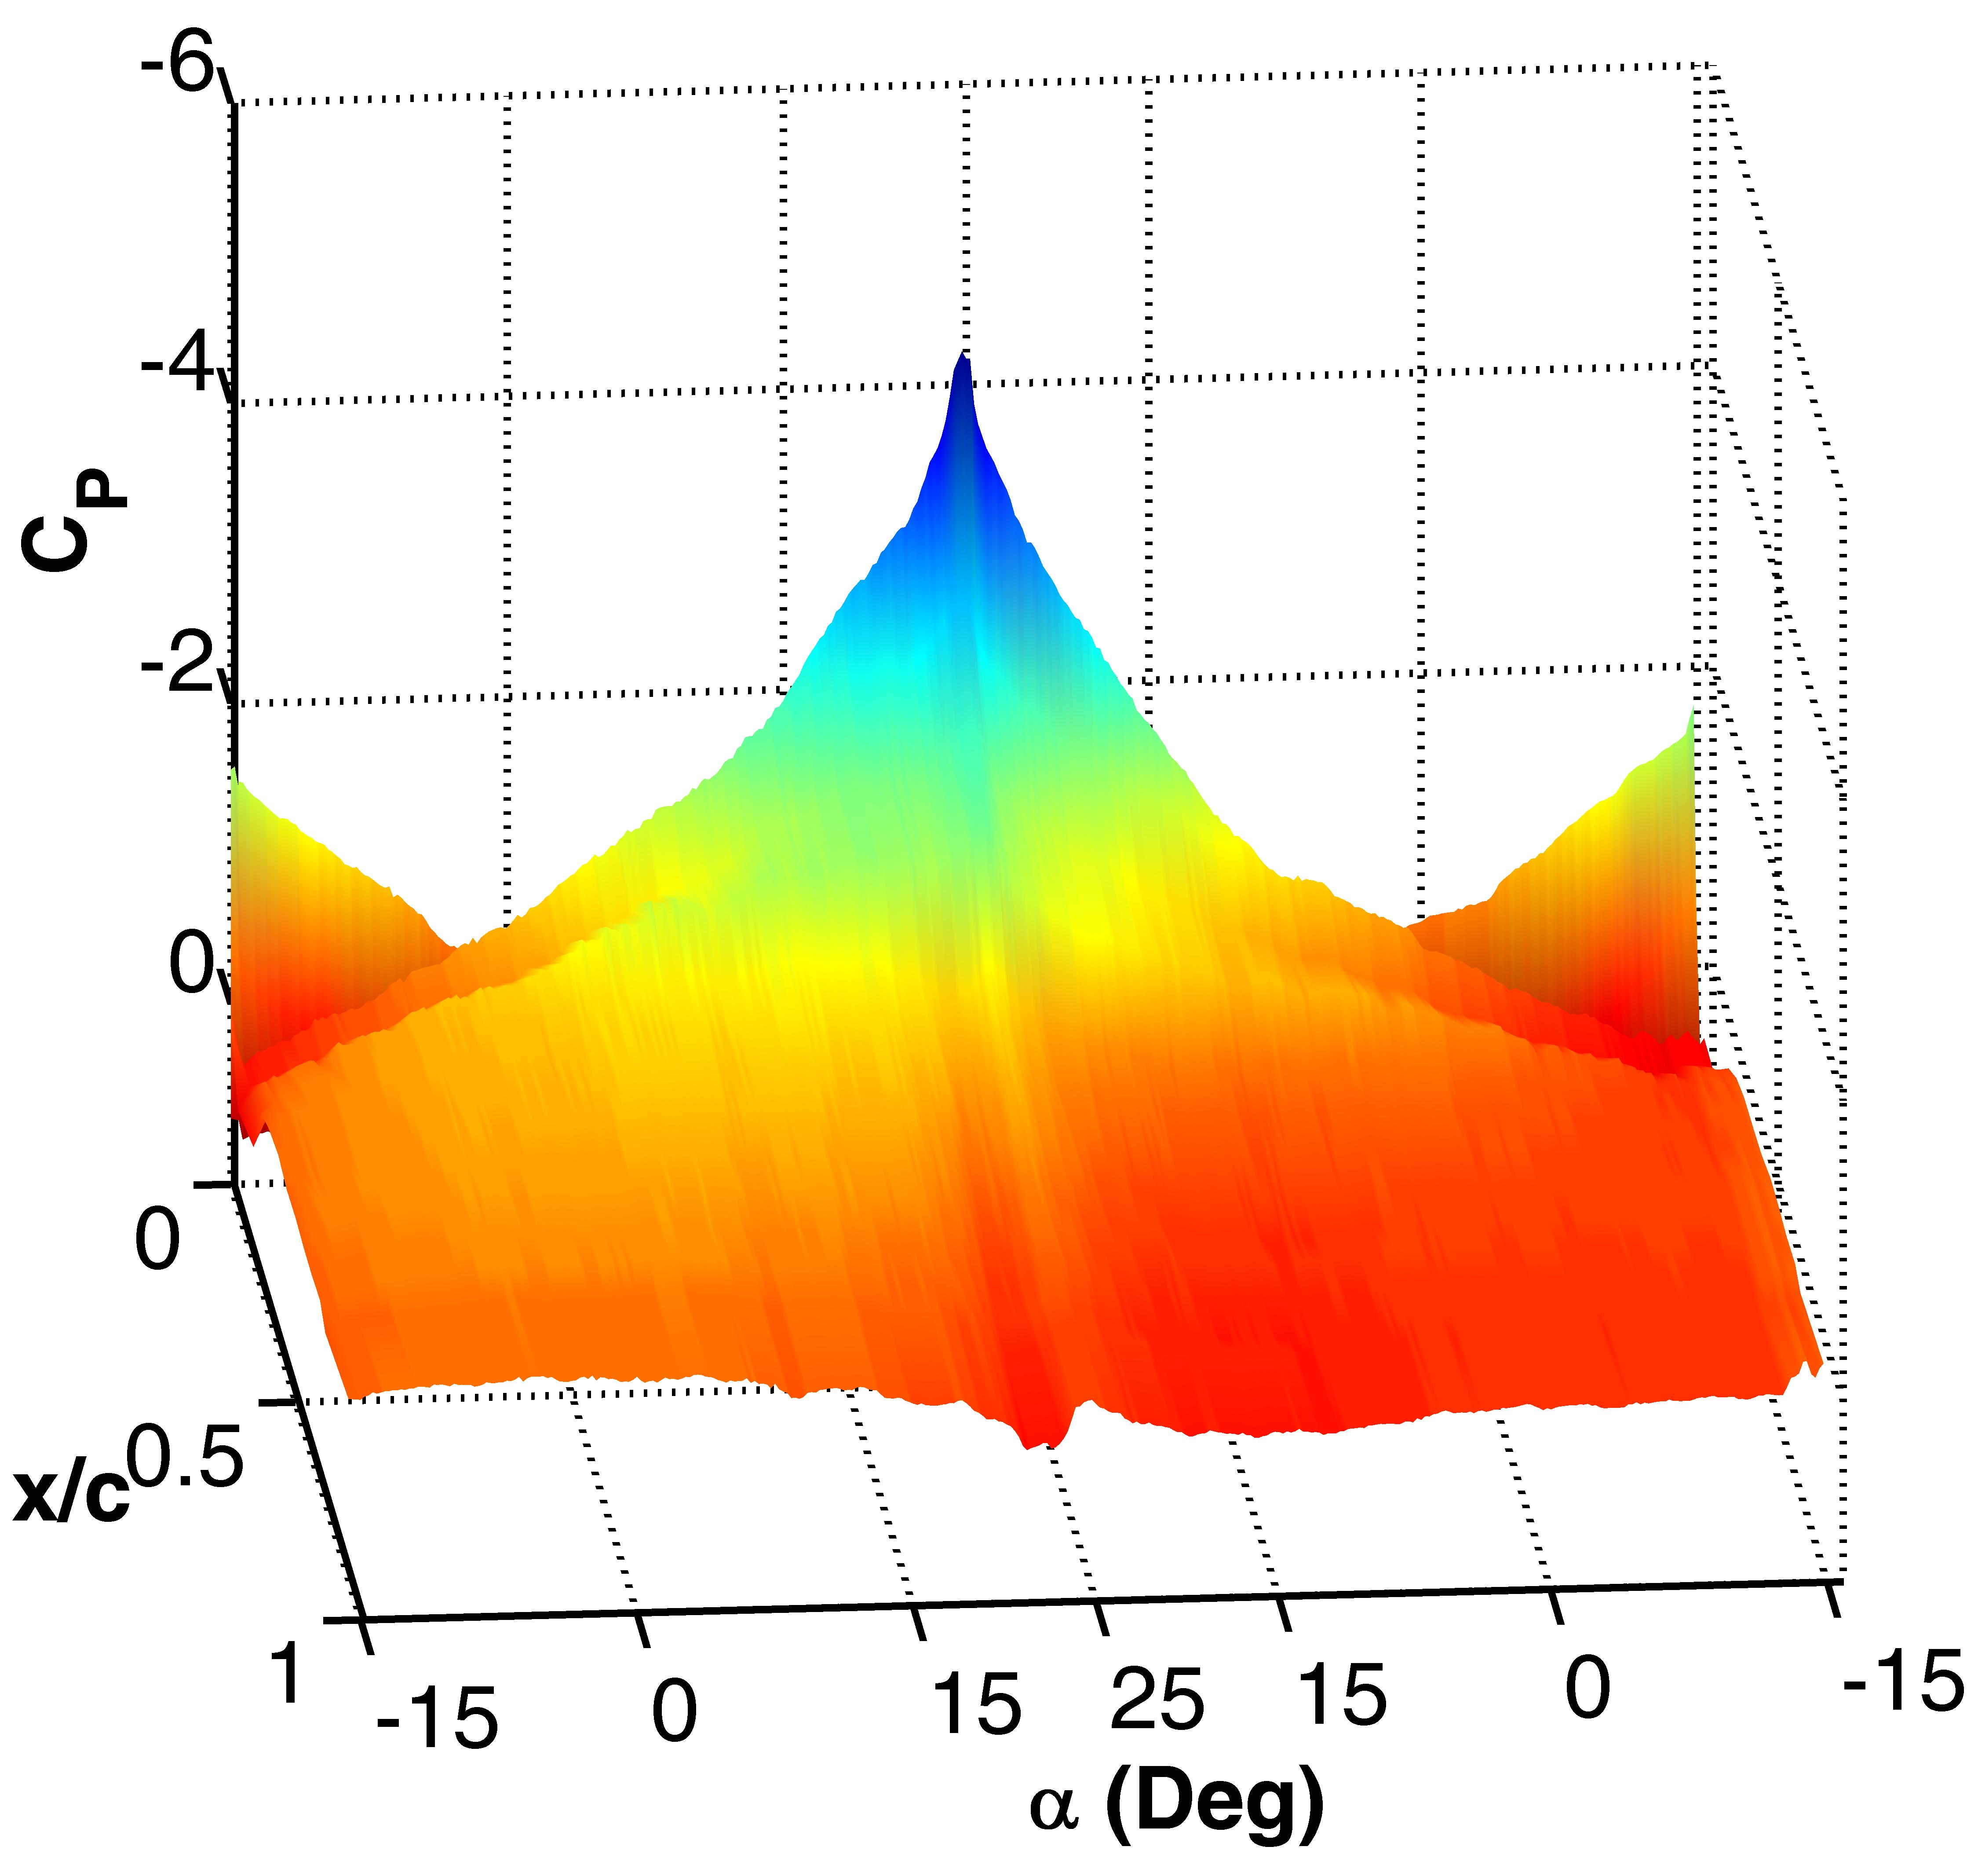
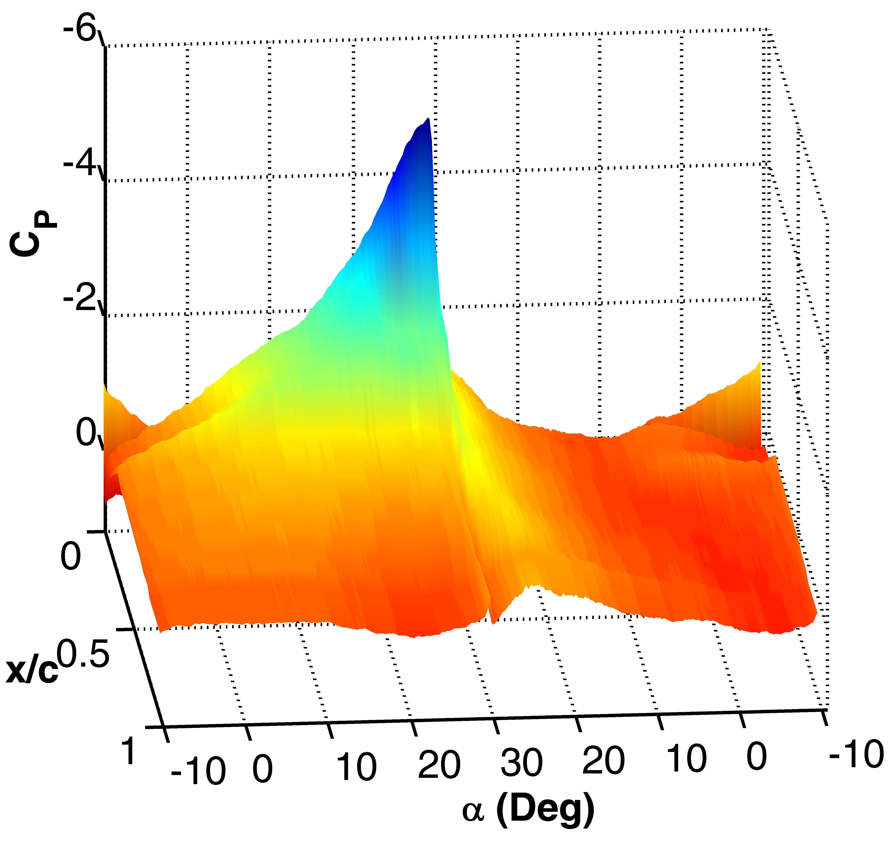
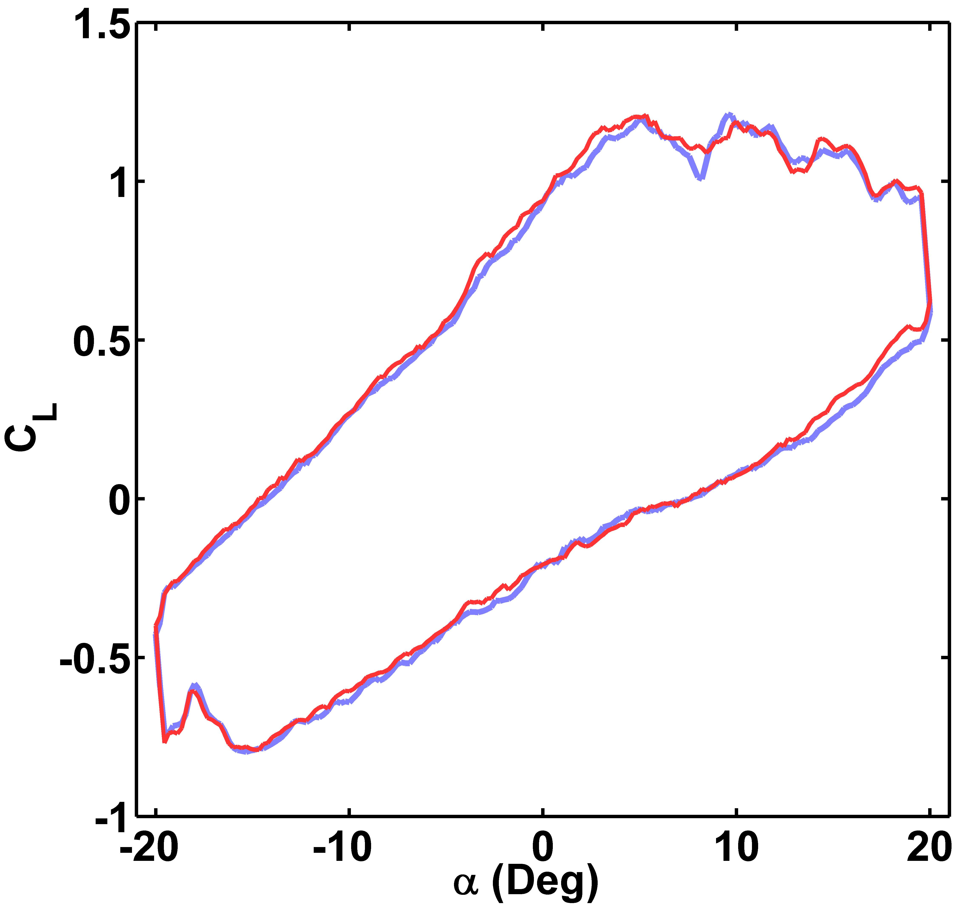
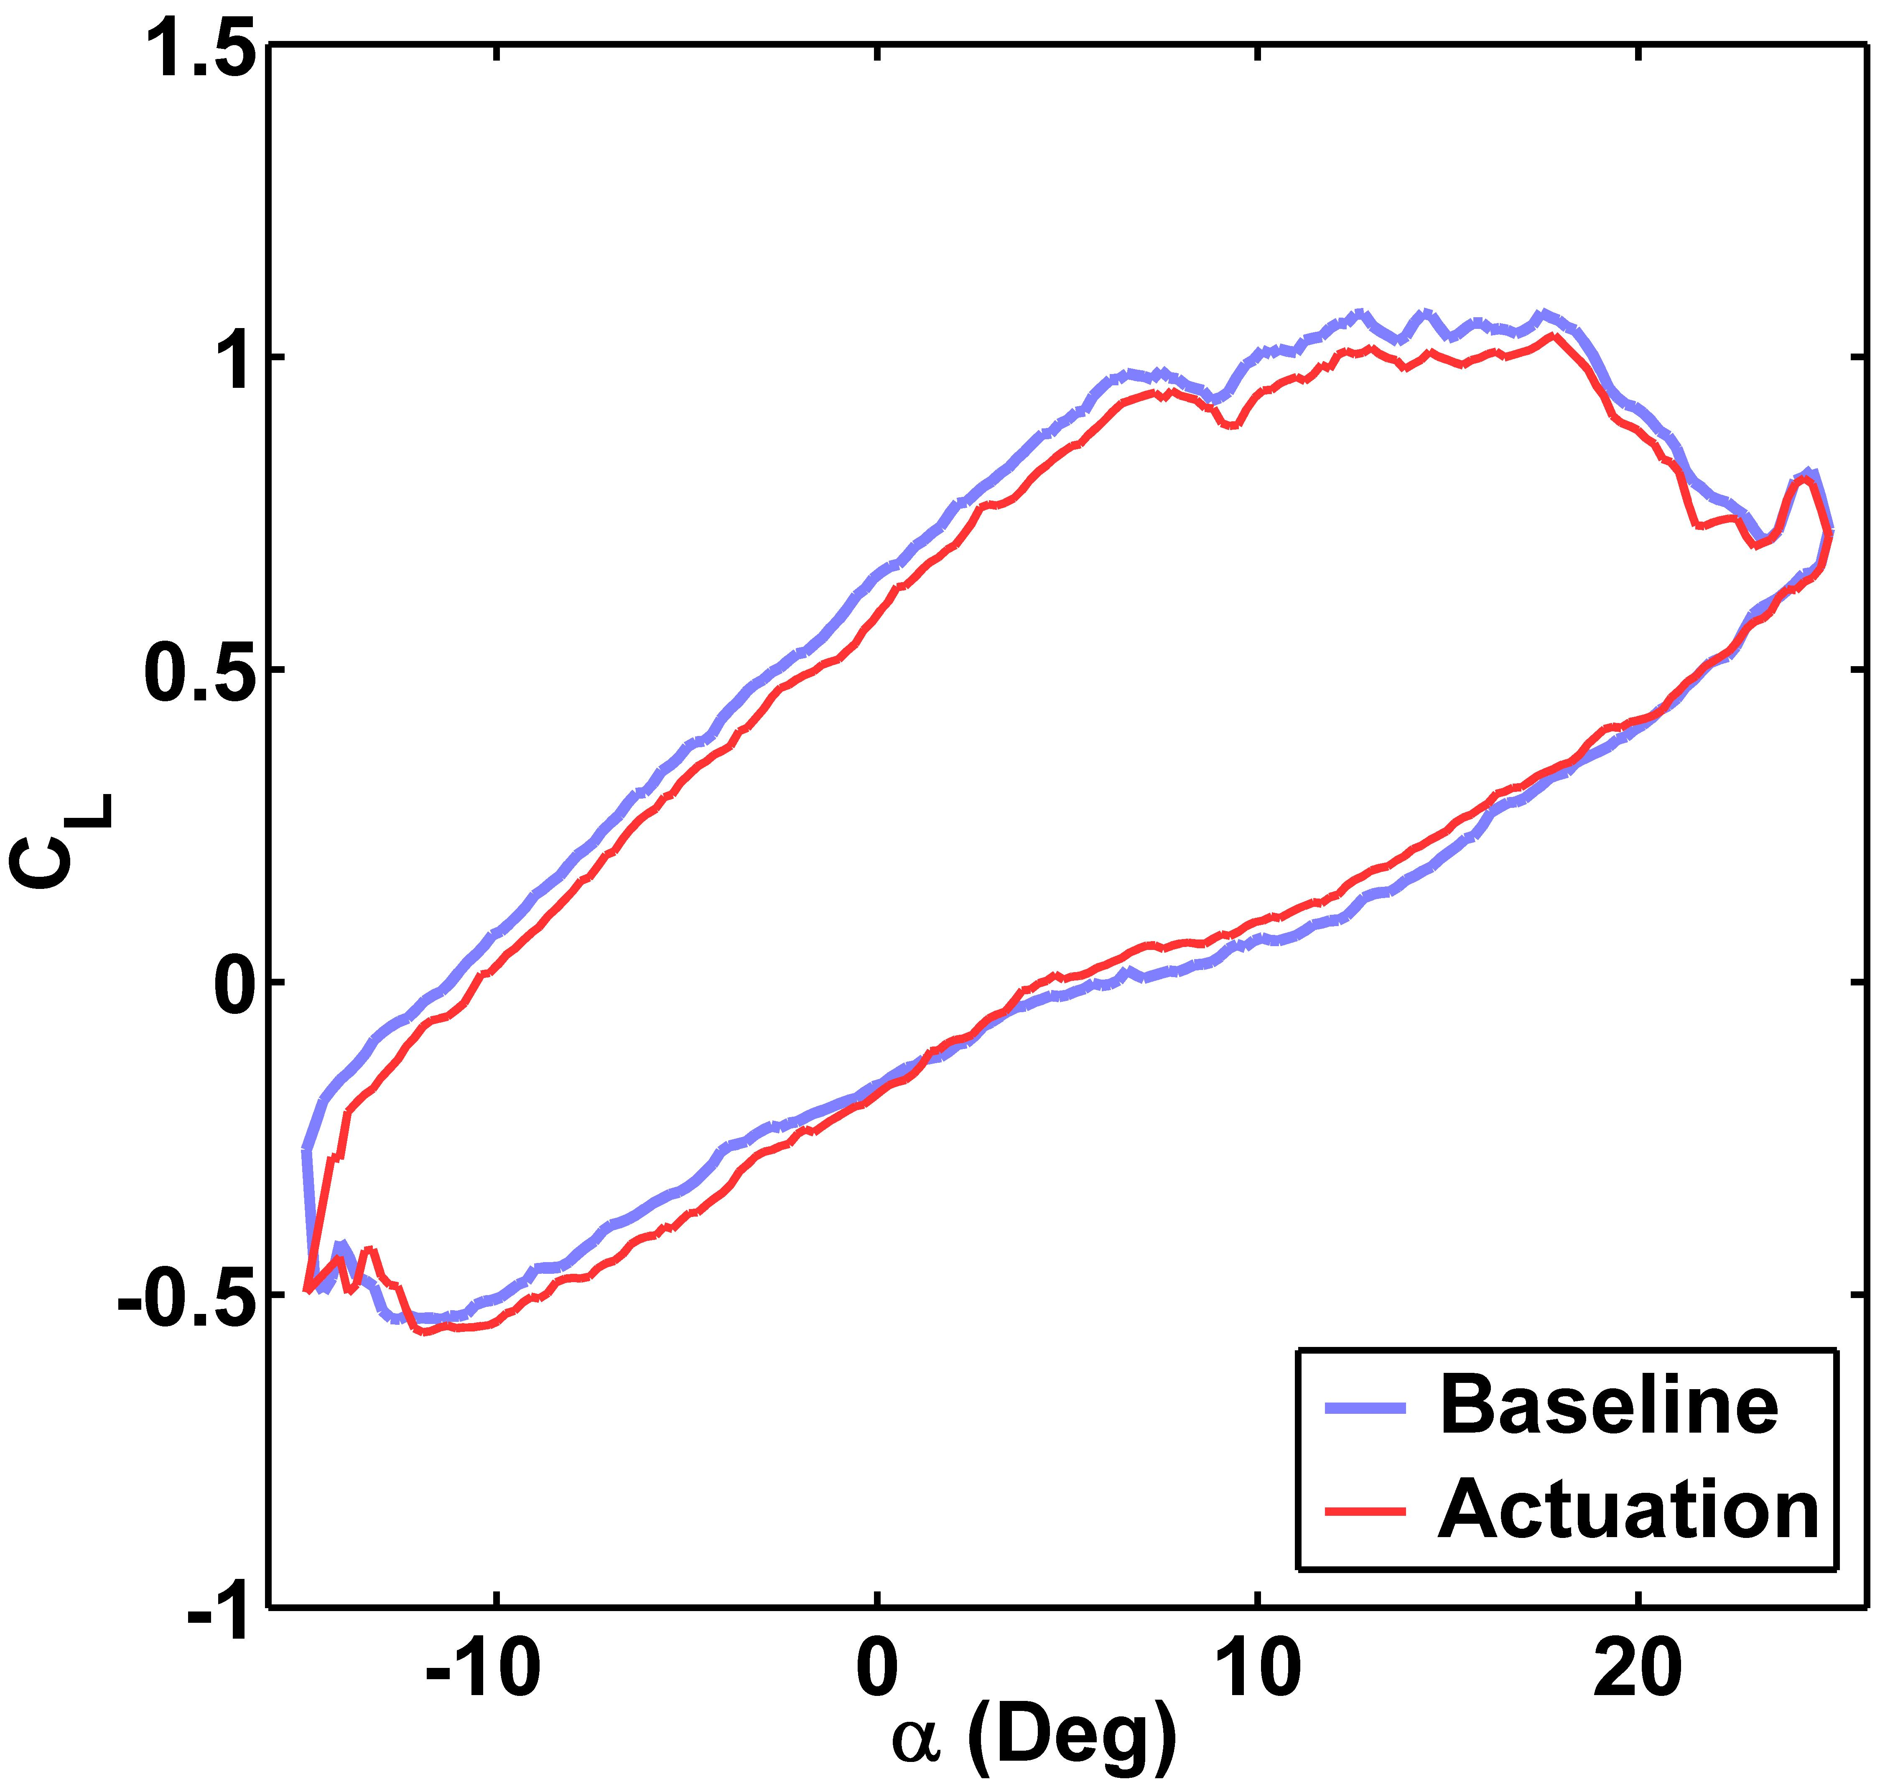
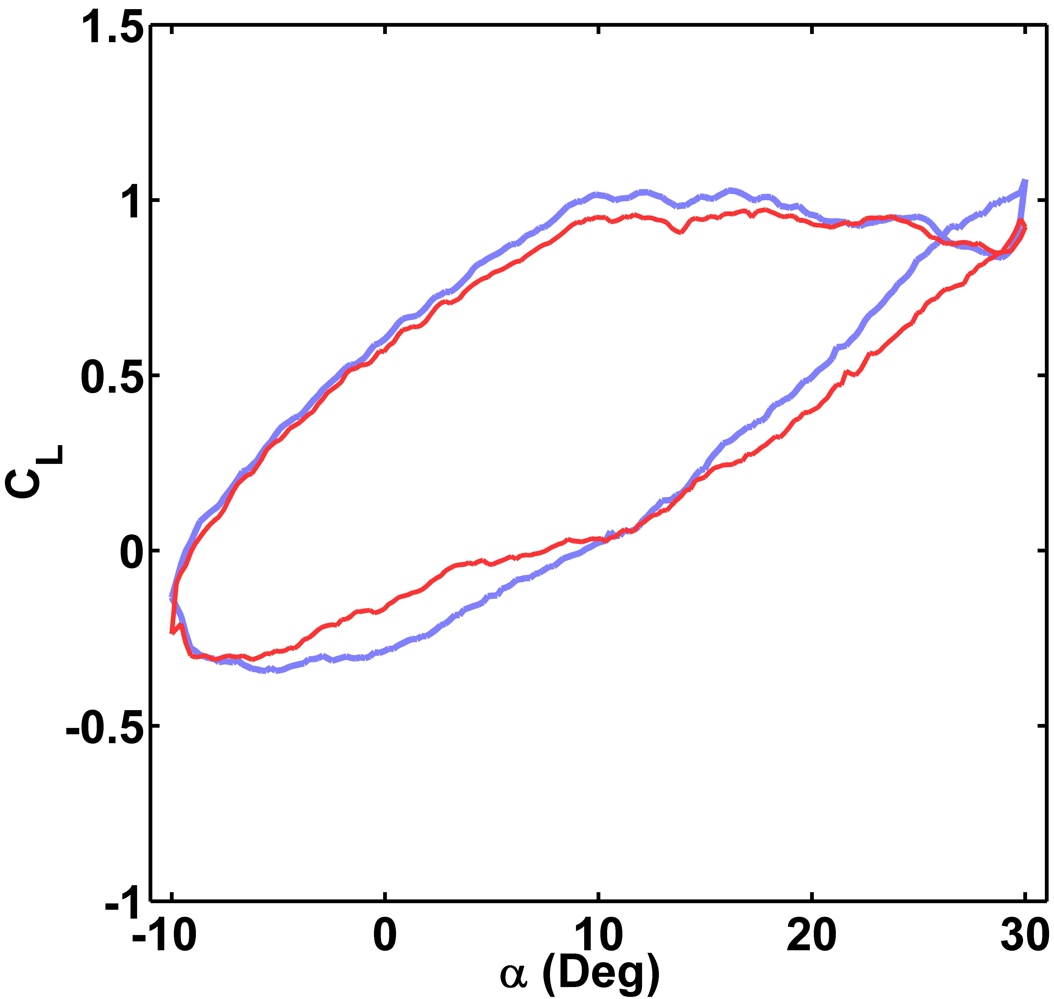
2026 Thesis Project
Comparison and Implementation of Data Compression Methods for SoC-based Radar Systems
Author: Jordan Mohindra
Supervisor: A/Prof Beena Ahmed
Why compress radar data?
What are DRHE and LPC?
[Photo: KCU116 FPGA board and laptop running the test]
Cascaded MIMO radars (here 12 transmitters × 16 receivers) produce very high data rates: 3.2 Gbit/s in Kiem's system [1].
The link to the car's central computer (SoC) becomes the bottleneck: bandwidth, power and delay.
So: compress at the sensor, losslessly. Less data on the link, identical data after decoding, so target detection is unchanged.
Both predict each sample from earlier chirps of the same transmitter, then Huffman-code the small prediction error. The decoder makes the same prediction and adds the error back, so nothing is lost.
DRHE (Kiem [1]): fixed filters predict the magnitude and phase from the previous ramps. Works as the data streams in.
LPC: fits 2 coefficients per range bin to the whole frame: x[m] ≈ a₁·x[m−12] + a₂·x[m−24].
Why these two? In the MATLAB screen (step 2) they were the only lossless methods with a compression ratio above 3.
Radar
393 KB / frame
FPGA
compress
SoC
decompress
93 KB
same data, bit for bit
Method → Results
1
Real radar data
Input: one frame = 128 range bins × 192 ramps × 4 RX, 16-bit I/Q = 393 KB
Output: a compressed bitstream of about 93 KB (DRHE). Decompressing it gives back exactly the same frame.
ColoRadar recordings [2] from a TI AWR2243 cascade (12 TX). Range FFT in MATLAB, then 16-bit frames.
2
Screen 8 algorithms
The green area is the goal: high compression (right) and no extra missed targets (bottom).
Lossy methods (BAQ, RDVLE) shrink the data but lose targets. Only DRHE and LPC land in the green.
The 3.77 % baseline comes from 16-bit rounding, not compression.
MATLAB: compression ratio and target detection for every method on 50 frames.
3
DRHE vs LPC
Where does the compression come from? Huffman coding, prediction, and a dictionary re-derived for this data. The dictionary helps more than the predictor.
4
Build it in hardware
Encoder + decoder use under a quarter of the chip: DRHE 23 %, LPC 25 % of the logic (LUTs).
The same C++ that was simulated runs on the FPGA, so the hardware can be checked bit for bit against the simulation.
C++ in Vitis HLS → Vivado → AMD KCU116 FPGA. Encoder and decoder on the chip.
5
Measure on the board
50 / 50 frames bit-exact on the FPGA
DRHE: 0.61 ms per frame. Output streams out as the data comes in.
LPC: 3.25 ms per frame. It must store the whole frame before it can output anything.
Decode timing: board run pending.
Stream 50 frames through the FPGA, check every frame is bit-exact, and time it.
Why an FPGA, not just simulation?
Conclusion
Compression has to run at the sensor, in real time, on small low-power hardware.
Simulation cannot show speed, latency or chip size.
Hardware proves the design reproduces the simulation bit for bit. Kiem's did not (3.25 in simulation, 3.17 on hardware [1]).
Both DRHE and LPC are lossless on real radar data, on real hardware.
LPC compresses most: 4.40× (DRHE 4.22×). Re-deriving the Huffman dictionary for this data helped more than the predictor did.
DRHE streams with no frame buffer; LPC must buffer a whole frame (3.25 ms). Both meet the 15 ms limit here, but DRHE scales better to bigger frames.
Next: a streaming LPC, all 16 receivers, fixed-point DRHE.
[1] L. Kiem, Design and Implementation of Data Compression Methods for SoC-based Radar Systems. [2] A. Kramer et al., ColoRadar: the direct 3D millimeter wave radar dataset, IJRR, 2022.

