Slide 1


Slide 2
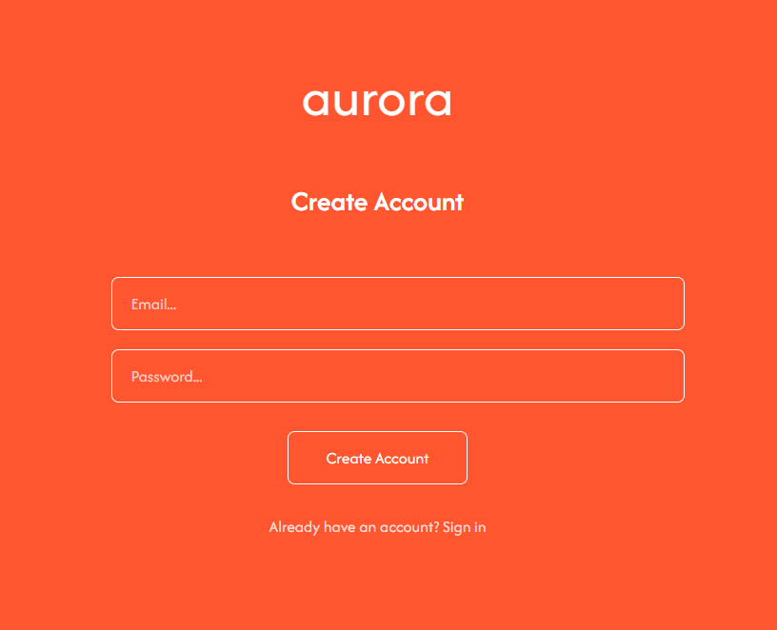
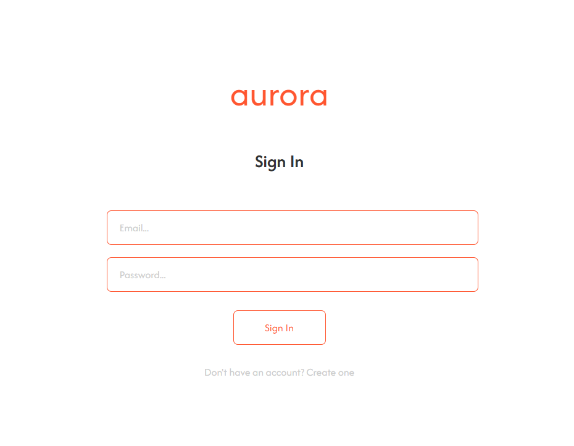
Login Page
This is the login page where we used Supabase Auth to create a secure login with Email verification that can switch from sign-in to create account and changes colour to show the user.

Slide 3
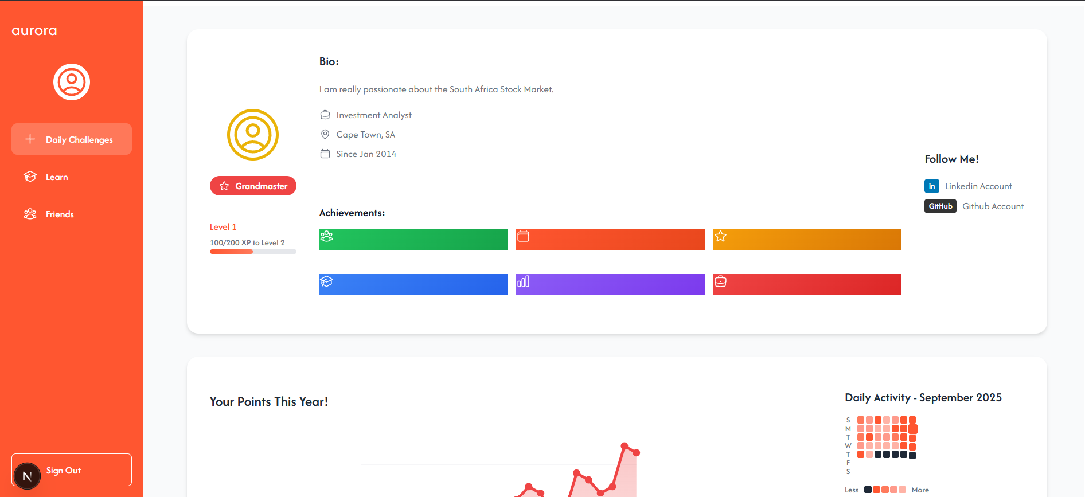
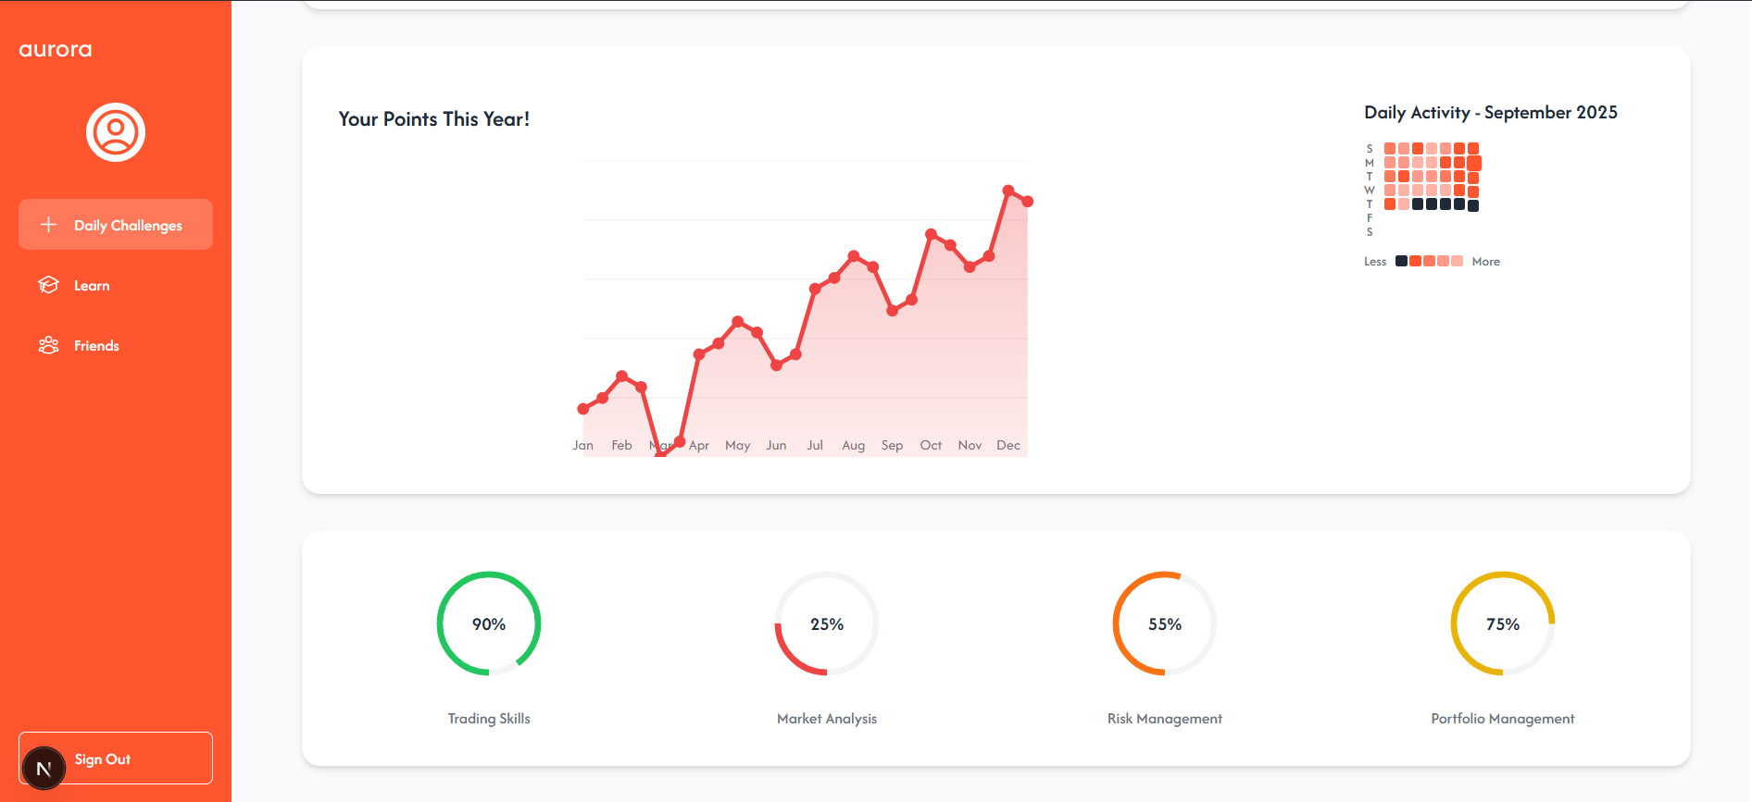
Home Page
This is the Home Page where the user is put and can see all their badges, level and progress over time where they will travel from here to learn / friends / daily challenge.

Slide 4
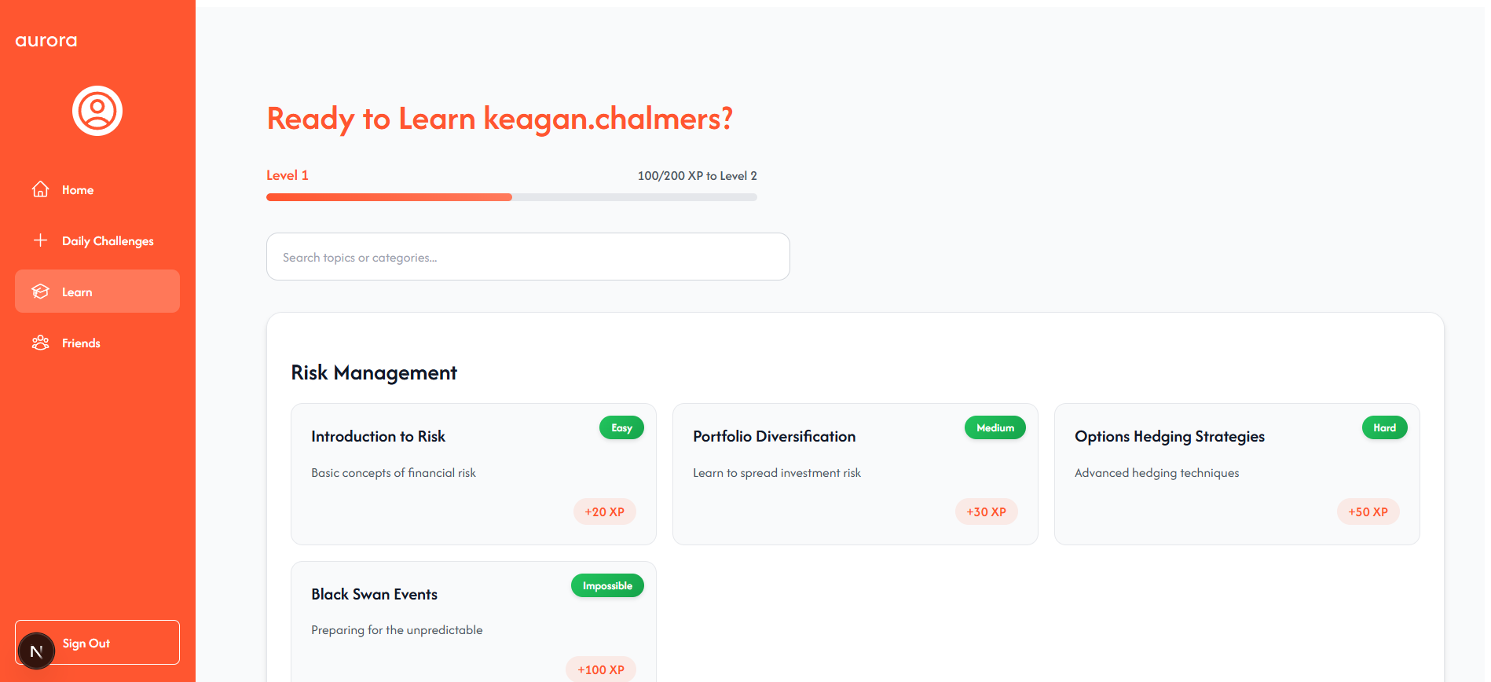
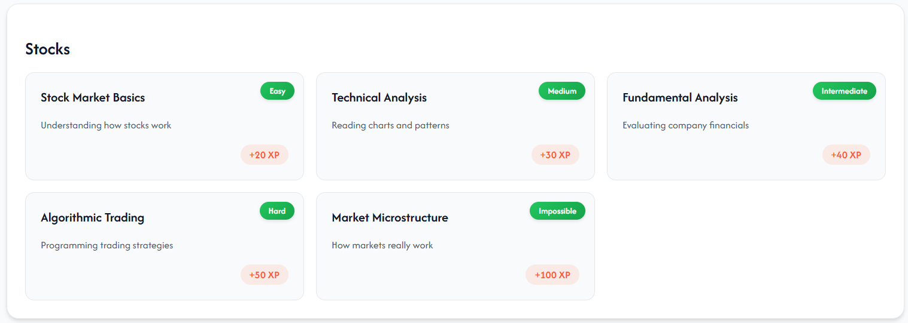
Learn Page
This is the Learn Page where we show the user will be shown different levels of difficulty modules of knowledge in different areas of finance where they can go and learn to earn points and level up.

Slide 5
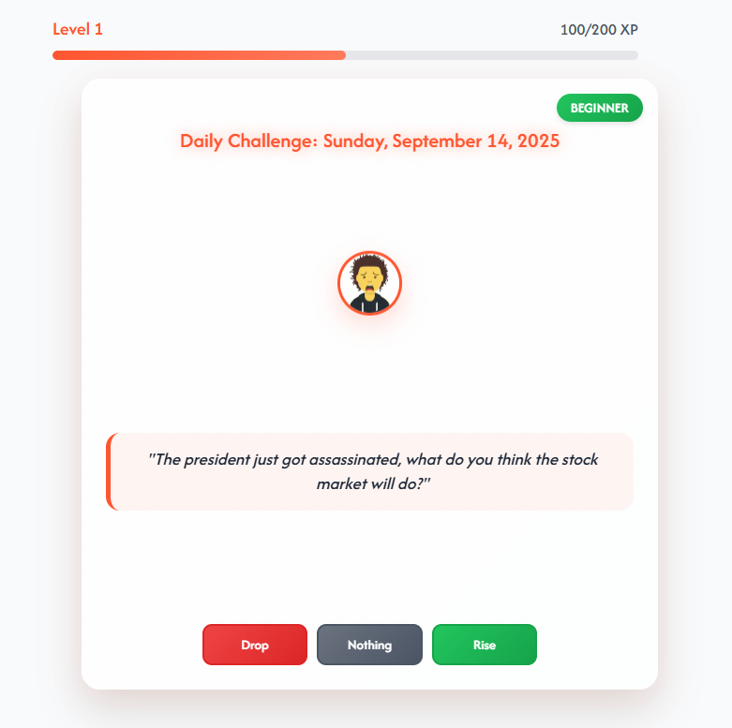
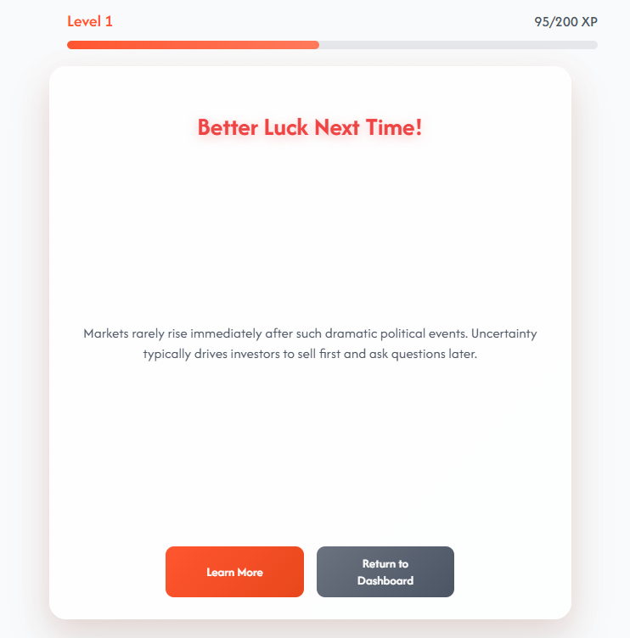
Daily Challenge Page
This is the daily challenge page where users will go each day to complete their daily challenge which is scaled based on their level as higher level users will do more difficult level challenges.

Slide 6
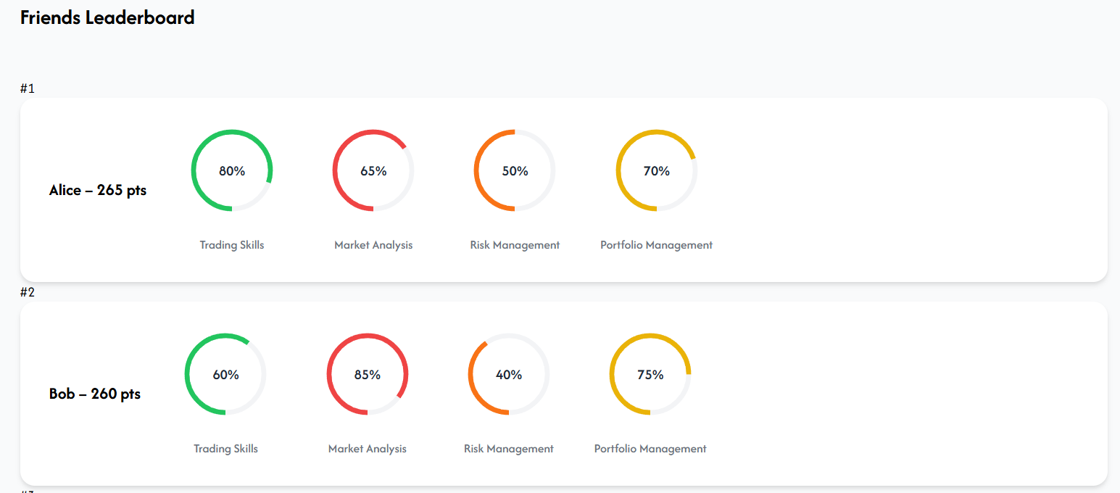
Leaderboard Page
This is the Friends page where users can go see a leaderboard of their friends and see where and which skills their friends have compared to themselves.

Slide 7
Thank You!

