Slide 1

PlayJ
Jordan Radushev
Semester 6
Individual Project
Sprint 1

Slide 2

Research
Suitable tech-stack
Potential problems investigation
CI/CD & Testing
Project structure
Notes:
The main challenge is to structure the project in an appropriate. How to build the application in an efficient way, so it can work smoothly with huge request load (Imagine it has 750k active users). Payment and security is also challenge, because it is very important to build the app in a secured and stable way. The separation of the business logic in the context of microservices is a key detail to achieve the scalability and reliability in terms of functionality.

Slide 3
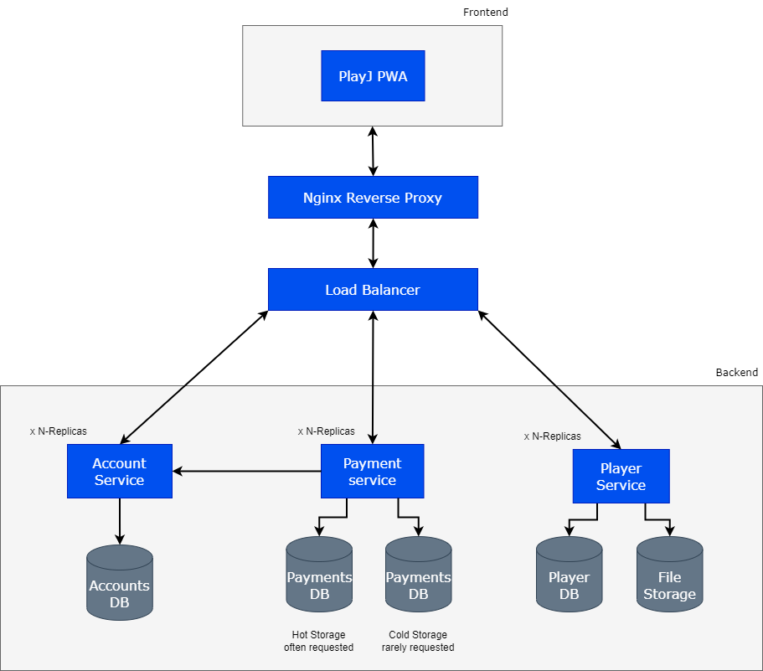
Architecture
Updated Architecture schema, so the application can be easily scaled up.

Slide 4




Tech stack

