Slide 1

Software and Data Evolution
Project Progress Presentation
Δημουλής Ευάγγελος
Φυδανάκης Ιορδάνης-Ραφαήλ
19/05/2019

Slide 2
Implemented Tests
Create Project
Edit Project
Load Project
Show PLD
Show Phases PLD
Show Phases PLD with Clusters
Show Full Detailed Lifetime Table
Zoom In
Zoom out
Set Data
2

Slide 3
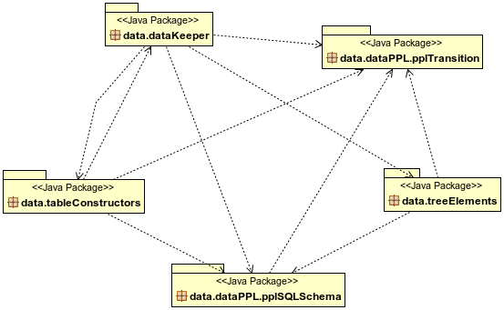
Data Package Diagram
3

Slide 4
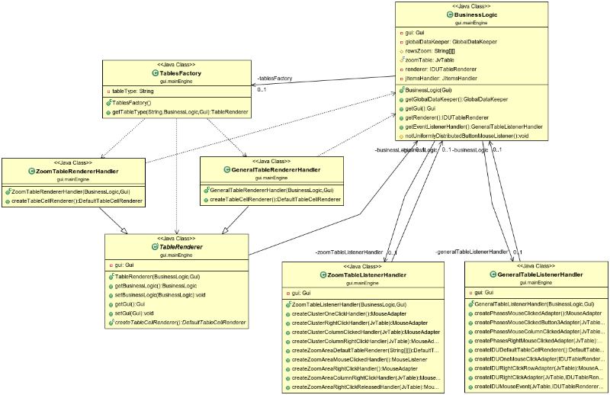
Factory Class Diagram
3

Slide 5
How the logic was moved out from GUI
Extracted the ActionListeners to separate classes
Added class JItemsCreator which is responsible for the creation and initialization of JItems
The methods that were handling the functionality Create Project, Edit Project, Load Project, Show PLD, Show Phases PLD, Show Phases PLD with Clusters, Show Full Detailed Lifetime Table, Zoom In, Zoom out, Set Data
Extracted code from the forementioned methods which depended on GlobalDataKeeper e.g. pupulateWithPhases, populatewithClusters
Moved TableConstructors inside the GlobalDataKeeper to avoid passing the GlobalDataKeeper object every time as a parameter to these constructors
4

Slide 6

Ερώτησεις / Απορίες
5

