Slide 1
MSU Data Analytics Boot Camp Project I
Beer Review Analysis

Slide 2
Project Title: Beer Review Analysis
Team Members: Jordan Schafer, Steve Freeland
Project Description: Analyze beer reviews to find insights

Slide 3
Project Title: Beer Review Analysis
Research Questions to Answer:
What is best beer in each review category?
Is there correlation between review types and overall review?
Perform ANOVA comparing most common beer types to see if significant differences exist across Overall Review score
Create heatmap of breweries (Where can I get a beer?)

Slide 4
Project Title: Beer Review Analysis
Datasets / APIs Used:
Kaggle - Beer Reviews (1.5 million of beer reviews from BeerAdvocates)
Google Maps Places / Geolocations API
Task Ownership:
Jordan: Data Cleaning, ANOVA, Heatmap
Steve: Scatter Plots, Presentation Development

Slide 5
Project Title: Beer Review Analysis
Explanation of Data Cleaning Efforts:
Grouped by beer_beerid
Found mean review scores and review count for each beer
Filtered on those beers with greater than 50 reviews
We next extracted brewery information
Using the Google API we found the latitude, longitude, and address for each brewery
Removed breweries with no results

Slide 6
Project Title: Beer Review Analysis
Explanation of Data Cleaning Efforts (cont.):
Extracted country of origin from address
Merged beer review with brewery information, removing those beers with no brewery information

Slide 7
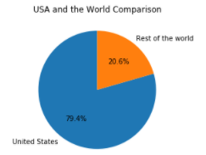
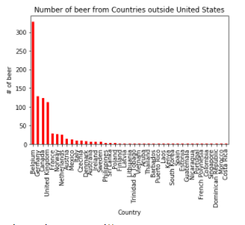
Project Title: Beer Review Analysis
A quick look at the data…
Most of our data is about American beer
How does the rest of the world break down?

Slide 8
Questions and Findings
What is the best beer in each review category?
Overall: Armand'4 Oude Geuze Lente (Spring)
4.73 out of 5.0
Aroma: Pliny The Younger
4.72 out of 5.0
Appearance: Cantillon Blåbær Lambik
4.64 out of 5.0
Palate: Vanilla Bean Aged Dark Lord
4.67 out of 5.0
Taste: Rare Bourbon County Stout
4.77 out of 5.0

Slide 9
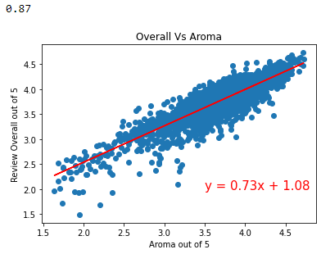
Questions and Findings
Is there a correlation between Aroma and Overall Review?
This scatterplot reflects an
r-squared value of 0.87, revealing a strong linear relationship between Aroma and Overall Review score.

Slide 10
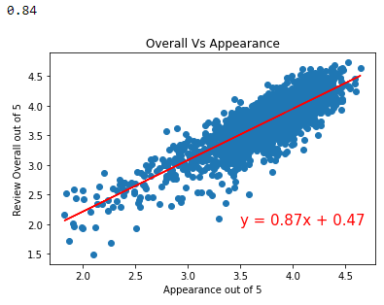
Questions and Findings
Is there a correlation between Appearance and Overall Review?
Considering correlation between Appearance and Overall Review score, this scatterplot reflects a strong relationship based on the
r-squared value of 0.84.

Slide 11
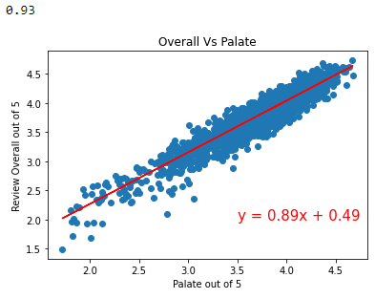
Questions and Findings
Is there a correlation between Palate and Overall Review?
With an r-squared value of 0.93, a very strong linear relationship between Palate and Overall Review score exists.

Slide 12
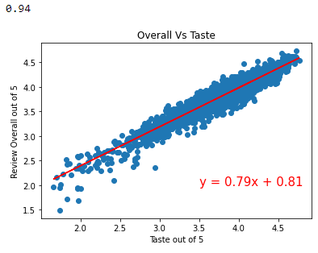
Questions and Findings
Is there a correlation between Taste and Overall Review?
Not surprisingly, the correlation between Taste and Overall Review score is very strong. With an r-squared value of 0.94, it is clear Taste is a critical driver of Overall Review score.

Slide 13
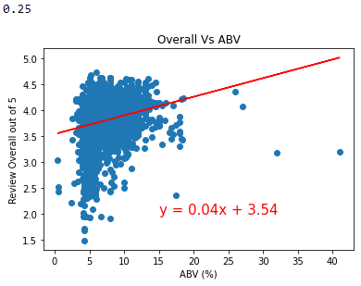
Questions and Findings
Is there a correlation between ABV (Alcohol by Volume) and Overall Review?
This scatterplot shows there is essentially no linear correlation between ABV and Overall Review score. Further research may indicate that beer consumers are more influenced by the other factors measured, regardless of alcohol content level.

Slide 14
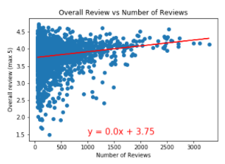
Questions and Findings
Overall Reviews versus Number of Reviews
This scatterplot shows there is no linear correlation between Number of Reviews and Overall Review score.

Slide 15
Conclusions and Learnings
Aroma, Appearance, Palate, and Taste highly correlate with Overall Review scores.
ABV (Alcohol by Volume) is not highly correlated with beer review scores, possibly indicating beer consumers do not care about this product aspect as much as others.
There is no linear correlation between Number of Reviews and Overall Review score.
The most influential factor across these factors appears to be Aroma.

Slide 16
ANOVA - Do Beer Styles make a significant difference in Overall Review scores?
Null hypothesis: Beer styles do not make a significant difference in Overall Review score
Alternative hypothesis: Beer styles do make a significant difference in Overall Review score

Slide 17
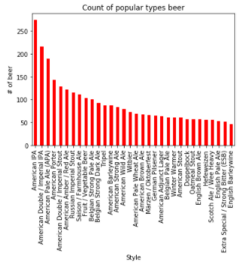
ANOVA - Do Beer Styles make a significant difference in Overall Review scores?
Let’s take a quick look at the beer styles
These are some of the most common styles of beer, in our dataset there were over 100 different styles of beer

Slide 18

ANOVA - Do Beer Styles make a significant difference in Overall Review scores?
For our ANOVA test we will concentrate on the five most common styles:

Slide 19
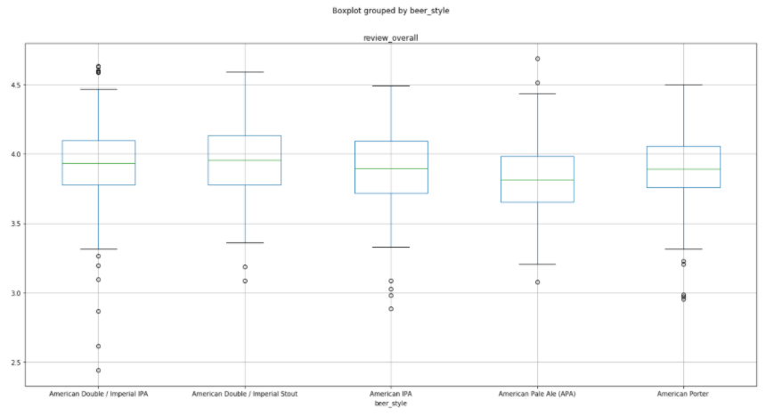
ANOVA - Do Beer Styles make a significant difference in Overall Review scores?

Slide 20
ANOVA - Do Beer Styles make a significant difference in Overall Review scores?
After running the ANOVA function, we got a resulting p-value of 0.00017
This is evidence that Alternative hypothesis: Beer styles do make a significant difference in Overall Review score is true

Slide 21
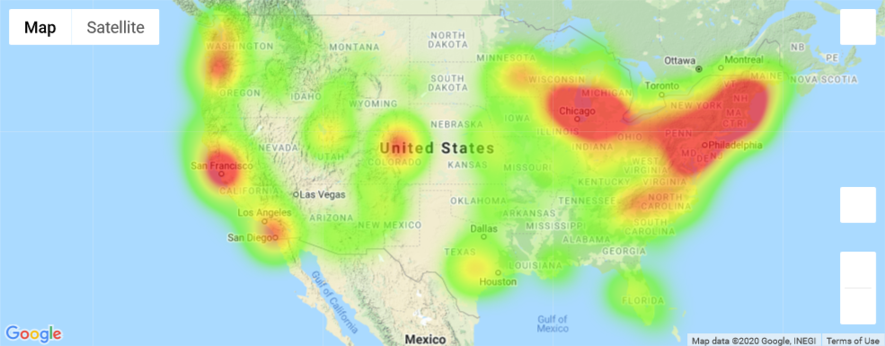
Brewery Heat Map

Slide 22
BACK-UP

Slide 23
Development Requirements:
Use Pandas to clean and format your dataset(s).
Create a Jupyter Notebook describing the data exploration and cleanup process.
Create a Jupyter Notebook illustrating the final data analysis.
Use Matplotlib to create a total of 6-8 visualizations of your data (ideally, at least 2 per “question” you ask of your data)

Slide 24
Development Requirements:
Save PNG images of your visualizations to distribute to the class and instructional team, and for inclusion in your presentation
(Optional) Use at least one API, if you can find an API with data pertinent to your primary research questions.
Create a write-up summarizing your major findings. This should include a heading for each “question” you asked of your data and a short description of your findings and any relevant plots.

