Slide 1
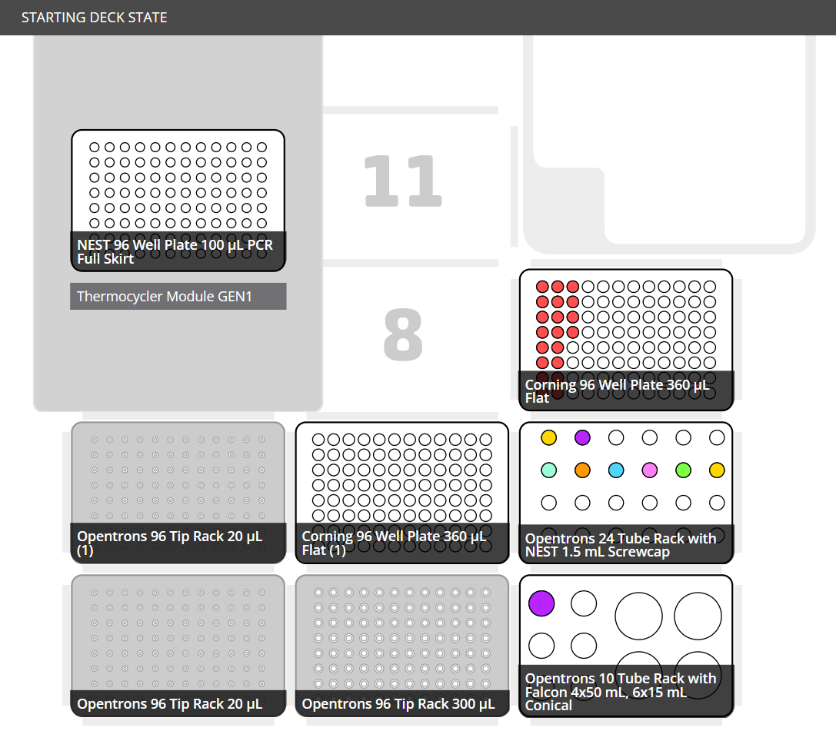

cDNA_synthesis.py
RNA: >15ul/well
10mM dNTP Mix: 250ul
Random Hexamers: 250ul
Nest 96Well Plate
10X RT Buffer: 1000ul
25mM MgCl2: 500ul
RNA
Nest 96Well Plate (100ul/well)
0.1M DTT: 250ul
Random Hexamers
dNTP
RNaseOUT: 100ul
10X RT
DTT
SSIII
MgCl2
RNase OUT
Distribute Plate
Nest 96Well Plate (100ul/well)
SuperScript III RT: 50ul
RNase H
Tubes
From Invitrogen SSIII Kit
E. Coli RNase H: 50ul
$$H_{2}O$$
Water: 5.5ml
Conicals
5.5ml of Water in a 15ml Conical

