Slide 1

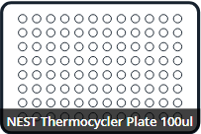
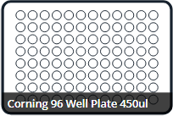
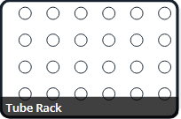
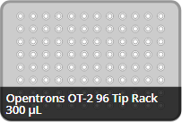
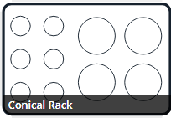
jsdilute.py
Dilutes Vertically
jsdilute.py will add water to plates or tubes. The user will input a list of ul amounts with each value corresponding to the amount of water to add to each well.
Dilutes Vertically
Dilutes Vertically: Values for water are added top to bottom for each column before moving to the next column.
Dilutes Horizontally: Values for water are added left to right for each row before moving to next row.
Dilutes Horizontally
H₂0
Conicals
50ml of Water in a 15ml Conical

