Slide 1
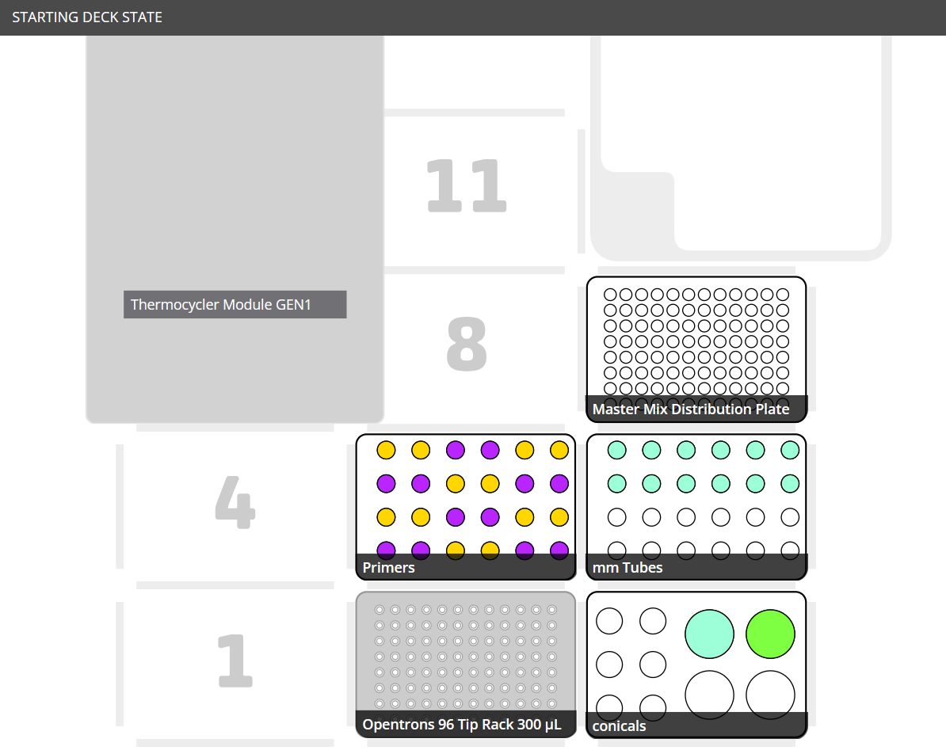


Basic Setup
mm_setup.py
9.
Master Mix Distribution Plate
Corning 96Well Conical(360ul/well)
4.
5.
6.
F
R
F
R
F
R
F
R
F
R
F
R
F
R
F
R
F
R
[10uM] F/R Primer Couples
Must have >300ul of liquid in 1.7ml Tubes
Empty 2ml Tubes
Must have 1 Tube per F/R Primer Couple
1.
2.
3.
$$H_{2}O$$
$$SYBR$$
$$Green$$
50ml Conicals
Water, SYBR Green
(Fill with 25ml MAX!)

Slide 2
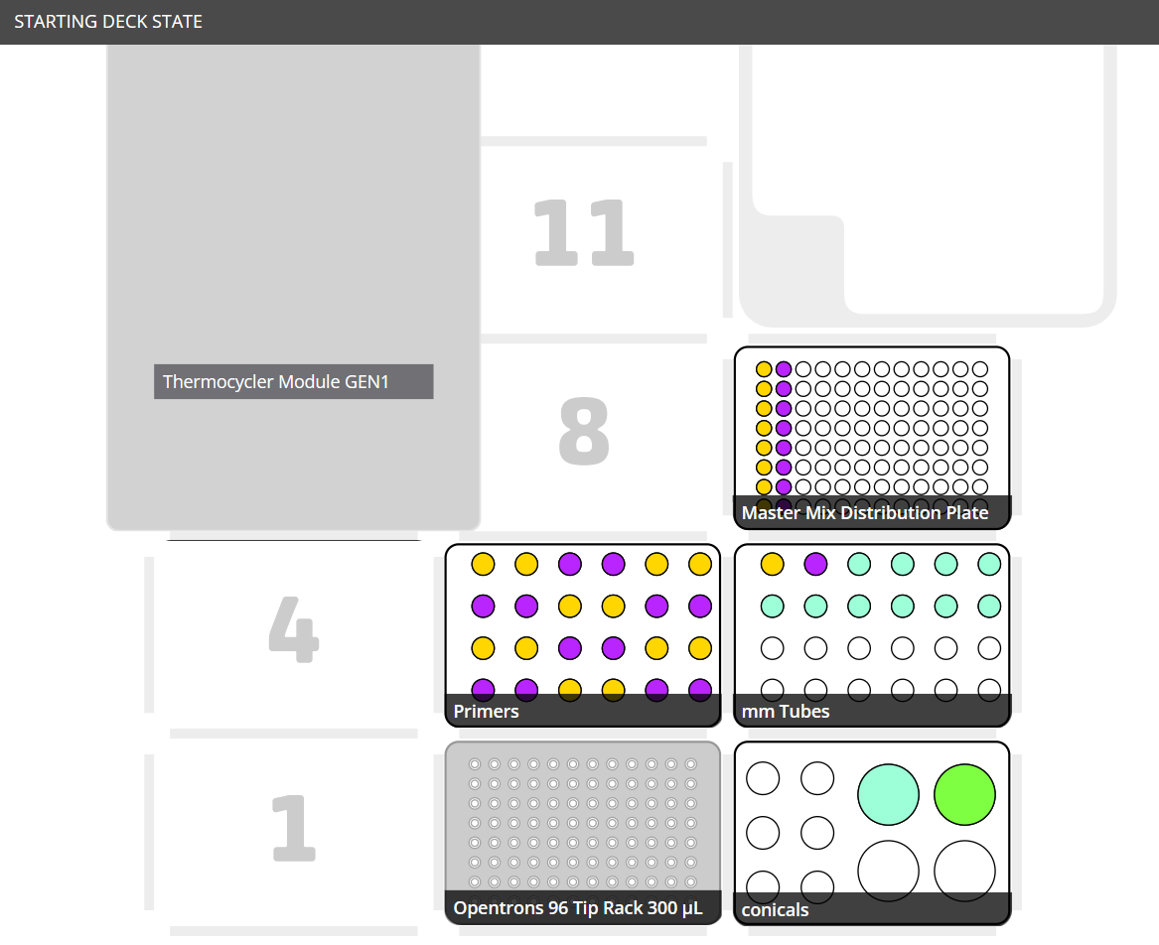


Protocol Flow
2
Master Mix Distribution Plate
F
R
F
R
Steps
F/R Primer Couples will be mixed with Water and SYBR Green in the Empty 2ml Tubes creating “Master Mixes”.
These “Master Mixes” will be distributed to a column of the Corning 96Well Master Mix Distribution Plate.
[10uM] F/R Primer Couples
Empty 2ml Tubes
1
$$H_{2}O$$
$$SYBR$$
$$Green$$
50ml Conicals
Water, SYBR Green

Slide 3
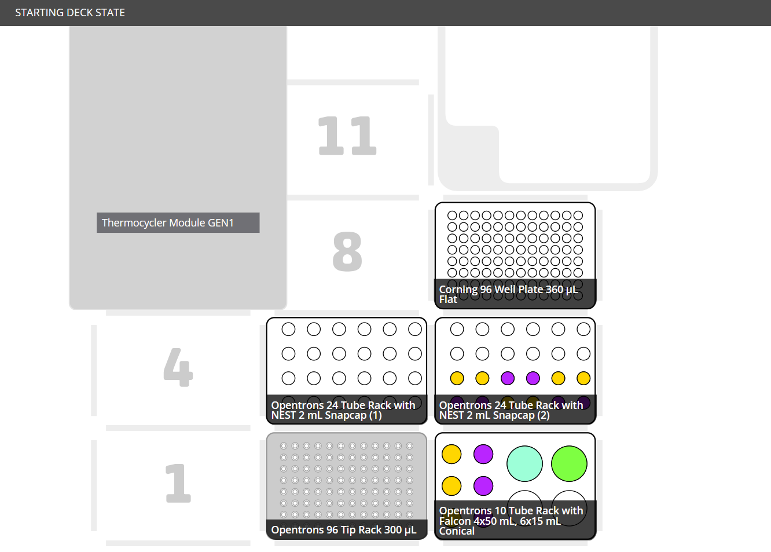
Repeat Primers Setup
mm_setup.py
Master Mix Distribution Plate
Unaffected by Repeat Primers
F
R
F
R
F
R
[10uM] F/R Primer Couples
Unaffected by Repeat Primers
[10uM] F/R Repeat Primer Couples
Must have 500ul per 3 repeats
$$H_{2}O$$
$$SYBR$$
$$Green$$
Empty 15ml Conicals
Must have 1 per Repeat Primer Couple
(50ml Conicals Unaffected)

Slide 4
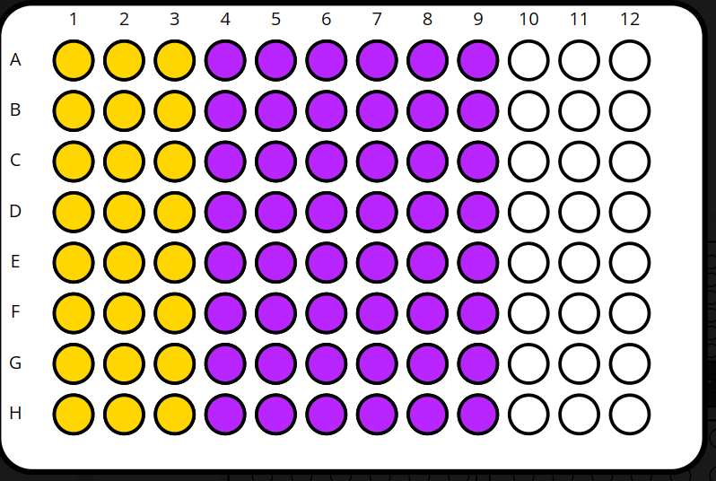


Repeat
Protocol Flow
Master Mix Distribution Plate
3
Steps
F/R Primer Couples will be mixed with Water and SYBR Green in the Empty 15ml Conicals creating “Master Mixes”.
Protocol will stop and user must manually vortex 15ml Conicals.
These “Master Mixes” will be distributed to a column of the Corning 96Well Master Mix Distribution Plate.
1
F
R
F
R
[10uM] F/R Primer Couples
[10uM] F/R Repeat Primer Couples
$$H_{2}O$$
$$SYBR$$
$$Green$$
2
Empty 15ml Conicals
(50ml Conicals Unaffected)

