Slide 1
Person Identification System
Group 2: Lee Joosung, Jordan Stickley, Shinya Honda, Liping Huang, Jenna Davis

Slide 2
User Stories
[US]1 As a user, I can see the main view of the tracking application in order to detect and track movement of people.
[US]2 As a user, I can see how many cameras are configured from the main view.
[US]3 As a user, each camera link can be clicked to see it's feed
[US]4 As a user, movement of people will be displayed in the video with a label and a tracking rectangle in order to track people.
[US]5 As a user, camera label and neighboring cameras can be seen from the main camera view screen.
[US]6 As a user on the main screen, I can see movement indicators on each camera.
[US]7 As a movement tracking system, take control of a ELP mini USB camera and capture person movement information into a database.
[US]8 As a user, I can see a textual log of movement activity.
[US]9 As a tracked person moving into a later camera, I can be labeled with an original label.
[US]10 As tracked people, multiple people can be tracked on the same or different cameras at the same time.
[US]11 As a movement tracking system, each camera will operate autonomously, storing it's data in a shared database.
[US]12 As a movement tracking system, the program will work with a variable amount of cameras.

Slide 3
Changes Since Last Demo
Setup database
Cameras automatically detected when plugged into device and is updated in the camera list
Clickable Camera navigation links
Neighboring cameras can be clicked on either side of the video feed
Motion detection icons
Red for no movement
Yellow for predicted movement
Green for current movement
Textual log of data read from database

Slide 4
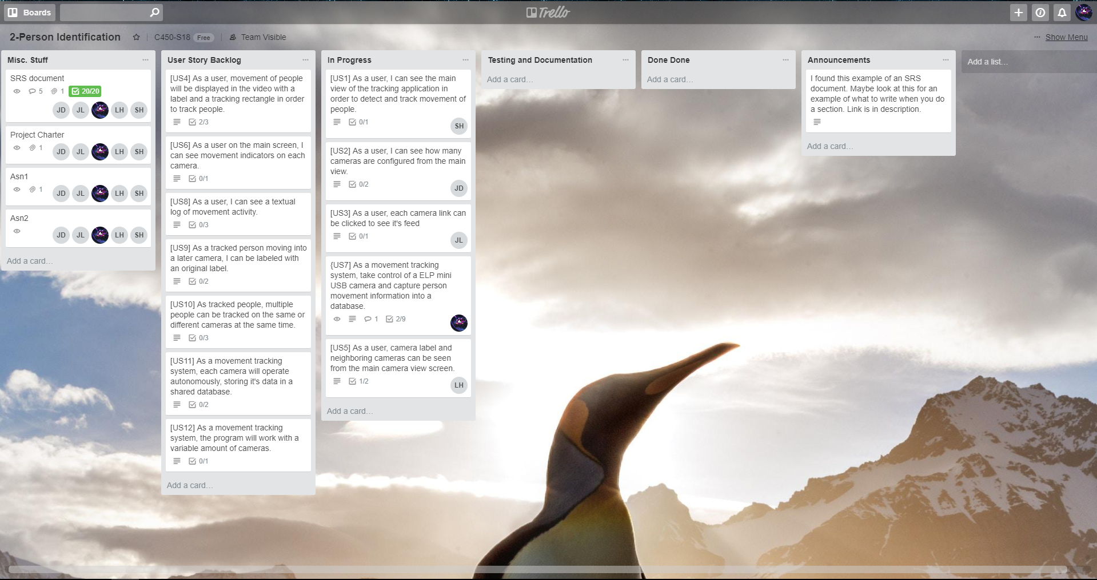
Trello board

Slide 5
Burndown chart

Slide 6
Percentage Chart
Not done: 85%
[US7]: 6%
[US5]: 2%
[US4]: 7%

