Slide 1
ENGI 301 Mobile Keyboard Proposal
9/29/22
Jordan Ngo
Notes:
Bluetooth
harder? Idk. Generally not that difficult. Need program on the other side to collect characters and display them.
step 1 = decipher characters
Step 2 = put on screen
Step 3 = do Bluetooth (if time)
How to display a message
Use a wifi adapter -> use internet to send a text message
Use a screen display (ie 16 x 2 character display, or something freeform) (don’t have to worry about transmission later)
Need links to parts
Bluetooth
screen (16x2)
Golf glove? More freedom
Start/stop – buttons? Switches?
How does user know what character they are typing
erase? A character?
Mobile power – 5V usb battery + cabling (good for prototype, but would need better battery for later)
1.8 V output from OK
Update proposal + list of parts by Friday morning
Spend time thinking about interactions and softwre flow – makes coding it much easier.

Slide 2
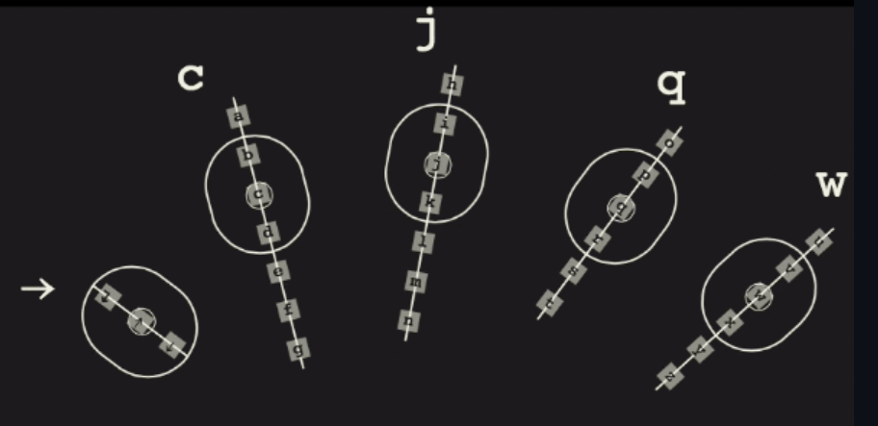
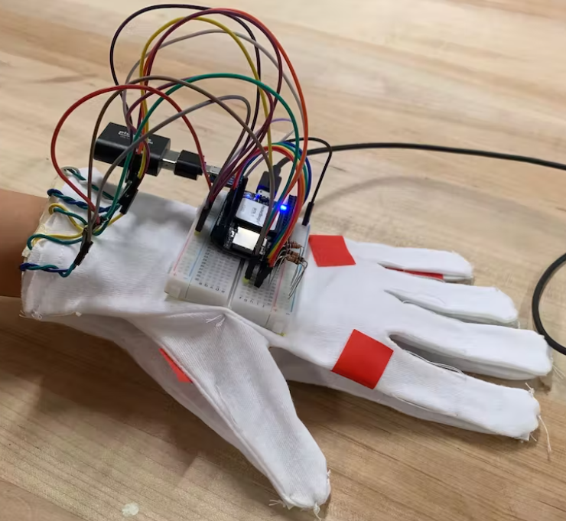
Background Information
Inspired by the movie Ender’s Game, I want to make a one-handed keyboard.
Ender’s keyboard was touchscreen based. As a part of my senior design, I want my glove to be designed for soldier to communicate messages at any time, especially during active combat. To do this, I want to create a glove on the non-dominant hand that can be used to type a message (or send a pre-designated message assigned to a keystroke) without having to take the user’s eyes off-of their target.
https://github.com/henrahmagix/enders-keyboard
https://www.hackster.io/eric-voigt/instrument-glove-4537b7

Slide 3
System Block Diagram
Create a System Block Diagram
Label interfaces / pins
Components (part numbers if possible)
Velostat Strips
AIN4
Pocket Beagle
AIN3
AIN2
AIN1
AIN0
USB1.DP
16x2 Screen

Slide 4
Power Block Diagram
Create a Power Block Diagram
Label voltages / currents of components
Velostat Strips
Pocket Beagle
5V battery
GND
1.8V, 100 mA

Slide 5
Components / Budget
Component | Need to Buy | Cost
Velostat | 1 | $5
Conductive Sewing Thread | 1 | $10
Electrical Tape | 0
Golf Glove | 1 | $12
Jumper Wires | 0
Resistor (10k) | 0
microUSB cable and adapters | 0
mini breadboard | 0
PocketBeagle | 0
Bluetooth | 1 | $10
16 x 2 Display | 1 | $9
USC Micro to USB | 1 | $3
Battery Pack | 1 | $26
Need all components to be purchased by instructor listed; additional components may be purchased by student

