Slide 1
CSE 4392/5320 · Software Engineering with Generative AI
An AI Advisor Using LangChain
Team Assignment 2 · October 2026
Team Members and Their Roles
Jordan Taylor
Data: SQLite schema, catalog parsing, seed data, degree requirements
Loc Nguyen
Degree planner, six verification checks, plan comparison
Miguel
RAG: document ingestion into Chroma, semantic retrieval and answers
Kyle
Agent: intent router, orchestrator, exact-query (SQL) chain
Talha Nadeem
Web UI, execution-trace logging, demo, presentation, packaging

Slide 2
Overview of Presentation
1
Functional requirements implemented what the advisor does, requirement by requirement
2
Assumptions and constraints what we assumed and the limits the system enforces
3
System architecture components, how they relate, the two databases, design decisions
4
Implementation a request end to end, then the code behind each component
5
Demo screenshots for every requirement and constraint, then the live app
6
Lessons learned, conclusions, future work
Academic AI Advisor · Overview · 2

Slide 3
Functional Requirements Implemented
Every requirement in the assignment, how we meet it, and where the demo shows it.
Requirement
How we meet it
Shown in demo
1 User interface
Streamlit web app: chat, plan timeline, dialogs for add / drop
Every screen
2 Multi-year degree plan
Deterministic planner orders the prerequisite graph into semesters
Plan → Build plan
3 Exact and semantic queries
Intent router sends facts to SQL, open questions to RAG
Ask: prereqs, ML courses
4 Six checks before recommending
Verification engine returns checks (a)–(f) with reasons
Check a course
5 Change plan, switch major, compare
Add / drop with undo; new plan side by side with a diff
Plan, Switch major
6 Conversation state
Session history passed into every turn; chat history in SQLite
Follow-up question
7–8 Structural + unstructured data, two DBMSs
SQLite for records, Chroma for catalog text and degree docs
Architecture
Academic AI Advisor · Requirements · 3

Slide 4
Assumptions and Constraints
Assumptions
Constraints the system enforces
Signed in: the student is already logged in (given by the assignment)
Catalog: requirements and courses come from the real UTA 2026–27 catalog
Students and sections: four personas and class sections are fabricated, consistent with prerequisites
Programs: BS CS + Cybersecurity certificate (123 credits) and BS SE + AI certificate (127)
Current term: Fall 2026; planning starts after it
Certificates: certificate courses also count toward the degree (not yet confirmed by UTA)
Prerequisites: every prerequisite passed (minimum grade C), or taken the same term when allowed
Credit caps: each student’s semester limit (15 or 18) and the degree total
Schedule: a conflict-free set of real sections must exist for the term
No repeats: a passed or already-planned course can’t be added again
Local only: runs offline on a laptop: Ollama, SQLite, Chroma; no accounts or API keys
Horizon: sections exist for Fall 2026 – Summer 2027; later terms are projected from catalog offering patterns
Academic AI Advisor · Assumptions and constraints · 4

Slide 5
System Architecture
One entry point, one router, specialised handlers, two databases, and a trace of every step.
Student
signed in (given)
Streamlit UI
app.py, ui/ · Talha
Orchestrator
memory + intent router (keywords → small LLM) · Kyle
Exact query chain
SQL lookups · Kyle
Degree planner
plan + six checks · Loc
Plan compare
diff of two plans · Loc
RAG chain
Chroma + LLM · Miguel
General chat
LLM fallback · Kyle
SQLite
courses, prerequisites, sections, students, records, requirement slots, plans, chat history · Jordan
Chroma
155 docs: catalog, descriptions, degree reqs
Ollama (local)
qwen3:4b · qwen3:0.6b · nomic-embed-text
Every step → logs/traces.jsonl → Traces screen in the app and the rendered execution log in the zip.
Academic AI Advisor · Architecture · 5

Slide 6
System Components and Relationships
What each component does, with its input and output.
Component
Function
Input
Output
UI (Streamlit)
Screens, dialogs, chat; calls the backend via ui/services.py
Clicks, typed questions
Rendered answers, plans, checks
Orchestrator
Keeps the conversation, routes each turn
student_id, message, history
Reply text
Intent router
Keyword rules first, small LLM for the rest
Message + last turns
One of 8 intents
Exact query chain
Answers facts with SQL
Course id / student id
Prereqs, schedule, record
RAG chain
Retrieves catalog passages, grounded LLM answer
Question
Answer from the documents
Degree planner
Orders the prerequisite graph into terms
Student, program, load, summer
DegreePlan JSON
Verification engine
Six checks (a)–(f) before recommending
Course, term, plan
Pass / fail + reason ×6
Plan compare
Diffs two plans after a change or switch
Old plan, new plan
Added, removed, moved
Trace logger
Appends one JSON line per step
Event + fields
logs/traces.jsonl
Academic AI Advisor · Architecture · 6

Slide 7
System Components and Relationships
How the components connect: each one is an agreed interface, frozen early so five people could build in parallel.
From → To
Interface
What passes between them
UI → backend
ui/services.py (the UI’s only door)
Clicks and questions in; (result, live / preview) out
UI → Orchestrator
handle_message(student_id, message, history)
One chat turn; history makes follow-ups work
Orchestrator → Router
route(message, history) → Intent
Which handler should answer
Orchestrator → Planner
LangChain tools: tools.*.invoke(...)
Plan, add / drop, eligibility, switch major
Planner → UI / Compare
DegreePlan.to_dict() JSON
Semesters, courses, credits, warnings
Chains, Planner → SQLite
schema.sql tables
Courses, prerequisites, sections, records, slots
RAG chain → Chroma
search_documents(query, k)
Top-k passages with source and score
Every component → Log
trace(event, **fields)
One JSON line per step in logs/traces.jsonl
Academic AI Advisor · Architecture · 7

Slide 8
Two databases, two kinds of data
Structured records go to SQL; text the LLM must read goes to a vector store.
SQLite: structural data
Chroma: unstructured data
106 courses with real catalog credit hours
141 prerequisite rules (OR groups, minimum grades; 21 may be taken the same term)
165 class sections for Fall 2026, Spring 2027, Summer 2027
4 student personas with transcripts and current enrollment
83 requirement slots for 2 programs (123 and 127 credits)
Plans and chat history saved per student
77 catalog entries parsed from the UTA CSE course PDF
75 course descriptions (course-desc.jsonl)
3 degree documents: BS CS + Cybersecurity, BS SE + AI, major switch
Embedded with nomic-embed-text via Ollama, stored locally
Used by the RAG chain for open-ended questions
Academic AI Advisor · Architecture · 8

Slide 9
Design decisions
What we considered, what we chose, and why.
Decision
Options considered
Chosen
Why
LLM
OpenAI API · local Ollama
Ollama, qwen3
Free, offline demo, no keys; OpenAI kept as a switch in .env
Vector DB
Pinecone · Chroma
Chroma (local)
No account or cost; LangChain integration
Routing
LLM only · keywords only · hybrid
Hybrid
Keywords are instant and predictable; LLM only for ambiguous phrasing
Degree planning
LLM writes the plan · algorithm
Deterministic
Plans must be correct: an LLM can't be trusted with prerequisites
UI
CLI · desktop · web
Streamlit web
Dialog boxes and prompts in one app, quick to build in Python
Layering
UI calls modules directly · one boundary
ui/services.py
UI never depends on backend internals; stubs show “not built yet”
Prompts
In code · template files (Jinja)
In code (for now)
Next step: move to template files, per the professor’s tip
Academic AI Advisor · Architecture · 9

Slide 10
One question, step by step
“Which courses cover machine learning or AI topics?”, as recorded in the trace log.
1
user_msg
The question arrives with the student id and session
2
router_keyword
A keyword rule matches “courses … cover” → semantic_query (no LLM call)
3
retrieval
Chroma returns the 5 closest passages: CSE 4309, CSE 4308, CSE 4311 …
4
llm_response
qwen3:4b answers using only those passages
5
assistant_msg
Reply shown in the chat and stored in history for follow-ups
Exact questions take the same path but step 3 is a SQL query and there is no LLM call: they answer in milliseconds.
Academic AI Advisor · Implementation · 10

Slide 11
Code: how the components are connected (Kyle)
advisor/orchestrator.py
def handle_message(student_id, message, history=None) -> str:
# The single UI <-> backend contract: one call per chat turn
tracing.trace("user_msg", student_id=student_id, message=message)
memory.add_message(student_id, "user", message) # chat history (SQLite)
intent = router.route(message, history) # router
tracing.trace("intent", student_id=student_id, intent=intent.value)
try:
reply = _dispatch(student_id, message, intent, history) # one handler
except NotImplementedError as e: # module not merged yet
reply = (f"That request routes to **{intent.value}**, which isn't "
f"implemented yet. `{e}`")
return _finish(student_id, reply, intent.value) # trace + save reply
What it does and why
The UI calls only this function, through ui/services.py
It ties memory, router, handlers and the trace log together in one place
Every step is traced, which is what the execution log is made of
Unfinished modules degrade to a message instead of crashing, so we could integrate early
Academic AI Advisor · Implementation · 11

Slide 12
Code: requirement data (Jordan)
advisor/seed/schema.sql
-- A program is a set of requirement slots. Fixed slots name one
-- course; elective slots list allowed courses in `options`.
CREATE TABLE requirement_slots (
slot_id INTEGER PRIMARY KEY AUTOINCREMENT,
program_id TEXT NOT NULL REFERENCES degree_programs(program_id),
category TEXT NOT NULL, -- core, math_science, cse_core, ...
course_id TEXT REFERENCES courses(course_id), -- NULL = elective
options TEXT NOT NULL DEFAULT '[]', -- JSON course ids
credits INTEGER NOT NULL
);
-- Prerequisites that may be taken in the same term (co-requisites).
CREATE TABLE prereq_concurrent (
course_id TEXT NOT NULL REFERENCES courses(course_id),
prereq_id TEXT NOT NULL REFERENCES courses(course_id),
PRIMARY KEY (course_id, prereq_id)
);
What it does and why
Turns the catalog’s degree plans into rows the planner can reason over
One table drives the planner, the six checks, and the progress rings
Generated from the real catalog by build_seed_data.py, not typed by hand
Academic AI Advisor · Implementation · 12

Slide 13
Code: intent router (Kyle)
advisor/router.py
def route(message, history=None) -> Intent:
# Stage 1: deterministic keyword pass: zero latency, predictable
if (kw := _keyword_route(message)) is not None:
trace("router_keyword", intent=kw.value)
return kw
# Stage 2: ambiguous phrasing: ask a small, fast LLM
recent = "\n".join(f"{m['role']}: {m['content'][:200]}"
for m in (history or [])[-4:])
try:
resp = get_router_model().invoke(
_PROMPT.format(history=recent, message=message))
text = _strip_think(resp.content).lower()
except Exception as e: # backend down -> safe fallback
trace("router_error", error=str(e))
return Intent.OTHER
return next((i for i in Intent if i.value in text), Intent.OTHER)
What it does and why
Decides which handler answers each message (spec req 3)
Keywords catch clear phrasing instantly; qwen3:0.6b handles the rest
Recent turns let follow-ups like “what about 3 classes?” resolve
Never crashes a turn: any failure falls back to general chat
Academic AI Advisor · Implementation · 13

Slide 14
Code: orchestrator dispatch (Kyle)
advisor/orchestrator.py
def _dispatch(student_id, message, intent, history) -> str:
if intent in (Intent.EXACT_QUERY, Intent.STATUS_QUERY):
return chains.answer_exact(message, student_id) # SQL
if intent == Intent.SEMANTIC_QUERY:
return chains.answer_semantic(message, student_id) # RAG
if intent == Intent.GENERATE_PLAN:
plan = tools.generate_degree_plan.invoke({
"student_id": student_id,
"include_summer": _wants_summer(message)})
return _format_plan(plan)
if intent == Intent.MODIFY_PLAN:
plan = tools.modify_plan.invoke({
"student_id": student_id, **_extract_modify_args(message)})
return _format_plan(plan)
if intent == Intent.SWITCH_MAJOR:
return _handle_switch_major(student_id, message)
if intent == Intent.CHECK_ELIGIBILITY:
return _handle_eligibility(student_id, message)
return _general_answer(message, history)
What it does and why
One place maps each intent to exactly one handler
Planner calls go through LangChain tools (tool.invoke), so the same operations are ready for an agent
Conversation history is passed in every turn (spec req 6)
Academic AI Advisor · Implementation · 14

Slide 15
Code: retrieval and grounded answers (Miguel)
advisor/chains.py
def answer_semantic(query, student_id=None, k=5) -> str:
if OVERRIDE_REQUEST.search(query): # prompt-injection guard
return "I can help with academic advising questions, ..."
matches = search_documents(query, k=k) # Chroma + exact course ids
if not matches:
return "I couldn't find that in the indexed documents."
references = [{"name": _source_name(h), "text": h["text"][:4000]}
for h in matches]
system_message = (
"You are an academic course and degree information assistant. "
"Use ONLY facts explicitly stated in the supplied "
"reference_documents ... If the sources do not answer the "
"question, say what cannot be confirmed. ...")
# JSON keeps the student's text separate from the documents
payload = json.dumps({"student_question": query,
"reference_documents": references})
response = get_chat_model(temperature=0).invoke([
("system", system_message), ("human", payload)])
What it does and why
Answers open-ended questions from the catalog and degree documents
Named courses are fetched directly, then semantic matches fill in
The model may only use retrieved text, so answers stay factual
Question and documents are treated as untrusted data: injection attempts are refused
Academic AI Advisor · Implementation · 15

Slide 16
Code: the six verification checks (Loc)
advisor/planner.py
def _verify(context, cid, term, plan) -> list[CheckResult]:
prereqs = _prerequisite_failures(context, cid, term, plan)
fulfills = _coverage(context, after) > _coverage(context, before)
schedule_ok = _section_assignment(context, semester_ids, term) is not None
return [
CheckResult("prerequisites_met", not prereqs, ...), # (a)
CheckResult("not_already_passed",
cid not in passed and not scheduled_elsewhere, ...), # (b)
CheckResult("fulfills_degree_requirement", fulfills, ...), # (c)
CheckResult("no_schedule_conflict", schedule_ok, ...), # (d)
CheckResult("within_semester_credit_cap",
semester_credits <= semester_cap, ...), # (e)
CheckResult("within_degree_credit_cap",
degree_credits <= degree_cap, ...), # (f)
]
What it does and why
Runs before any course is recommended or added (spec req 4)
Each check returns pass/fail and a human-readable reason
Schedule check searches for a conflict-free set of real sections
Pure Python over SQLite: no LLM, so results are exact and repeatable
Academic AI Advisor · Implementation · 16

Slide 17
Code: UI boundary and execution traces (Talha)
ui/services.py, advisor/tracing.py
def _call(action, student_id, live, fallback, use_preview, **fields):
try:
result, source = live(), "live"
except NotImplementedError as e: # teammate's module not merged
if not use_preview:
raise NotReady(str(e)) from e # UI shows "not built yet"
result, source = fallback(), "preview"
tracing.trace("ui_action", student_id=student_id, action=action,
source=source, **fields)
return result, source
def trace(event: str, **fields) -> None: # one JSON line per step
record = {"ts": datetime.now(timezone.utc).isoformat(),
"event": event,
**({"session": s} if (s := _session.get()) else {}),
**fields}
with TRACE_LOG.open("a") as f:
f.write(json.dumps(record, default=str) + "\n")
What it does and why
The UI touches the backend in one file, so each layer was built in parallel
Every UI action and chat step lands in logs/traces.jsonl, tagged by session
The Traces screen and scripts/render_traces.py turn it into the execution log
Academic AI Advisor · Implementation · 17

Slide 18
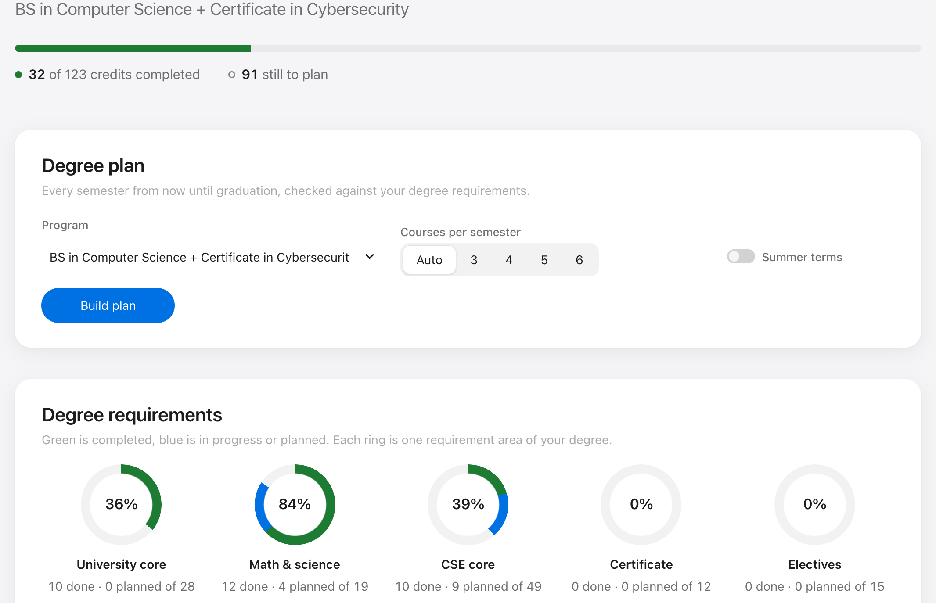
Demo · Req 1, 7: the student’s record at a glance
Input
Pick a student
Output
Credits done, in progress, and per-area requirement rings from SQLite
What it means
Sam has 32 of 123 credits; blue is this fall’s 4 classes. The certificate ring is empty: still to plan.
Academic AI Advisor · Demo screenshots · 18

Slide 19
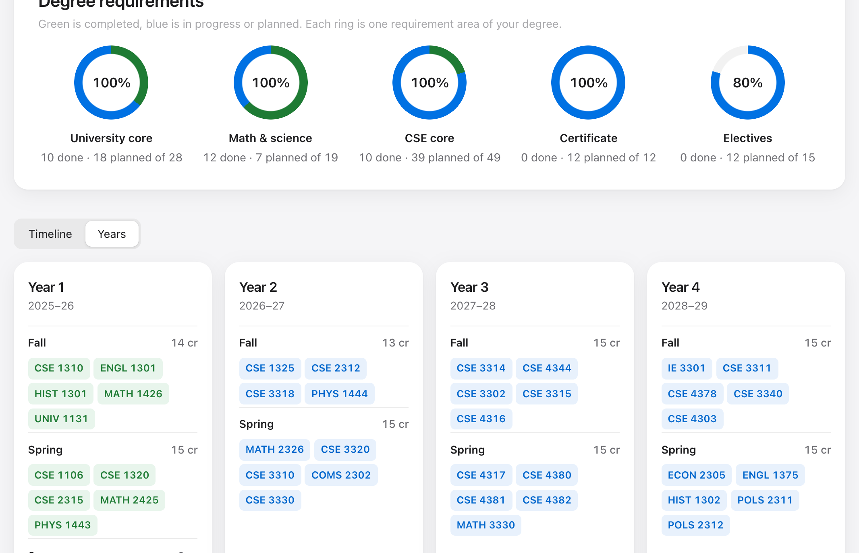
Demo · Req 2: a multi-year plan to graduation
Input
Plan → Build plan (auto load, no summer) → Years
Output
Completed terms (green), then planned semesters (blue), year by year
What it means
Graduation in Spring 2029, in prerequisite order within the 15-credit cap; terms after Summer 2027 are projected.
Academic AI Advisor · Demo screenshots · 19

Slide 20
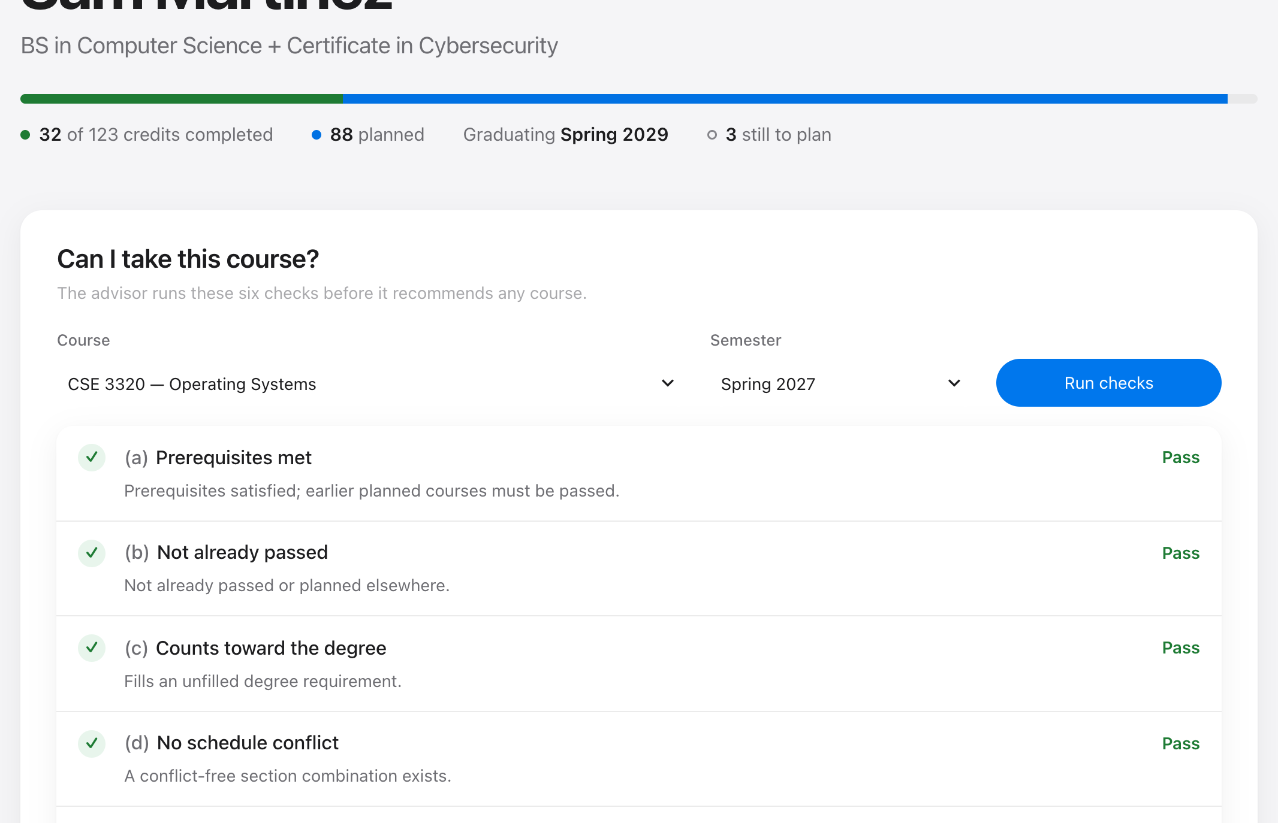
Demo · Req 4: six checks before recommending
Input
Check a course: CSE 3320, Spring 2027
Output
Checks (a)–(f), each with pass/fail and the reason
What it means
All six pass for the course the planner chose for Spring 2027; any failure blocks a recommendation and says what to fix.
Academic AI Advisor · Demo screenshots · 20

Slide 21
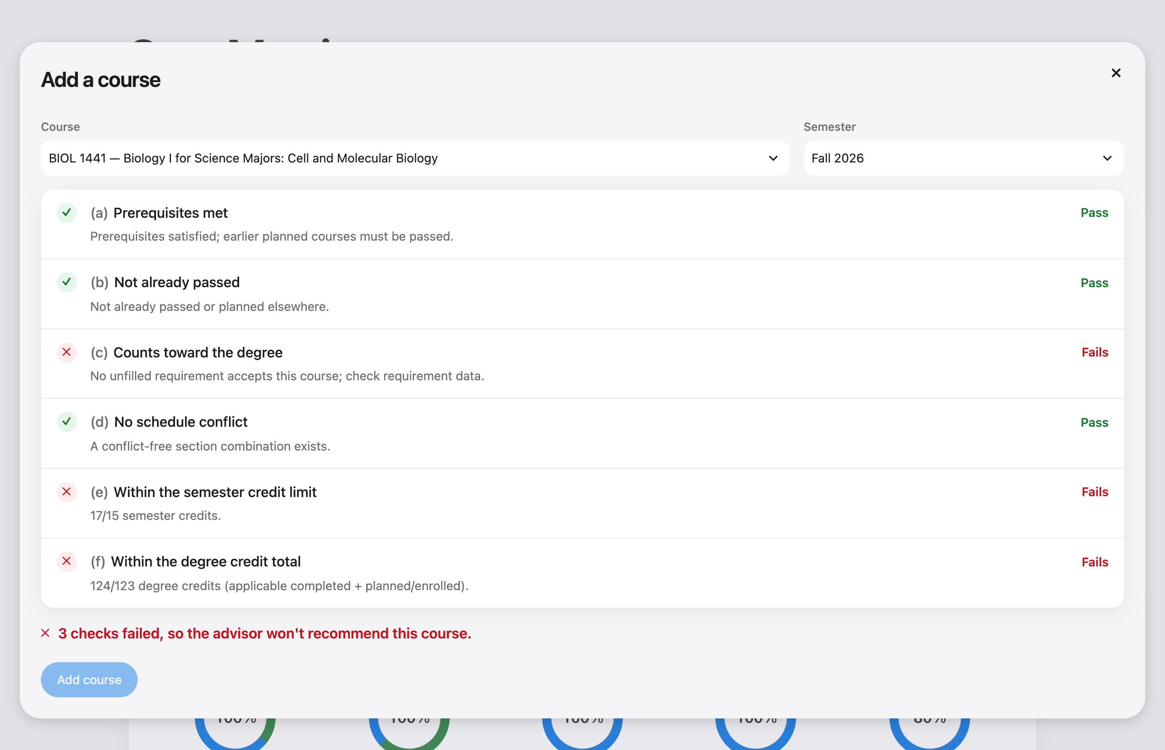
Demo · Constraints: a course the system refuses
Input
Plan → Add a course: BIOL 1441, Fall 2026
Output
Three checks fail: it doesn’t count toward the degree, 17 of 15 semester credits, 124 of 123 degree credits. Add stays disabled
What it means
Constraints are enforced, not just reported: the advisor won’t add a course that breaks one.
Academic AI Advisor · Demo screenshots · 21

Slide 22
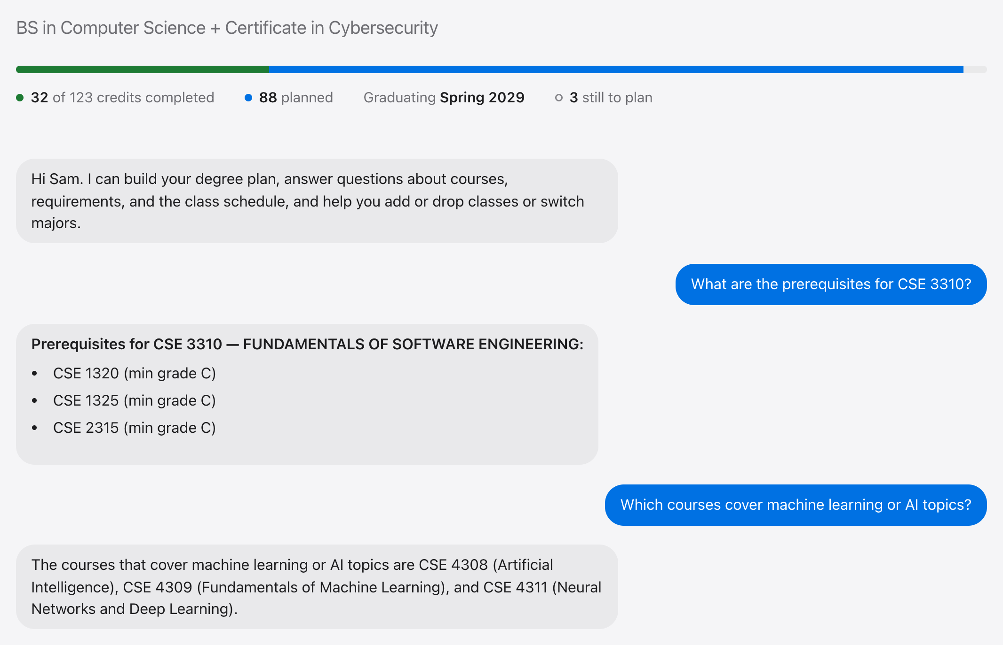
Demo · Req 3: exact vs. semantic questions
Input
“Prerequisites for CSE 3310?” then “Which courses cover machine learning?”
Output
SQL answer in milliseconds; RAG answer grounded in the catalog
What it means
Same chat, two paths: the router sent the first to SQL and the second to Chroma + the LLM.
Academic AI Advisor · Demo screenshots · 22

Slide 23
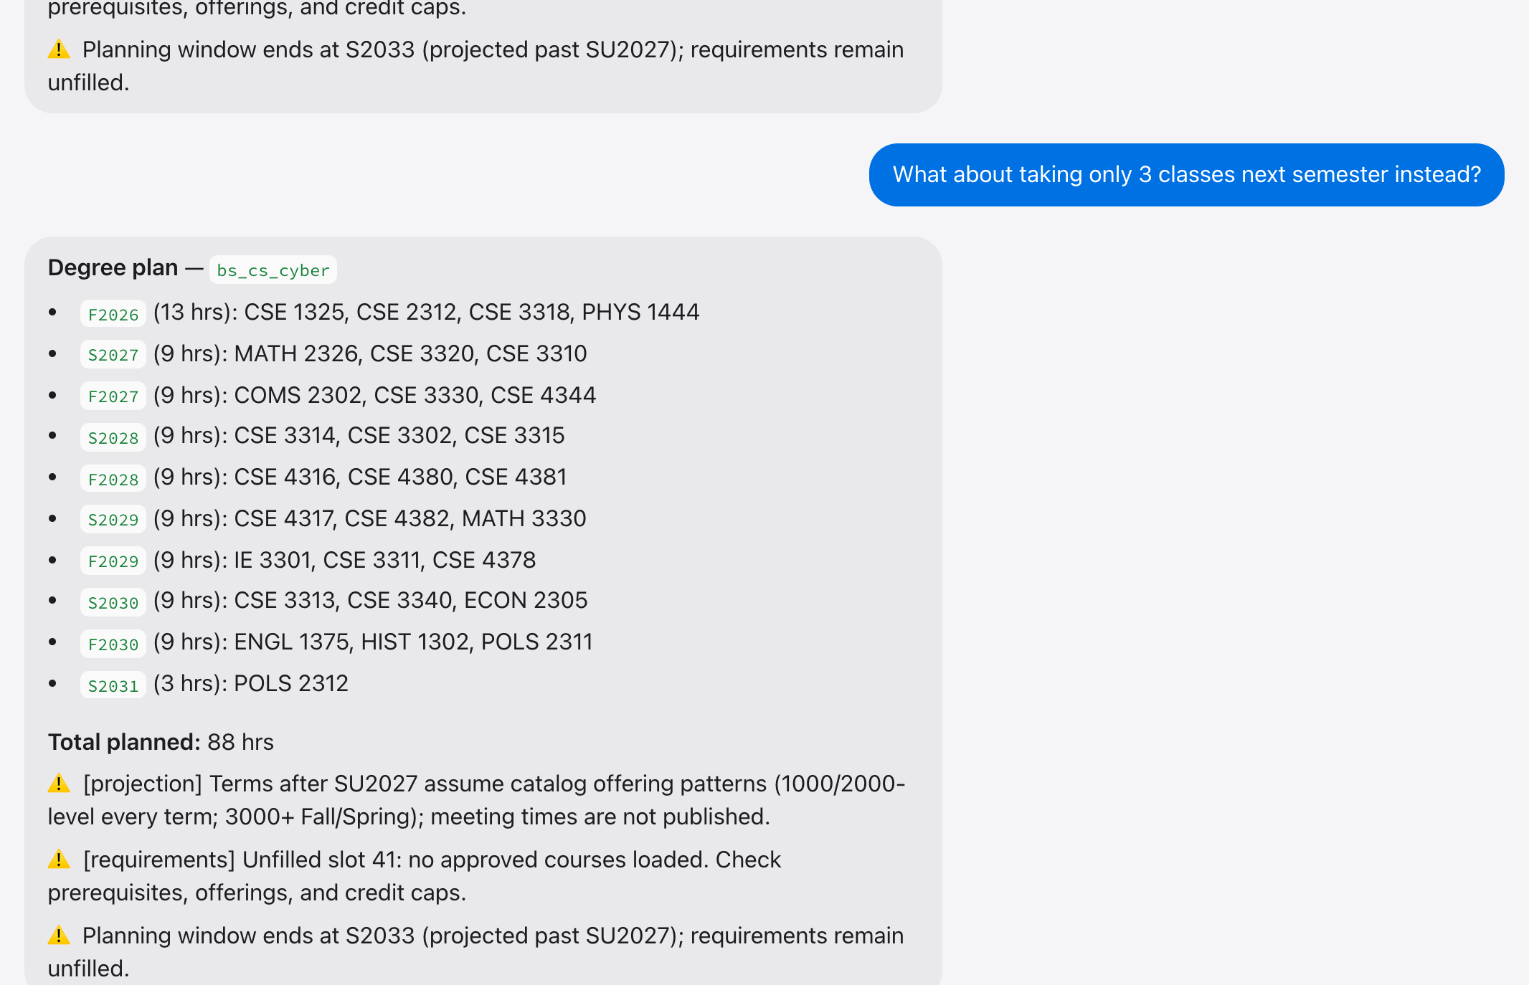
Demo · Req 6: the conversation remembers
Input
“Generate my degree plan”, then “What about only 3 classes next semester?”
Output
A new plan with 3 classes in Spring 2027
What it means
The follow-up has no subject of its own; the history passed into the turn makes it resolvable.
Academic AI Advisor · Demo screenshots · 23

Slide 24
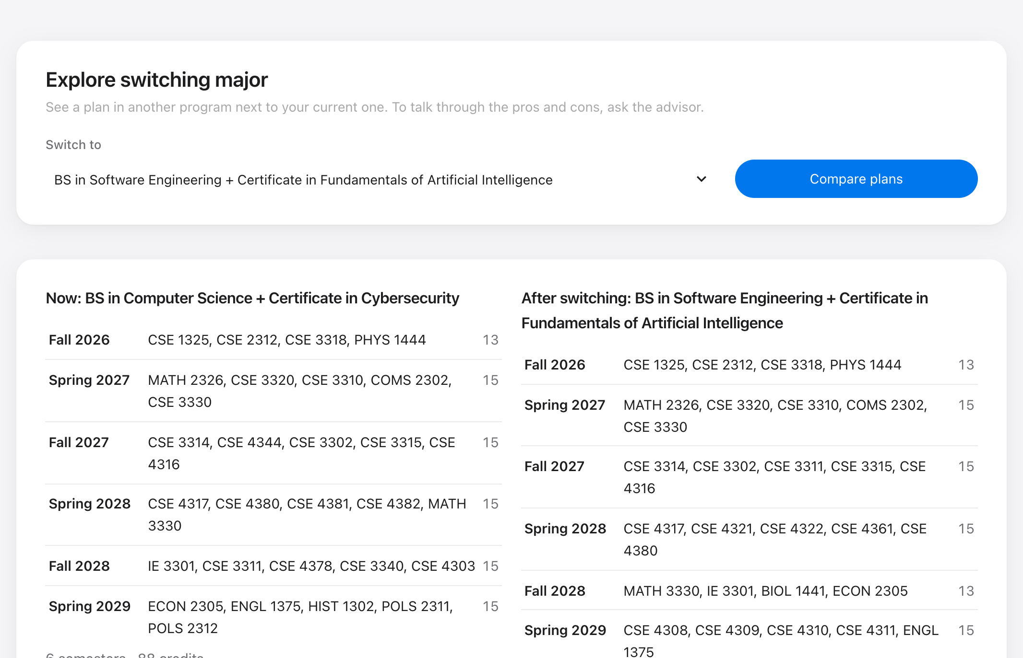
Demo · Req 5: switching major, compared
Input
Switch major → Software Engineering + AI → Compare plans
Output
Current plan and the new one side by side, plus what changes
What it means
Lets a student see the cost of switching before committing to it.
Academic AI Advisor · Demo screenshots · 24

Slide 25
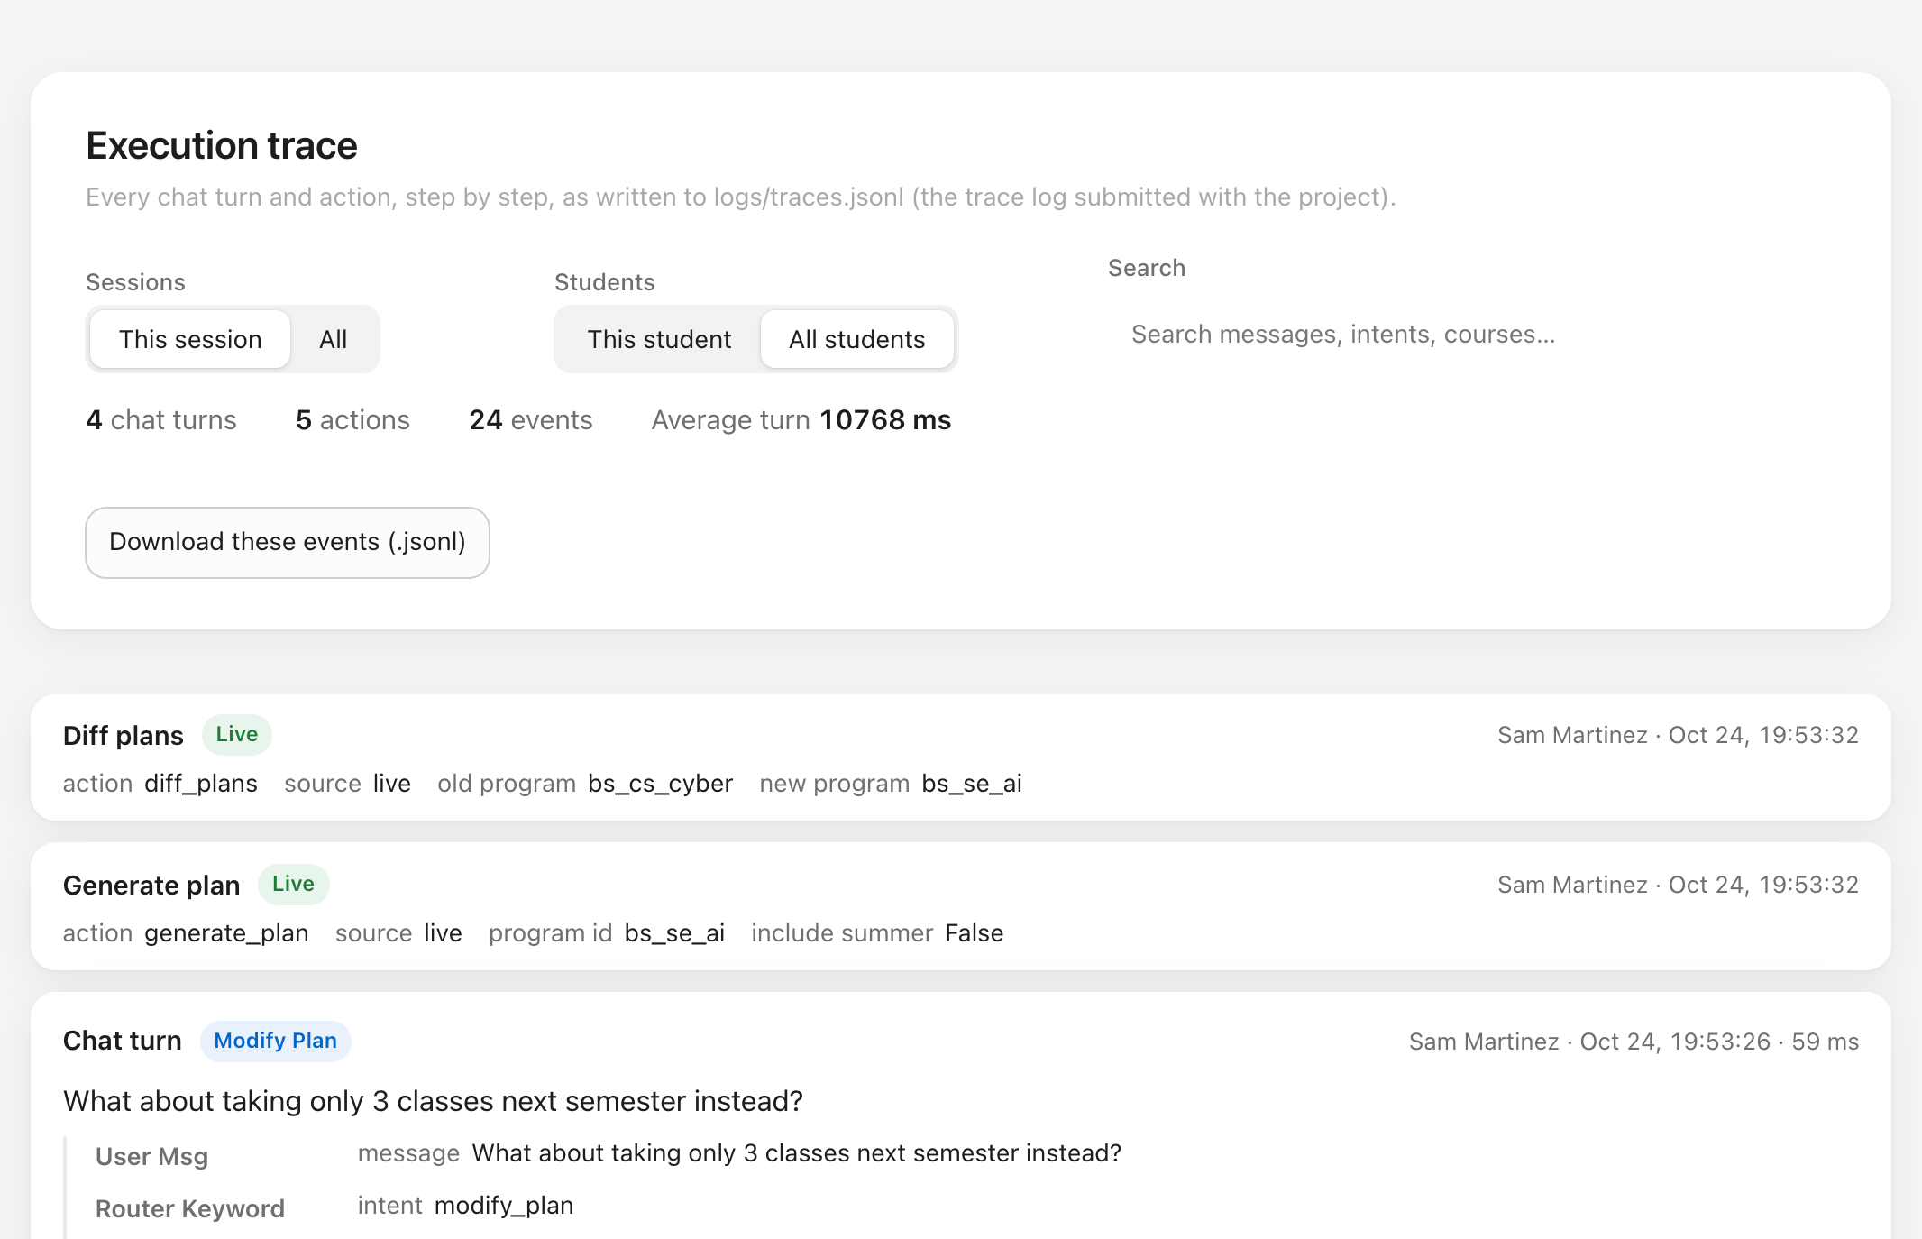
Demo · Deliverable: the execution trace
Input
More → Show execution traces → Traces
Output
Every turn and action, step by step, with timings
What it means
This is the required log of execution traces; the zip has the same data as JSONL and as a readable report.
Academic AI Advisor · Demo screenshots · 25

Slide 26
Live Demo
The same walk-through in the running app, if time allows.
1 Pick Sam Martinez; show progress and requirement rings
2 Plan → Build plan; open Add a course to show the checks
3 Check a course: CSE 3320, Spring 2027
4 Ask: prerequisites for CSE 3310, then machine learning courses
5 Switch major → Compare plans
6 Traces: the turns just asked, step by step
Good to know
The local model answers open questions in 20–70 s; exact questions and plans are instant
If time is short, the screenshots on the previous slides cover every step
Academic AI Advisor · Live demo · 26

Slide 27
Lessons Learned
Working with LangChain, a local LLM, and two databases.
What worked
What to avoid
Freeze interfaces first: schema, plan JSON, handle_message and the trace format let five people build in parallel
LLM only where it helps: keyword routing and a deterministic planner are instant and always correct
Local stack: Ollama + Chroma + SQLite meant no accounts, no cost, and an offline demo
Trace from day one: the log made debugging fast and is itself a deliverable
LangChain tools: wrapping planner functions as tools keeps them ready for an agent
Changing shared contracts late: a mid-project schema rewrite had to be reverted
Trusting “no reasoning” flags: qwen3 still emitted its reasoning; strip it at the boundary
Side effects in exploratory tools: “thinking about switching” must not change the record
Reformatting shared files: line-ending changes caused merge conflicts
Unpinned environments: a new Python version broke an install; pin it
Academic AI Advisor · Lessons learned · 27

Slide 28
How we know it works
82 automated tests across planner, router, RAG retrieval, data schema, UI services, and tracing; run with a linter on every pull request
Scripted demo (scripts/run_demo.py) replays the 7 demo questions end to end and renders the trace log
Scripted screenshots (scripts/take_screenshots.py) drive the real app in a browser
All five branches tested together in one combined copy, plus a fresh-unzip install test
Response time on a laptop (M5, 16 GB)
Question type
Time
Exact (SQL)
< 0.1 s
Plan / checks / modify
< 0.1 s
Semantic (RAG + qwen3:4b)
20–70 s
General chat (qwen3:4b)
≈ 20 s
Academic AI Advisor · Conclusions and future work · 28

Slide 29
Conclusions and Future Work
Teamwork
Achievements
If the project continues
Five workstreams on five branches, joined through agreed interfaces
Every branch tested together before the final merge; tests and lint run on every pull request
Work merged into main through pull requests
All eight functional requirements implemented
Six checks before any recommendation
Exact and semantic answers over two databases
A full execution trace for every turn
Chat: add / drop by message, “next semester” as the next term, progress questions
Make exploring a switch read-only until the student confirms
Prompts in template files (Jinja); split the code into layer folders
Faster answers: a GPU or the OpenAI switch
Real records from the registrar instead of personas
Academic AI Advisor · Conclusions and future work · 29

Slide 30
Questions
github.com/JordanTaylorGit/CSE-4392-AI-Academic-Advisor
Academic AI Advisor · 30

