Slide 1
GDP Discovery Service
Status Update

Slide 2
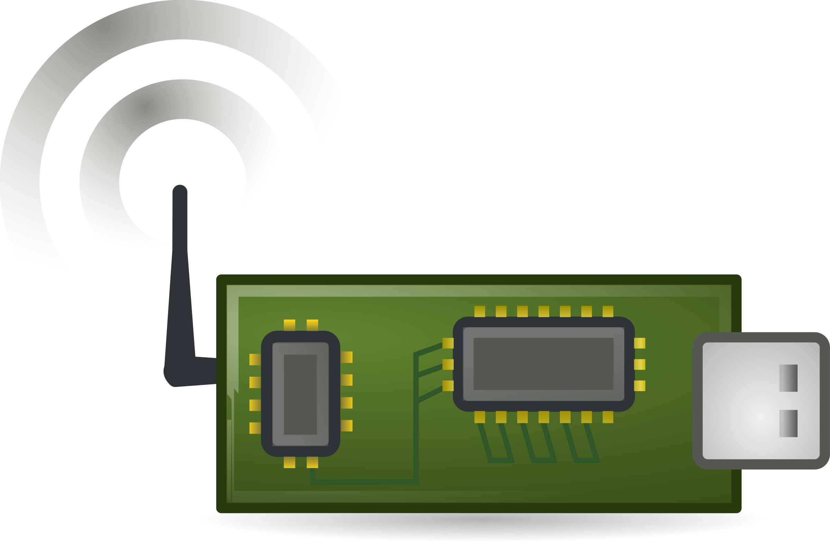
Manufacturer/User created logs
Manufacturer
32-byte GUID
Info Log
Output Log (optional)
Input Log (optional)
N capabilities
  Up to 767 bytes each
  Can conform to a
  variety of ontologies
N permissions
  Up to 767 bytes each
Sensor data
Additional device info
General output from
device
Information to be read
by the device
Instructions for
actuators
*Currently logs must be created manually using GCL create, but a better API should be developed in the future

Slide 3

Discovery service: current state
Query Application
Query API
Example query:
Find all clients with:
  Permission x or y
  Capability a and b
Local Query
GUID 1, GUID 2, GUID 6, GUID N
Local Discovery Server
Network broadcast
RPC requests
GDP
Client 1 Info
Client 2 Info
Discovery Client 1
Discovery Client 2

Slide 4
Global Discovery

Slide 5
Proposal 1: Hierarchical Discovery

Slide 6
Global discovery goal
Global discovery service N
Query Application
Query API*
GUID 1, GUID 3, etc.
Example query:
Find all clients with:
  Permission x or y
  Capability a and b
Global discovery service 1
Local discovery service 1
Local discovery service 2
Discovery Client 1
Discovery Client 2
Discovery Client 3
Discovery Client 4

Slide 7
Hybrid Distributed Discovery

Slide 8

Initial Info Log Registration
Registering device
class
Global Discovery Service
info_log: info_log name
Create and write contents
Info Log
N capabilities
  Up to 767 bytes each
  Can conform to a
  variety of ontologies
N permissions
  Up to 767 bytes each
Reads and stores every info
log in a MySQL database
Responds to queries for
capabilities and/or permissions
with GUIDs and log names
associated with devices

Slide 9
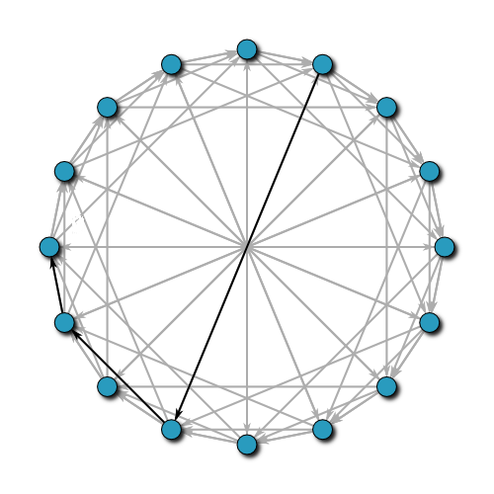
Simple Distributed Discovery
Local Service 1
Devices
Discovery DHT
. . .
Local Service n
DHT Contents
Key: Info Log Name | Value: Registered Devices List
Info Log 1 | [(GUIDa, IPa), (GUIDb, IPa)]
Info Log 2 | [(GUIDi, IPn), .., (GUIDk, IPm)]
... | ...
Info Log n | []

Slide 10
Query
Global Registry
Capabilities, Permissions
Querying Application
List of devices’ info
Devices
Local Server 1
Discovery DHT
. . .
Local Server n

Slide 11
Proposal 3: Hybrid Distributed

Slide 12
Hybrid Distributed Discovery
Global Discovery Service
Capabilities, Permissions
Querying Client
GUIDs, Log Names
Local Service 1
Devices
Discovery DHT
. . .
Local Service n

Slide 13
Initial Info Log Registration
Manufacturer
Global Discovery Service
Info Log contents
Info Log
N capabilities
  Up to 767 bytes each
  Can conform to a
  variety of ontologies
N permissions
  Up to 767 bytes each
Parses and stores every info
log in a MySQL database
Responds to queries for
capabilities and/or permissions
with GUIDs and log names
associated with devices

Slide 14
Local Discovery Services
Local Discovery Service 1
Key: Hash (Info Log) | Value: Local Service IP(s)
Hash (Info Log 1) | 111.111.111.111
... | ...
GUID | Info Log | Input Log | Output Log | Local Service IP
ID1 | Log 1 | Log 2 | Log 3 | 333.333.333.333
ID2 | Log 1 | Log 5 | Log 6 | 222.222.222.222
... | ... | ... | ... | ...
Local Discovery Service 2
Local Discovery Service 3

Slide 15
Query Process
Global Discovery Service
Querying Client
Capabilities, Permissions
GUIDs, Log Names
Hash (Info Log Name)
Discovery DHT
Local Discovery Service IP
Info Log Name
GUIDs, Log Names
Local Discovery Service

Slide 16
Query Process
Global Discovery Service
Querying Client
Capabilities, Permissions
GUIDs, Log Names
Hash (Info Log Name)
Discovery DHT
Local Discovery Service IP
Info Log Name
GUIDs, Log Names
Local Discovery Service

Slide 17
Query Process
Global Discovery Service
Querying Client
Capabilities, Permissions
GUIDs, Log Names
Hash (Info Log Name)
Discovery DHT
Local Discovery Service IP
Info Log Name
GUIDs, Log Names
Local Discovery Service

Slide 18
Query Process
Global Discovery Service
Querying Client
Capabilities, Permissions
GUIDs, Log Names
Hash (Info Log Name)
Discovery DHT
Local Discovery Service IP
Info Log Name
GUIDs, Log Names
Local Discovery Service

Slide 19
Query Process
Global Discovery Service
Querying Client
Capabilities, Permissions
GUIDs, Log Names
Hash (Info Log Name)
Discovery DHT
Local Discovery Service IP
Info Log Name
GUIDs, Log Names
Local Discovery Service

Slide 20
Query Process
Global Discovery Service
Querying Client
Capabilities, Permissions
GUIDs, Log Names
Hash (Info Log Name)
Discovery DHT
Local Discovery Service IP
Info Log Name
GUIDs, Log Names
Local Discovery Service

Slide 21
Query Process
Global Discovery Service
Querying Client
Capabilities, Permissions
GUIDs, Log Names
Hash (Info Log Name)
Discovery DHT
Local Discovery Service IP
Info Log Name
GUIDs, Log Names
Local Discovery Service

