Slide 1
GDP Discovery Service
Overview

Slide 2

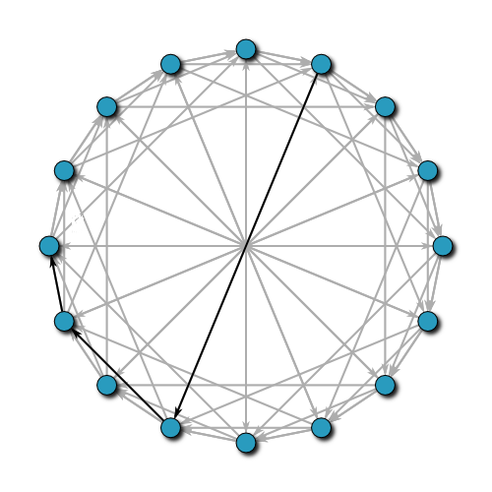

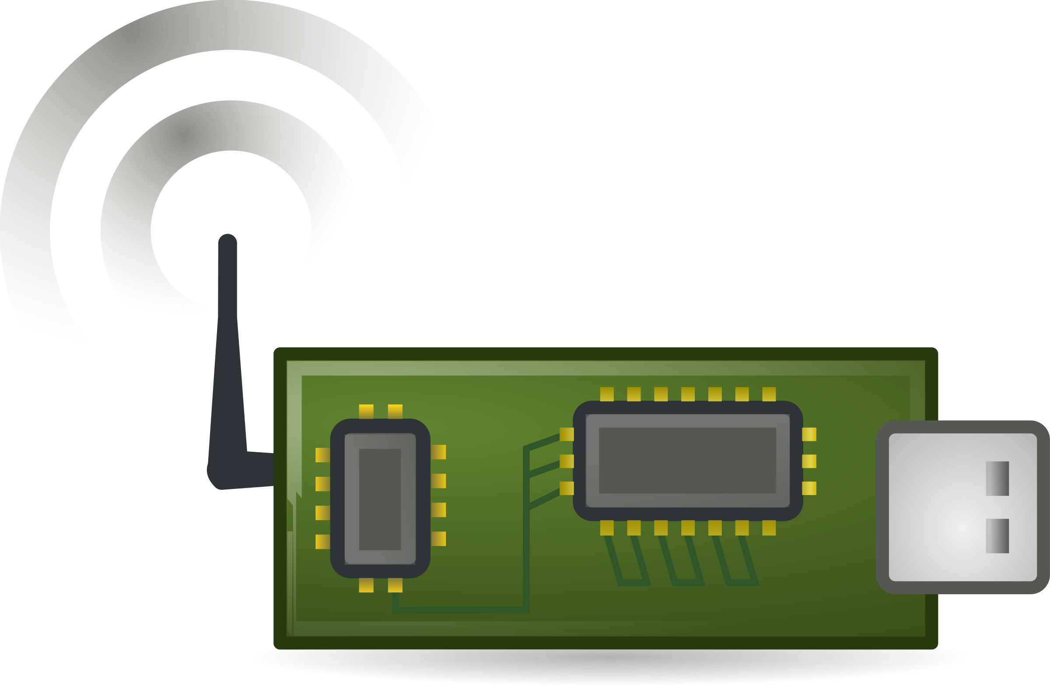
Query
Global Registry
Capabilities, Permissions
Querying Application
List of devices’ info
Devices
Local Server 1
Discovery DHT
. . .
Local Server n

Slide 3
Discovery DHT
Devices described by info log 1
 | Device i | Device k
guid | guiddevicei | guiddevicek
info_log | lognameinfoi | lognameinfok
output_log | lognameouti | lognameoutk
input_log | lognameini | lognameink
capabilities | [c1, c2, …, cn] | [c1, c2, …, cn]
permissions | [p1, p2, .., pn] | [p1, p2, …, pn]
datetime | 2016-12-05 | 2016-12-08
logger_ip | 1.1.1.1 | 2.2.2.2
Key: Hash (Info Log) | Value: List of devices
Hash (Info Log 1) | [Device i, …, device k]
... | ...
Local server
Local server
Device i
Device k

Slide 4
Discovery service: current state
Query Application
Query API
Example query:
Find all clients with:
  Permission x or y
  Capability a and b
Local Query
GUID 1, GUID 2, GUID 6, GUID N
Local Discovery Server
Network broadcast
RPC requests
GDP
Client 1 Info
Client 2 Info
Discovery Client 1
Discovery Client 2

Slide 5
Sequence Diagram
User
GDP
client_setup.py
client.py
local_server.py
DHT
global_registry.py
Create info log
Write info log (config.txt, key, optional cert)
Registration
Write to info log
HTTP PUT: register info log
Read info log contents and store in DB
client.advertise (log names, optional key)
Broadcast (ZC)
Advertisement
Connect (RPC)
Update for client
Renew (RPC)
...
...
Update for client
Renew (RPC)
Update for client
HTTP GET: devices with [capabilities], [permissions], active since
Search DB
for qualifying
info logs
Query
Get devices’ info
Filter
inactive
Return devices’ info

Slide 6
Potential Improvements
Automate info log creation and registration with the global registry
Build global registry UI
Choose ontology and optimize global registry search

Slide 7
Appendix

Slide 8
Initial Info Log Registration
Registering device
class
Global Discovery Service
info_log: info_log name
Create and write contents
Info Log
N capabilities
  Up to 767 bytes each
  Can conform to a
  variety of ontologies
N permissions
  Up to 767 bytes each
Reads and stores every info
log in a MySQL database
Responds to queries for
capabilities and/or permissions
with GUIDs and log names
associated with devices

Slide 9
Manufacturer/User created logs
Manufacturer
32-byte GUID
Info Log
Output Log (optional)
Input Log (optional)
N capabilities
  Up to 767 bytes each
  Can conform to a
  variety of ontologies
N permissions
  Up to 767 bytes each
Sensor data
Additional device info
General output from
device
Information to be read
by the device
Instructions for
actuators
*Currently logs must be created manually using GCL create, but a better API should be developed in the future

Slide 10
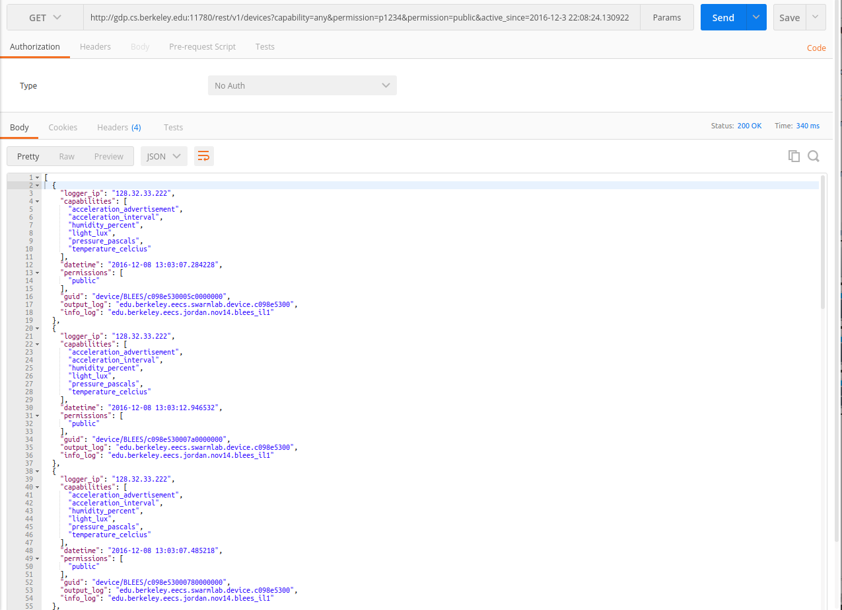
Using Global Registry API

