Slide 1


Slide 2

Data Science. For economists
Richard Davies
Autumn 2022

Slide 3
Week 1.
Intro and plan. Team, learning objectives, resources, assessment.
What is Data Science? Data, insights and responsibilities.
Building blocks. HTML, CSS and JavaScript
Practical 1. Setting up your portfolio site.

Slide 4

Motivation. The way we use data evolves

Slide 5
















Where we are.
Currently analysts will tend to have five steps or more between their raw data and their output.
Example: a journalist or consultant making a chart of US GDP
Data source
Public-sector
aggregator
Commercial
aggregator
Analyst
Publisher
Output
JPEG
SVG
SVG
XLS
SVG
TXT
CSV
SVG
BLS
FRED
Bloomberg
Editorial dept
Web team
Note how this system works:
Many players. Some add delay, others add commercial cost. It is slow and expensive.
Error prone. Each link can, and does, break. Each one adds to the chance of a human error.
Compatibility problems. Many different file types. Delay and compatibility problems
Data storage costs. Huge data storage requirement, with data stored in each silo along the way.
The result is a data system that is slow, costly and inaccurate.

Slide 6





Where we are going.
The modern approach used in this course is different. We will aim to build single secure channels linking an analyst’s output right back to the raw data.
Data source
Output
Analyst’s code
BLS
Note the differences with the new system:
Auto-refresh. Your presentation is always up to date. When the raw data updates, it flows through the channel instantly and automatically.
Cost eradication. The number of players (and associated costs) collapses. There are no data silos – the data shown on the web site are the raw data, not a copy of them.
Auto-verification. The one-to-one link back to the original data provider means fact checks can be swift.
The result is analysis that is faster, cheaper and more accurate.

Slide 7


What’s possible.
Today we carry supercomputers in our pockets in the form of smartphones. This means the combination of this hardware, along with JavaScript, and web-browsers can even create a data analysis loop with no links in the chain, where the phone is both the input and output.
Input
Output

Slide 8
Why it matters.
The problems and opportunities set out above matter in many fields that use data. But they are particularly acute in economics, for the following reasons:
Regular data updates. Economic data is high-frequency. This means that the ‘repeated analysis’ problem is particularly acute.
Positive/descriptive. Often we are aiming to clarify or get the bottom of some new finding. We need our work to be replicable (someone else can run your code and get the same result) and verifiable.
Normative/policy. Economic data is hard-wired into policy decisions. Getting it right affects people’s lives.

Slide 9
Team.
Prof Richard Davies
www.richarddavies.io
www.extremeeconomies.com
Charlie Meyrick
https://meyrickcharlieecon.github.io
Dr Denes Csala
www.csaladen.es
Mr Emilien Valat
www.emilienvalat.net/

Slide 10
Learning objectives. What you can expect from this course
Knowledge. You will gain an understanding of the principles and theory of data and of visualisation.
Skills. This is a hands on, practical course. Starting from no programming knowledge we will guide you as you learn how to access, manipulate and display data using HTML, CSS, JavaScript, Python, and Vega.
Portfolio. You will be build a live web site that hosts both your DS portfolio and your project. These can be used professionally and/or in further study.

Slide 11
Resources.
Key resource 1: demonstrations of code, chart examples, course plan:
www.rapidcharts.io/datascience
The repository behind this site:
https://github.com/RDeconomist/RDeconomist.github.io
In particular familiarise yourself with the following pages:
www.rapidcharts.io/datascience | The course syllabus
www.rapidcharts.io/datascience2022 | Some of the best projects from last year.
www.rapidcharts.io/dashboards | Some dashboards.
www.rapidcharts.io/library | A compendium of different types of chart, with links to the code and data.
Key resource 2: In addition, there is a course DropBox, holding PDFs of notes and examples of code:
Data Science DropBox

Slide 12
Weekly plan.
Monday 11:00-13:00: Lecture and practical.
Thursday 09:00-11:00: Skill (taught) and project discussion.
Office Hours:
RD: Mon, 14:00-15:00 (2C3, 12 Priory Road)
DC: Thu, 15:00-16:00 (online)
CM: Wed, 09:00-10:00 (3C7, 12 Priory Road)
EV: Thu, 14:00-15:00 (0C6, 12 Priory Road)

Slide 13
Questions / comments / requests.
How to get help:
Thursdays. Please ask questions during our project sessions. If you have a question, however, basic, just ask: many people will face similar problems.
Office hours. There are 4h per week for Q&A.
Email teaching team. data-science-econ@bristol.ac.uk
Important note: The team is not able to answer questions about the basic functioning of your computer (e.g. hardware problems, operating system problems) : these should go the manufacturer, or IT services.

Slide 14
Assessment. {Deadline: 10th Jan 11am}
Coursework. The coursework consists of two parts.
DS Portfolio (20%). In each of the first 10 weeks you learn the steps to produce charts, tables or visualisations. These are worth 20% of your grade. Each week is graded equally, i.e. 2%. These should be completed during the week. Note that the portfolio is NOT the same as for 2021.
DS Project (80%).
Between 3 and 8 charts. Embedded in your site, hosted by GitHub pages.
An accompanying write-up (also embedded on your page) discussing:
the aims of your project;
the data you used, how you accessed it, including notes on automation/replication;
challenges in data cleaning and/or analysis, and the tools you used to overcome them;
your conclusions.
Each section must not exceed 200 words.

Slide 15
A vital diary date. The festival of economics
Part of your portfolio will be to comment on / analyse and argument made at the Festival of Economics.
The dates for this are 15th -16th -17th November.
The events are here: https://www.economicsobservatory.com/events
You will need to attend at least one session. The cost is £5.*
The event is an opportunity to meet professional economists and potential employers, and we look forward to seeing you there.
* If this is problem for anyone, please let us know, as the Observatory will have some sponsored tickets we may be able to provide free of charge.

Slide 16
Steps to take immediately. Three things to do today
Key resources. Check that you can access both the RapidCharts GitHub repository, and the course drop box. The links are here and here.
Economics Observatory. Sign up for our newsletter. We will be emphasising charts and data over coming months. https://www.economicsobservatory.com/join-us
Social Accounts. Follow our social accounts. On IG: @RapidCharts, @EconomicsObservatory. On Twitter: @EconObservatory, @RD_Economist. We will post chart ideas, along with code, during the duration of the course. These will help with both your portfolio and project.

Slide 17
Success on the course. Some advice from the team
The course is designed to take you from no coding skills to a position where you can make a professional quality web-site which collects, cleans, analyses and displays data.
The skills we teach and code-along sessions are an essential part of this.
The weekly homework will build the skills that you need to score well in the final coursework.
However…
Coding and data are not like writing. They cannot be done in a short and rushed way. Our advice is to treat this course professionally. Complete each homework in the week it is set, attend and ask questions about your project.

Slide 19

Building blocks.

Slide 20
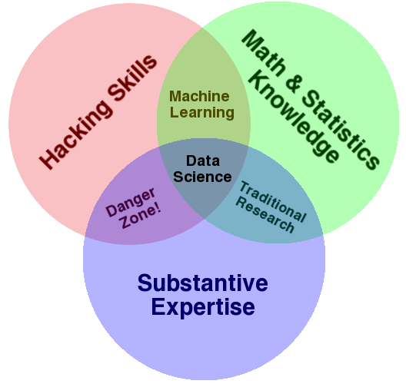
Data science.
What is it?

Slide 21
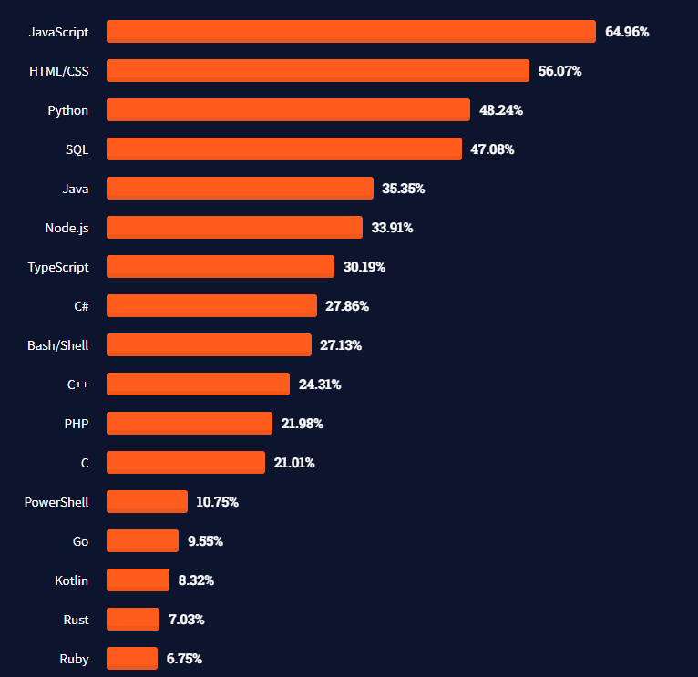
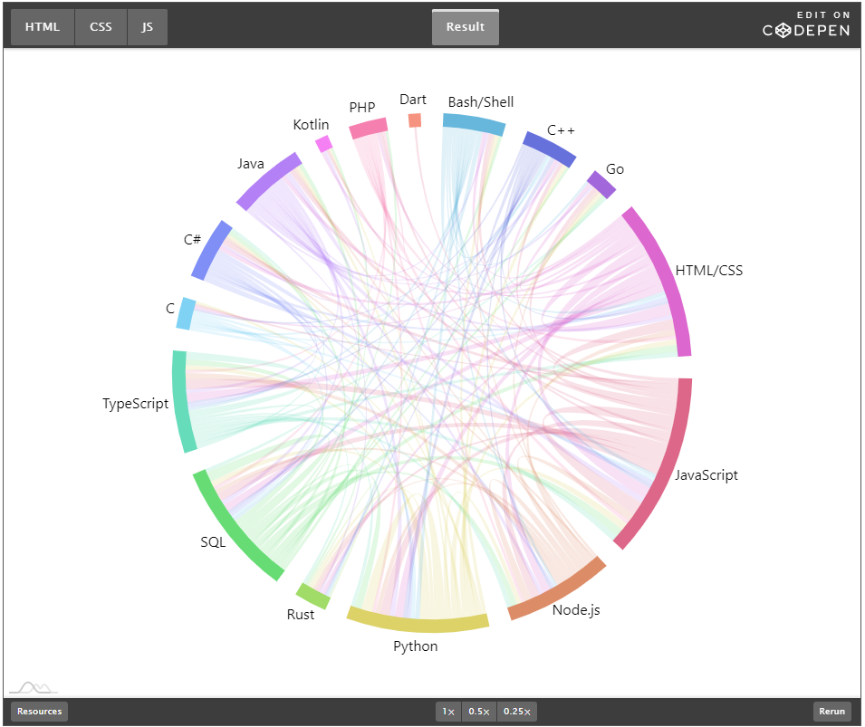
Learning a new language.
The most used languages, 2021
https://insights.stackoverflow.com/survey/2021#technology-most-popular-technologies
https://stackoverflow.blog/2021/08/02/2021-stack-overflow-developer-survey-results/

Slide 22

HTML.
HT. Hypertext.
As in http:// (Hypertext Transfer Protocol)
ML. Markup language
1993. Invented at CERN by Tim Berners-Lee.
1994. Dave Raggett (Hewlett Packard, Bristol), develops HTML+ and Arena browser.
1995. WC3 guidelines published, to end browser wars.
Big idea. The HT in the name is the big idea. There were lots of markup languages (SGML for example) but TBN idea was to link documents together, it added hyperlinks.
Tim Berners-Lee. Image: CERN
https://home.cern/science/computing/birth-web/short-history-web
https://www.vanityfair.com/news/2018/07/the-man-who-created-the-world-wide-web-has-some-regrets

Slide 23
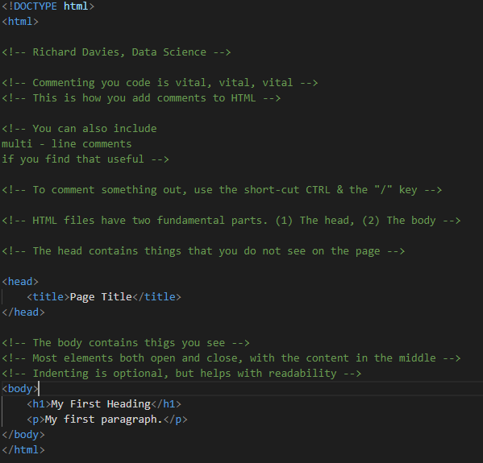
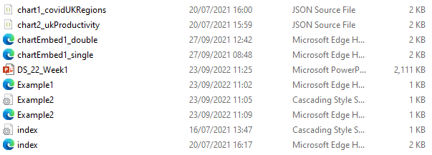
HTML example.
All code examples are in the course Dropbox

Slide 24
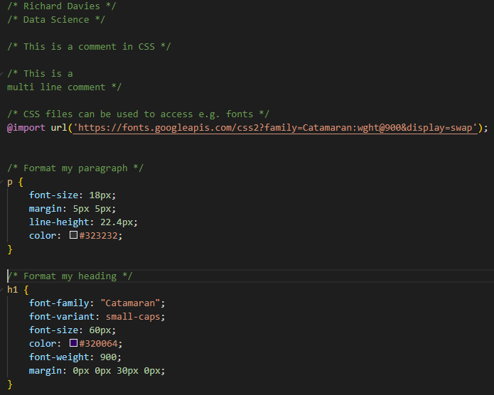

CSS.
Cascading Style Sheets
1994. First proposal – again at CERN.
Håkon Wium Lie, 12 December 1995
https://www.w3.org/Style/CSS20/history.html

Slide 25
Putting HTML and CSS together. To link your HTML page to a CSS file you specify the location in the head section of your page. <!-- Here is the head section --> <head> <title>Page Title</title> <!-- Link to my CSS file --> <link rel="stylesheet" href="Example2.css"> </head> Your page will now have the styles set out in the CSS file.

Slide 26
JavaScript.
1995. JS launched by Netscape. Brief war with Microsoft before widespread adoption.
Brendan Eich. Key role in development of JS. Now used in almost all (>95%) of web sites. Interesting podcast discussion here.
Interactivity. JS allows us to make web sites interactive. Changing what the web site looks like and does in response to our choices.
In Data Science. Some uses of JS.
Fetching data. Grab data from another site, via an API, when you open you page.
Cleaning and manipulating data. Prepare and analyse the data for use in a chart or table.
Visualising data. Display the data in a way you wish. There are lots of charting “libraries” that do this. We will use two (Vega Lite and Charts.js).
Interactivity. Make visualisations interactive + sites fun and engaging.

Slide 27
JSON data.
JavaScript Object Notation. An important data type. Why use it?
It is the way computers share data.
Most importantly it is what many APIs will deliver – your data will arrive to you in this way.
It looks complicated at first, but is easy to convert into access, change and chart.
Formatted as key : value pairs (aka name : value pairs)
'{"name":“Richard", “kids":2, “team":“Manchester United”, “address”:null}’
Keys are strings, always in double quotes.
Values can be many things: string, number, arrays, objects.
Useful tools:
www.jsonlint.com. Test and format JSON.
JSON formatter. Chrome extension.

Slide 28
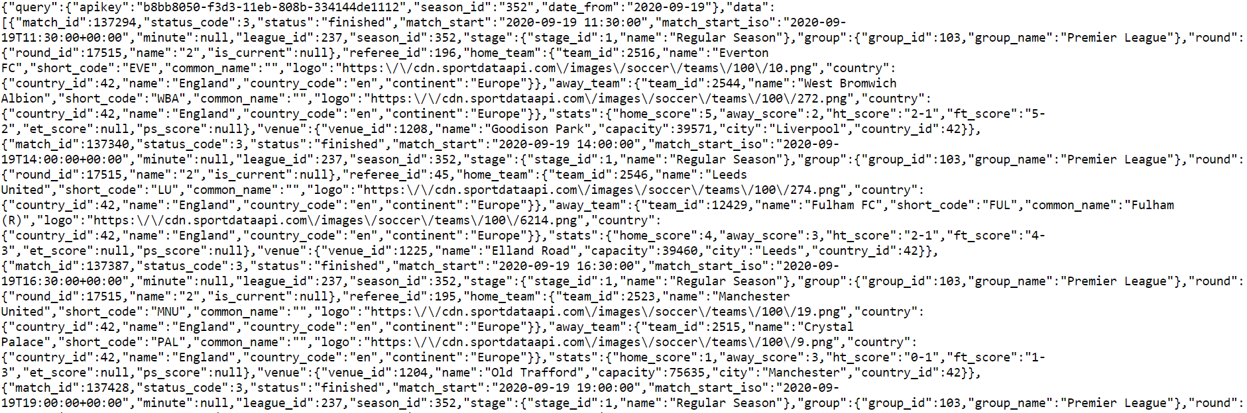
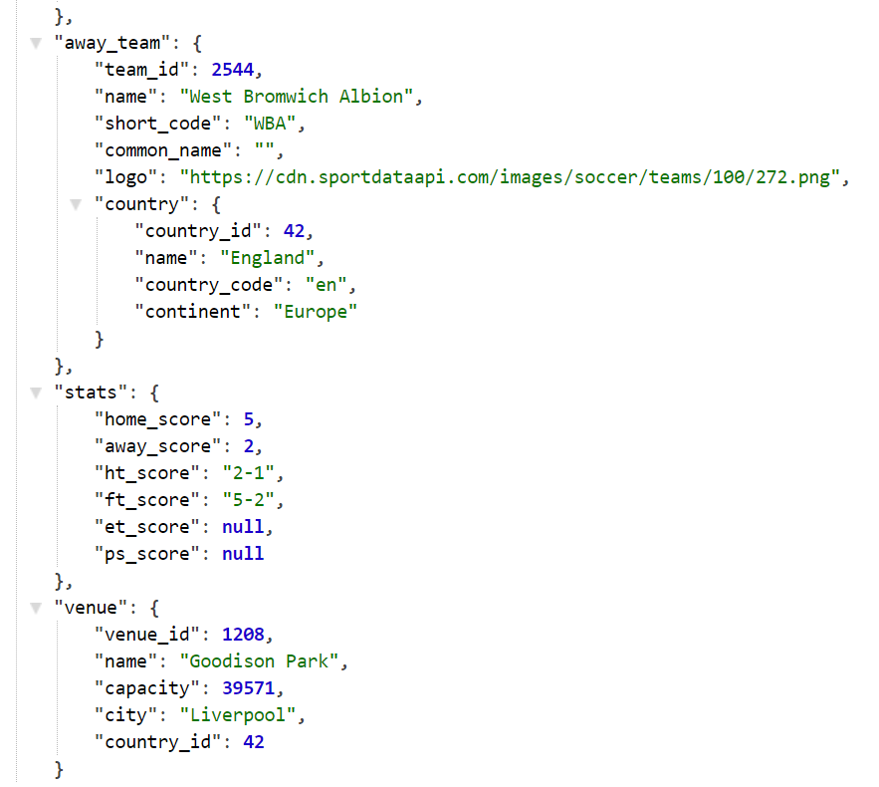
Raw.
Parsed.
API returns. The results of request to Sport Data API.

Slide 29
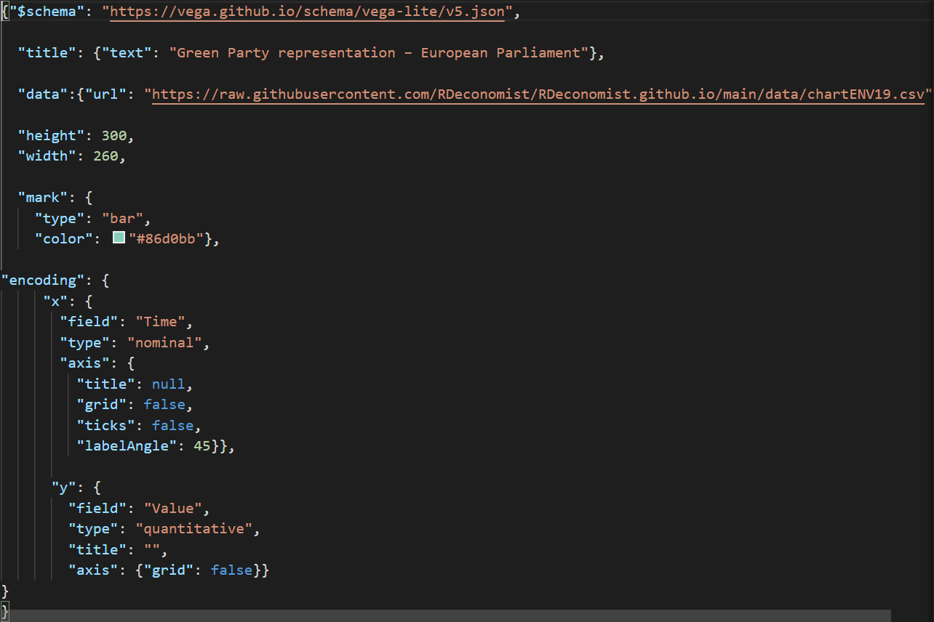
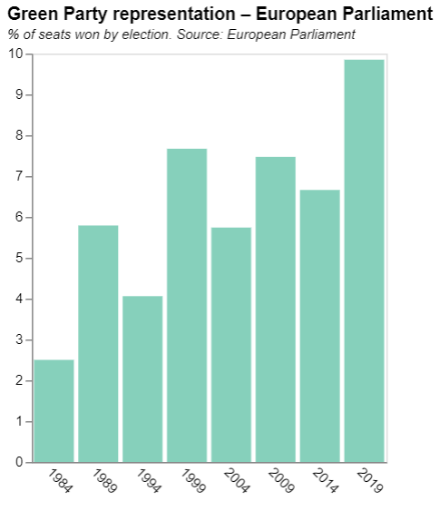
Charts as JSON.

Slide 31

Practical 1.
Set up your GitHub pages site.
Enter your details HERE.
Embed first two charts in your page.

