Slide 1


iVid
Anotate your YT videos
Јордaнчо Ефтимов
Јетон Рамадани
Ментор: Бобан Јоксимоски

Slide 2
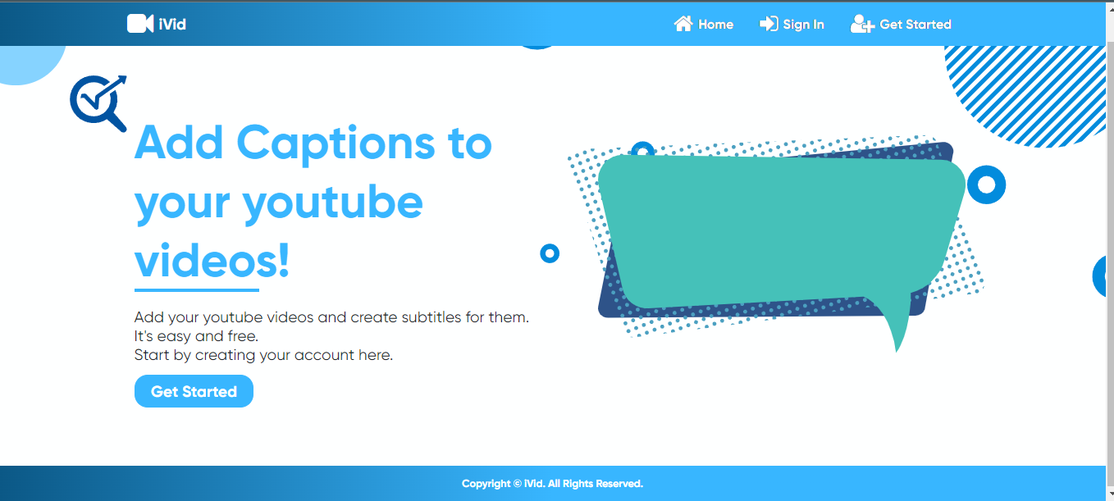



Slide 3

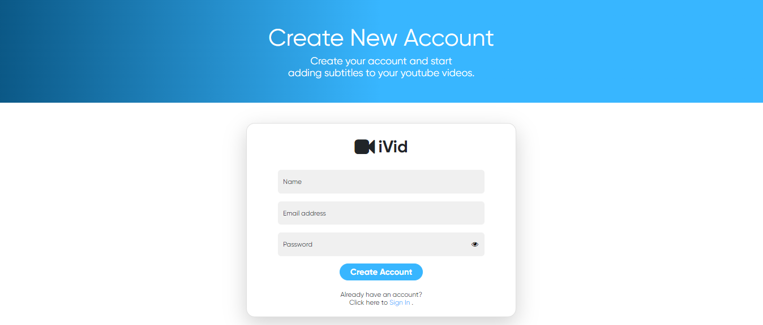
I have to enter a name, valid email address and also the length of password must be at least 8 characters
Example user
example@gmail.com
*********

Slide 5
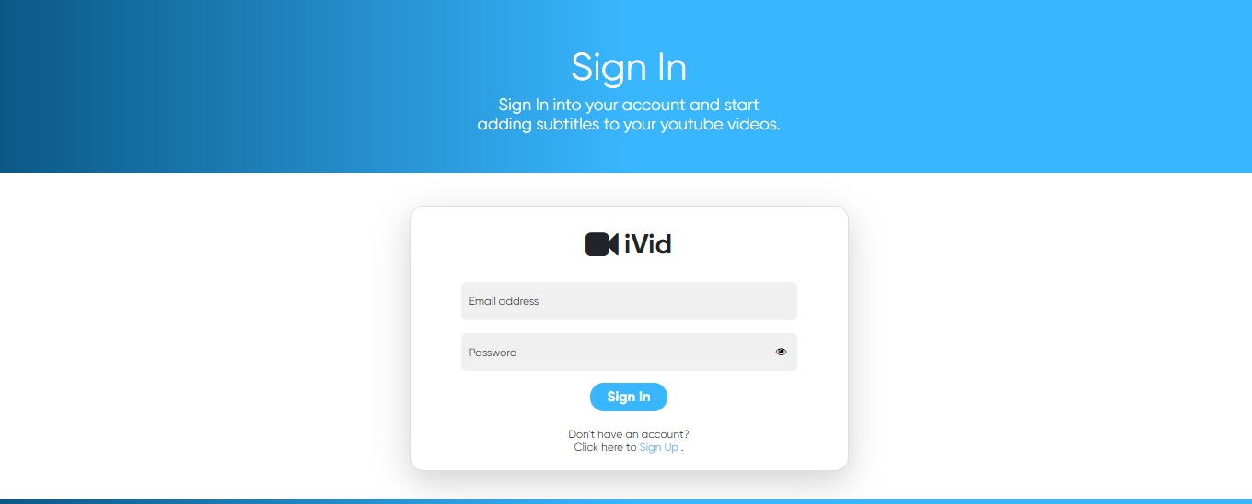
I have to enter the email and password I used during creation of my account,
example@gmail.com
*********

Slide 6
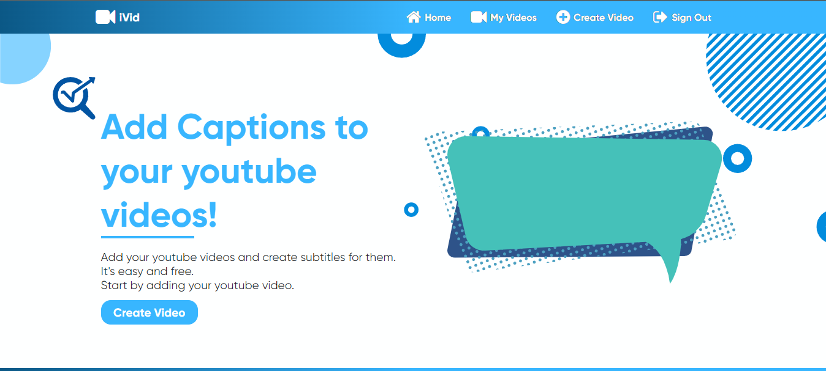
Now i can sign out, watch the videos i annotated and create a new video which can be annotated.

Slide 7
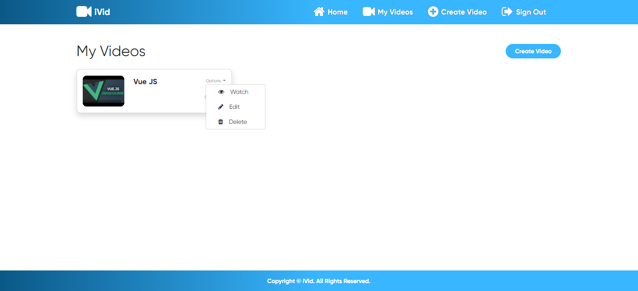
Now lets see the create video and edit video annotation part.

Slide 8
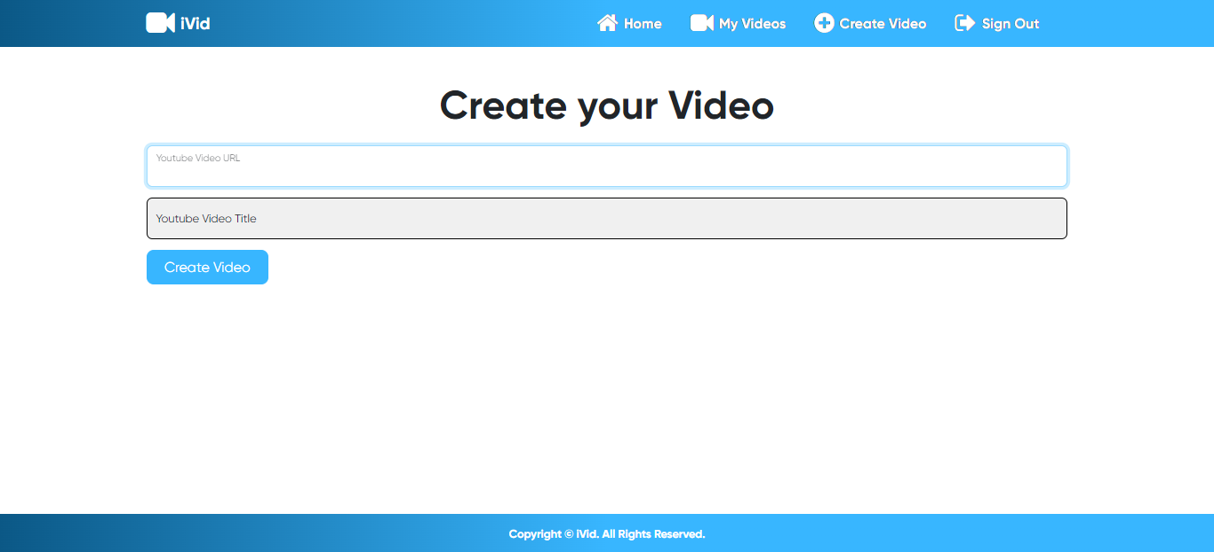
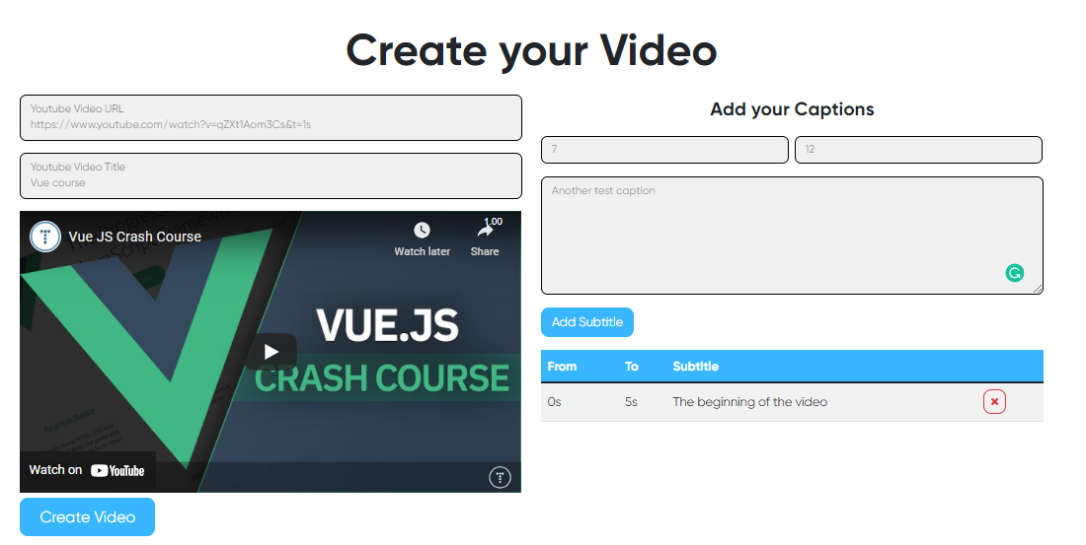
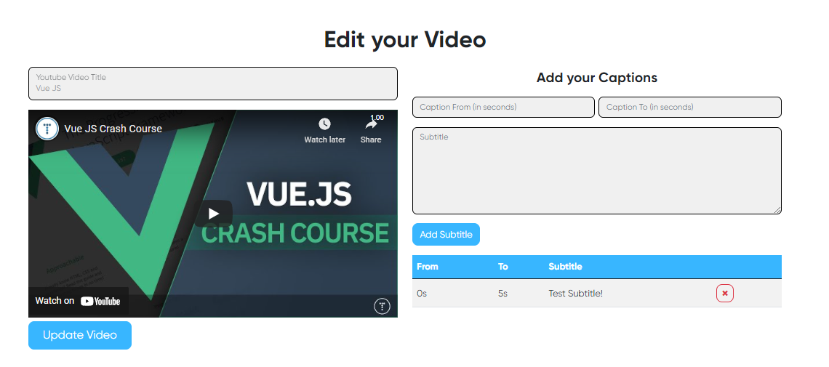
The create and update video are different on the submit button and during update you cant change the youtube source.
https://www.youtube.com/watch?v=qZXt1Aom3Cs&t=1s

Slide 9
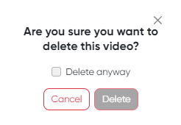
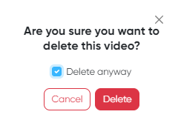
Its time to delete. Yay…
And the video is wiped out

Slide 10
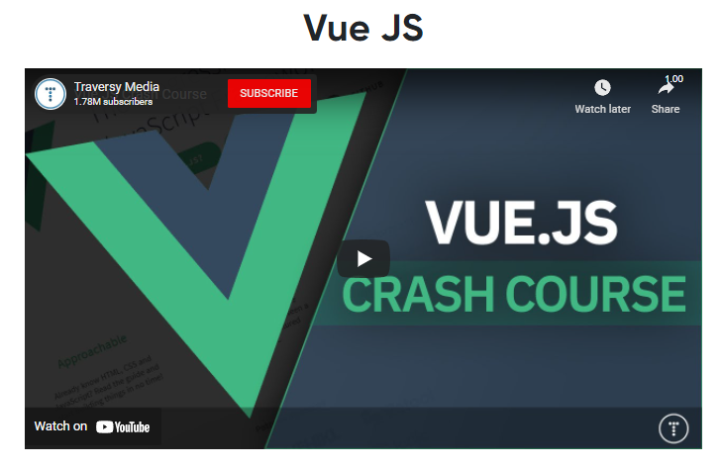
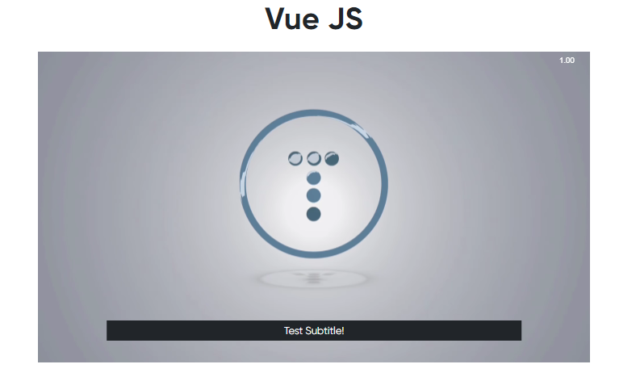
And now lets enjoy watching the video that we annotated.
Click play and enjoy

Slide 11
Thanks!
Any questions? You can find us at:
ejordancho@gmail.com
jeton.r123@gmail.com

