Slide 1
Day 4
Going Live
Jan, 31 2017
Notes:
‹#›

Slide 2
Check-Up Session
How’s it going?
After 1 week of Bootcamp, how are you holding up?
What feedback do you have so far?
Notes:
‹#›

Slide 3

Instructor Feedback
Seriously, mind-blown.
Notes:
‹#›

Slide 4
Instructor Feedback
Things I’ve noticed people doing incredibly well:
All of you are handling an enormous volume of information.
All of you are asking the right questions.
You notice the right details.
You all help each other out.
And, most importantly, you are figuring out things on your own.
Notes:
‹#›

Slide 5
A Few Admin Things…
Notes:
‹#›

Slide 6
Instructor Feedback
Remember, Homework #1 is due on Thursday before 6PM.
Homework Link: http://www.bootcampspot.com/homework
Remember to submit Homework via GitHub (and Heroku)
And seriously!
Submit whatever you have! Don’t get a 0.
(Even if you don’t like what you’ve made.)
Notes:
‹#›

Slide 7
Office Hours + Additional Help
Also, remember….
In Class Office Hours: 45 minutes before class, 30 minutes after.
Review In Class Material (Exercises and Slides): http://gt.bootcampcontent.com/GT-Coding-Boot-Camp/01-17-SAV-Class-Content
Re-Watch Class Videos:
Slack Channel: #live-webcast-sav

Slide 8
Recapping

Slide 9

Recap
In just one whirlwind week we’ve covered:
Full-Stack Development Conceptually
Terminal / Git Bash
HTML Syntax
Git Concepts and Commands
CSS Purpose, Syntax, and Styles
Floating
Positioning
Box Model
Google Dev Tools
How to learn on Your own!!

Slide 10
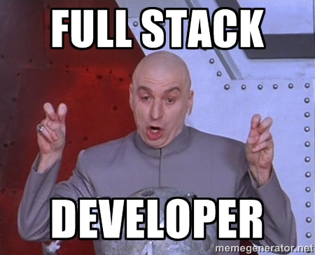
Full-Stack Development?

Slide 11
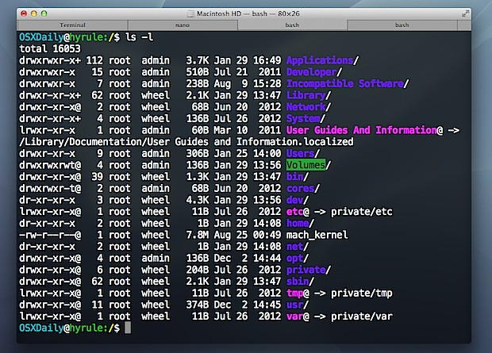
> Intro to Console

Slide 12

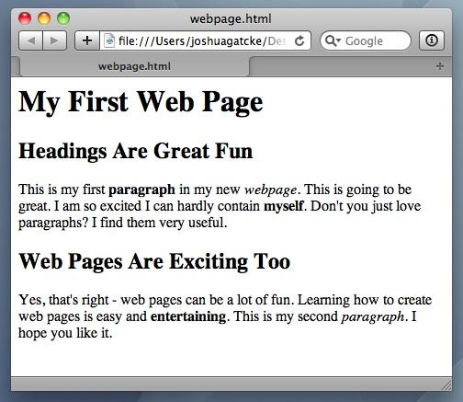
<title> Intro to HTML </title>
HTML is one of the three base languages behind every single website.
It defines all of the basic content and a bit of formatting.

Slide 13



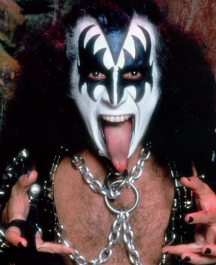

Pushing and Pulling to GitHub
1
2
3
4
GitHub Branch
Pull Code
Push Code
Pull Code
Pull Code
Push Code
Pull Code
Push Code

Slide 14
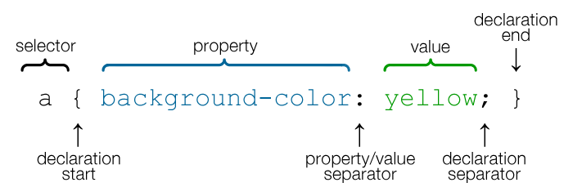
CSS Syntax
CSS works by hooking onto selectors added into HTML using “classes and identifiers”.
Once hooked, we apply styles to those HTML elements using CSS.

Slide 15
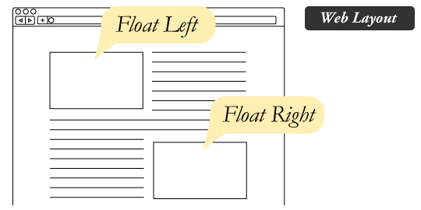
The Concept of “Flow”
In HTML/CSS, (by default) every element displayed is governed by a concept called “flow.”
This means that HTML elements force their adjacent elements to flow around them.

Slide 16
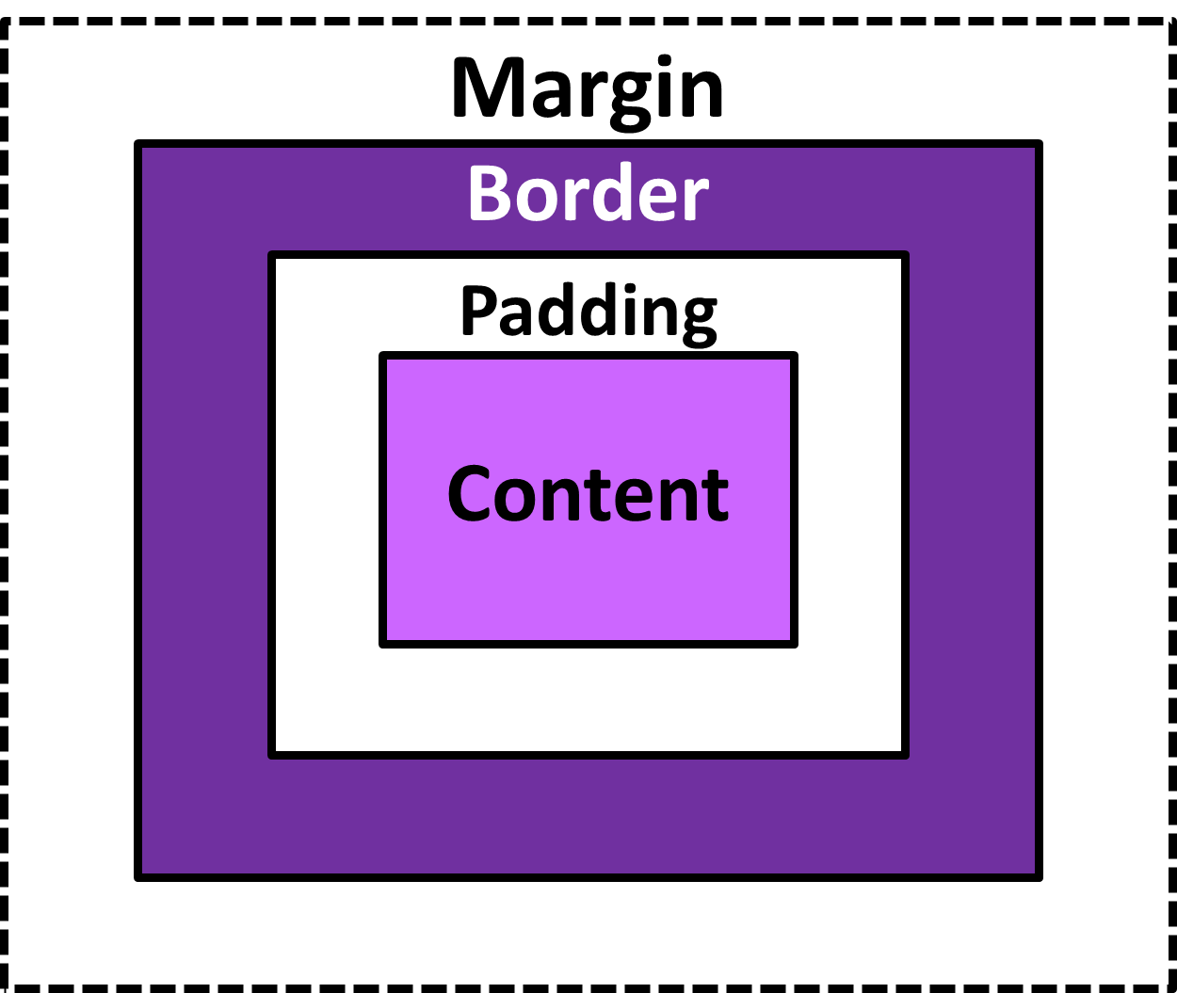
The Box Model
The Box Model wraps every CSS element in padding, border and margin – allowing developers to modify spacing styles.

Slide 17
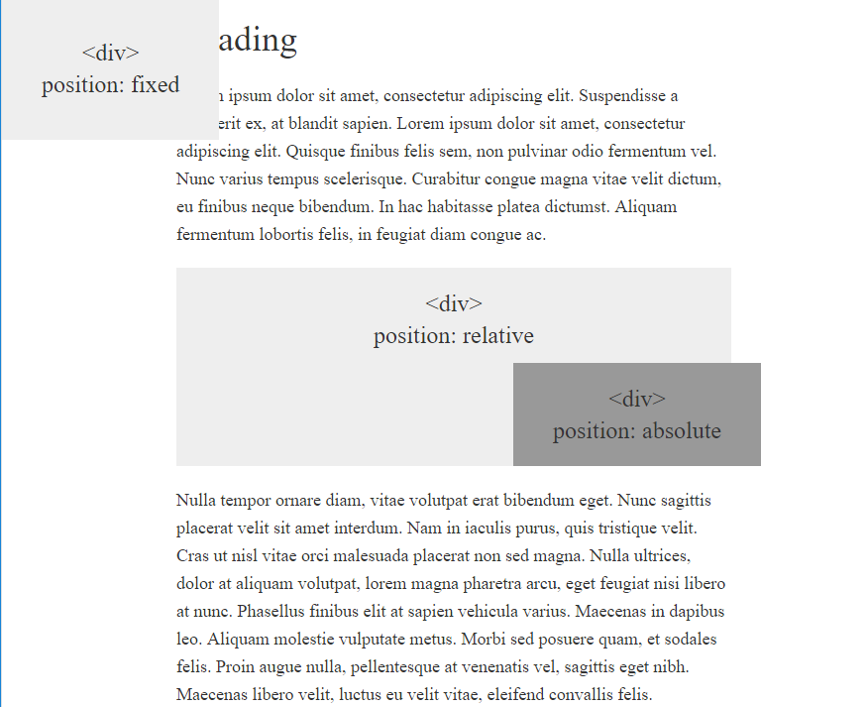
CSS Positioning
We can orient our HTML elements in relation to space with CSS positioning (static, relative, fixed, absolute).

Slide 18









How to Learn…

Slide 19

General Questions / Issues?

Slide 20
Double Take

Slide 21
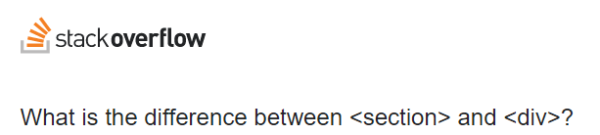
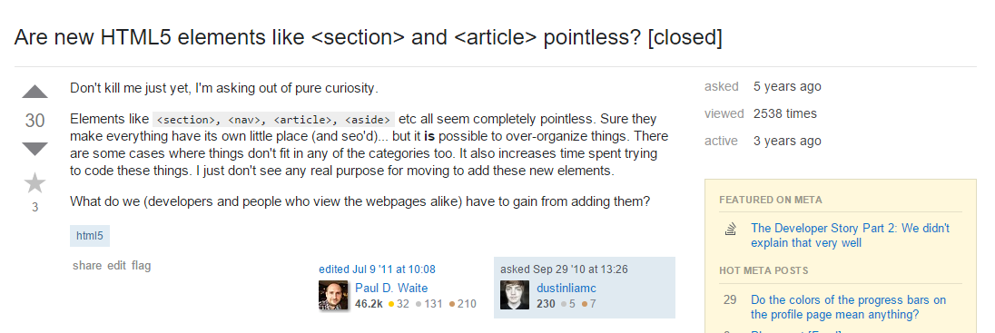
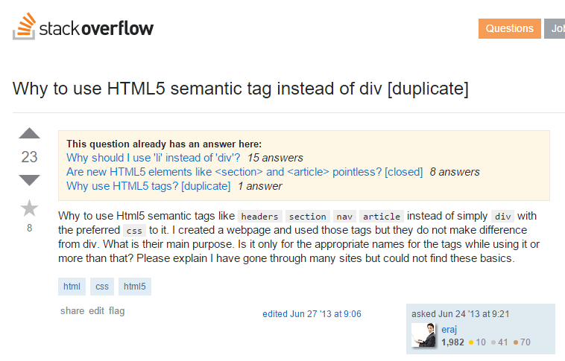

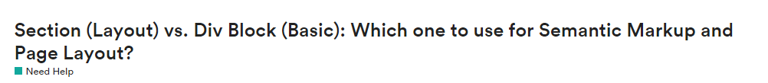
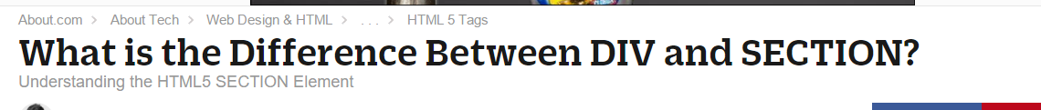
Divs, Sections, Navs, Etc….

Slide 22
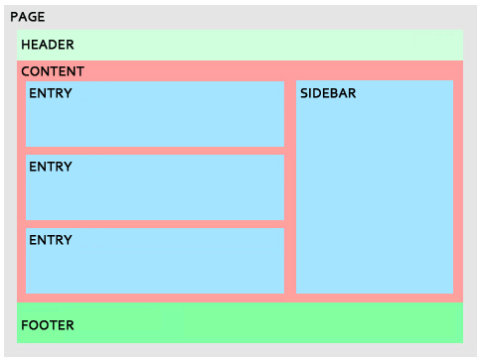
Divs, Sections, Navs, Etc….
All web layouts are inherently composed of containers, traditionally called “divs.”

Slide 23
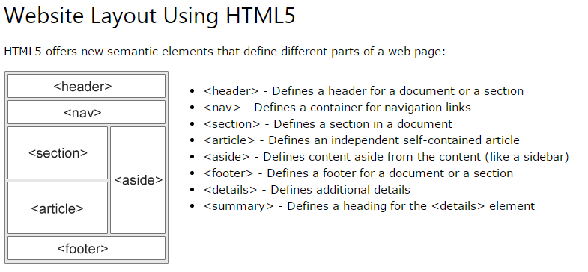
Divs, Sections, Navs, Etc….
HTML5 introduced the concept of “semantic layouts,” meaning “divs” could be given more meaningful names.
In theory, this helps with organization and search engine optimization.

Slide 24
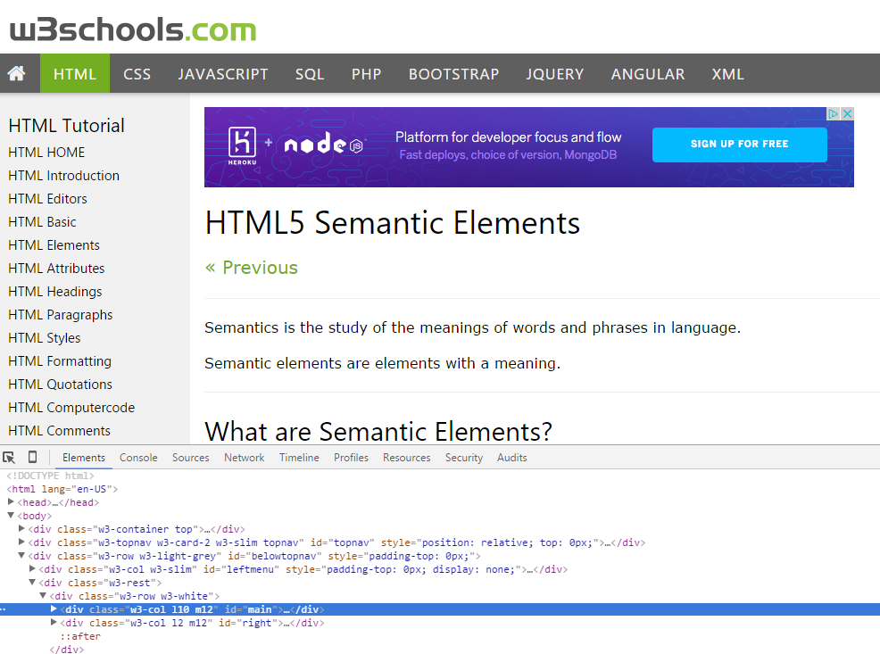
Divs, Sections, Navs, Etc….
That said… many (if not most) websites, seem to still be using basic divs.
There are reasons for this that we’ll showcase in later sections.
Additionally, it’s possible to include “semantics” by using id names and classes.

Slide 25
Divs, Sections, Navs, Etc….
div?
Section?
Bottom line: Follow your homework’s instructions. But when you get out in the “real world,” follow the convention of where you work!

Slide 26

Classes vs. IDs
Classes = Barcode (all iPods)
IDs = Serial Number (unique iPod)
When choosing between a CSS ID and a CSS Class follow the convention:
Classes (.classname) are to be used if the same style will be used on multiple HTML elements.
IDs (#idname) are to be used if a style is unique to that HTML element.

Slide 27
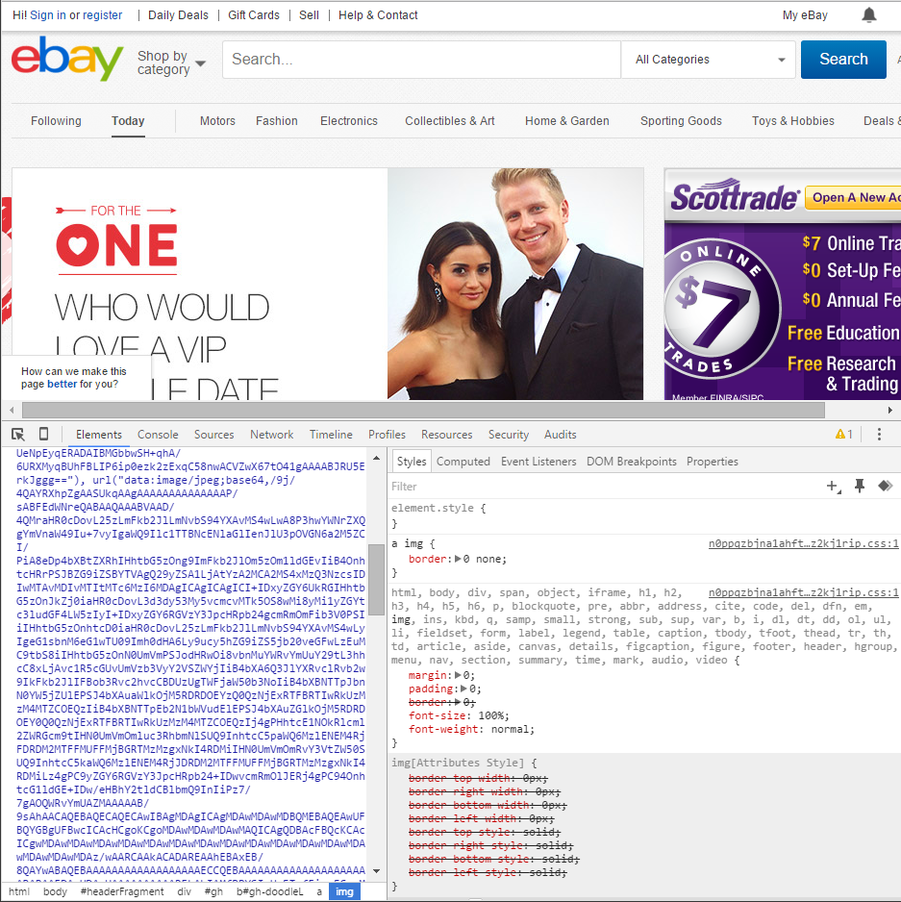
Google Developer Tools (Inspector)
GDT is one of the most frequent tools you will use in web dev.
It allows you to truly, debug your web designs.
Start using it!

Slide 28
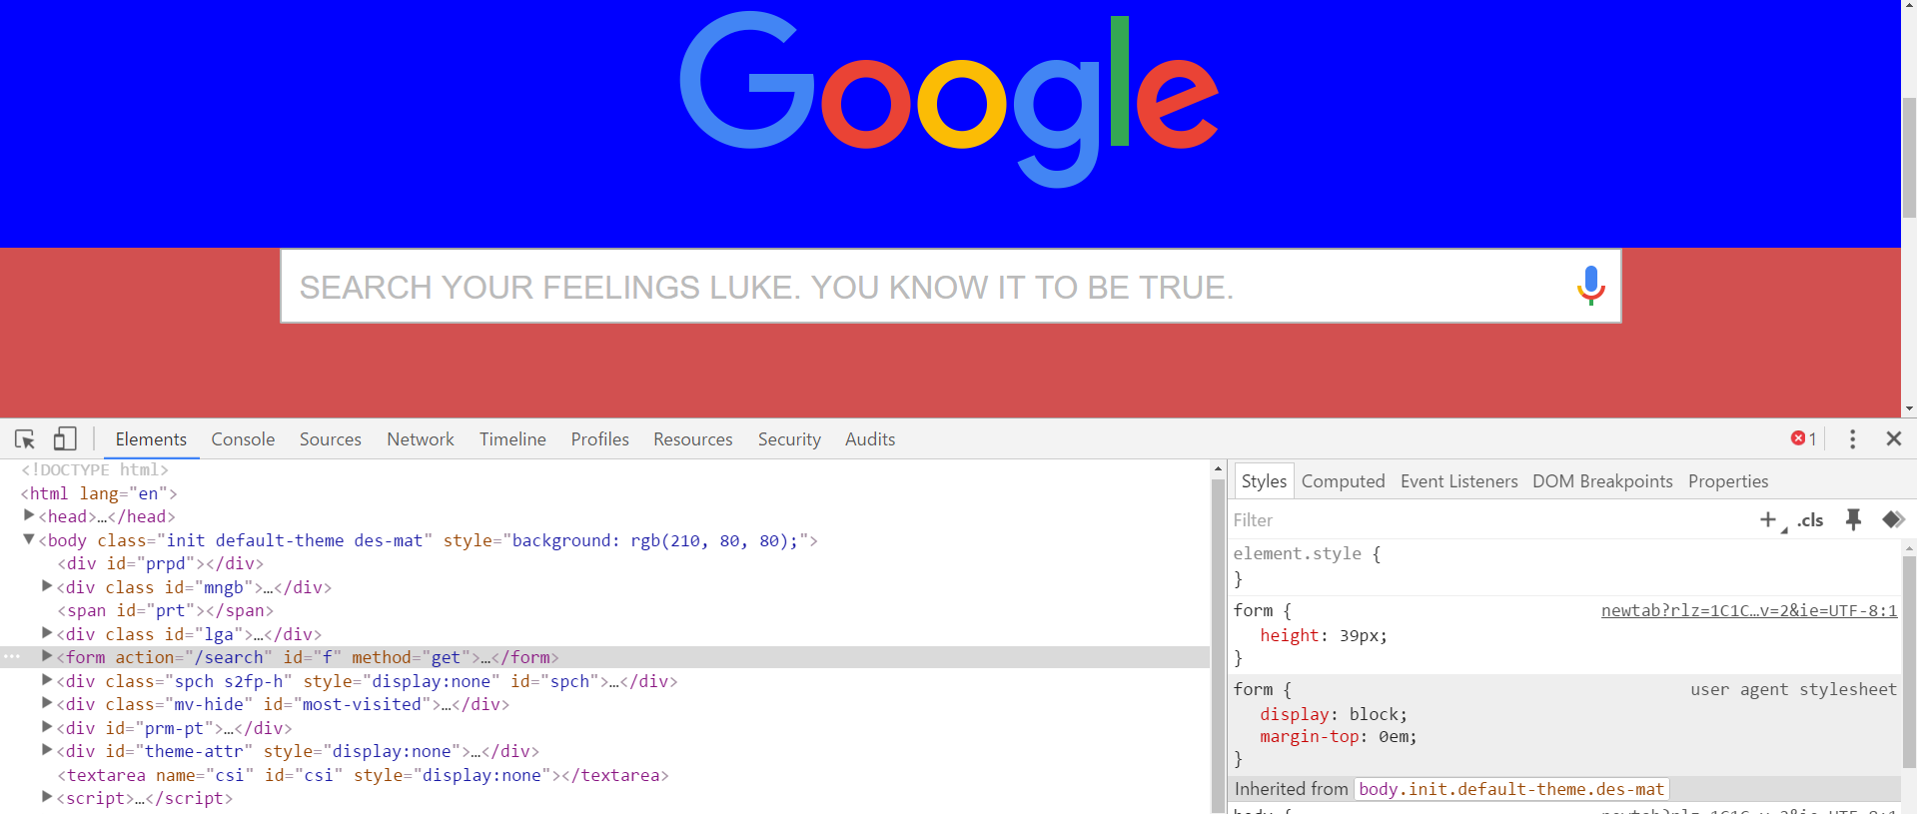
Modifying Sites
You can edit any web page’s HTML and CSS with Chrome Inspector.
Plus, you’ll see your results instantly.

Slide 29
INSTRUCTOR DEMO!
Instructor: Demo
(Google Developer Tools)
Notes:
‹#›

Slide 30
> YOUR TURN!!
Suggested Time: 15 min
Assignment
For the next 15 minutes, take a website you commonly use (Amazon, Google, Huff Po, etc.) and heavily modify it using the Google Developer Tools.
Be sure to at least modify:
Content (Change words)
Colors
Spacing
Send a screenshot to the class’s slack profile when you’re done.

Slide 31
> YOUR TURN!!
Suggested Time: 10 min
Assignment
For the next 10 minutes, edit any site that you’ve been working on in-class or for homework with Google’s dev tools.
Be sure to at least modify:
Content (Change words)
Colors
Spacing

Slide 32
CSS Resets
Notes:
‹#›

Slide 33
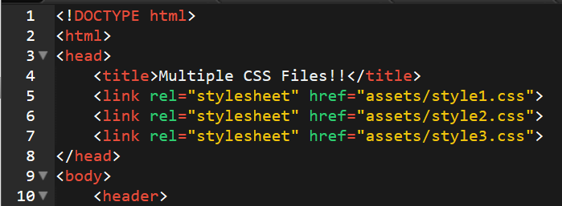
Loading Multiple CSS Files ***(Very Important!!!)***
An incredibly powerful technique: using multiple CSS files (aka stylesheets) simultaneously.
This lets developers to create complex designs made up of abounding design elements.
Just remember: the loading order matters!!!
Notes:
‹#›

Slide 34
INSTRUCTOR DEMO!
Instructor: Demo
(1-3_CSSFiles.html | 1-MultipleCSS)
Notes:
‹#›

Slide 35
What Browser?
By a show of hands…
Which browser do you use?
Notes:
‹#›

Slide 36
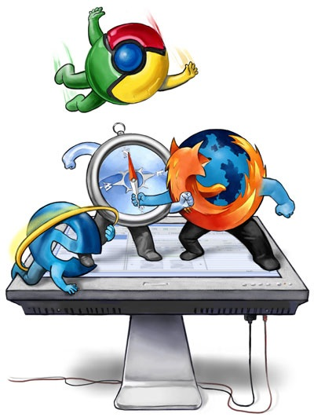
Battle of the Browsers
Under the hood, web browsers often render web pages differently than their competition.
These disparities could mean HTML/CSS displaying differently in each web client.
Because of these potential divergences, web developers need to make their websites cross-browser compatible.
Notes:
‹#›

Slide 37
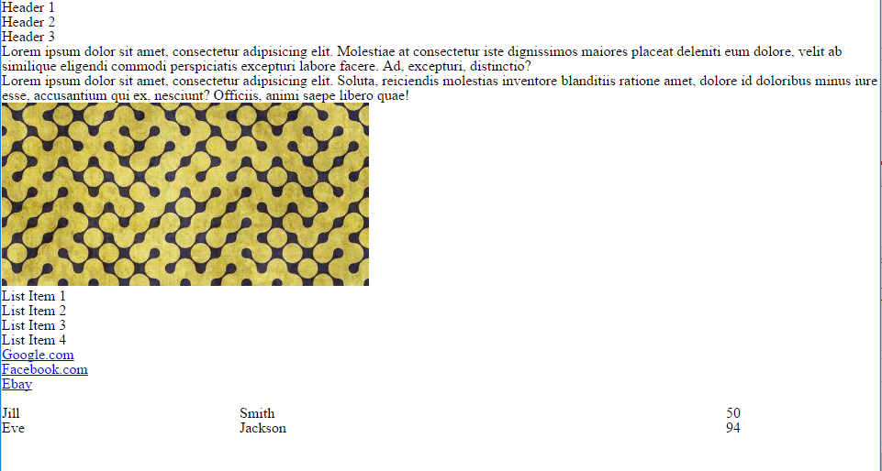
Reset.css (or Normalize.css)
Reset.css will “reset” all browser-specific CSS. This means your site will appear the same in all browsers.
However, you will have to re-style everything yourself.
Notes:
‹#›

Slide 38
INSTRUCTOR DEMO!
Instructor: Demo
(Example.html | 2-ResetCSS)
Notes:
‹#›

Slide 39
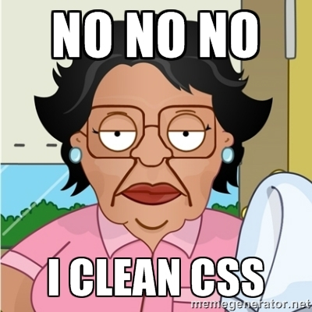
Why CSS Resets Matter
It’s important for creating browser-compatible websites
It’s an example of using someone else’s CSS in your website!!!
It’s a common Front-End Developer Interview question.
Notes:
‹#›

Slide 40
Why CSS Resets Matter
It’s important for creating browser-compatible websites
It’s an example of using someone else’s CSS in your website!!!
It’s a common Front-End Developer Interview question.
Notes:
‹#›

Slide 41
> YOUR TURN!!
Suggested Time: 10 min
Assignment
Follow the instructions given via slack to incorporate a reset.css file into a basic HTML file.
Note the impact the reset file makes after its inclusion.

Slide 42
To the Web with Heroku!
Notes:
‹#›

Slide 43
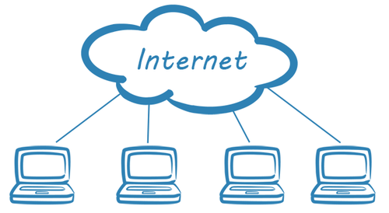
The Internet
A deep and complex diagram above on how the internet works.
Notes:
‹#›

Slide 44

The World Will See Our Greatness!
Heroku provides a cloud application hosting platform – which means we can deploy our websites and applications onto their servers for the world to see.
Notes:
‹#›

Slide 45
Together Now…
Let’s all login to Heroku
Notes:
‹#›

Slide 46
INSTRUCTOR DEMO!
Instructor: Demo
(Heroku Deployment)
Notes:
‹#›

Slide 47
Deploying Static Websites to Heroku
Basic Steps:
Go to folder you want to host (must be .git enabled).
Add a file called composer.json and include an empty bracket {}.
Add a file called index.php with the following inside:
Add and Commit new files to git (git add -A, then git commit -m “hi”)
Run Heroku login (for windows users, remember the workaround!).
Run git remote –v.
Run heroku create.
Run git remote –v.
Run git push heroku master.

Slide 48
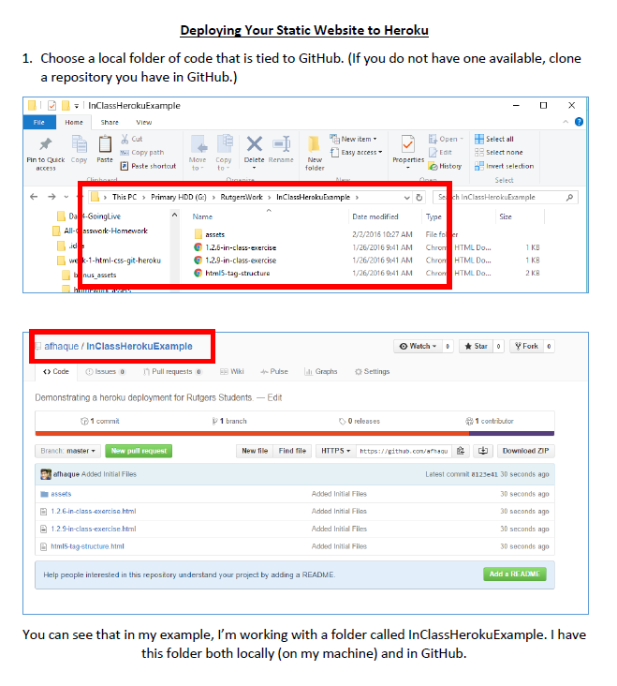
Follow our Guide!
Step-by-Step Guide
on Creating Heroku Deployments

Slide 49
> YOUR TURN!!
Suggested Time: 30 min
Assignment
Time to take your newfangled website and deploy it to the cloud. Setup your own instance of Heroku and deploy one of your HTML creations to Heroku.
Additional instructions to be sent via Slack.

Slide 50
Practice Through Frustration
Keep Practicing!
It gets better.
Notes:
‹#›

Slide 51
Questions?
Notes:
‹#›

Slide 52
Homework 1 - Help?
Notes:
‹#›

Slide 53
EXTRA MATERIAL
Notes:
‹#›

Slide 54
And Back to Git…
Notes:
‹#›

Slide 55

The Group Project
OMG. I HAZ THE GREATEST HTML IDEA!!!!!
SpongeSite.com
Notes:
‹#›

Slide 56

The Group Project
Programming Away…
Spongebob’s idea is dumb. We should call it…
PrincezzzSite.com
Notes:
‹#›

Slide 57
The Group Project
– Tragedy #1
Programming Away…
Now they have two completely different versions.
Programming Away…
Notes:
‹#›

Slide 58
The Group Project – Push vs Pull
Main Branch (Spongebob’s)
Spongebob continues programming
1
2
3
4
5
This is NON-IDEAL
Prince pushes his code changes into the main branch.
If Prince is allowed to push his code, it could seriously ruin Spongebob’s vision and working code.
Prince’s Branch
Notes:
‹#›

Slide 59
The Group Project – Push vs Pull
Main Branch (Spongebob’s)
Spongebob continues programming
1
2
3
4
5
Prince’s Branch
Notes:
‹#›

Slide 60
The Group Project – Push vs Pull
Main Branch (Spongebob’s)
Spongebob continues programming
1
2
3
4
5
Ideal Approach – Using Pull Requests
Because Spongebob controls the “master branch” he must elect to pull Prince’s Code. All Prince can do is submit a “pull request”
This is the ideal way to maintain code in version control.
?
Prince’s Branch
Notes:
‹#›

Slide 61
General Steps for Git Pull Requests
Create a new branch of on your local computer git branch <BRANCH NAME>
Checkout that branch (locally) on your machine git checkout <BRANCH NAME>
Add / Commit your changes (will automatically save to this branch) git add –A git commit –m “Comment”
Push your branch to GitHub git push origin <BRANCH NAME>
Submit a Pull Request on GitHub
Other user must accept these changes on GitHub

Slide 62
INSTRUCTOR DEMO!
Git Pull Request
Notes:
‹#›

Slide 63
> YOUR TURN!!
Assignment
Time to take your newfound collaborative git skills to the real-world. Find a partner and follow the steps sent via slack to
Share each other’s code
Make modifications
Submit a Pull Request
Accept the Pull Changes

Slide 64
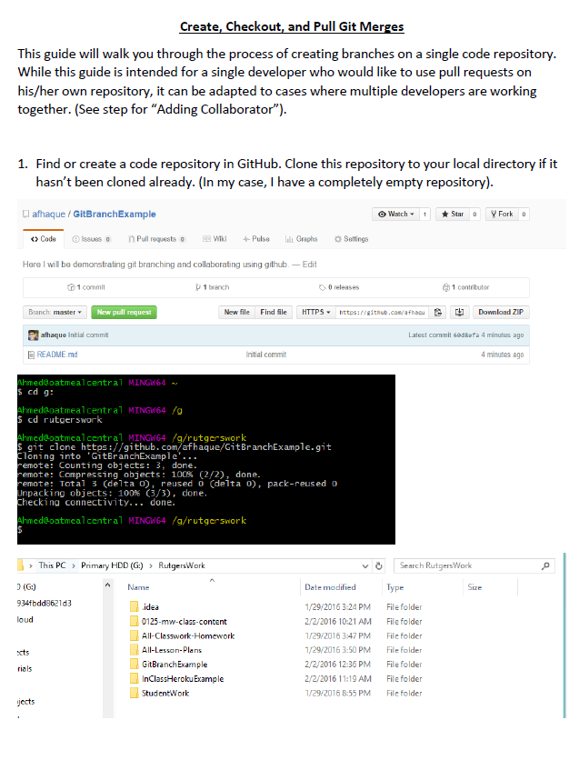
Follow our Guide!
Step-by-step guide
on creating Git Pull Requests

Slide 65
Don’t Worry!
We’ll be coming back to this.
You won’t need this fully until Week 8.
Notes:
‹#›

Slide 66
Practice At Home
But practice when you can!
You don’t need a partner to submit pull requests!
Notes:
‹#›

