Slide 1

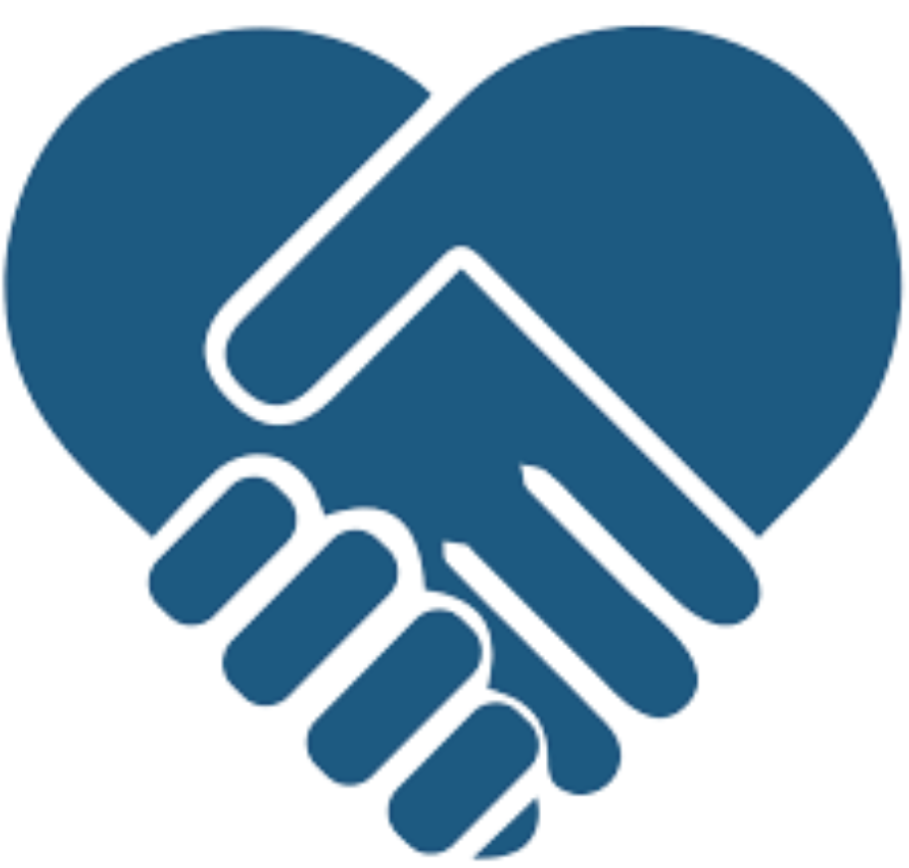

MyHealth Story: The Next Chapter of MyHealth (Patient Portal)
Team 8: MyHealth Storytellers

Slide 2


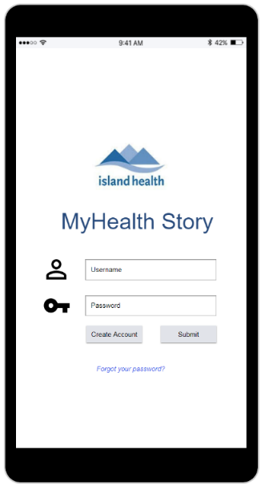
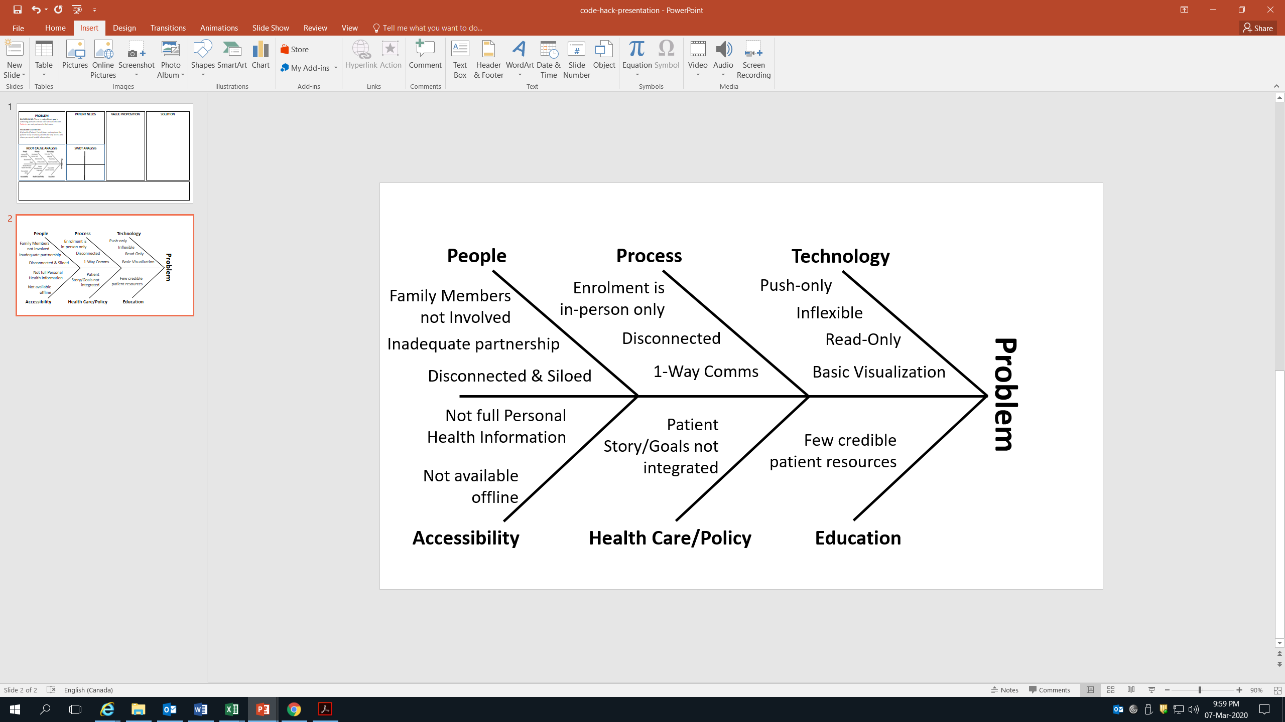






MyHealth Story: The Next Chapter of MyHealth (Patient Portal)
Team 8: MyHealth Storytellers
PROBLEM
Background: There is a significant gap in achieving person-centred care at Island Health. Patients are not partners in their care.
Problem Statement:
MyHealth (Patient Portal) does not capture the patient story or allow patients to fully access and share personal health information.
Impact: Patients, families, and care team are insufficiently prepared for person-centred care.
CLIENT NEEDS
VALUE PROPOSITION
SOLUTION
PROBLEM
CLIENT NEEDS
VALUE PROPOSITION
SOLUTION
Wants
Gain Creators
To be empowered
To be engaged
To be seen & heard
Informed & Activated Patient
Share Patient Story
Patient-annotated data
Care coordination
PROMS (patient-reported)
An interactive app that:
Enables patients to be partners in care
Pulls and pushes patient data
Enhances patient and care team preparation for person-centred care
Needs
Concerns
Products
& Services
To share story
Connect with data everywhere every time, even offline
Usability
Security
Data quality
Increased Accessibility
2-way comms.
Pain Relievers
SWOT ANALYSIS
ROOT CAUSE ANALYSIS
SWOT ANALYSIS
More flexible data visualization
Reduced hospital overutilization
Reduced costs
Patient goals integrated with care
More patient resources
ROOT CAUSE ANALYSIS
Strengths
Weaknesses
- Modular Design
- Few clicks
- End-User Support
- Evidence
- Read (Push) only
- Unavailable offline
- No Patient story
- Limited features
FEASIBILITY ANALYSIS
FEASIBILITY ANALYSIS
Go/No-Go Analysis
Challenges
Can it be implemented?
- Yes! Used in multiple care settings.
Opportunities
Threats
Key Points of Differentiation:
Two-Way Interaction
Patient Annotation
Offline Access
- Enhancements
- Push & Pull data
- Offline access
- Partnership
- Privacy & Security
- Tech. adoption
- Funding; Competitors
- Competing Priorities
Can it be scaled?
- To include other health authorities
People
Technology
Can it be spread?
- To other jurisdictions
Policy
Funding
IMPLEMENTATION ROADMAP
IMPLEMENTATION ROADMAP
PROJECT TEAM PROFILE
Phase 0: Code Hack
(March 7-8, 2020)
Phase 1: Patient-Created Roadmap (March, 2021)
Phase 2: Health Record API Integration & Data Visualization (March 2023)
Phase 3: Integration with other Health Authorities (March 2025)
Phase 0.5: Prototyping, Piloting, and Evaluation (August 2020)
- Integration Expert
- Project Manager
- Policy Expert

Slide 3

MyHealth Story: The Next Chapter of MyHealth (Patient Portal)
Team 8: MyHealth Storytellers
CLIENT NEEDS
VALUE PROPOSITION
SOLUTION
PROBLEM
Background: There is a significant gap in achieving person-centred care at Island Health. Patients are not partners in their care.
Problem Statement:
MyHealth (Patient Portal) does not capture the patient story or allow patients to fully access and share personal health information.
Impact: Patients, families, and care team are insufficiently prepared for person-centred care.
SOLUTION
PROBLEM
VALUE PROPOSITION
SOLUTION
CLIENT NEEDS
SOLUTION
Wants
Gain Creators
To be empowered
To be engaged
To be seen & heard
An interactive app that:
Enables patients to be partners in care
Pulls and pushes patient data
Enhances patient and care team preparation for person-centred care
Informed & Activated Patient
Share Patient Story
Patient-annotated data
Care coordination
PROMS
An interactive app that:
Enables patients to be partners in care
Pulls and pushes patient data
Enhances patient and care team preparation for person-centred care
Needs
Concerns
Products
& Services
To share story
Connect with data everywhere every time, even offline
Usability
Security
Data quality
Increased Accessibility
2-way comms.
Pain Relievers
SWOT ANALYSIS
ROOT CAUSE ANALYSIS
SWOT ANALYSIS
More flexible data visualization
Reduced hospital overutilization
Reduced costs
Patient goals integrated with care
More patient resources
ROOT CAUSE ANALYSIS
Strengths
Weaknesses
- Modular Design
- Few clicks
- End-User Support
- Evidence
- Read (Push) only
- Unavailable offline
- No Patient story
- Limited features
FEASIBILITY ANALYSIS
FEASIBILITY ANALYSIS
Go/No-Go Analysis
Challenges
Can it be implemented?
- Yes! Used in multiple care settings
Opportunities
Threats
Key Points of Differentiation:
Two-Way Interaction
Patient Annotation
Offline Access
- Enhancements
- Push & Pull data
- Offline access
- Partnership
- Privacy & Security
- Tech. adoption
- Funding; Competitors
- Competing Priorities
Can it be scaled?
- To include other health authorities
People
Technology
Can it be spread?
- To other jurisdictions
Policy
Funding
IMPLEMENTATION ROADMAP
IMPLEMENTATION ROADMAP
PROJECT TEAM PROFILE
Phase 0: Code Hack
(March 7-8, 2020)
Phase 1: Patient-Created Roadmap (March, 2021)
Phase 2: Health Record API Integration & Data Visualization (March 2023)
Phase 3: Integration with other Health Authorities (March 2025)
Phase 0.5: Prototyping, Piloting, and Evaluation (August 2020)
- Integration Expert
- Project Manager
- Policy Expert

Slide 4


