Slide 1
The Technology Value Stream
By Jordany Gonzalez
CSD-380

Slide 2
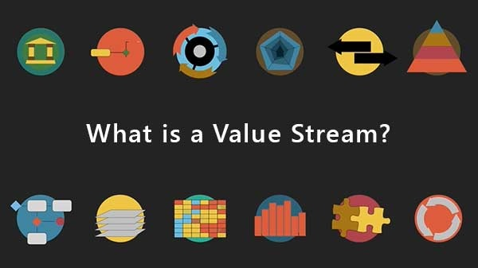
Introduction:
We will be exploring the concept of the Technology Value Stream in modern software development. I will be defining important topics such as lead time, explain common issues with deployment lead times, and try to illustrate how adopting DevOps practices can achieve faster, more efficient deployments

Slide 3
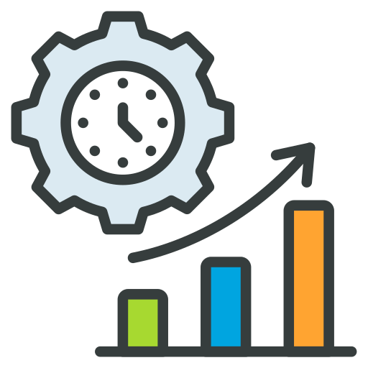
Tech Value Stream
The Technology Value Stream is the series of steps and processes uses in delivering a product or a service to customers through technology. This is usually used in software development and it includes planning, developing, testing, deploying, and maintaining software. The goal is to follow these steps as fast as possible with the utmost efficiency. Companies that focus on improving their value streams can reduce delays, minimize waste, and increase customer satisfaction

Slide 4
Lead time vs. Processing Time
In the Technology Value Stream, understanding the difference between lead time and processing time is essential for improving efficiency.
Lead Time: is the total time from when a customer makes a request to when the request is delivered.
Processing Time refers to the actual time spent actively working on the specific request.
Example: Imagine a customer orders a customs software feature on Monday. It takes two days to review the request, three more days to develop the feature, and one additional day for testing and deployment.
In this case, the lead time includes waiting periods, while processing time only accounts for hands-on work. Reducing lead time by streamlining handoffs and automating tasks can significantly improve customer satisfaction.

Slide 5

The Common Scenario: Deployment Lead Times Requiring Months
Many traditional organizations face long deployment lead times, sometimes taking months to release new software updates. This is often due to multiple handoffs between teams, manual processes, and rigid approval procedures. The result is a slow feedback loop, where customers must wait a long time to see new features or bug fixes. Additionally, long lead times can cause businesses to fall behind competitors, lose customer trust, and incur higher costs due to delays. In today's fast-paced digital world, months-long deployment cycles are no longer sustainable for businesses that want to remain competitive.

Slide 6
DevOps Ideal: Deployment Lead Times of Mintues
In contrast to traditional long deployment cycles, DevOps aims to reduce deployment lead times to minutes. By adopting practices like Continuous Integration/Continuous Deployment (CI/CD) and automating testing, building, and deployment processes, organizations can achieve fast and reliable releases. This means new features, bug fixes, and updates can be delivered almost immediately after development. With shorter lead times, businesses can respond faster to customer needs, reduce downtime, and improve overall system performance. This shift to rapid deployments is a core goal of the DevOps movement.

Slide 7
Lead Times Comparison
Traditional Process | DevOps Process
Lead Time: Several Months | Lead Time: Minutes
Manual Approval Steps | Automated Pipelines
Multiple Handoffs Between Teams | Collaborative Workflow
Slow Feedback | Fast Feedback Loops

Slide 8


Conclusion
The Technology Value Stream helps organizations deliver software and services efficiently by reducing delays and optimizing workflows. Understanding the difference between lead time and processing time is key to identifying areas for improvement. Traditional methods often result in slow, lengthy deployment cycles that hinder innovation and customer satisfaction. DevOps practices, such as automation and continuous integration, enable businesses to achieve faster, more reliable deployments. By focusing on shortening lead times and improving collaboration, companies can deliver value more quickly, respond to customer needs, and remain competitive in a fast-paced digital world.

Slide 9
References
Kim, G., Debois, P., Willis, J., & Humble, J. (2016). The DevOps Handbook: How to Create World-Class Agility, Reliability, and Security in Technology Organizations. https://dl.acm.org/citation.cfm?id=3044729
Beal, H. (n.d.). What is a Value Stream? https://www.vsmconsortium.org/blog/what-is-a-value-stream#:~:text=%E2%80%9CIn%20DevOps%2C%20we%20typically%20define,.%E2%80%9D%20(Learning%20to%20See)
Ely, R. (2022, January 19). Value Stream Management: Explained in Plain English. DevOps Institute. https://www.devopsinstitute.com/value-stream-management-explained-in-plain-english/

