Slide 1
Welcome to EasyModel!
This tutorial will teach you how to model and simulate a systems biology model.
In each slide you will find annotations, indicating how you can use the user interface.
Press next to start the tutorial (or press skip to use EasyModel).

Slide 2
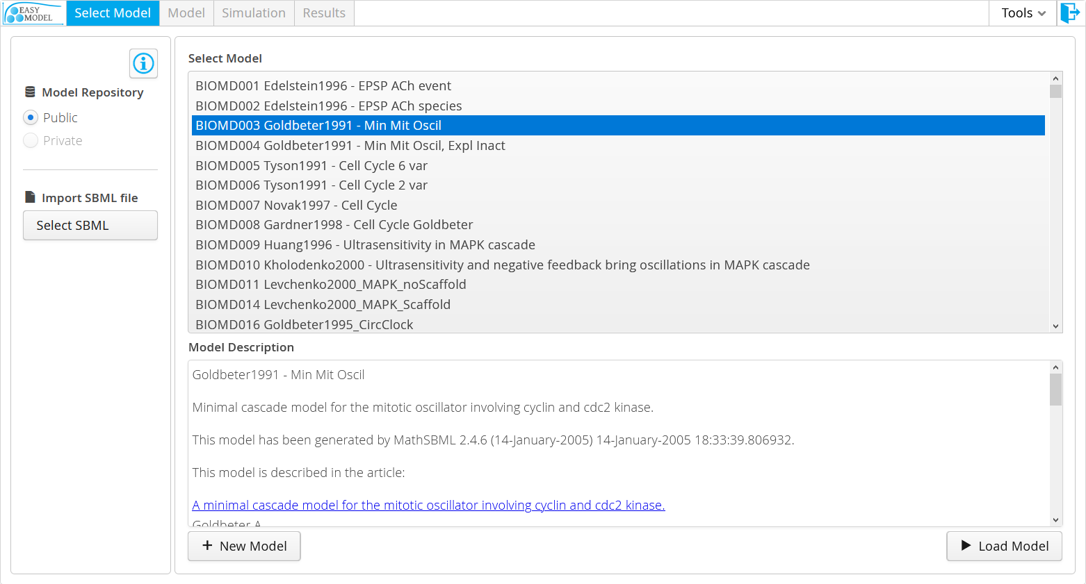
Information buttons can be found across the application
Step buttons: from model to simulation results
Log out
Public repository
Load and modify public models. Changes won’t be saved.
Private repository
Create and modify your personal models. Changes will be saved every time model is validated.
List of models
Import a model via a local SBML file
Create or load a model to proceed to the next step

Slide 3
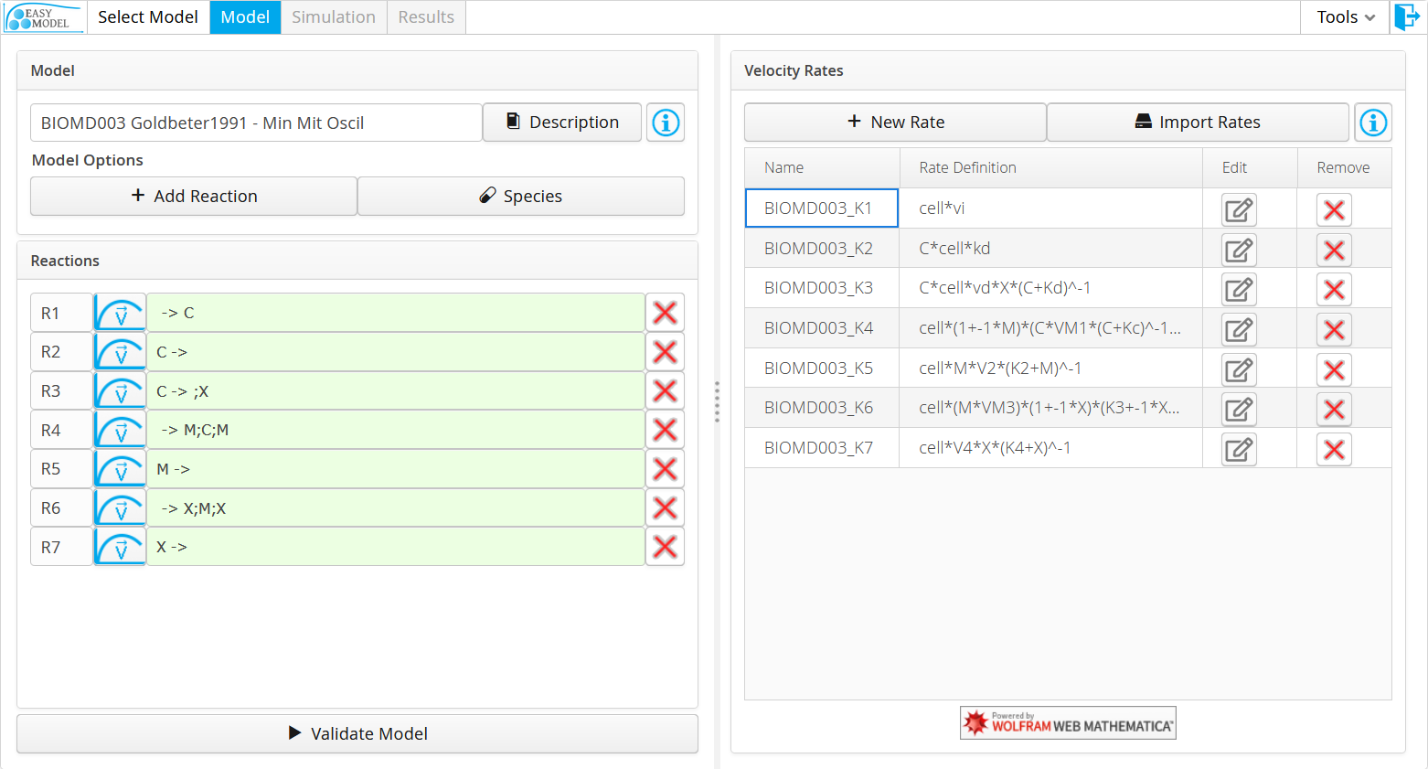
1. Start by naming your model. Description is optional
4. Create or import rates (see next slide)
2. Define reactions
(see below note)
3. Set initial concentrations and variable types (see next slide)
5. Select a rate for each reaction (see next slide)
Adjustable Split Bar
6. Validate model to advance to the Simulation step
Model editor
Rate editor
How to write reactions using Substrates, Products and Modifiers:
n1*S1 + n2*S2 + ... -> m1*P1 + m2*P2 + … ; M1; M2;...
ni,mi: Stoichiometric coefficient.
Si,Pi: Substrates and Products.
Mi: Modifiers that can activate or inhibit the reaction rate.

Slide 4
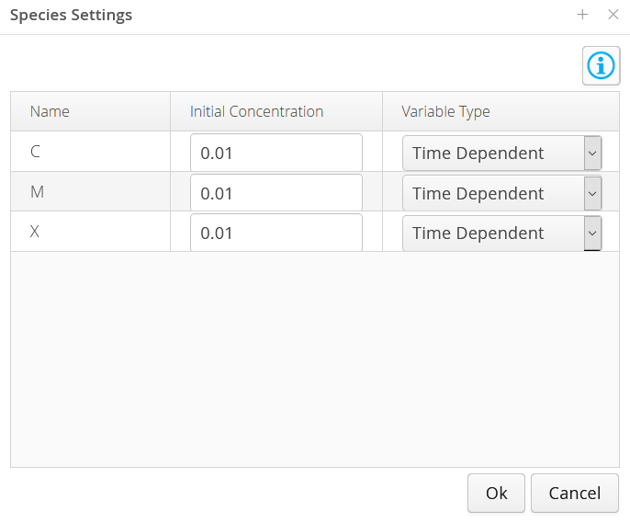
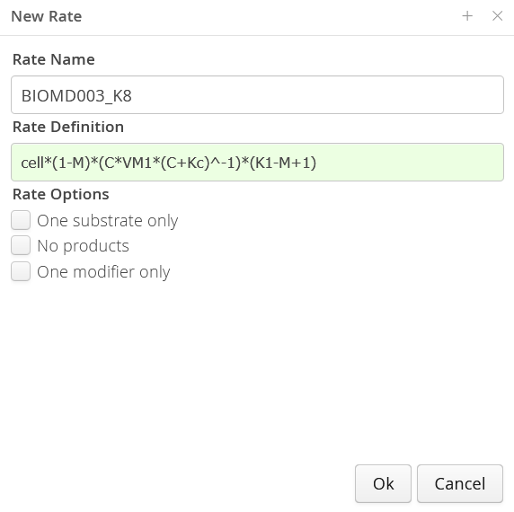
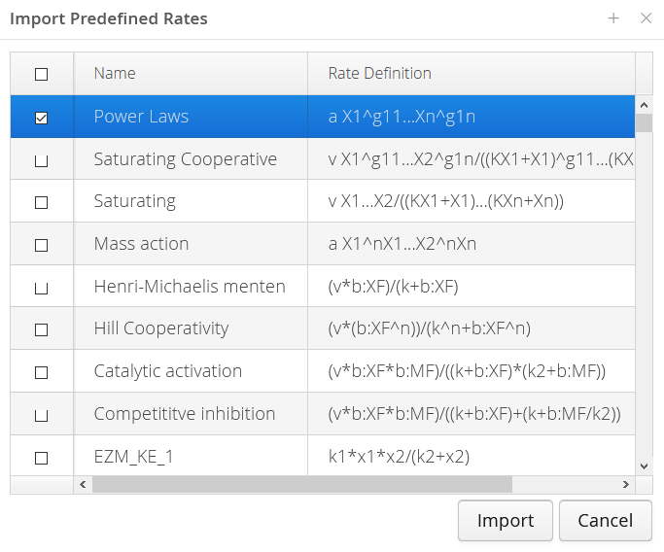
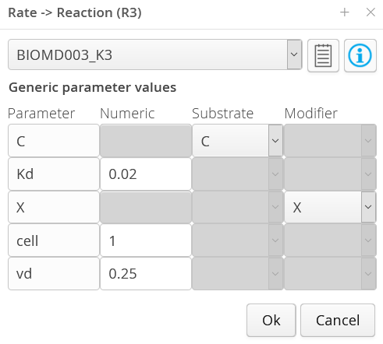
4. Create or import rates
3. Set initial concentrations and variable types
5. Select a rate for each reaction and set a value for all the rate’s parameters. Each parameter must have either a numeric value, a reference to a substrate, or a reference to a modifier.

Slide 5
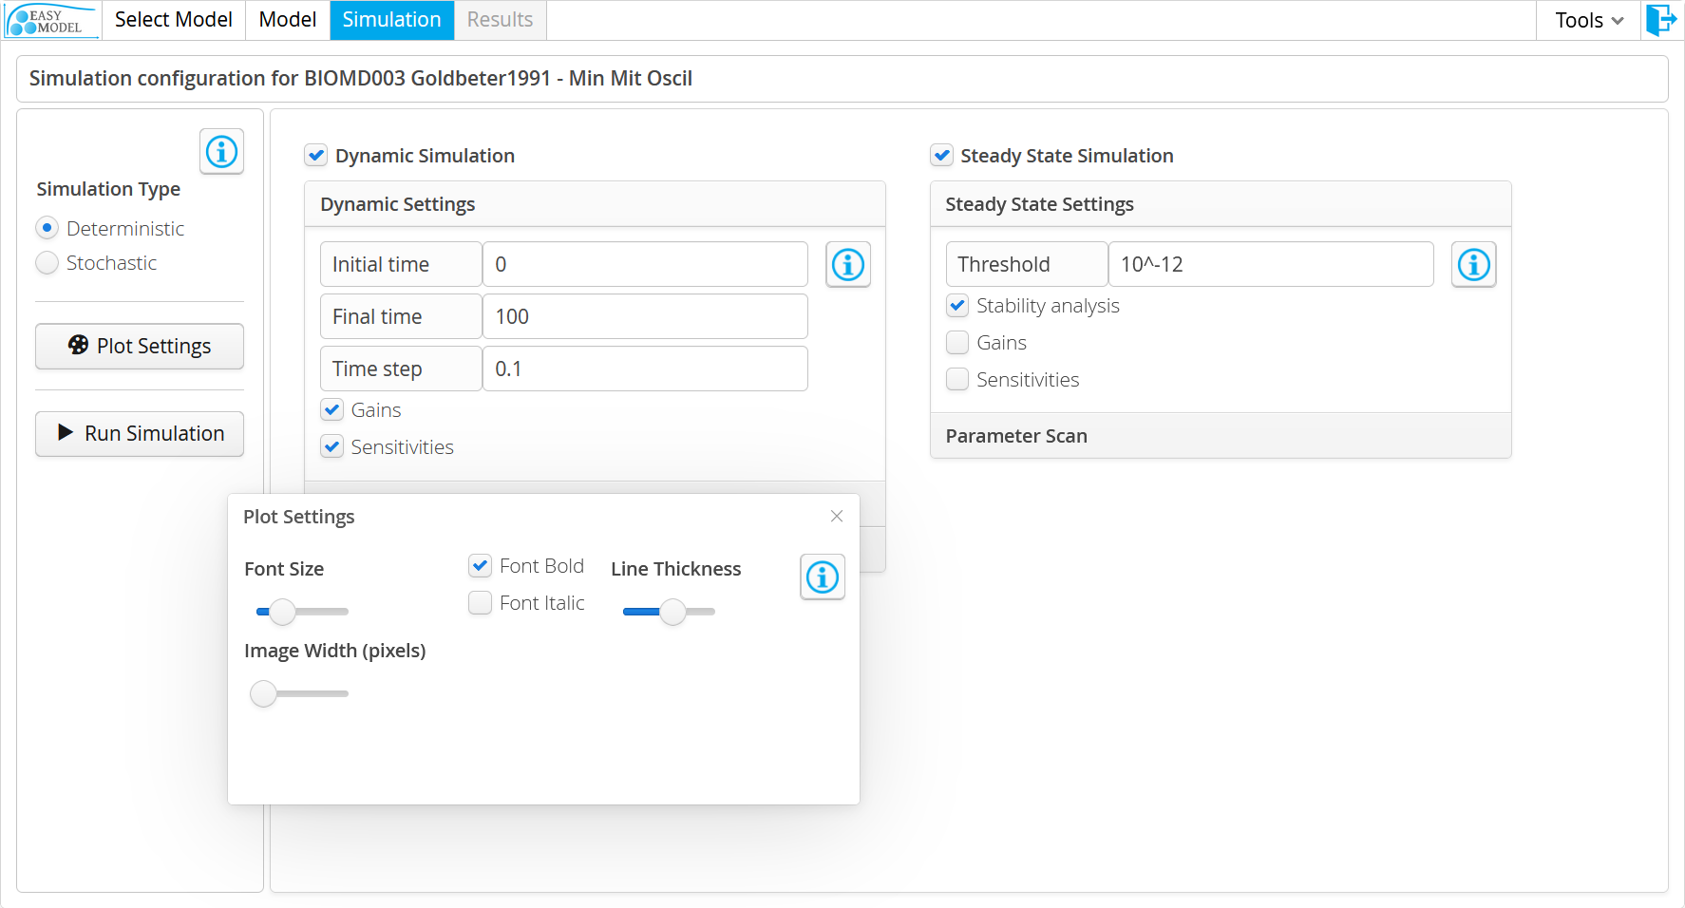
Steady state simulation: calculates the steady states (non-trivial equilibriums) of the biological system. These steady states remain constant over the time.
Dynamic simulation: time evolution of the species in the model.
"Gains" option analyses how changes in the independent variables affect the values of the time-dependent variables.
"Sensitivities" option analyses how changes in the parameter values affect the values of the time-dependent variables.
"Stability analysis" calculates if the steady state (homeostasis) is stable (negative real parts for all eigenvalues) or not (non-negative real part for at least one eigenvalue).
Plot settings: contains several configuration parameters for the graphical plots that will be performed.

Slide 6
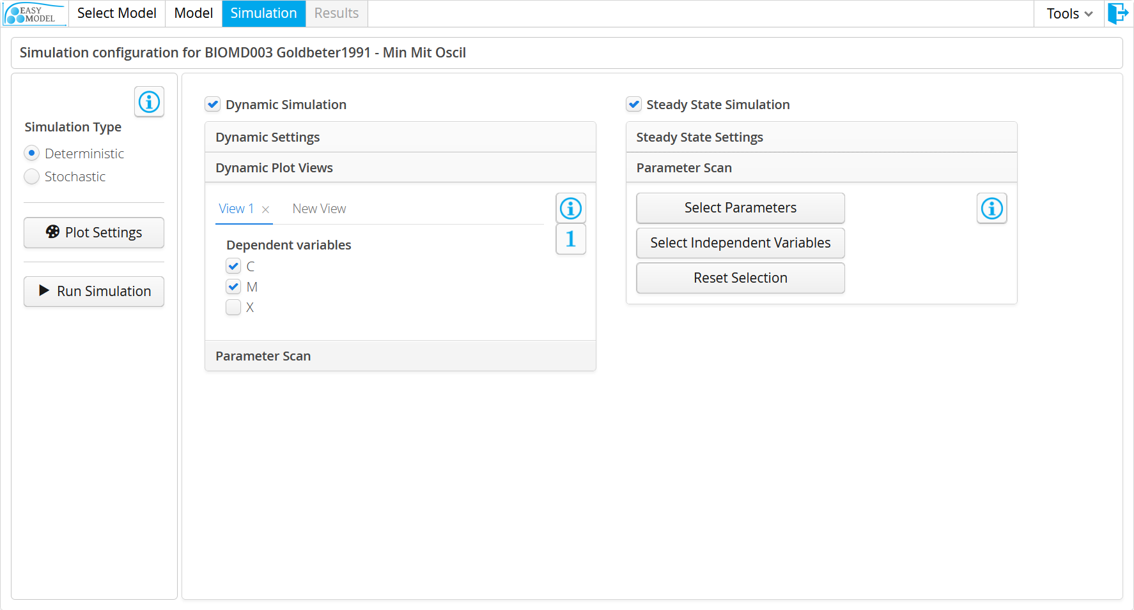
Parameter scan: perform the simulation for several values of the rate parameters or independent variables. Select a numerical range and the number of range intervals for the parameter you want to scan to observe how the system evolves with the values variation. Each parameter scan is simulated separated from the others.
Plot views: you can select which time-dependent species are to be plotted in the simulation graphics. Furthermore, you can define several plot views, each of them with its own selected time-dependent species.

Slide 7
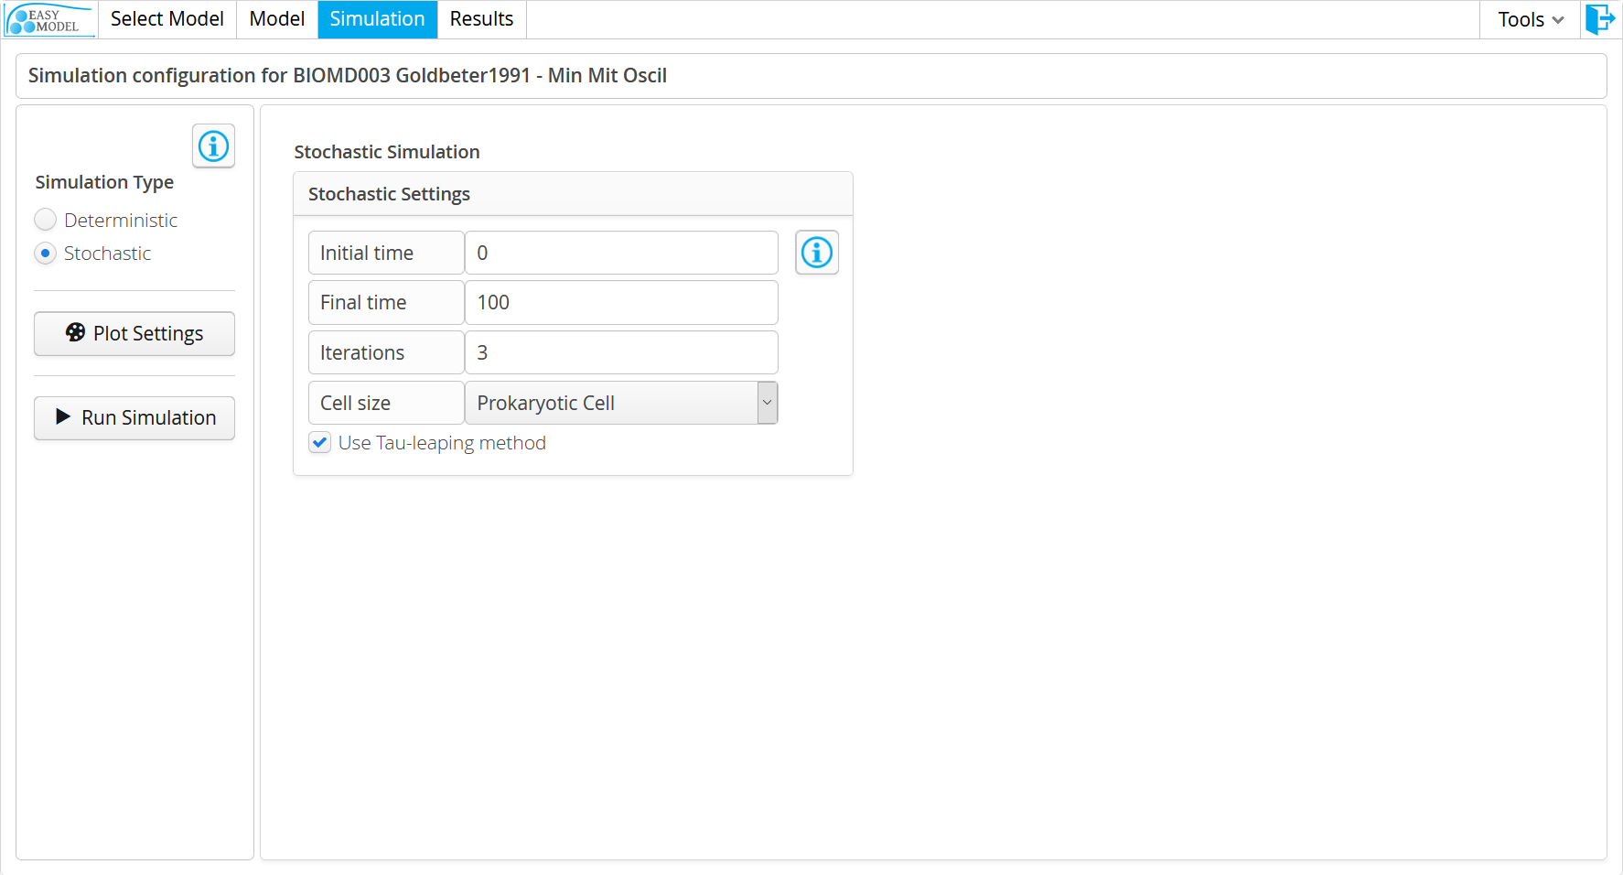
Stochastic simulation: time evolution of the species using the Gillespie SSA stochastic simulation method. Compared to the deterministic simulation, it provides a more accurate simulation, specially when the model is composed of a small number of molecules and linear noise analysis is a more appropriate tool than the deterministic sensitivity analysis to understand the limitations and regulation of the system. All these benefits come at the expense of a longer simulation time.
Tau-leaping method: useful to reduce the simulation time. Not all models can benefit from it.

Slide 8
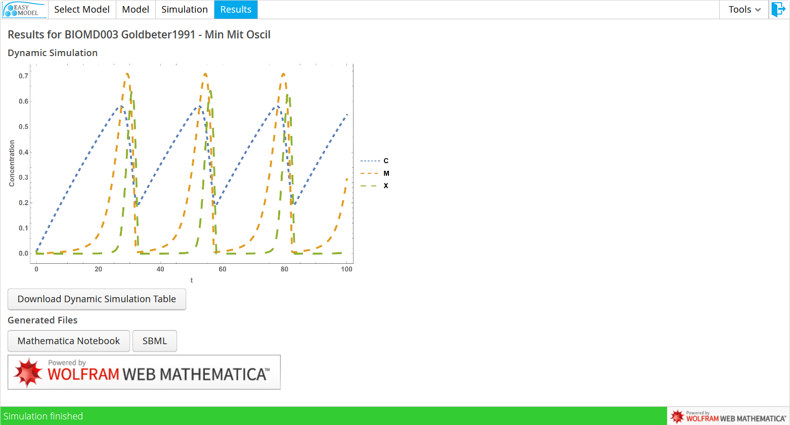
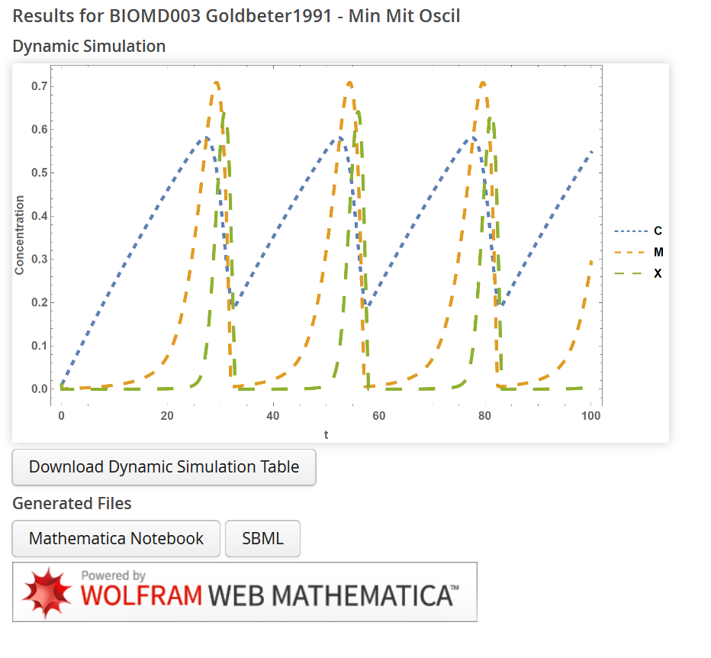
The simulation results are displayed in the final step. Clicking the cancel button aborts the simulation.
Left-click images for high-resolution copies.
You can download:
-Images.
-Results text files.
-Mathematica Notebook of the model and simulation.
-SBML file of your model.

Slide 9
You have completed the tutorial!
Press next to start using EasyModel.

