Slide 1
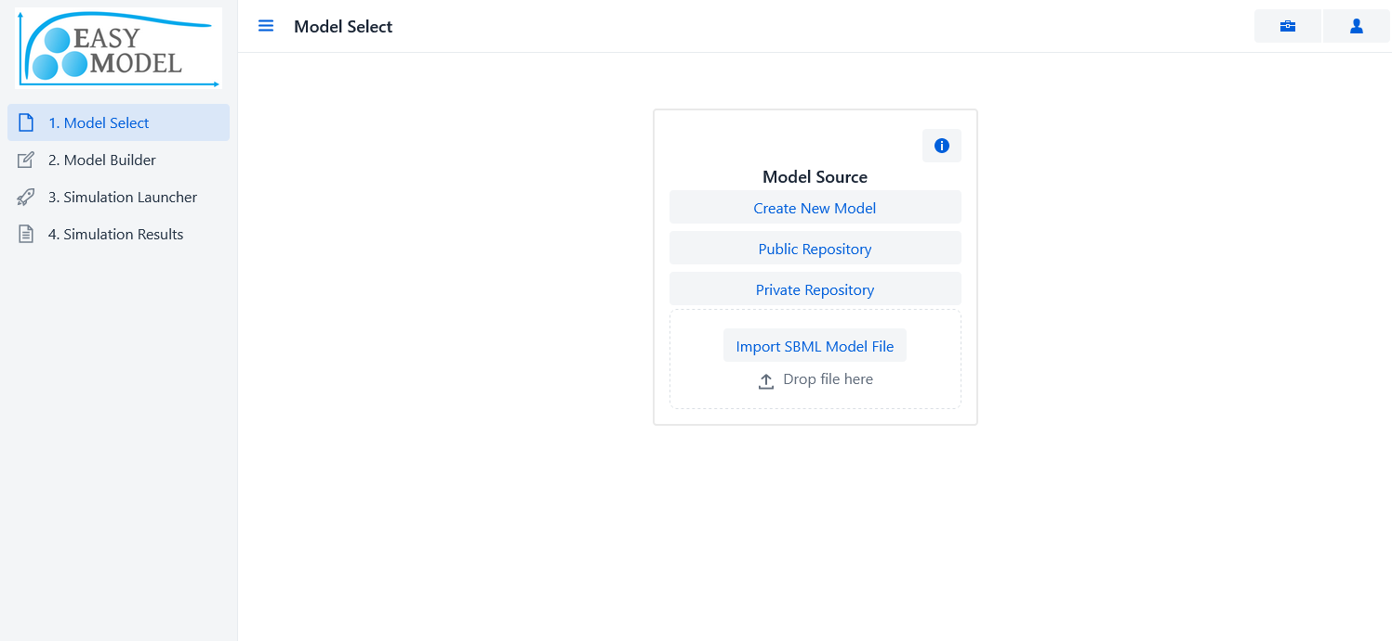
Model Select – Model Source
1. Model Select – Model Source
Information buttons can be found across the application.
Tutorial
Navigation buttons: from 1. Model Select to 4. Simulation Results.
Login & Register
Create New Model
Create a blank model. Model can’t be saved unless user is logged in.
Public Repository
Load public models. Model can’t be saved unless user is logged in.
Private Repository
Load and modify your personal models. Models can be saved into your private repository.
Import SBML Model File
Upload a SBML model file. Model can’t be saved unless user is logged in.

Slide 2
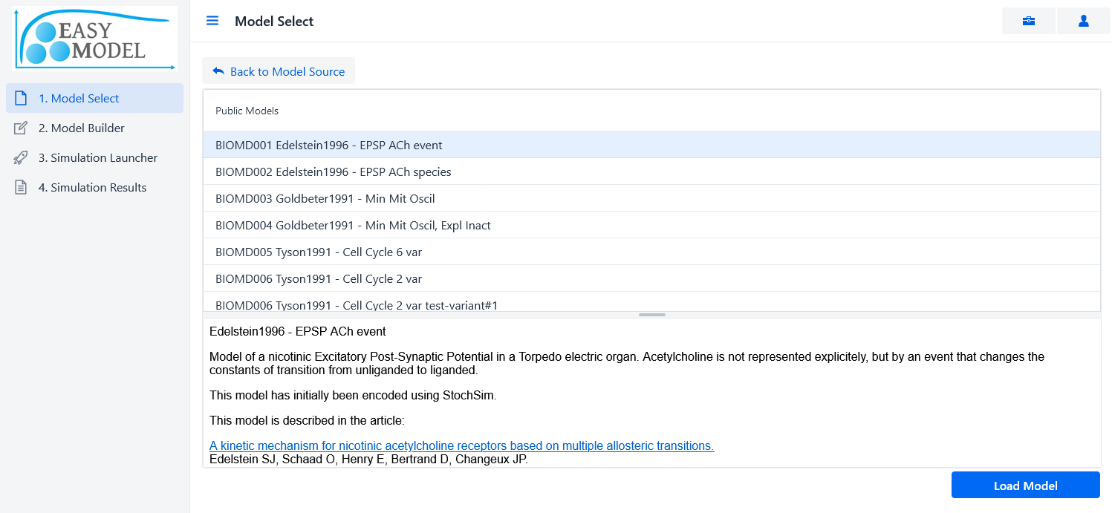
Model Select – Model Source
1. Model Select – Model Repository
Select a model from the list.
Selected model description.
Load the model to edit.

Slide 3
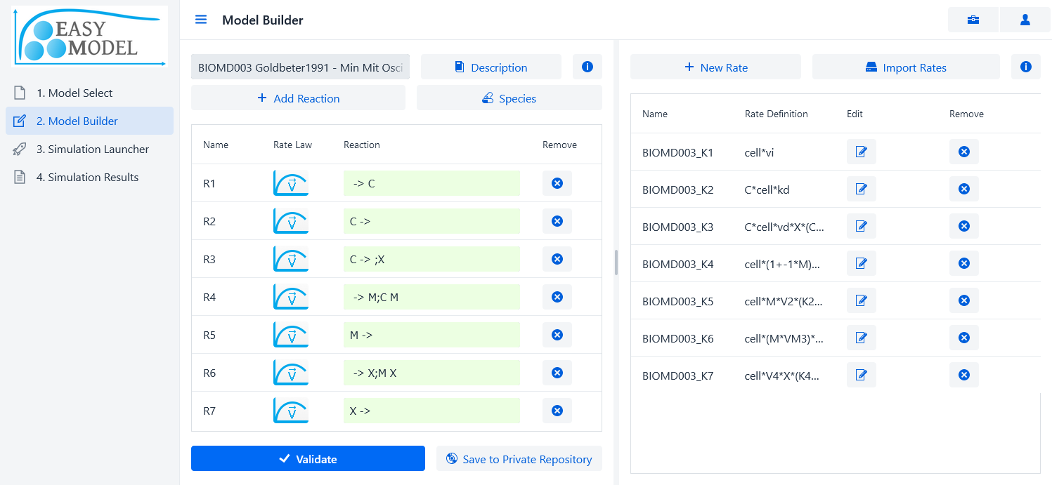
2. Model Builder – Define Reactions
4. Create or import rates (see next slide)
1. Start by naming your model. Description is optional.
3. Set initial concentrations and variable types (see next slide)
2. Define reactions
(see below note)
Adjustable Split Bar
5. Select a rate for each reaction (see next slide)
How to write reactions using Substrates, Products and Modifiers:
n1*S1 + n2*S2 + ... -> m1*P1 + m2*P2 + … ; M1; M2; ...
ni, mi: Stoichiometric coefficient.
Si, Pi: Substrates and Products.
Mi: Modifiers that can activate or inhibit the reaction rate.
6. Validate model to advance to the Simulation Launcher step.
Model Editor
Rate Editor

Slide 4
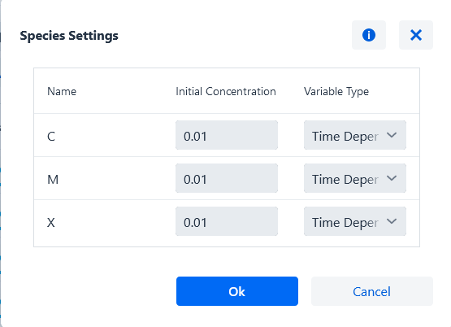
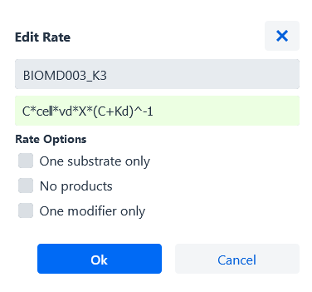
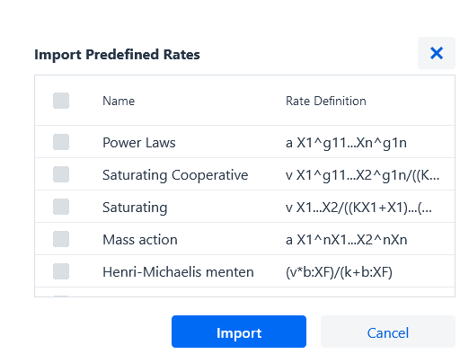
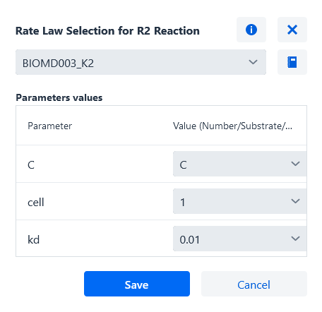
2. Model Builder – Species, Define rates, Select a rate for each reaction
3. Set initial concentrations and variable types
4. Create or import rates
5. Select a rate for each reaction and set a value for all the rate’s parameters. Each parameter must have either a numeric value, a reference to a substrate or a reference to a modifier.

Slide 5
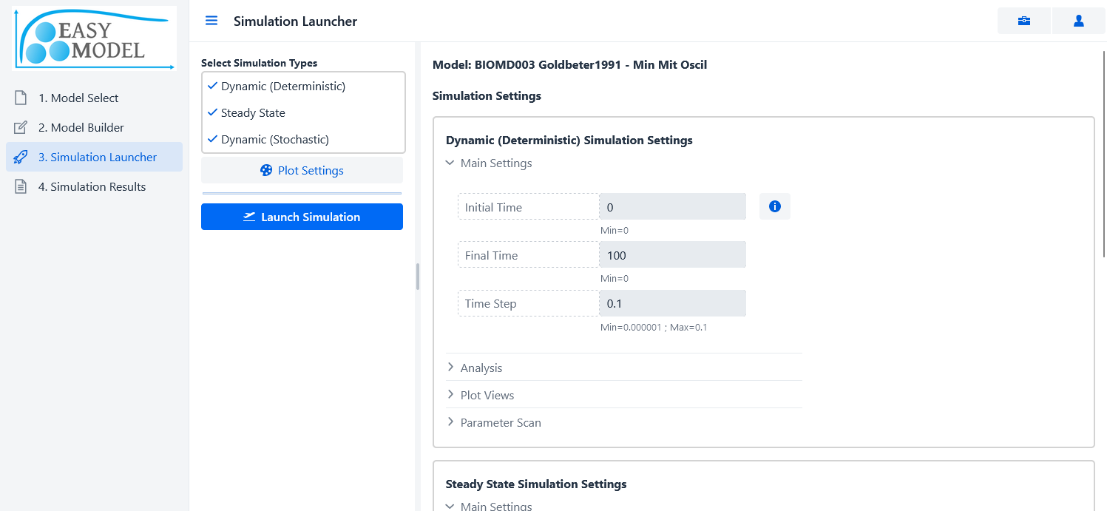
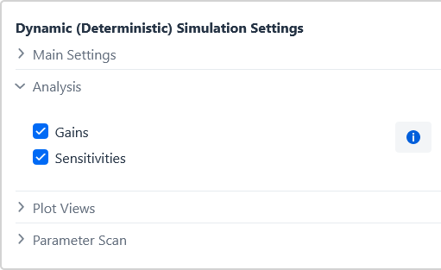
3. Simulation Launcher – Dynamic and Steady State simulation
Dynamic simulation: time evolution of the species in the model.
Steady state simulation: calculates the steady states (non-trivial equilibriums) of the biological system. These steady states remain constant over the time.
Analysis options
"Gains" option analyses how changes in the independent variables affect the values of the time-dependent variables.
"Sensitivities" option analyses how changes in the parameter values affect the values of the time-dependent variables.
Plot settings: contains several configuration parameters for the graphical plots that will be performed.
Launching the simulation will add the simulation job to the job queue. You can check the progress of the job inside of the queue in the next step.

Slide 6
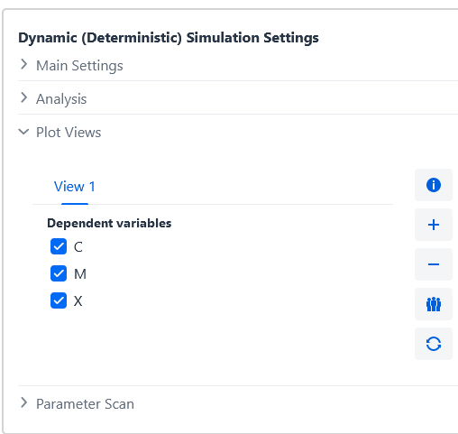
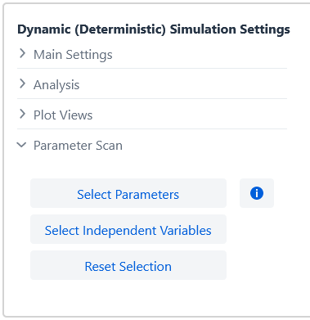
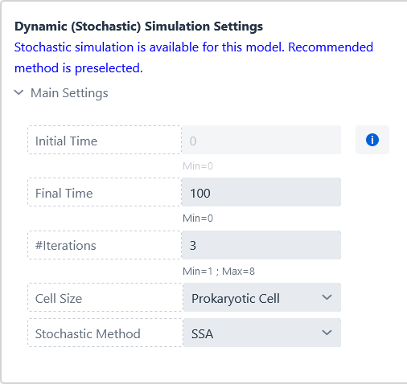
3. Simulation Launcher – Plot Views, Parameter Scan, Stochastic simulation
Plot views: you can select which time-dependent species are to be plotted in the simulation graphics. Furthermore, you can define several plot views, each of them with its own selected time-dependent species.
Parameter scan: perform the simulation for several values of the rate parameters or independent variables. Select a numerical range and the number of range intervals for the parameter you want to scan to observe how the system evolves with the values variation. Each parameter scan is simulated separated from the others.
Stochastic simulation: time evolution of the species using the Gillespie SSA stochastic simulation method. Compared to the deterministic simulation, it provides a more accurate simulation, specially when the model is composed of a small number of molecules and linear noise analysis is a more appropriate tool than the deterministic sensitivity analysis to understand the limitations and regulation of the system. All these benefits come at the expense of a longer simulation time.
Tau-leaping method: useful to reduce the simulation time. Not all models can benefit from it.

Slide 7
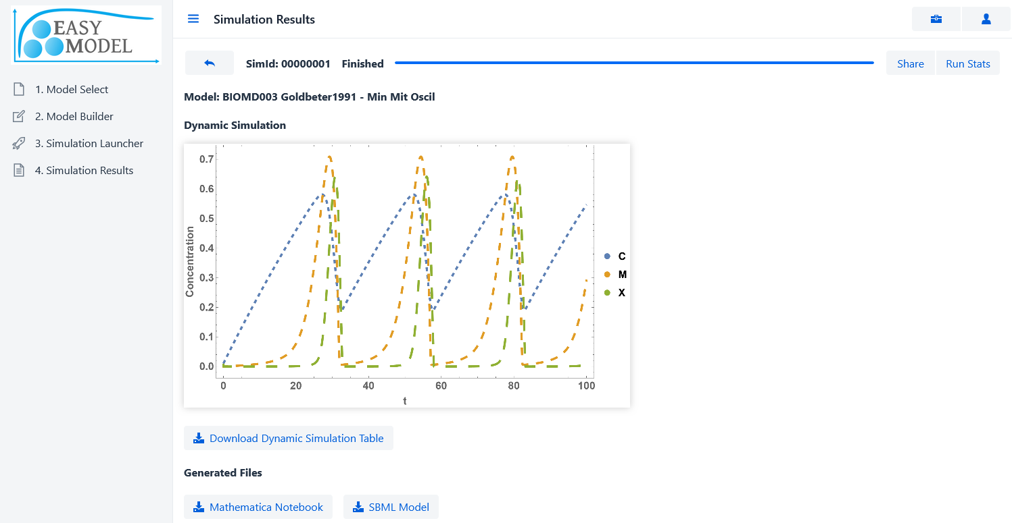
4. Simulation Results – Simulation Job Results
The simulation results are displayed in the final step.
Left-click images for high-resolution copies.
You can download:
-Images.
-Results text files.
-Mathematica Notebook of the model and simulation.
-SBML file of your model.

Slide 8
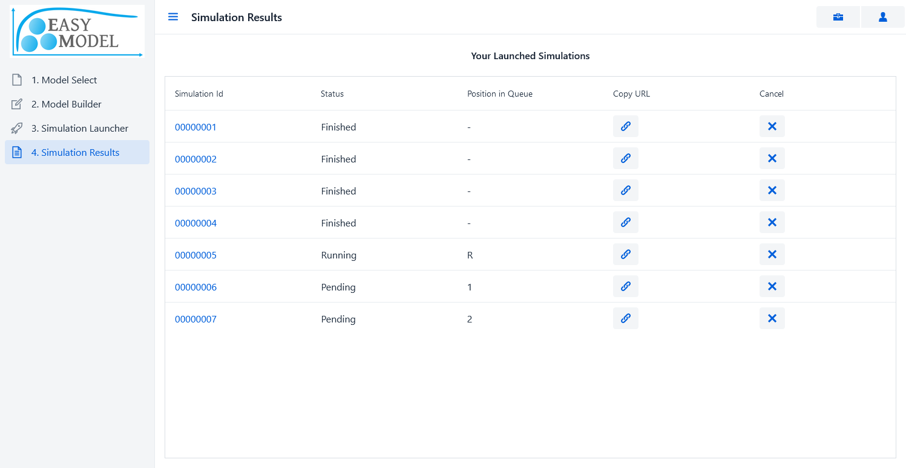
4. Simulation Results – Simulation Queue
When you launch a simulation, it is added into the processing queue. You can check the progress of your launched simulations in the queue view. You may also share and cancel unfinished simulations.

