Slide 1
Economic Viability
CampManager
MEINF UDL – EPS 2022-2023

Slide 2

Table Of Contents
Executive Summary
Financial Viability
Purchases
Initial Investments
Initial Financing
Sales Forecast
Preliminary Results
Evolution Results
Investment Evolution

Slide 3
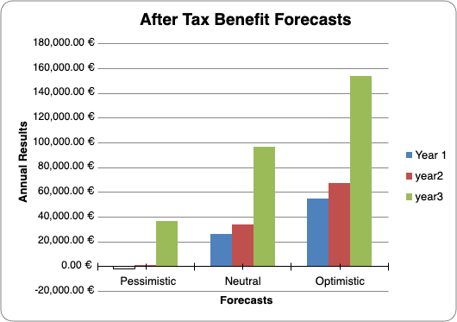
Executive Summary
Harsh Cost Cutting
49,493.79€ required to start functioning
63,684.00€ forecasted average yearly income
 | Cash Flow
 | Pessimistic | Neutral | Optimistic
Home project | (49,493.79) | (49,493.79) | (49,493.79)
Year 1 | -1,665 € | 26,011€ | 54,763 €
year 2 | -12,957 € | 18,480 € | 50,456 €
year 3 | 21,464 € | 80,300 € | 135,896 €
Evaluation criteria of investment
ROI | -0.86 | 1.52 | 3.87
Net Present Value (NPV) | -49,874 € | 1,897 € | 53,632 €
Pay Back Period (PBP) | -29.72 | 1.90 | 0.90
Internal Rate of Return (IRR) | -36.64% | 49.79% | 116.39%
The most pessimistic scenario fails to break even after 3 years
The best scenario has a >3 ROI

Slide 4
Financial Viability
Purchases
Initial investments
HARDWARE | UNITS | SRP | AMOUNT
Computer | 1 | 849.00 € | 849.00 €
Monitor | 1 | 131.62 € | 131.62 €
Peripherals | 1 | 29.99 € | 29.99 €
TOTAL HARDWARE |  |  | 1,010.61 €
 | AMOUNT
DEFERRED EXPENSES | 400.00 €
Business License (City Hall) | 400.00 €
TANGIBLE | 1,010.61 €
Computer hardware | 1,010.61 €
TOTAL INVESTMENTS | 1,410.61 €

Slide 5

Financial Viability
Initial financing
Capitalisation: 3.000€
Own resources: 12.000€
Total: 15.000€

Slide 6
Financial Viability
Sales forecast
Services | % Sales | SRP | AMOUNT
Premium | 30% | 15.00 € | 1,620.00 €
Algorithm prioritisation | 10% | 8.00 € | 288.00 €
Customer service | 33% | 520.00 € | 61,776.00 €
TOTAL SALES |  |  | 63,684.00 €
Potentials clients: 2000
Estimation 1st year: 30

Slide 7
Financial Viability
Preliminary results
CONCEPT | % TOTAL INCOME | AMOUNT
TOTAL INCOME | 100% | 76,684 €
TOTAL STAFF COST | 48.80% | 38,400 €
TOTAL OTHER EXPENSES STRUCTURE | 12.31 % | 9,683.18 €
EBITDA | - | 30,904 €
​EBIT ​ | ​38.89% ​ | ​30,600.82 € ​
​EBT ​ | ​38.89% ​ | ​30,600.82 € ​
Income Tax ​ | ​5.83% ​l | ​4,590.12 € ​
​NET PROFIT ​ | ​33.06% ​ | ​26,010.69€ ​

Slide 8
Financial Viability
Evolution results
Periods / Prev. Desp benefit. Taxes | Pessimistic | Neutral | Optimistic
Year 1 | -1,665.26 € | 26,010.69 € | 54,762.93 €
Year 2 | 543.37 € | 33,480.16 € | 66,956.43 €
Year 3 | 36,314.24 € | 96,799.62 € | 154,045.94 €

Slide 9
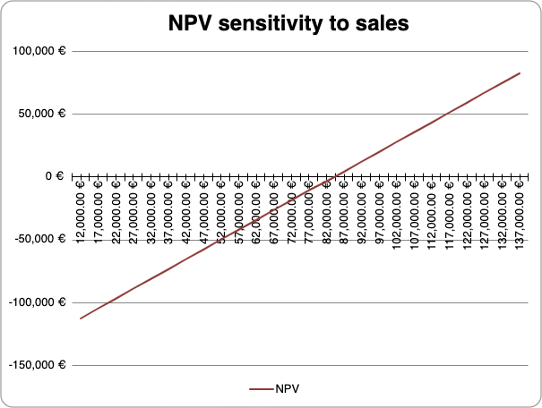
Financial Viability
Sales | NPV
62,000.00 € | -34,842 €
67,000.00 € | -27,024 €
72,000.00 € | -19,205 €
77,000.00 € | -11,387 €
82,000.00 € | -3,569 €
87,000.00 € | 4,249 €
92,000.00 € | 12,067 €
97,000.00 € | 19,885 €
Investment Evolution

Slide 10

Thank You For Your Attention!

