Slide 1
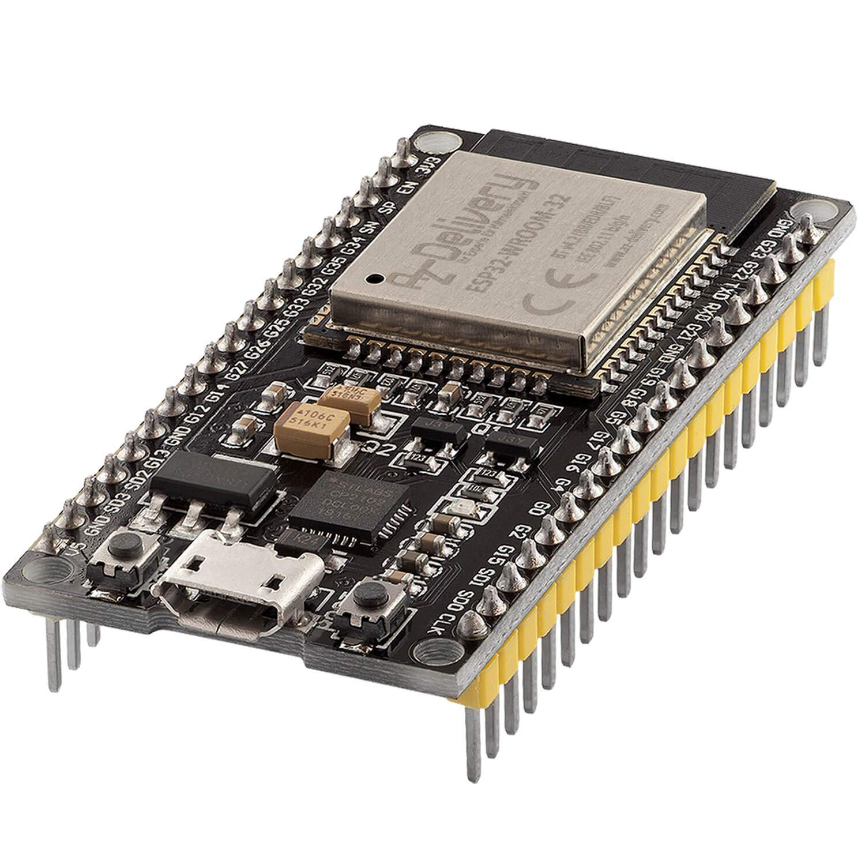
ESP32
Dr. Manel Puig i Vidal

Slide 2
ESP32
The ESP32 is a popular and versatile microcontroller development board that is widely used for various Internet of Things (IoT) applications.
Some key features of the ESP32 board include:
Dual-Core Processor:
Xtensa LX6 Microprocessor
High processing power (up to 240 MHz clock speed)
Integrated Wi-Fi (802.11 b/g/n):
2.4 GHz frequency band.
Supports various Wi-Fi modes
Station,
Access Point,
Station+AP.
Enables seamless internet connectivity.
3. Integrated Bluetooth (v4.2 BR/EDR and BLE):
Bluetooth Classic and Bluetooth Low Energy support.
Suitable for short-range communication and IoT applications.

Slide 3
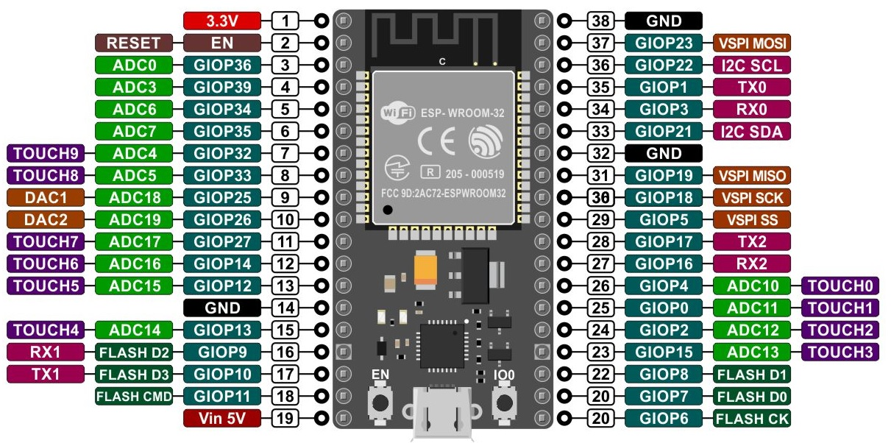
ESP32
Integrated Peripherals:
ADC (Analog-to-Digital Converter), DAC (Digital-to-Analog Converter).
I2C (Inter-Integrated Circuit), SPI (Serial Peripheral Interface), UART (Universal Asynchronous Receiver-Transmitter) communication interfaces.
PWM (Pulse Width Modulation), Timers, Capacitive Touch Sensors.
GPIO (General Purpose Input/Output) pins for versatile interfacing.
Memory:
SRAM (working memory): 520KB
Flash memory (for storing the program code and data): 4MB, 8MB or 16MB

Slide 4
ESP32
https://docs.espressif.com/projects/arduino-esp32/en/latest/installing.html
Low Power Consumption:
making it suitable for battery-powered applications.
Rich Development Ecosystem:
Well-supported by Espressif's ESP-IDF (IoT Development Framework).
Arduino IDE compatibility for easier programming.
Large community and extensive documentation.
Cost-Effective:
Relatively low cost makes it accessible for hobbyists and professionals.

Slide 5
ESP32
Wi-Fi modes
Station Mode (STA): In this mode, the ESP32 connects to an existing Wi-Fi network as a client.
Access Point Mode (AP): In this mode, the ESP32 acts as a Wi-Fi hotspot, allowing other devices to connect to it. Station + Access Point Mode (STA+AP): This mode combines both Station and Access Point modes. The ESP32 can connect to an existing Wi-Fi network while simultaneously acting as a Wi-Fi hotspot for other devices.
MQTT (Message Queuing Telemetry Transport):
Is a lightweight messaging protocol designed for machine-to-machine (M2M) communication and the Internet of Things (IoT).
Exemple: weather station that measures temperature and humidity:
The weather station (a "client") "publishes" its readings to a topic called "weather/station1".
Your phone and a display in your house (also "clients") "subscribe" to the "weather/station1" topic.
The MQTT "broker" manage the topics and messaging transmission.
Everyone who's interested in the weather data gets it in real-time.
MQTT is a powerful tool for IoT solutions.

Slide 6
Exemples:
Read IMU and send data to web server
Read IMU and publish data to topic using mqtt messaging protocol
Create a webpage to subscribe to imu topic and publish data to webpage
My labtop subscribes to the topic and print values using mqtt studio
Read IMU data and send data to:
another ESP32 using ESP-now
The 2nd esp32 send data in serial to PC
Python program reads data and plot it on screen

Slide 7

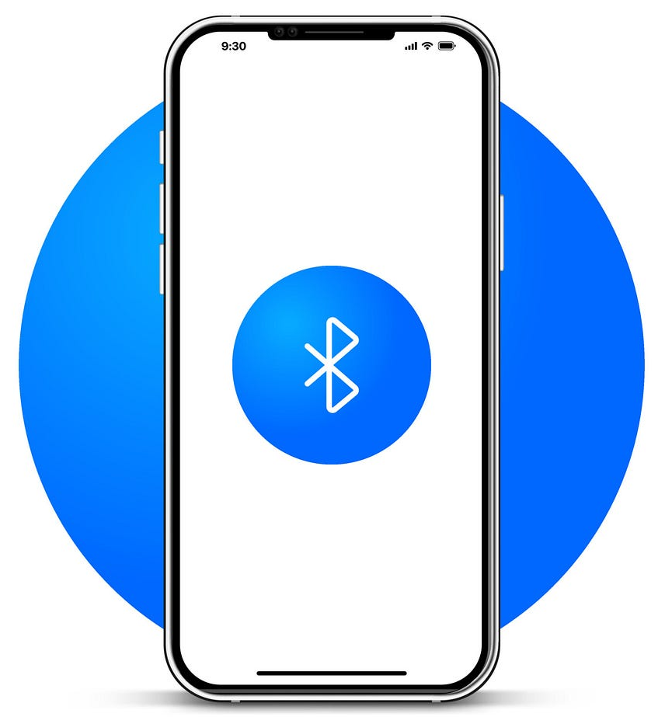

Slide 8

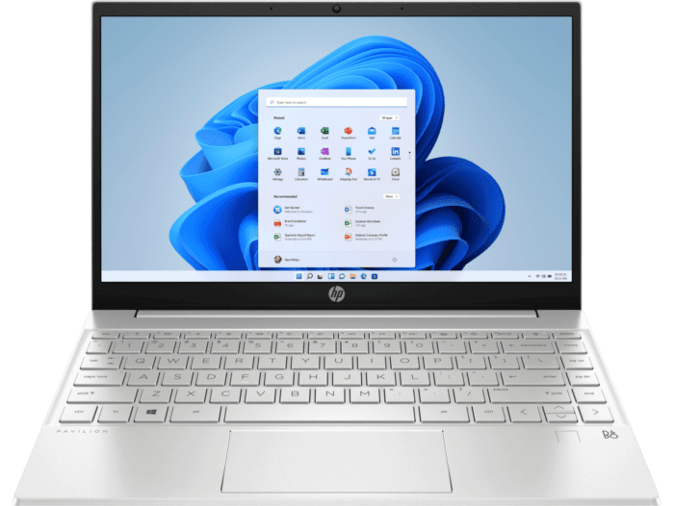
WiFi_SocketUDP_IMU

Slide 9
WiFi_SocketUDP_2_ESP32
ESP32_Sender
ESP32_Receiver

