Slide 1
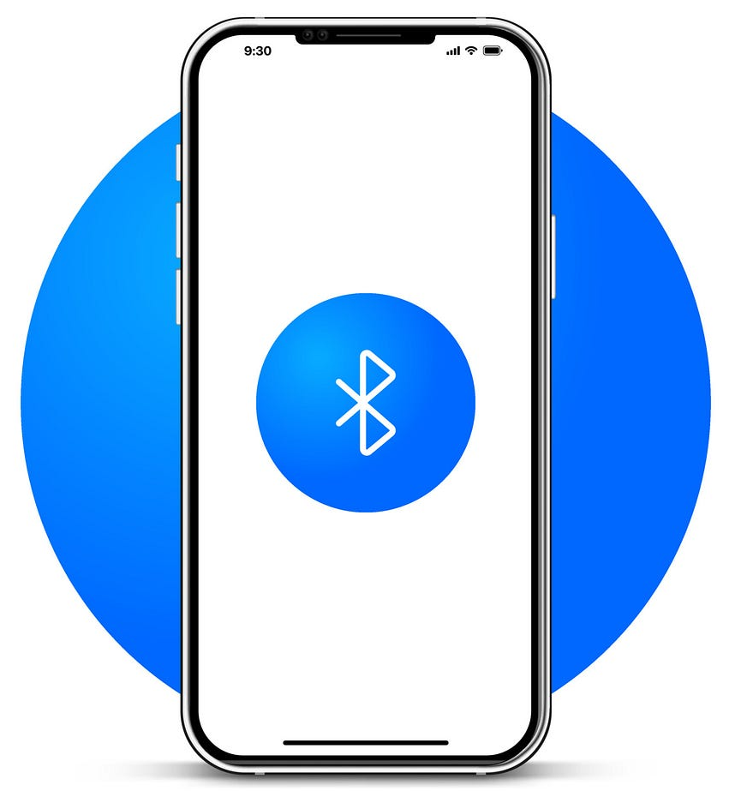

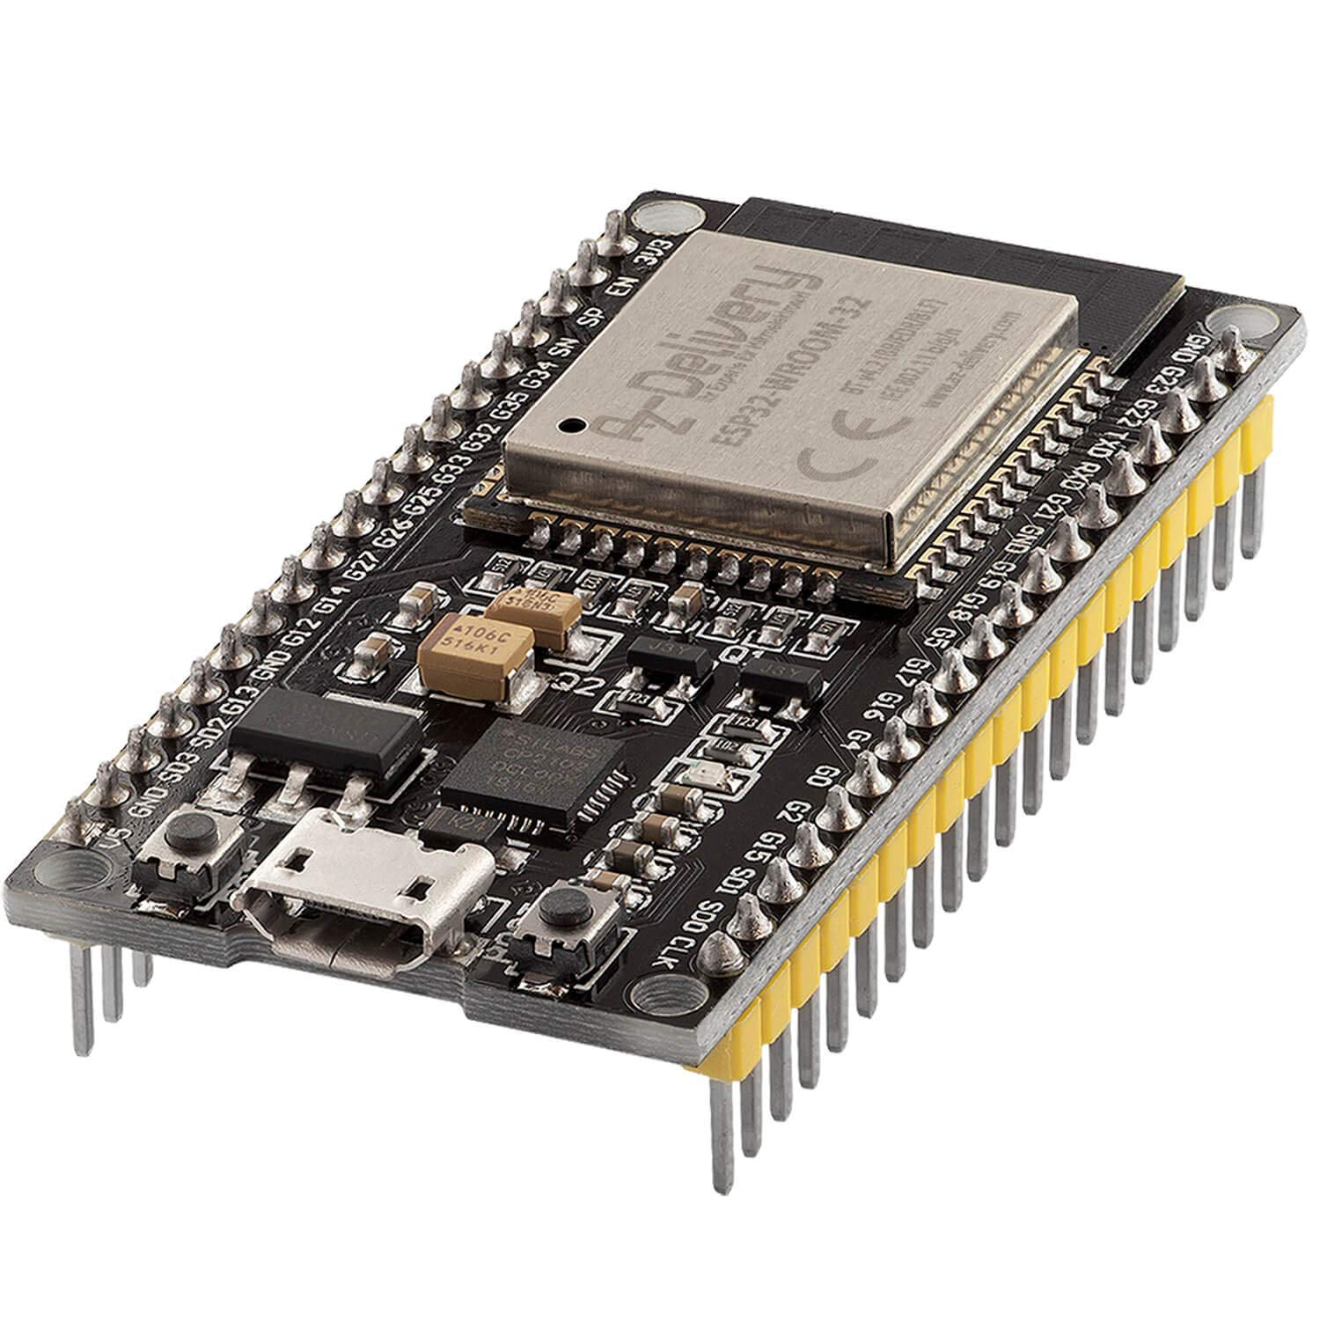
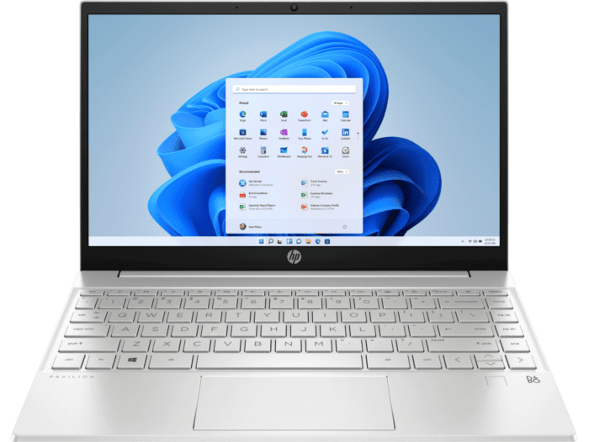

Slide 2

WiFi_SocketUDP_IMU

Slide 3
WiFi_SocketUDP_2_ESP32
ESP32_Sender
ESP32_Receiver

