Slide 1
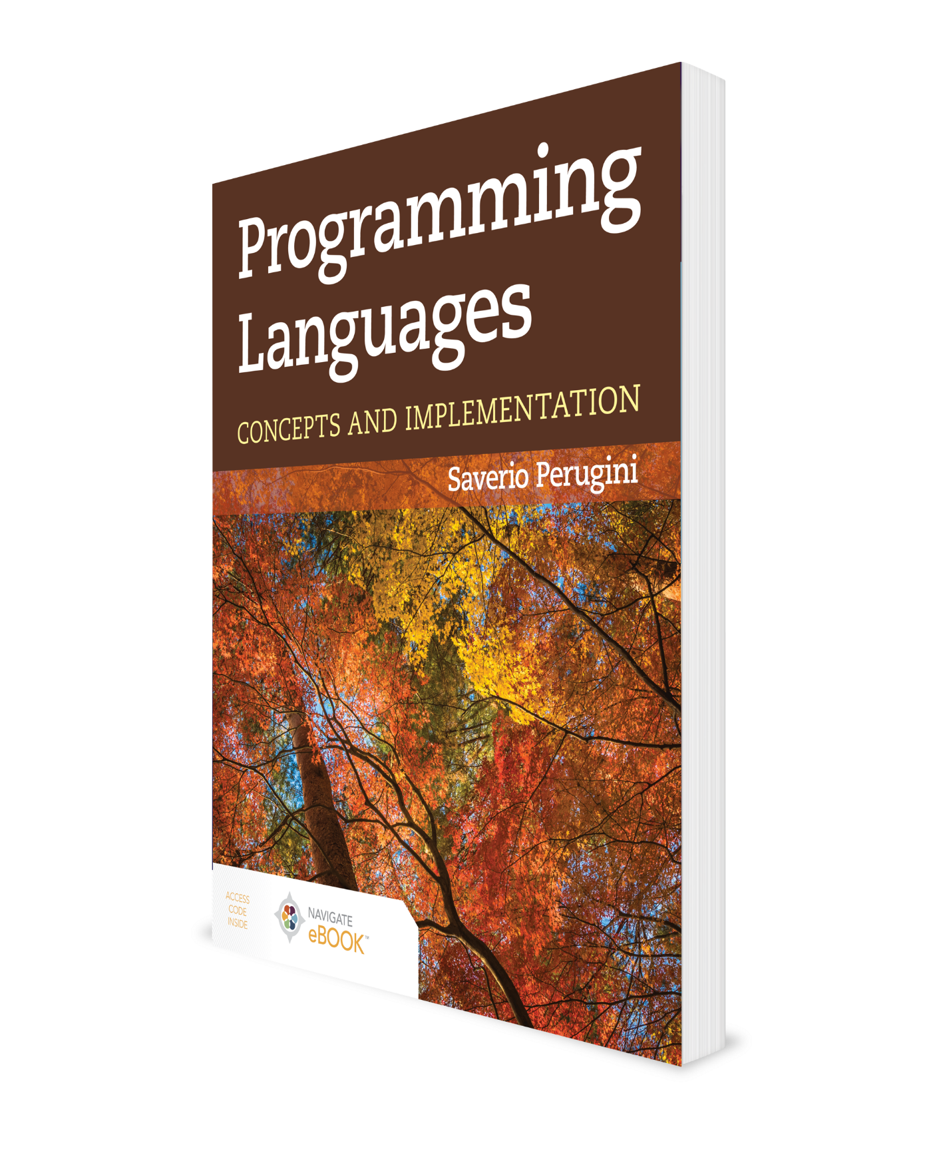
Scanning and Parsing
CHAPTER 3
Additional Material: Brian Hare, UMKC

Slide 2
Chapter 3: Scanning and Parsing
Although mathematical notation undoubtedly possesses parsing rules, they are rather loose, sometimes contradictory, and seldom clearly stated. . . .The proliferation of programming languages shows no more uniformity than mathematics. Nevertheless, programming languages do bring a different perspective. . . .Because of their application to a broad range of topics, their strict grammar, and their strict interpretation, programming languages can provide new insights into mathematical notation.
—Kenneth E. Iverson
Any implementation of a programming language involves scanning and parsing the source program into a representation that can be subsequently processed (i.e., interpreted or compiled or a combination of both).

Slide 3
Outline
3.1 Chapter Objectives
3.2 Scanning
3.3 Parsing
3.4 Recursive-Descent Parsing
3.5 Bottom-up, Shift-Reduce Parsing and Parser Generators
3.6 PLY: Python Lex-Yacc
3.7 Top-down Vis-à-Vis Bottom-up Parsing
3.8 Thematic Takeaways

Slide 4
3.1 Chapter Objectives
Establish an understanding of scanning.
Establish an understanding of parsing.
Introduce top-down parsing.
Differentiate between table-driven and recursive-descent top-down parsers.
Illustrate the natural relationship between a context-free grammar and a recursive-descent parser.
Introduce bottom-up, shift-reduce parsing.
Introduce parser-generation tools (e.g., lex/yacc).

Slide 5
Outline
3.1 Chapter Objectives
3.2 Scanning
3.3 Parsing
3.4 Recursive-Descent Parsing
3.5 Bottom-up, Shift-Reduce Parsing and Parser Generators
3.6 PLY: Python Lex-Yacc
3.7 Top-down Vis-à-Vis Bottom-up Parsing
3.8 Thematic Takeaways

Slide 6
3.2 Scanning (1 of 2)
The first step of scanning (also referred to as lexical analysis) is to parcel the characters (from the alphabet Σ) of the string representing the line of code into lexemes.
Lexemes can be formally described by regular expressions and regular grammars.
Lexical analysis is the process of determining if a string (typically of a programming language) is lexically valid—that is, if all of the lexical units of the string are lexemes.

Slide 7
3.2 Scanning (2 of 2)
Free-format languages are languages where formatting has no effect on program structure—of course, other than use of some delimiter to determine where lexical units begin and end.
Languages where formatting has an effect on program structure, and where lexemes must occur in predetermined areas, are called fixed-format languages.
Other languages, including Python, Haskell, Miranda, and Ocaml, use layout-based syntactic grouping (i.e., indentation).

Slide 8
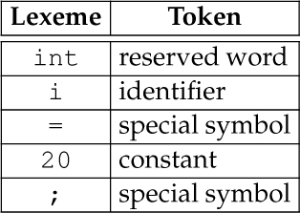
Table 3.1 Parceling Lexemes into Tokens in the Sentence int i = 20;

Slide 9
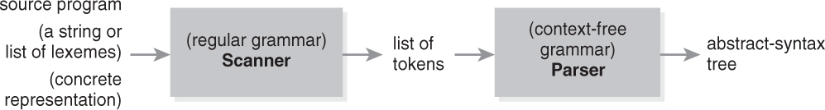
Figure 3.1 Simplified View of Scanning and Parsing: The Front End

Slide 10
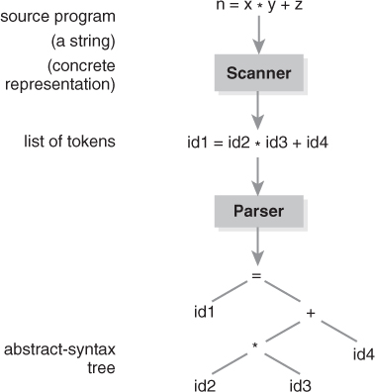
Figure 3.2 More Detailed View of Scanning and Parsing

Slide 11
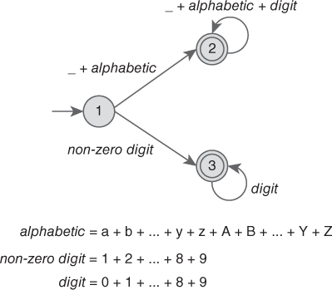
Figure 3.3 A Finite-State Automaton for a Legal Identifier and Positive Integer in C

Slide 12
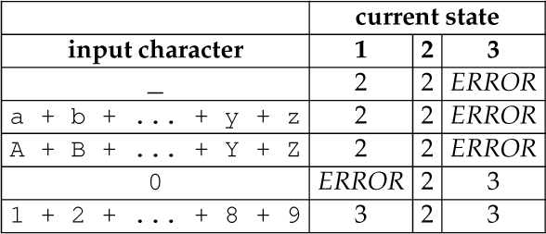
Table 3.2 Two-Dimensional Array Modeling a Finite-State Automaton for a Legal Identifier and Positive Integer in C

Slide 13
Outline
3.1 Chapter Objectives
3.2 Scanning
3.3 Parsing
3.4 Recursive-Descent Parsing
3.5 Bottom-up, Shift-Reduce Parsing and Parser Generators
3.6 PLY: Python Lex-Yacc
3.7 Top-down Vis-à-Vis Bottom-up Parsing
3.8 Thematic Takeaways

Slide 14
3.3 Parsing
Parsing (or syntactic analysis) is the process of determining whether a string is a sentence (in some language) and, if so, (typically) converting the concrete representation of it into an abstract representation, which generally facilitates the intended subsequent processing of it.
A concrete-syntax representation of a program is typically a string (or a parse tree as shown in Chapter 2, where the terminals along the fringe of the tree from left-to-right constitute the input string).
A parse tree and abstract-syntax tree are the syntactic analogs of a lexeme and token from lexics, respectively (Table 3.3). (See Section 9.5 for more details on abstract-syntax representations.)
A parser (or syntactic analyzer) is the component of an interpreter or compiler that also typically converts the source program, once syntactically validated, into an abstract, or more easily manipulable, representation.

Slide 15
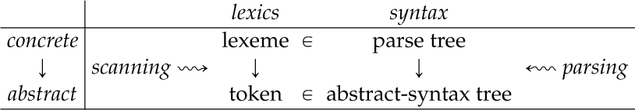
Table 3.3 (Concrete) Lexemes and Parse Trees Vis-à-Vis (Abstract) Tokens and Abstract-Syntax Trees, Respectively

Slide 16
Outline
3.1 Chapter Objectives
3.2 Scanning
3.3 Parsing
3.4 Recursive-Descent Parsing
3.5 Bottom-up, Shift-Reduce Parsing and Parser Generators
3.6 PLY: Python Lex-Yacc
3.7 Top-down Vis-à-Vis Bottom-up Parsing
3.8 Thematic Takeaways

Slide 17
3.4 Recursive-Descent Parsing
3.4.1 A Complete Recursive-Descent Parser
3.4.2 A Language Generator

Slide 18
3.4.1 A Complete Recursive-Descent Parser
Python code for a parser, with an embedded scanner, for a language of S-expressions with atoms x, y, and z

Slide 19
3.4.2 A Language Generator
A Python program that is a generator of sentences from the language of S-expressions with atoms x, y, and z

Slide 20
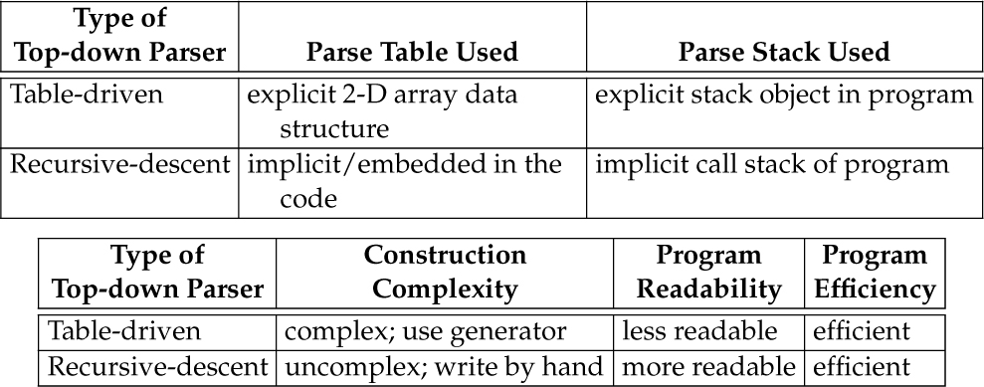
Table 3.4 Implementation Differences in Top-down Parsers: Table-Driven Vis à Vis Recursive-Descent

Slide 21
Outline
3.1 Chapter Objectives
3.2 Scanning
3.3 Parsing
3.4 Recursive-Descent Parsing
3.5 Bottom-up, Shift-Reduce Parsing and Parser Generators
3.6 PLY: Python Lex-Yacc
3.7 Top-down Vis-à-Vis Bottom-up Parsing
3.8 Thematic Takeaways

Slide 22
3.5 Bottom-up, Shift-Reduce Parsing and Parser Generators
A parser generator is a program that accepts a syntactic specification of a language in the form of a grammar and automatically generates a parser from it.
Parser generators are available for a wide variety of programming languages, including Python (PLY) and Scheme (SLLGEN). ANTLR (ANother Tool for Language Recognition) is a parser generator for a variety of target languages, including Java.

Slide 23
3.5 A Complete Example in lexx and yacc
symexpr.l and symexpr.y:
Specifications for lex and yacc (respectively) that generate a shift-reduce, bottom-up parser for the symbolic expression language presented earlier in this chapter

Slide 24
Outline
3.1 Chapter Objectives
3.2 Scanning
3.3 Parsing
3.4 Recursive-Descent Parsing
3.5 Bottom-up, Shift-Reduce Parsing and Parser Generators
3.6 PLY: Python Lex-Yacc
3.7 Top-down Vis-à-Vis Bottom-up Parsing
3.8 Thematic Takeaways

Slide 25
3.6 PLY: Python Lex-Yacc
3.6.1 A Complete Example in PLY
3.6.2 Camille Scanner and Parser Generators in PLY

Slide 26
3.6.1 A Complete Example in PLY
The PLY analog of the lex and yacc specifications from Section 3.5 to generate a parser for the symbolic expression language.

Slide 27
3.6.2 Camille Scanner and Parser Generators in PLY
A PLY scanner specification for the tokens in the Camille language and a PLY parser specification for the Camille language defined by the grammar for a Camille version used in Chapter 11.

Slide 28
Outline
3.1 Chapter Objectives
3.2 Scanning
3.3 Parsing
3.4 Recursive-Descent Parsing
3.5 Bottom-up, Shift-Reduce Parsing and Parser Generators
3.6 PLY: Python Lex-Yacc
3.7 Top-Down Vis-à-Vis Bottom-up Parsing
3.8 Thematic Takeaways

Slide 29
3.7 Top-Down Vis-à-Vis Bottom-up Parsing
A hierarchy of parsers can be developed based on properties of grammars used in them (Table 3.5).
Top-down and bottom-up parsers are classified as LL and LR parsers, respectively.
The first L indicates that both read the input string from Left-to-right.
The second character indicates the type of derivation the parser constructs:
Top-down parsers construct a Leftmost derivation.
Bottom-up parsers construct a Rightmost derivation.

Slide 30
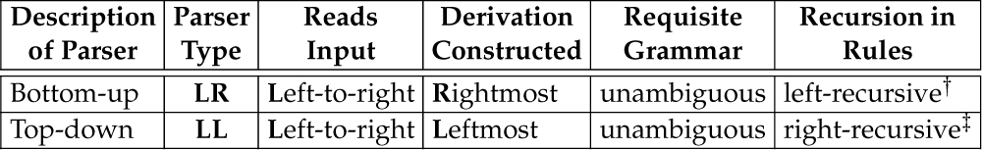
Table 3.5 Top-down Vis à Vis Bottom-up Parsers
(Key: ‡ = requisite; † = preferred.)

Slide 31
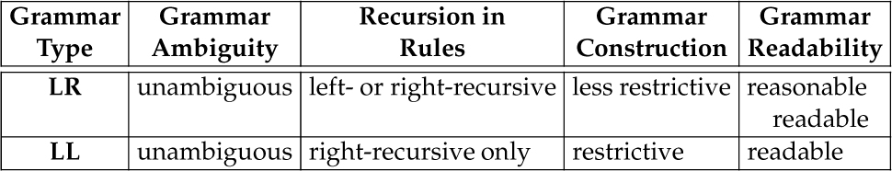
Table 3.6 LL Vis-à-Vis LR Grammars (Note: LL ⊂ LR.)

Slide 32
Outline
3.1 Chapter Objectives
3.2 Scanning
3.3 Parsing
3.4 Recursive-Descent Parsing
3.5 Bottom-up, Shift-Reduce Parsing and Parser Generators
3.6 PLY: Python Lex-Yacc
3.7 Top-down Vis-à-Vis Bottom-up Parsing
3.8 Thematic Takeaways

Slide 33
3.8 Thematic Takeaways
A seminal contribution to computer science is the discovery that grammars can be used as both language-generation devices and language-recognition devices.
The structure of a recursive-descent parser follows naturally from the structure of a grammar, but the grammar must be in the proper form.

