Slide 1

DEEP LEARNING · MULTI-CLASS IMAGE CLASSIFICATION
Real-Time American Sign Language Recognition System
Sinan Büyük · Michael Eith · Jordi Xu Wang

Slide 2
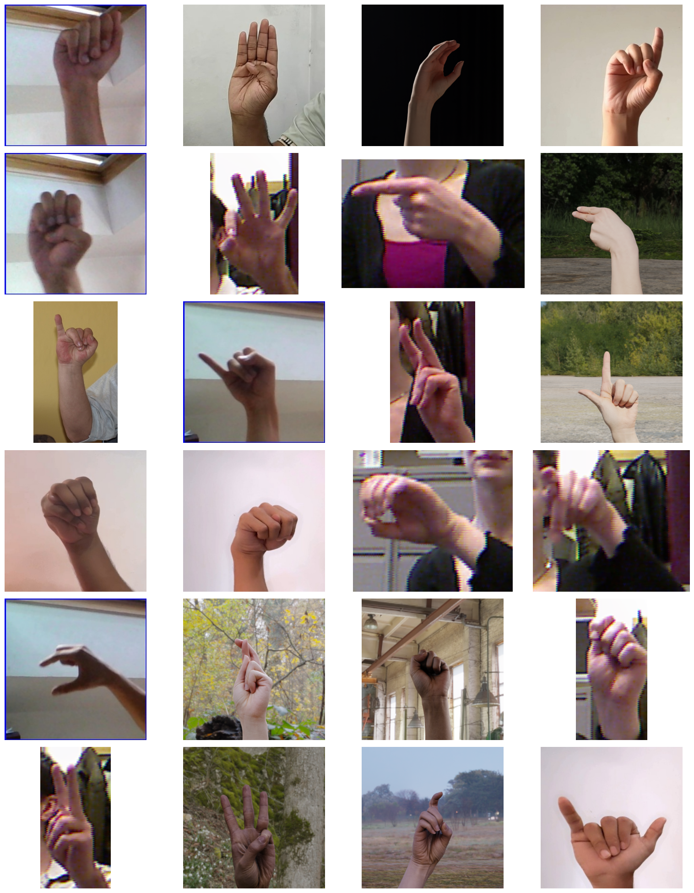
01 - INTRODUCTION
What is American Sign Language?
ASL is the primary language of approximately 500,000 deaf and hard-of-hearing individuals in North America and is used in some capacity by up to 6-7 million Americans.
Despite this, access to human interpreters remains limited and costly , creating a significant communication barrier within digital interfaces.
Objective: develop a robust model for real-time ASL recognition via standard webcams, generalizing across different signers, lighting conditions, and backgrounds.
37 classes: digits 1-10, letters A-Z, and a "blank" class representing no sign.
ASL hand gesture classes used in this study

Slide 3
01 - INTRODUCTION
Motivation & Domain Challenges
SOCIAL VALUE
DOMAIN-SPECIFIC CHALLENGES
Improves accessibility for Deaf and Hard-of-Hearing communities
Enables real-time transcription apps and interactive sign-learning platforms
Visual ambiguity: M and N differ by a single finger fold; U and V by a tiny gap between fingers
Orientation is semantic: flipping a gesture changes its meaning entirely - unlike standard object detection
TECHNICAL VALUE
Dataset diversity: clean studio hands vs. cluttered real-world backgrounds, varied lighting
Well-defined image-classification task with meaningful real-world difficulty
Cross-dataset generalization as the primary evaluation challenge
These constraints directly dictate which augmentation strategies are permissible during training - horizontal and vertical flips are strictly forbidden.

Slide 4
02 - RELATED WORK
State of the Art
1
Handcrafted Features + SVM
HOG features combined with Support Vector Machines. Functional in controlled lab environments, but fails to generalize to real-world lighting and background variation.
2
Shallow CNNs on Single Datasets
Near-duplicate consecutive video frames leak between train/test splits, inflating metrics. Performance collapses in real-world conditions, a common but underreported flaw.
3
MediaPipe Hands (Skeleton Landmarks)
Rapid detection but discards texture and depth information crucial for distinguishing highly similar signs such as M, N, S, and T, all fist-shaped gestures.
4
Transfer Learning — Current SOTA
Fine-tuning ImageNet-pretrained architectures on diverse, aggregated ASL datasets. Typically achieves 95–99% accuracy on benchmark sets, but frequently under easier conditions than our evaluation.

Slide 5
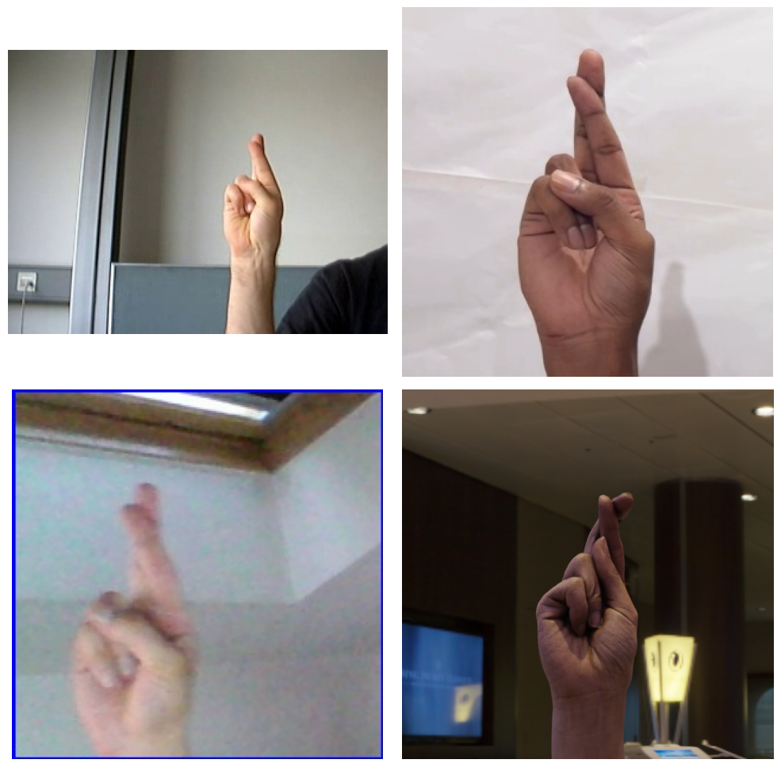
03 - DATASET
Dataset Unification
48,183
5
37
total images after filtering
source datasets
gesture classes
Source
Origin
Resolution
ASL Alphabet
Kaggle
200 × 200
ASL-HG
Mendeley
Variable HD
Combined ASL
Kaggle
400 × 400
LexSet Synthetic (×2)
Kaggle (Synthetic)
Variable
33,727
7,231
7,225
Training (70%)
Validation (15%)
Test (15%)
Strict stratified split applied after merging, every source contributes to every split.
Same sign across source datasets, illustrating the visual domain gap between sources.

Slide 6
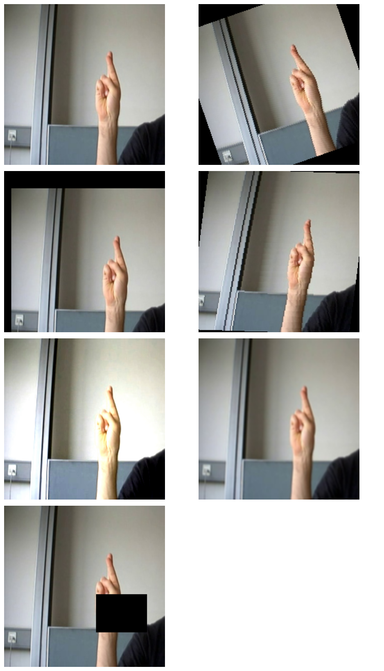
03 — DATASET
Preprocessing & Augmentation
NEAR-DUPLICATE FRAME FILTERING
ASL-HG: retain 1 in 50 frames - reduces to ~30 images per class
ASL Alphabet: retain 1 in 20 frames - reduces to ~151 images per class
Combined ASL: retain 1 in 50 frames (only for videos)
Prevents data leakage from consecutive near-identical video frames across splits
SHARDING & NORMALIZATION
Packed into WebDataset tar shards I/O efficiency
Stats computed from 8,000 training images only -> no data snooping
mean = [0.4876, 0.4538, 0.4196] / std = [0.2514, 0.2589, 0.2716]
DOMAIN-SPECIFIC AUGMENTATION (TRAINING ONLY)
Resize to 224 × 224; random affine (±15° rotation, 15% translation, 10° shear)
Color Jitter · Gaussian Blur · Random Erasing (p = 0.2)
No horizontal/vertical flips · No 90° rotations - orientation is meaning
Augmentations

Slide 7
04
Architecture & Methodology

Slide 8
04 - METHODOLOGY
Implemented Architectures
SCRATCH CNNS - INCREMENTAL ABLATION
TRANSFER LEARNING - PRETRAINED BACKBONES
Each model isolates a single component's contribution. All 37-dimensional output logits.
ImageNet-pretrained; classifier head replaced with Dropout + Linear(37).
ResNet-18
11.18M params
BaselineCNN - 2-block conv network; performance floor (0.16M params)
ResNet-50
25.56M params
DeepCNN - 4-block; tests whether capacity alone generalizes (1.45M params)
EfficientNet-B0
5.29M params
MobileNetV3-Small
2.54M params
+ Dropout (p = 0.5) - regularization ablation on top of BN
+ Batch Normalization - addresses optimization instability
Two-Phase Training Strategy
+ Augmentation - improves generalization
Phase 1 - Freeze backbone, train head only (5 epochs)
Phase 2 - Unfreeze all layers, fine-tune end-to-end

Slide 9
05 - TRAINING
Training Configuration
Hyperparameter
Value
CLASS IMBALANCE HANDLING
The "blank" class is over-represented with 1,422 images vs. roughly 700 for digit classes. Inverse-frequency class weights penalize majority-class bias in the loss.
Optimizer
Adam
Learning Rate
1e-3 | 1e-4 with Cosine Annealing
Weight Decay
1e-4
PRIMARY EVALUATION METRIC
Epochs
50
Loss Function
Class-weighted Cross-Entropy
Macro-F1 Equal weight per class, robust to imbalance. Also tracked: Accuracy, Balanced Accuracy, and parameter count.
Gradient Clipping
max norm = 1.0
Mixed Precision
Enabled (AMP)

Slide 10
06
Experimental Results

Slide 11
06 - RESULTS
Quantitative Results
Model Architecture
Params (M)
Test F1
Test Acc
Bal Acc
ResNet-50 (Transfer)
25.56
99.59%
99.61%
99.59%
EfficientNet-B0 (Transfer)
5.29
99.57%
99.60%
99.57%
ResNet-18 (Transfer)
11.18
99.46%
99.49%
99.45%
MobileNetV3-Small (Transfer)
2.54
98.92%
98.95%
98.92%
DeepCNN + BN (Scratch)
1.45
95.76%
95.71%
95.75%
DeepCNN + BN + Dropout (Scratch)
1.45
93.49%
93.33%
93.43%
BaselineCNN (Scratch)
0.16
69.29%
69.65%
69.46%
Evaluated on the untouched held-out test set. Macro-F1 is the primary metric (equal weight per class).

Slide 12
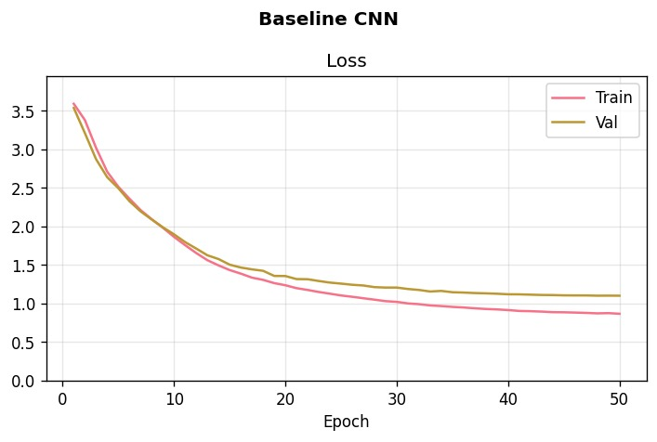
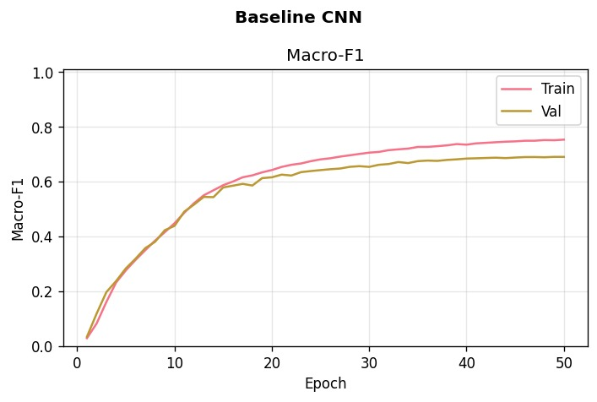
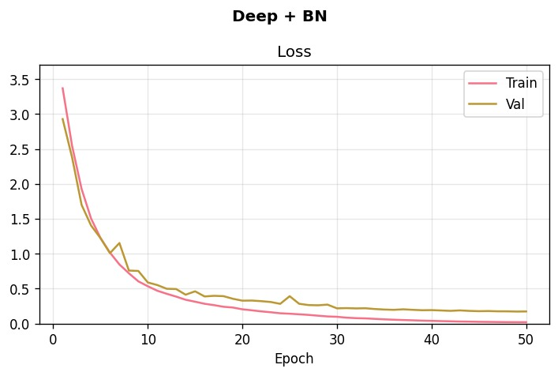
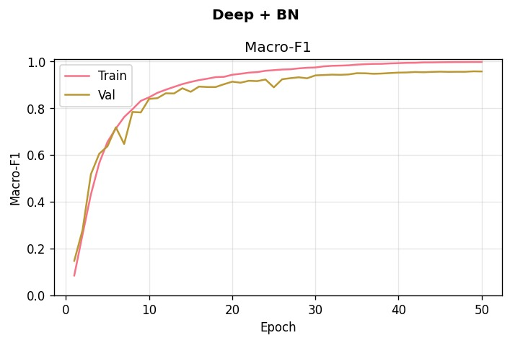
06 - RESULTS
Learning Curves & Convergence Behaviour
Scratch models climb gradually over 30 Epochs.
Biggest change can be seen during switch from Deep CNN to Deep + Batch Normalization
BaselineCNN shows classic overfitting by showing training loss falls while validation loss rises

Slide 13
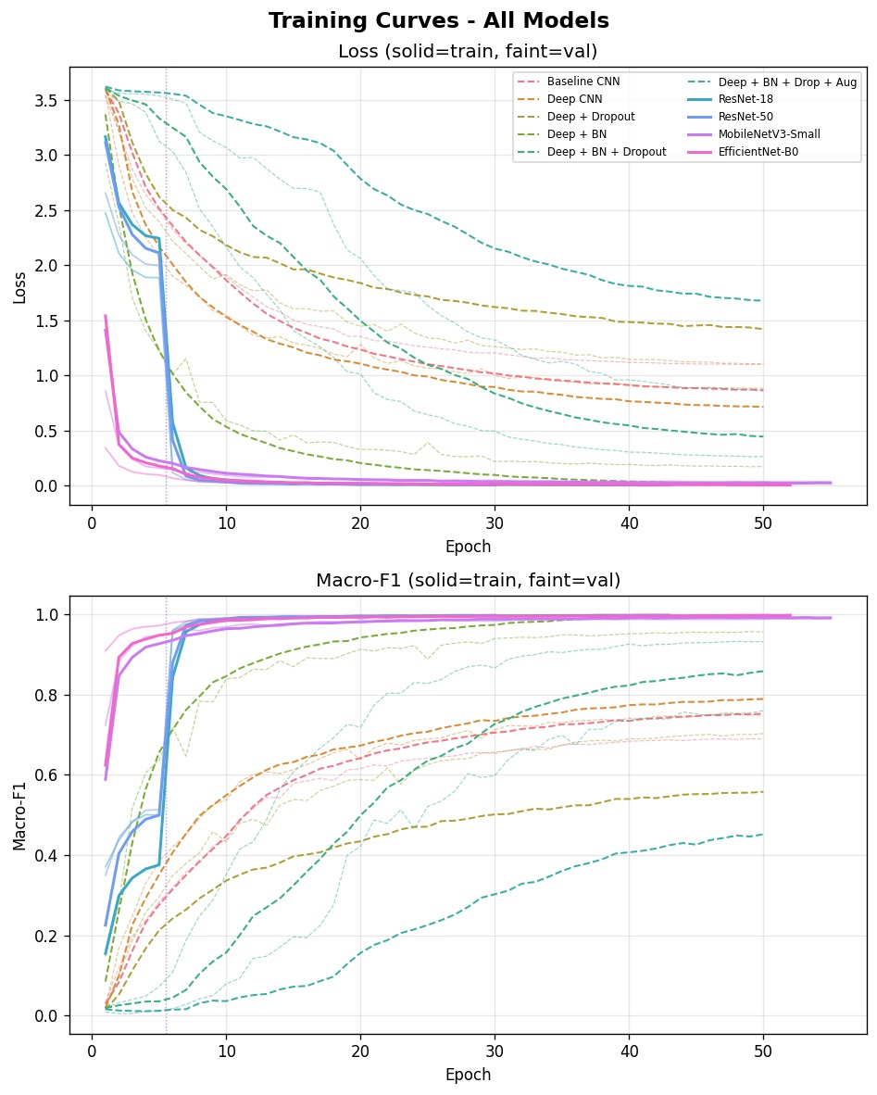
06 - RESULTS
Training Dynamics
Transfer models converge in a few epochs
→ fine-tune jump at epoch 5 is clearly visible
Even though EfficientNet-B0 has only 1/5 of the parameters, it performs equally well to ResNet-50

Slide 14
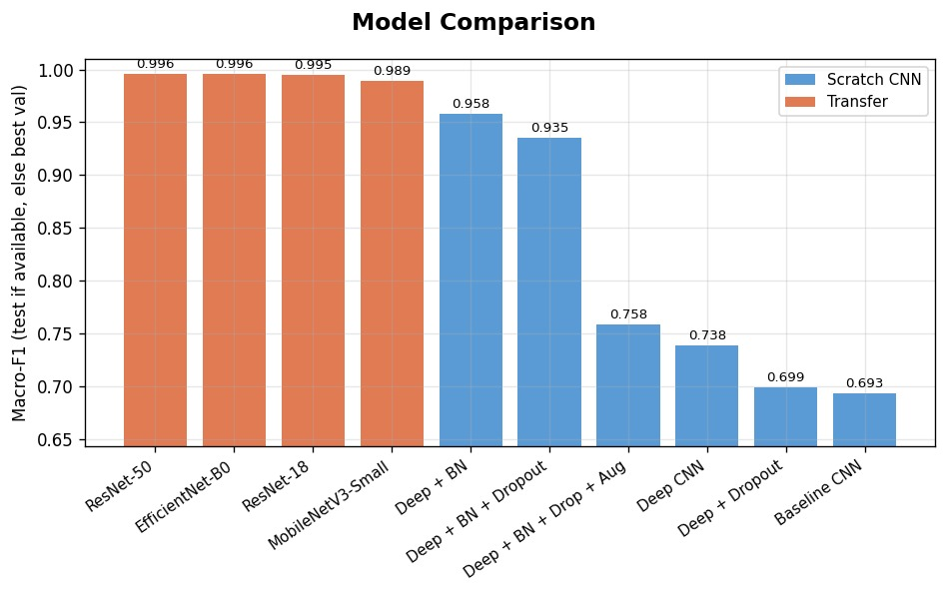
06 - RESULTS
Component Analysis & SOTA Comparison
KEY FINDINGS
BatchNorm is the critical scratch lever approximately +30 pp gain over unregularized DeepCNN
Parameter saturation at ~11M: ResNet-50 (25.6M) ≈ ResNet-18 (11.2M) in Test F1 as extra parameters add no generalization benefit
Transfer learning also adds a good chunk over the best scratch model
vs. Published SOTA
SOTA reports 95–99% on fewer classes without near-duplicate filtering. Our ResNet-50 and EfficientNet-B0 achieve >99.5% Test F1 on a 37-class, heavily deduplicated dataset which demonstrates genuine cross-dataset generalization.

Slide 15
07 — LIMITATIONS
Limitations & Observations
Static Frame Constraint
Environmental Limitations
Hardware Overhead
Synthetic Domain Gap
The system classifies each frame independently. Continuous ASL signing relies on motion vectors and transitions. Therefore, dynamic sequence understanding is not captured by the current model.
Training images were predominantly from clean, hand-only settings. Performance degradation in cluttered environments remains systematically unquantified.
Despite fewer parameters, EfficientNet-B0 required the highest GPU memory (11.6 GB) due to large intermediate activation maps from its compound scaling architecture.
LexSet computer-rendered hands improved minority class coverage but injected a visible domain gap via artificial skin textures and lighting falloffs absent in real-world images.

Slide 16
07 — CONCLUSIONS
TAKEAWAYS
—
A unified cross-dataset pipeline reaches SOTA-level accuracy on 37 classes
Conclusions & Deployment
—
Transfer learning is the dominant lever: +30 pp over scratch baselines
—
MobileNetV3-Small optimal for edge, laptop inference, no dedicated GPU required
99.59%
best Test F1 for ResNet-50
98.92%
MobileNetV3-Small, optimal edge deployment (2.54M params)
FUTURE WORK
95.76%
—
best scratch CNN (DeepCNN + BN)
Temporal sequence modeling (Transformers / LSTMs) for continuous signing
—
Automated hand-detection preprocessin which eliminates fixed ROI bounding boxes

Slide 17
Real Time Demonstration

