Slide 1
Phone Dump
Solving first world problems for the third world

Slide 2
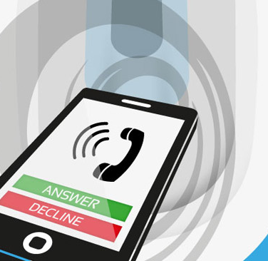
Phone Dump
Solving first world problems for the third world

Slide 3
Team Phone Dump
Jordan Knight
David Burela
Jeff Alexander
Simon Jäger
Vaughan Knight
Andrew Coates

Slide 4
Problem Statement
Add what are we solving here…

Slide 5
Architecture
\
Local Network
Token Validation
CAH
File Save
Discovery
Notifications
Share Target Cache
List Files
Show File
Registration
Share File

Slide 6
Use Cases
Add your first bullet point here
Add your second bullet point here
Add your third bullet point here

Slide 7
Process
DevOps
Team Communication
Testing

Slide 8
Devops
Visual Studio Team Services
Continuous Integration
Continuous Delivery
Continuous Monitoring
Kanban
Hockey App
Xamarin Test Cloud
Perfecto

