Slide 1
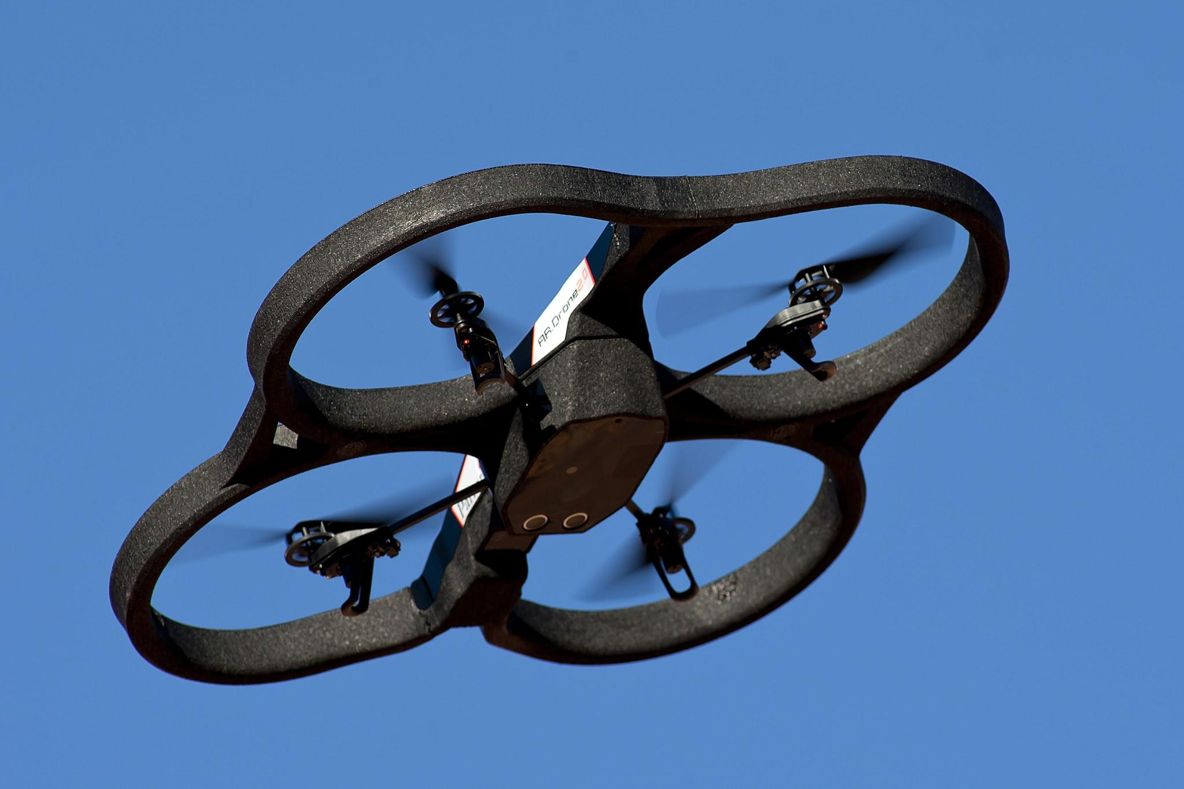
Navigation of an UAV Utilizing a Created Map and Physical Markers
Jordon Garza
University of Houston
Mario Greene
Lawson State Community College
By Nicolas Halftermeyer [CC BY-SA 3.0 (https://creativecommons.org/licenses/by-sa/3.0)], from Wikimedia Commons

Slide 2
Overview
Context of the Problem
Discussion of Other Methods
SLAM and Types of SLAM
Marker Recognition and Homing
Our Project
Hardware for the Project

Slide 3
Context of the Problem
Global Positioning System is standard for navigation, but comes with limitations
Need for GPS-less travel and homing
Solution must be feasible in terms of payload limitations

Slide 4
Other Methods of GPS-less Travel
Neural Networks and Deep Learning
Using LiDAR sensors
Ultrasonic sonar systems

Slide 5
Neural Networks and Deep Learning
Useful for navigation and object avoidance
Weights and Probabilities for performing a selection of many choices
Capable of extremely fast movements and changes, racing level
S. Jung, S. Hwang, H. Shin and D. H. Shim, "Perception, Guidance, and Navigation for Indoor Autonomous Drone Racing Using Deep Learning," in IEEE Robotics and Automation Letters, vol. 3, no. 3, pp. 2539-2544, July 2018

Slide 6
Using LiDAR Sensors
Capabilities for SLAM and object avoidance
Sensors are weighty
Also need additional work to get from a 2D LiDAR to 3D LiDAR mapping
Miller, Mikel M ; Soloviev, Andrey ; Uijt de Haag, Maarten ; Veth, Michael ; Raquet, John ; Klausutis, Timothy J ; Touma, Jimmy E, “Navigation in GPS Denied Environments: Feature-Aided Inertial Systems”

Slide 7
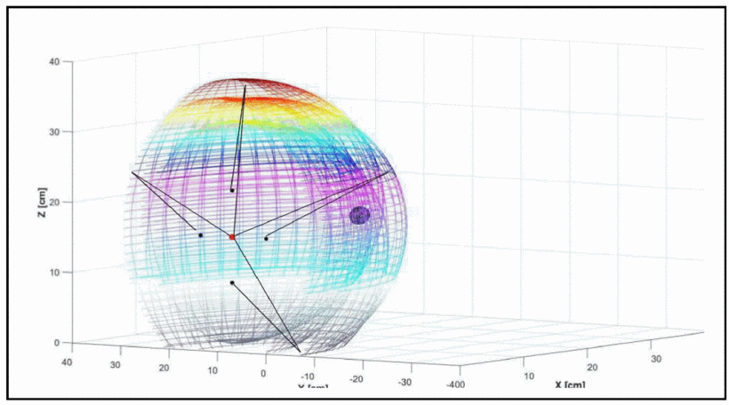
Ultrasonic Sonar Systems
For localization of a drone
Acoustic signals sent and reflect back to receivers
Ellipsoids created by transmitters and receivers
Intersections of ellipsoids provide a 3D location
F. Guarato, V. Laudan and J. F. C. Windmill, "Ultrasonic sonar system for target localization with one emitter and four receivers: Ultrasonic 3D localization," 2017 IEEE SENSORS, Glasgow, 2017, pp. 1-3.

Slide 8
SLAM and Types of SLAM
LSD SLAM (large-scale direct monocular vision)
monocular
ORB SLAM
Stereo
Lidar
RGB-D SLAM
Stereo

Slide 9
LSD SLAM
Monocular Vision
Features
Direct Monocular Input
Realtime camera trajectory
Mapping
Tracking
Engel J., Schöps T., Cremers D. (2014) LSD-SLAM: Large-Scale Direct Monocular SLAM. In: Fleet D., Pajdla T., Schiele B., Tuytelaars T. (eds) Computer Vision – ECCV 2014. ECCV 2014. Lecture Notes in Computer Science, vol 8690. Springer, Cham

Slide 10
ORB SLAM
Monocular Vision
Stereo Vision
RGBD Vision
Features
Realtime camera trajectory
Use to reconstruct 3D mapping
R. Mur-Artal and J. D. Tardós, "ORB-SLAM2: An Open-Source SLAM System for Monocular, Stereo, and RGB-D Cameras," in IEEE Transactions on Robotics, vol. 33, no. 5, pp. 1255-1262, Oct. 2017.

Slide 11
RGB-D SLAM
RGB-D Vision
Features
Estimate camera trajectory
Use to reconstruct 3D mapping
F. Endres, J. Hess, N. Engelhard, J. Sturm, D. Cremers and W. Burgard, "An evaluation of the RGB-D SLAM system," 2012 IEEE International Conference on Robotics and Automation, Saint Paul, MN, 2012, pp. 1691-1696.

Slide 12
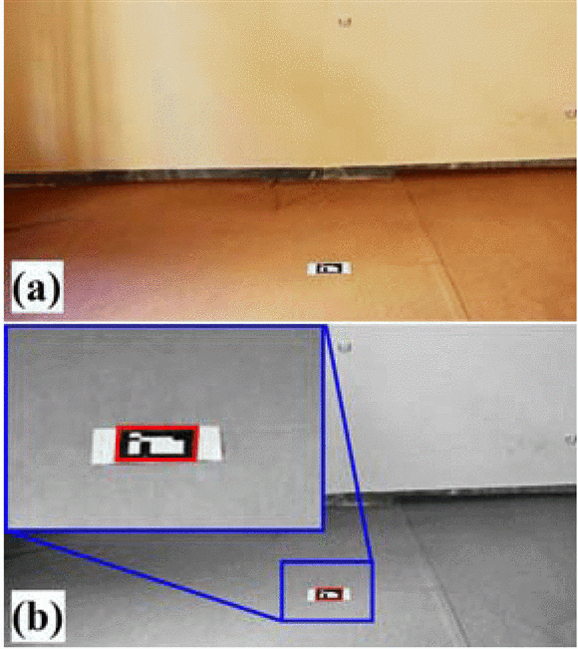
Marker Recognition and Homing
ArUco markers and AR markers that the drone’s camera can recognize as unique markers
Can get relative-pose of marker in relation to drone
Research focusing on homing and landing on markers
R. Polvara, S. Sharma, J. Wan, A. Manning and R. Sutton, "Towards autonomous landing on a moving vessel through fiducial markers," 2017 European Conference on Mobile Robots (ECMR), Paris, 2017, pp. 1-6.
M. F. Sani and G. Karimian, "Automatic navigation and landing of an indoor AR. drone quadrotor using ArUco marker and inertial sensors," 2017 International Conference on Computer and Drone Applications (IConDA), Kuching, 2017, pp. 102-107.

Slide 13
This Project: Use SLAM and AR markers to allow a drone to return home autonomously
Have the drone take-off on an physical marker that the drone will recognize and log as a “home base”
Using Stereo SLAM, have the drone localize itself in its environment and create a map
The home base will be a saved position
Have the drone travel to back to its home base autonomously
Out of scope: Landing Capabilities on the Marker, Object Avoidance

Slide 14
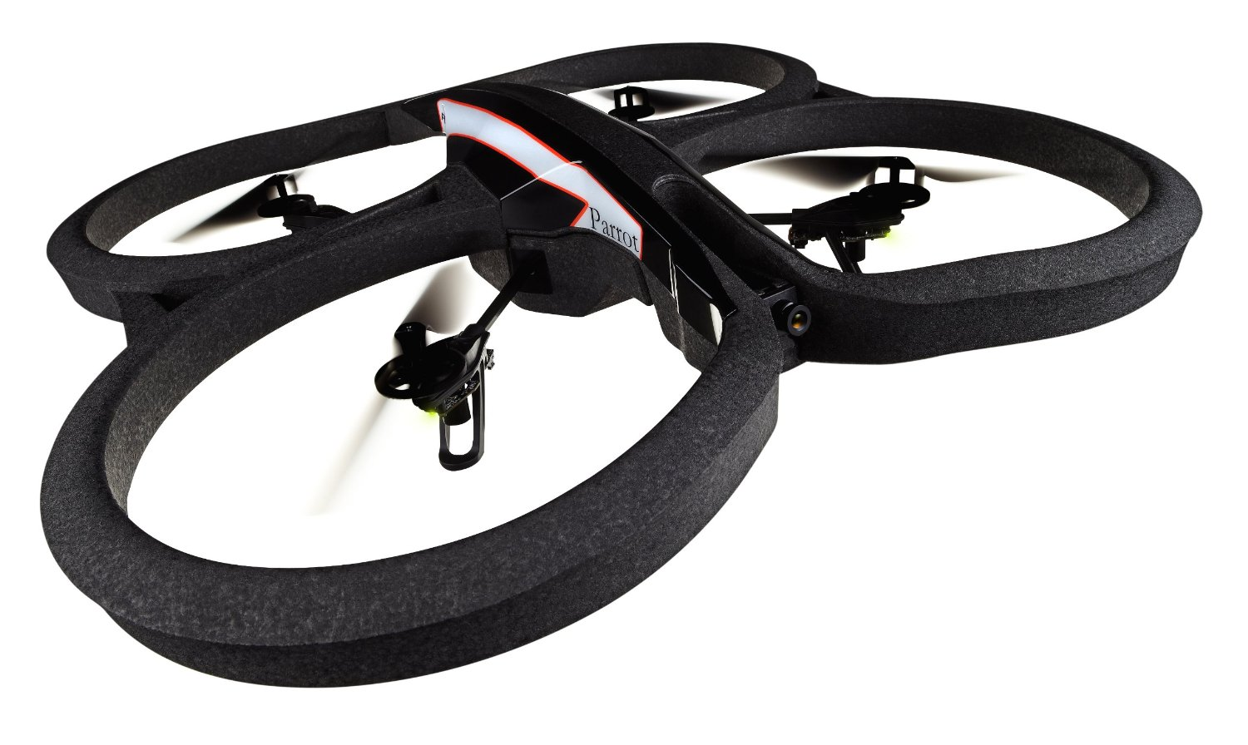
Hardware of the Project
Parrot AR.Drone 2.0 connected to ROS framework
Raspberry Pi and Stereo Cameras
By Syahlevi [CC BY-SA 4.0 (https://creativecommons.org/licenses/by-sa/4.0)], from Wikimedia Commons

Slide 15
Where is the Project Currently
AR.Drone 2.0 fully functional, flyable and connected to the ROS framework
Some packages installed for general control and autonomy
Identified packages allowing for Stereo SLAM and marker recognition
Getting Raspberry Pi prepped

Slide 16
Review of Presentation
Topics Covered:
Context of the Problem (GPS-less Travel)
Discussion of Other Methods for UAV Navigation
SLAM and Types of SLAM
Marker Recognition and Homing
Our Project of Combining SLAM and Marker Recognition
Hardware for the Project

