Slide 1

Connect Four
Minimax and alpha-beta Pruning

Slide 2
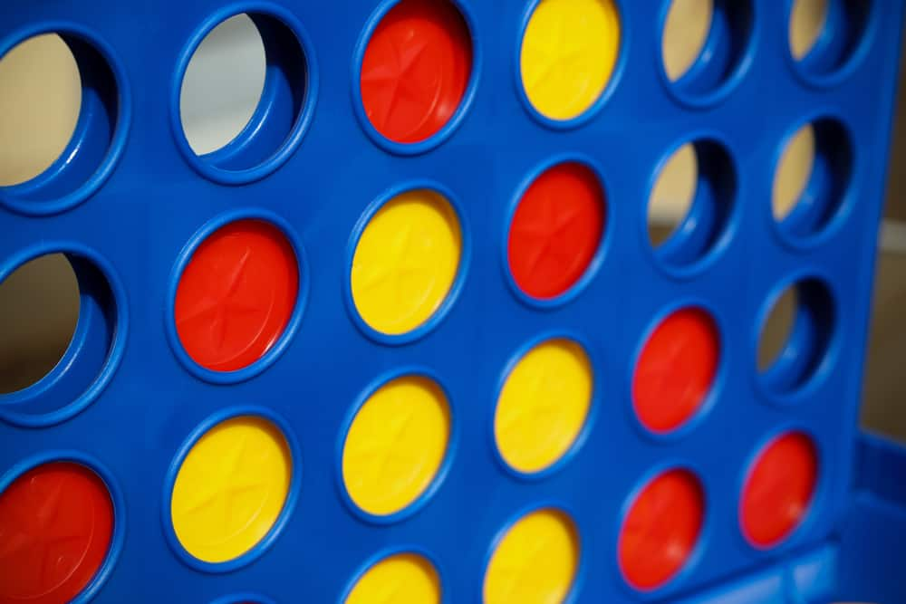
What is Connect four?
Connect Four is a two-player, turn-based connection game, where players must choose a color and drop colored tokens into a seven-column, six-row grid.
The objective of the game is to be the first player to have four of the same-colored tokens placed horizontally, vertically or diagonally, to each other.

Slide 3

My Implementation
I used HTML, CSS and JavaScript primarily for my implementation.

Slide 4
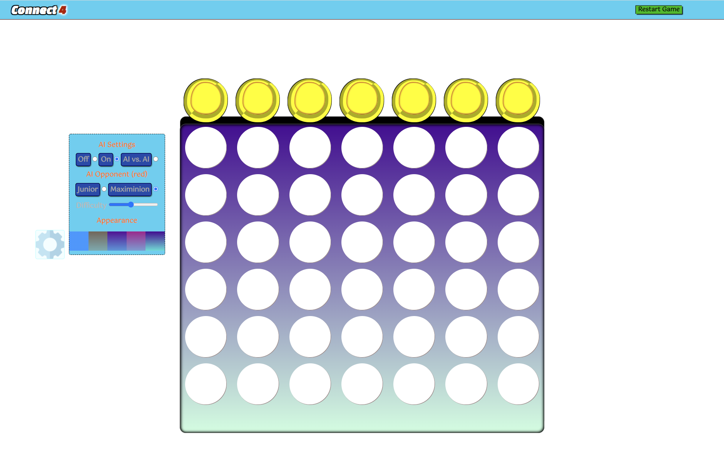
My Implementation(HTML)
HTML used to place the different elements around the webpage, where they needed to be.
Navigation Bar
Restart Button
Settings Menu
Main Game Area

Slide 5
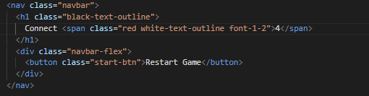
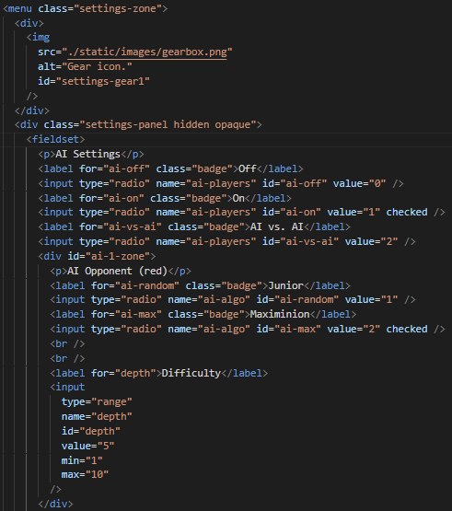
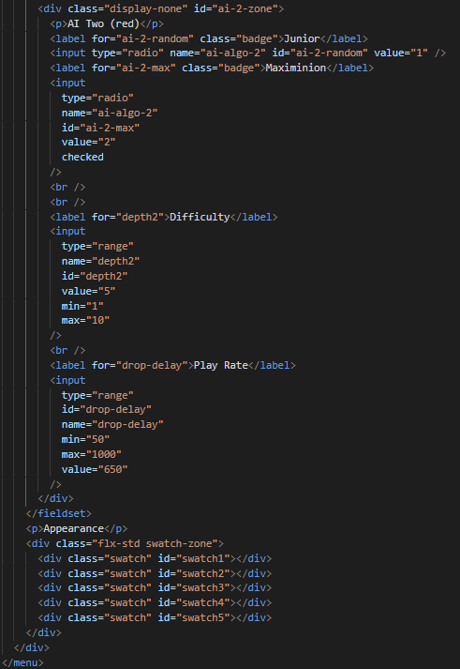
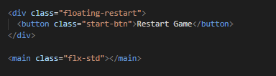
My implementation(html)
Navigation Bar
Restart Button & Main Game Area
Settings Menu

Slide 6
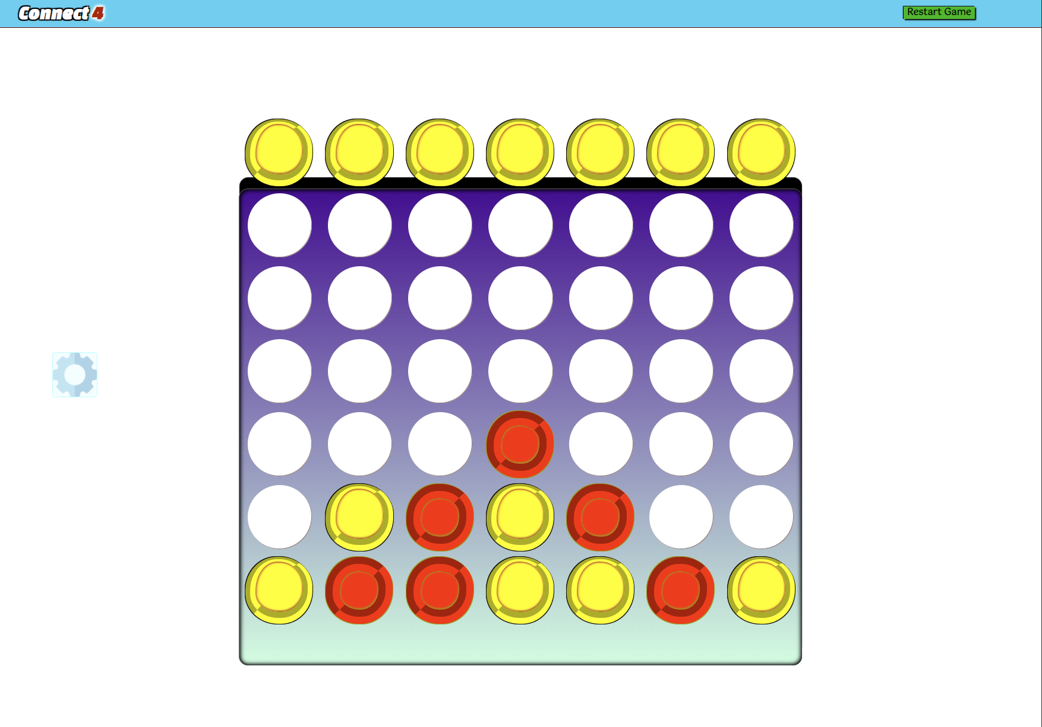
My Implementation(CSS)
Basic CSS for everything
Design of Grid
Style of Menus
Style of game pieces

Slide 7
My implementation(JAVASCRIPT)
Phase one
Create platform
Create Grid
Create Game Pieces
Implement game rules
Player switches each turn.
Check for horizontal/vertical/diagonal set of 4 for win.
Phase two
Implement AI-logic for AI player
Minimax
Alpha-beta Pruning

Slide 8
PHASE ONE

Slide 9
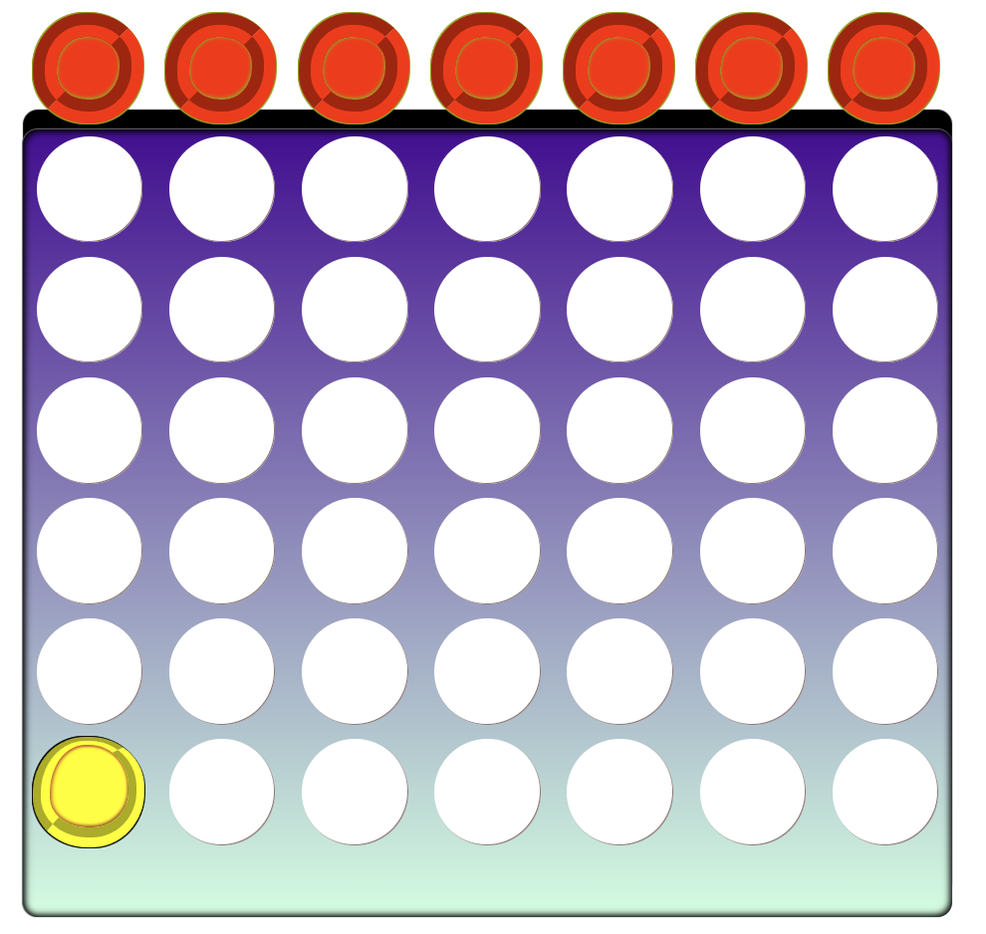
Create Platform
Create the grid (6 rows, 7 columns)
Create drop pieces(red, yellow)

Slide 10
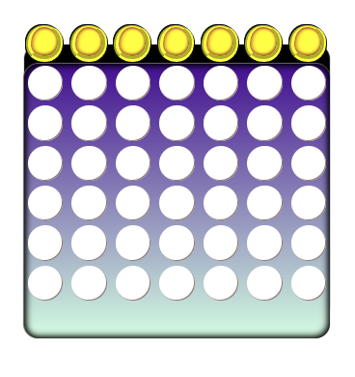
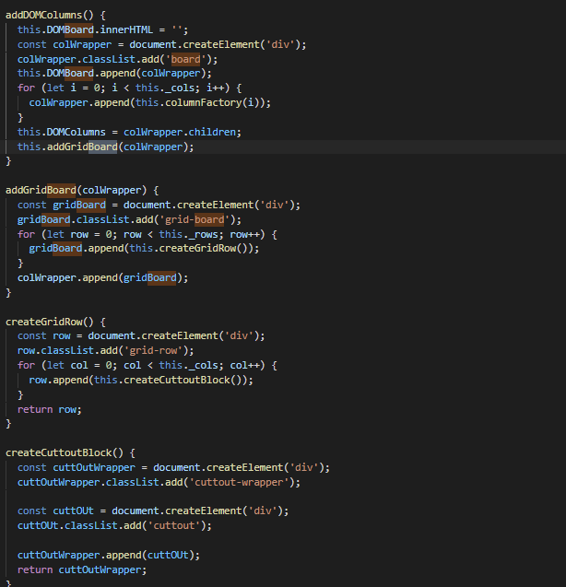
Create grid/Board
addDomColumns() creates columns as div elements (colWrapper).
Each column (colWrapper) is passed into addGridBoard() where it creates a new div element comprising all the columns.
createGridRow then creates the rows .
createCuttoutBlock() creates the cutout holes for the game pieces to be placed in.

Slide 11
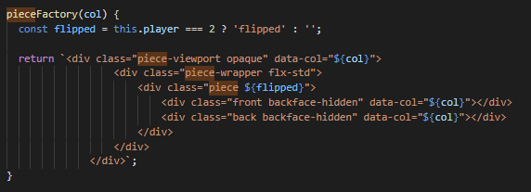
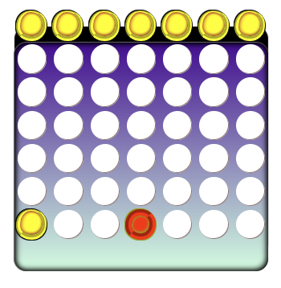
Create Game pieces
pieceFactory() returns a set of innerHTML elements that creates the game pieces.
These pieces are styled in css

Slide 12
Implement Game rules
Turn based( p1 moves then p2 then p1 moves again)
Check for winning play.
line of 4 pieces vertical, horizontal or diagonal

Slide 13
Turn Based
placePiece()
alterBoard() returns the open rows/spots available
Player makes decision
animateDrop() this does the animation for the pieces falling into the slots
checkForWin() checks if there is 4 pieces of the same color diagonally, horizontally or vertically*
switchPlayer() switches to the next player
Checks if both AI players or if one player1 and one AI player
makeAIMove() Random at first

Slide 14
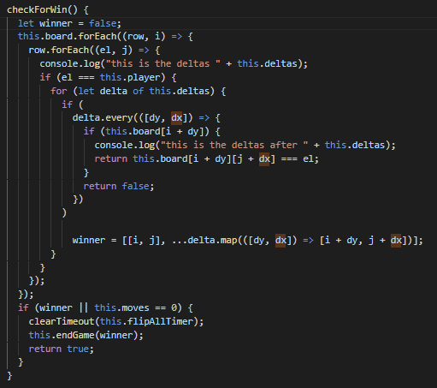
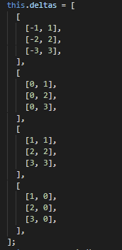
Check for 4 IN A ROW
CheckForWin() checks for pieces using delta values like a graph

Slide 15
PHASE TWO

Slide 16
Implementing AI-logic
Minimax With Alpha-beta pruning

Slide 17
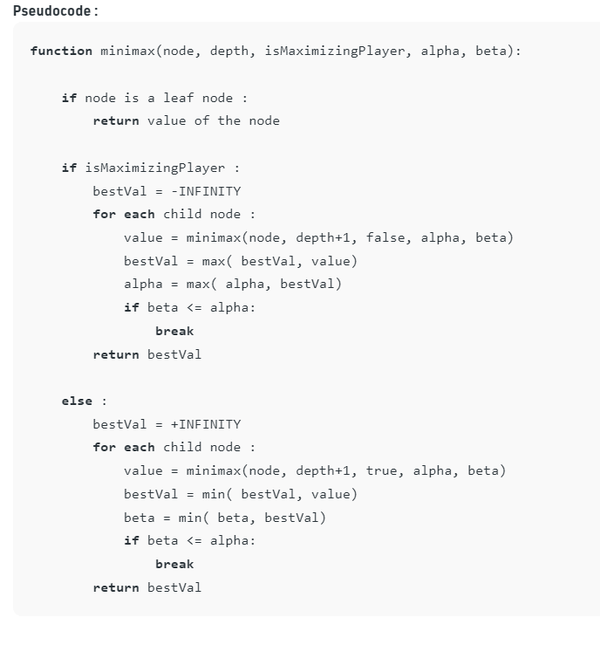
Minimax and Alpha-Beta Pruning

Slide 18
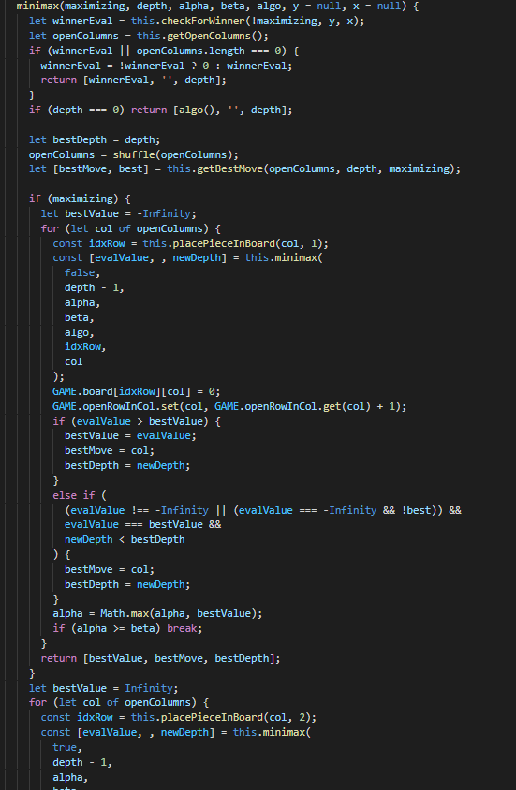
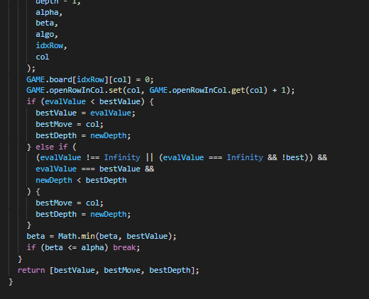
Minimax and Alpha-Beta Pruning

Slide 19
references
“Minimax Algorithm in Game Theory: Set 4 (Alpha-Beta Pruning).” GeeksforGeeks, 18 Aug. 2021,
https://www.geeksforgeeks.org/minimax-algorithm-in-game-theory-set-4-alpha-beta-pruning/
Wikipedia Contributors. “Connect Four.” Wikipedia, Wikimedia Foundation, 16 Nov. 2019,
en.wikipedia.org/wiki/Connect_Four.
‌Wikipedia contributors. “Minimax.” Wikipedia, 12 Mar. 2022,
en.wikipedia.org/wiki/Minimax.
https://connect4.gamesolver.org/
“How to Program a Connect 4 AI (Implementing the Minimax Algorithm).” YouTube, uploaded by Keith Galli, 2 Jan. 2019, www.youtube.com/watch?v=MMLtza3CZFM.
“Algorithms Explained – Minimax and Alpha-Beta Pruning.” YouTube, uploaded by Sebastien Lager, 20 Apr. 2018, www.youtube.com/watch?v=l-hh51ncgDI&t=0s.
“Connect 4 Game Python.” YouTube, uploaded by Keith Galli, 6 Dec. 2017, www.youtube.com/playlist?list=PLFCB5Dp81iNV_inzM-R9AKkZZlePCZdtV.
“CSS Tutorial.” W3schools, www.w3schools.com/css. Accessed 3 May 2022.
Marcomelilli, and Marcomelilli. “Four-in-a-Row-Js-Minimax/Minimax.Js at Master · Marcomelilli/Four-in-a-Row-Js-Minimax.” GitHub, github.com/marcomelilli/four-in-a-row-js-minimax/blob/master/minimax.js. Accessed 3 May 2022.

