Slide 1
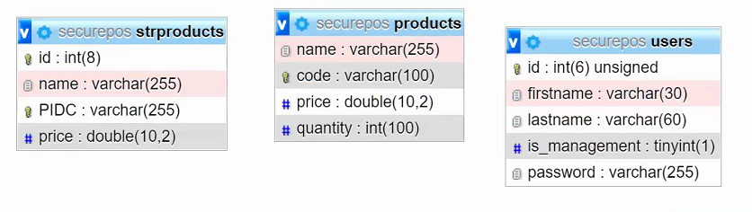
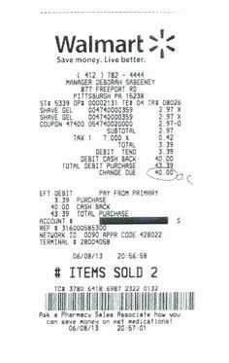
vendors
VID
company
EIN
street1
street2
city
state
zip
phone
fax
website
contact
email
Super market retail items
Employee – management levels, timesheet
Transactions – several tables
Logs - how many tables?
Z-reports – several tables
Vendor – x 2?
Lost liters
Tax
returns
products
PID - ai
name
sku
VID
quantity
ws_cost
rt_cost
is_taxable
is_perishable

Slide 2
Super market retail items
Employee – management levels, timesheet
Transactions – several tables
Logs - how many tables?
Z-reports – several tables
Vendor – x 2?
Lost liters
Tax - TXID
returns
Header - THID
transaction
TID
THID
EID
timestamp
TXID
…
qr_code
products_sold
PSID
TID
PID
COID

