Slide 1
Meeting Kaitlin
Joren Janzing

Slide 2
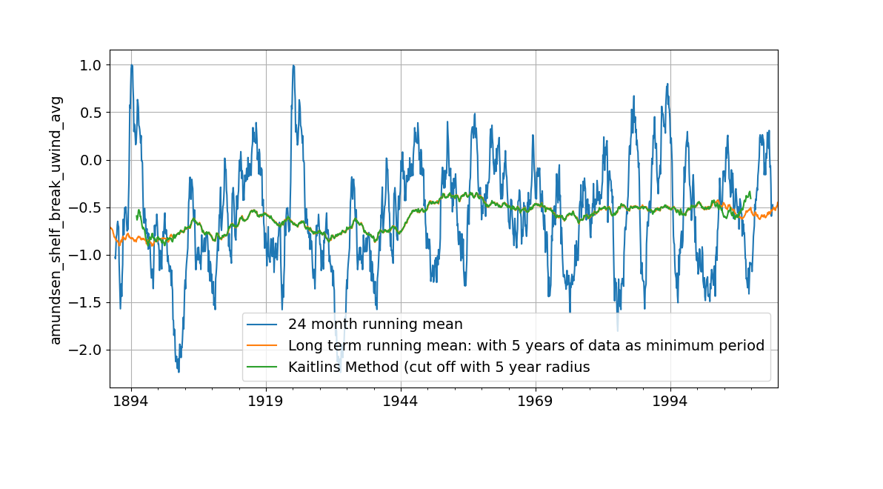
How to apply running mean?

Slide 3
