Slide 1
Overview
21-12-2021

Slide 2
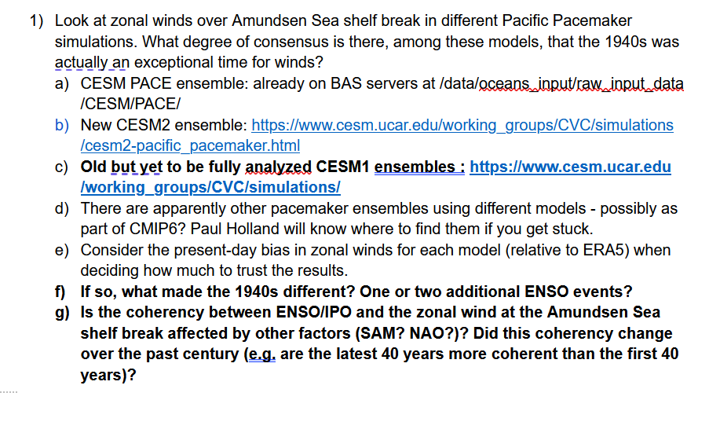

Slide 3
To what extent was the 1940s an exceptional period for winds in the PACE ensemble?
Wind centered and 1940s centered question!
What is normal? - Average winds over the region per month.
Are the 1940s anomalous (in PACE; without looking at ENSO)?
If so, what made these different? How unique is the ENSO event? What is the contribution of other indices?
Relevant side questions:
How reliable are the model results?

Slide 4
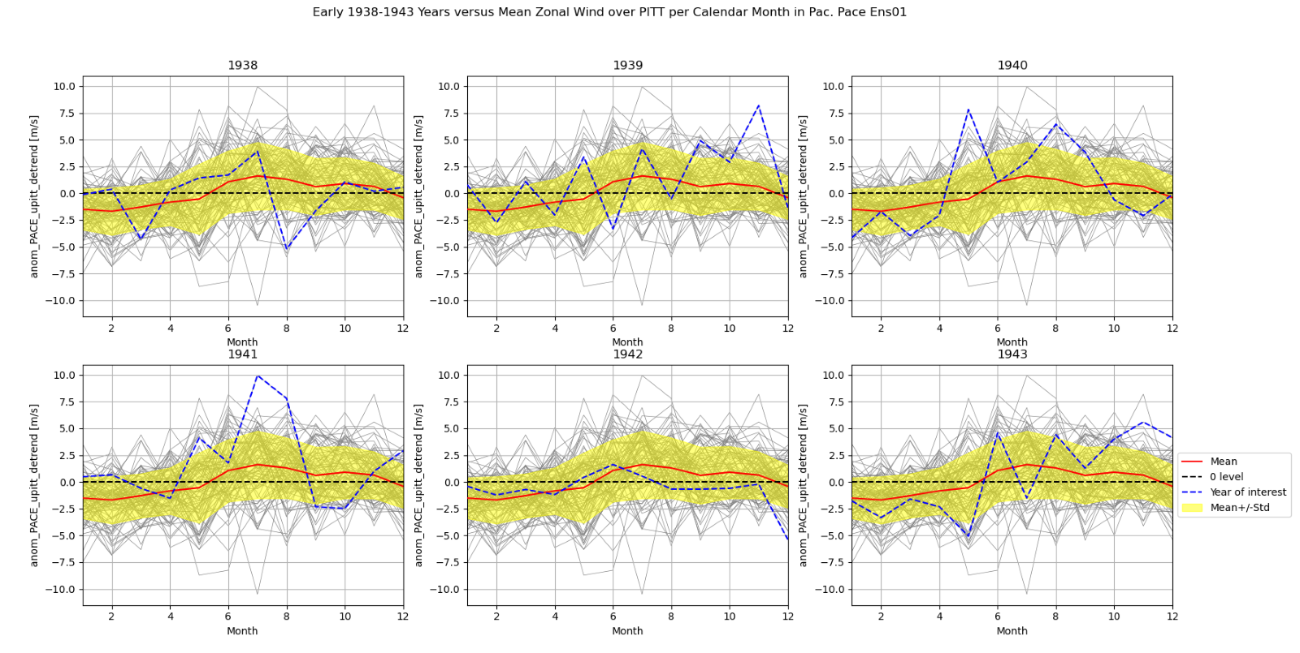
Figure Main 1: Detrended mean zonal wind per calendar month over the PITT region compared with individual 1938-1943 years in the Pacific Pacemaker ensembles. NOTE: NOW ONLY ENS01 IS USED. Red shows the mean per calendar month, yellow shows the 1 standard deviation and blue shows the year of interest. The grey lines show individual years.

Slide 5
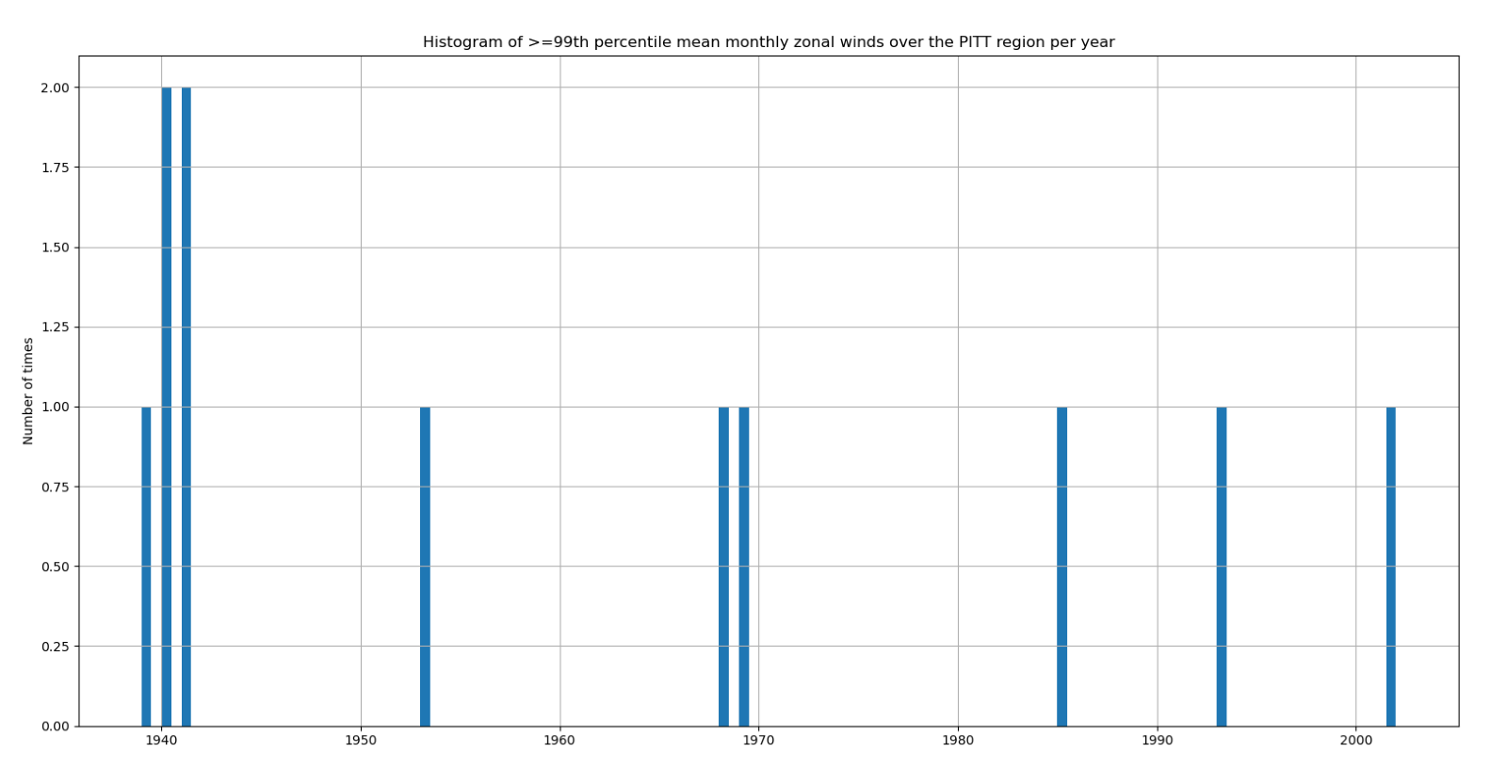

Slide 6
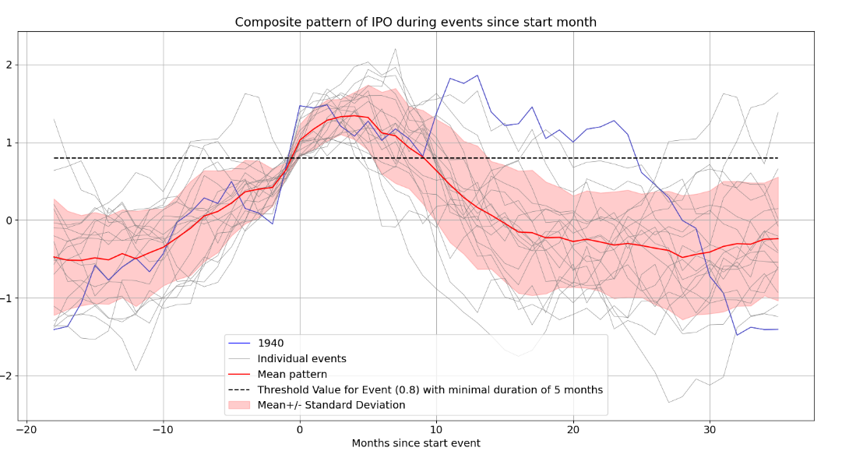
Figure 6 Stack of all events in the IPO index found by looking at a threshold of 0.8 for a minimal duration of 5 months. Horizontal axis shows the time in months since the start of the detection, vertical axis the IPO value. Note that therefore the calendar months are not aligned. Blue line shows the 1940 event, grey lines show other events. The red bold line shows the mean of all events together, the red shaded area is the mean +/- the standard deviation for that month and the black dashed line shows the indicated threshold value.

Slide 7
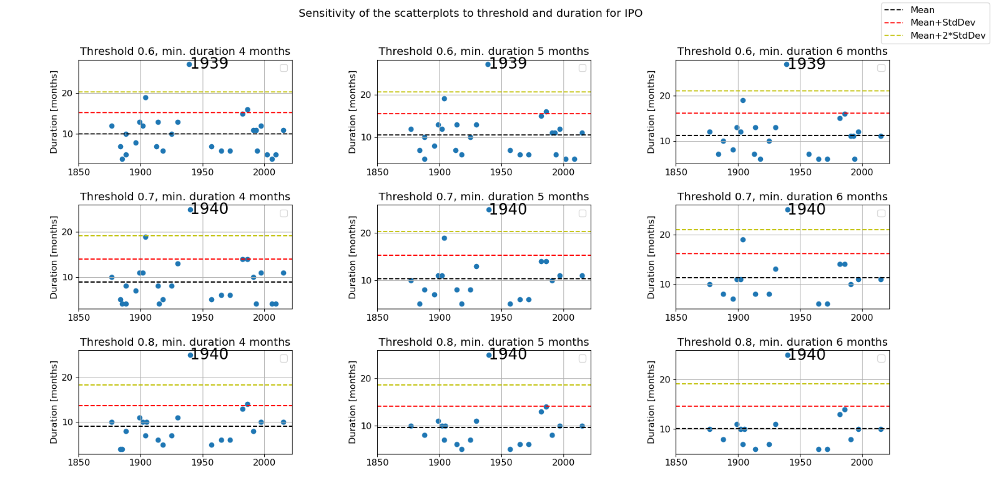
Figure 9 Dependency of the El Niño event duration in the IPO index on the used threshold and minimal duration. Scatterplots are similar to figure 7 and show the duration of that the events detected in the IPO remain above the threshold value. Horizontal axis show the calendar year, the vertical axis shows the duration of the events in months. Black dashed line indicates the mean duration of all events, the red and yellow dashed indicate the mean plus 1 and 2 standard deviations, respectively. 1940 event is indicated.

Slide 8
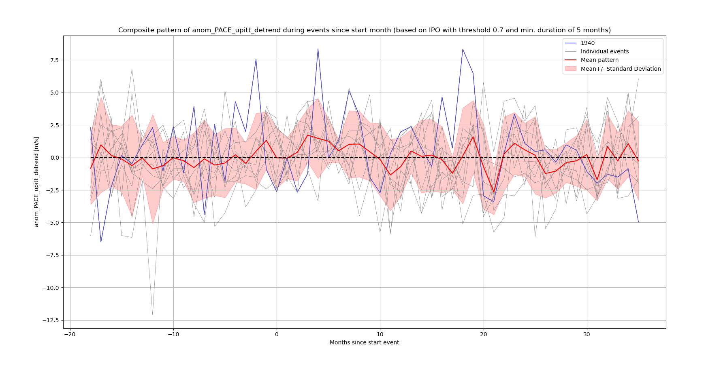

Slide 9
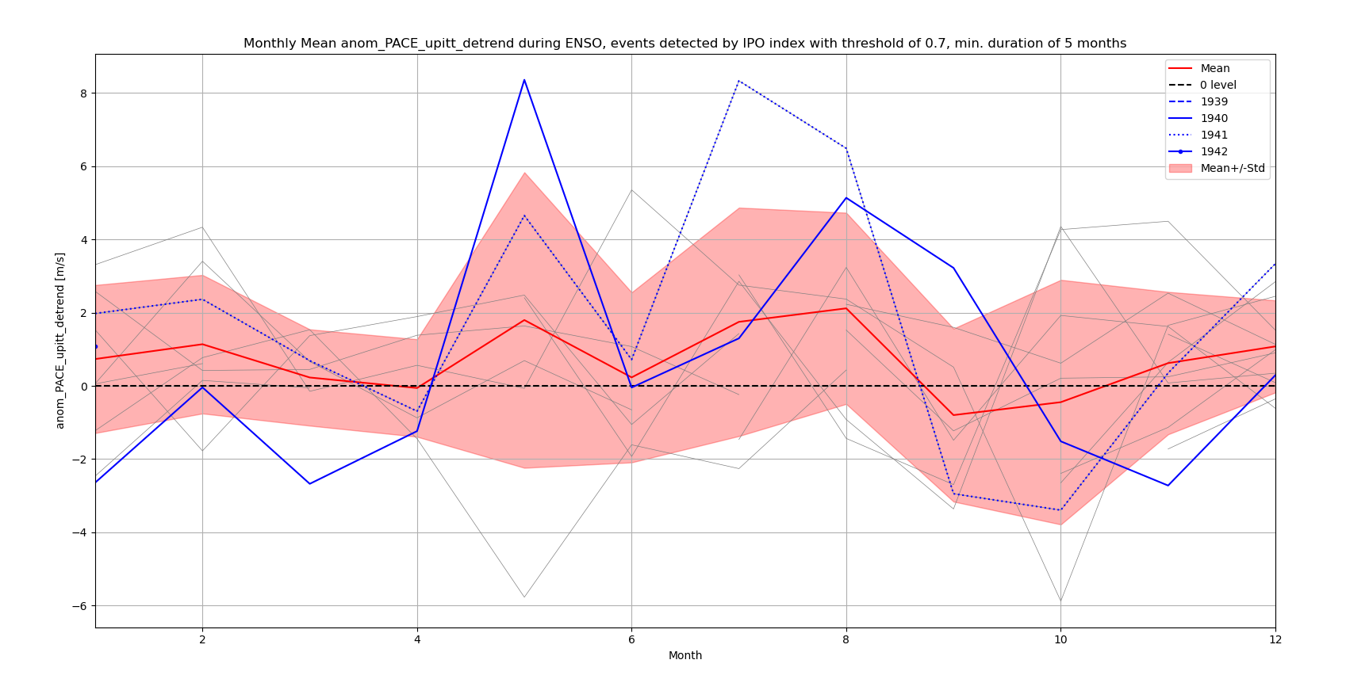
CAlendar

