Slide 1
Meeting 24/1/2022
Joren Janzing

Slide 2
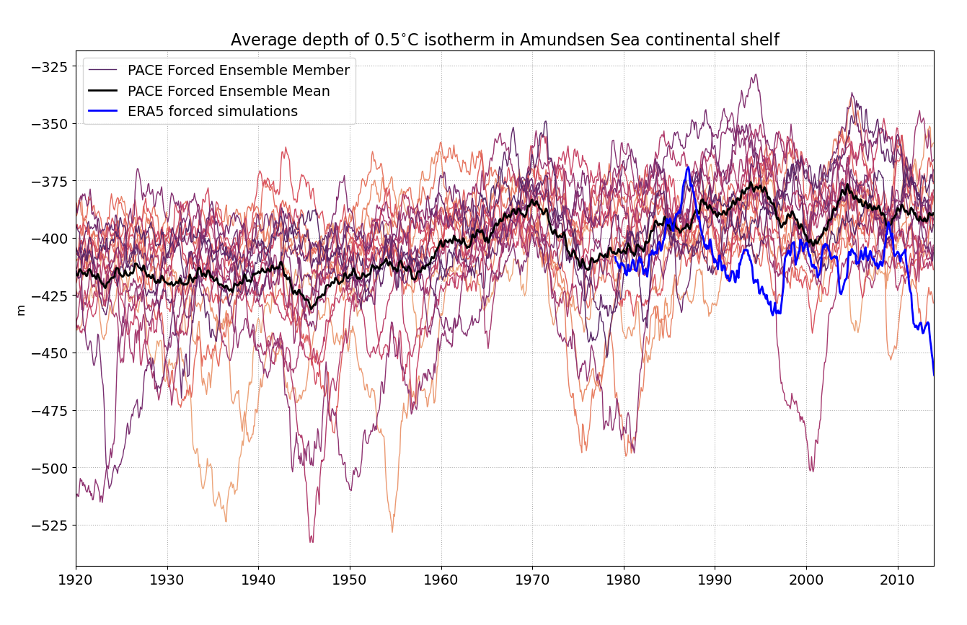

Slide 3
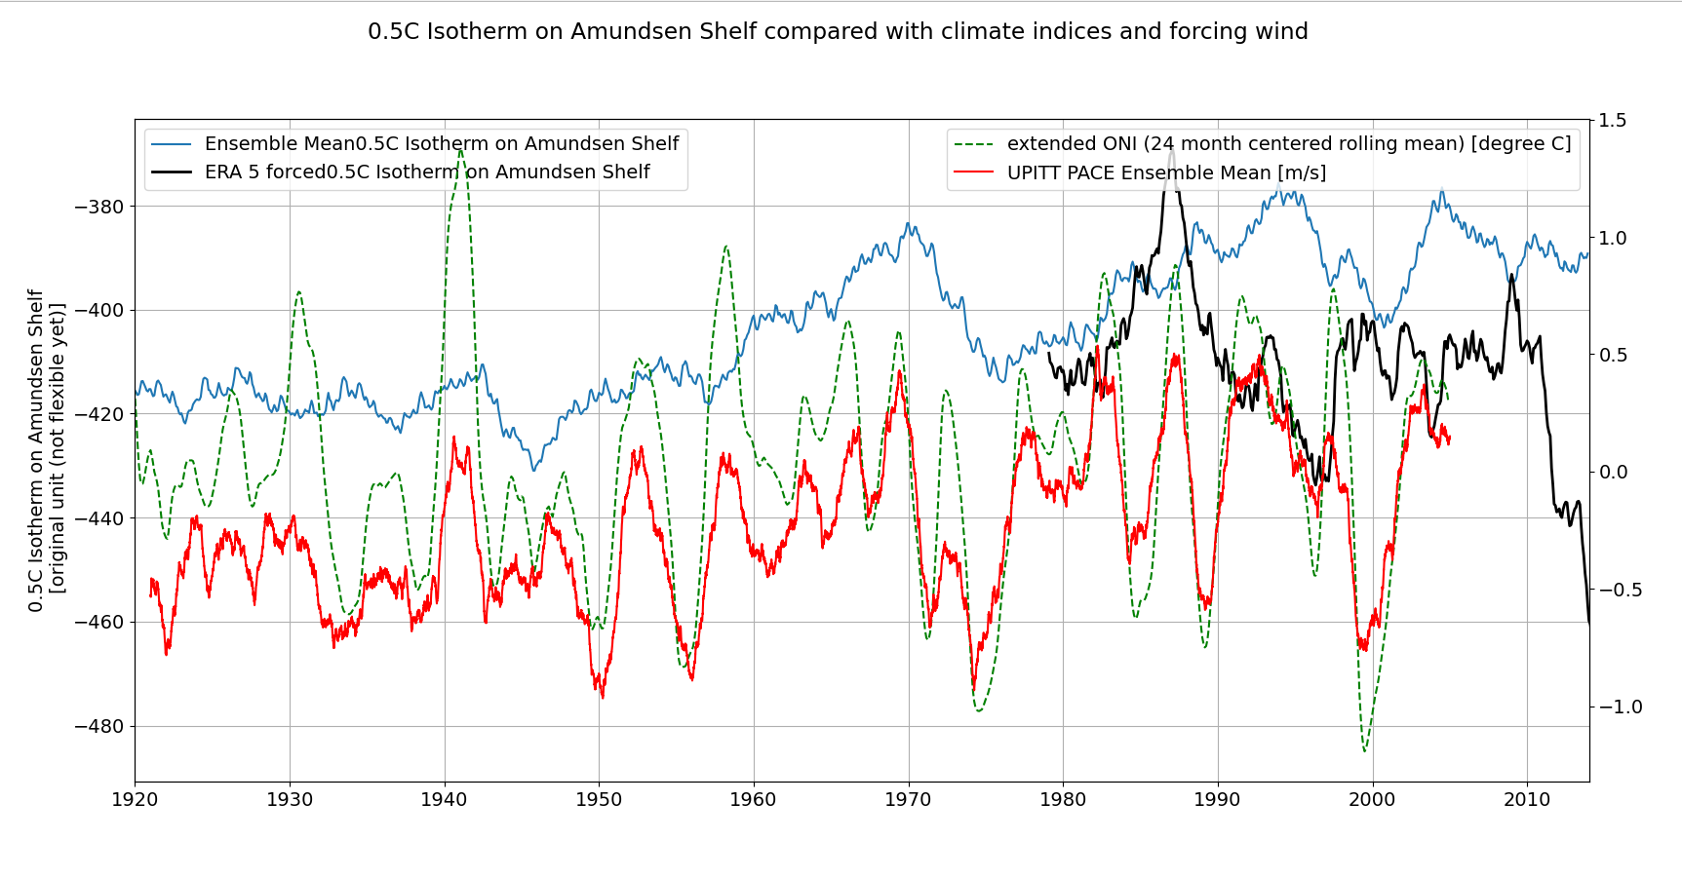

Slide 4
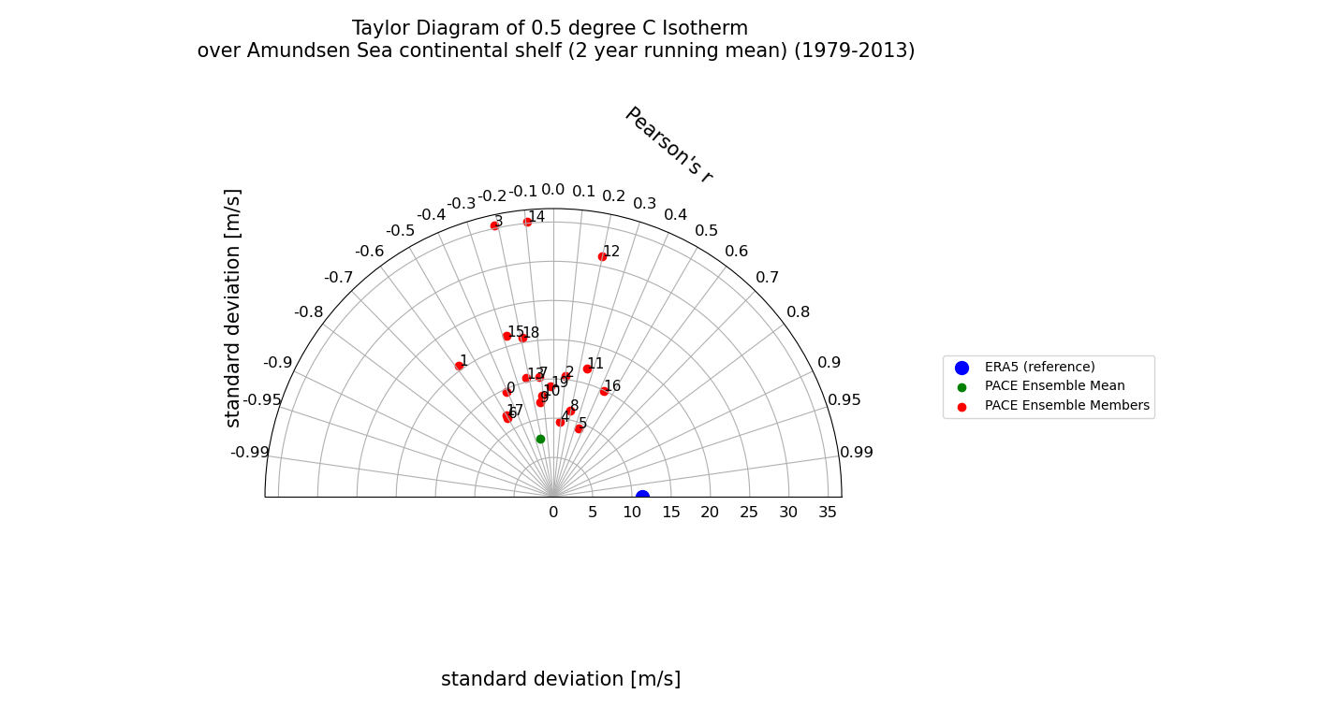
Taylor Diagram

Slide 5
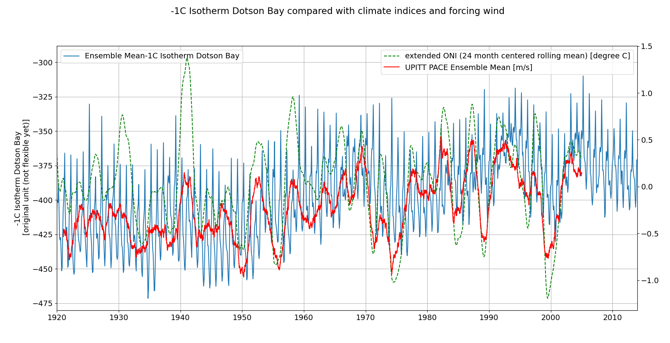

Slide 6
