Slide 1
Meeting with Kaitlin
Joren Janzing

Slide 2
Questions
Coding effectively on the Linux server? - saving worktime? - multiprocessing
What is the best way to make a proper correlation map? - Normalize or standardize it? → detrend it (per member); piecewise linear, higher order quadratic, longer term running mean, smoothing?; magnitude; Don’t overfit it!
Isobath 1000m? Vector field: mean wind directions. - How to make best use of all data? One linear regression for all data? - How to find the correct lag without it costing too much calculation time?
All the pictures are based on 4 ensemble members.
Later:
Zonal, meriodional, speed and wind stress curl

Slide 3
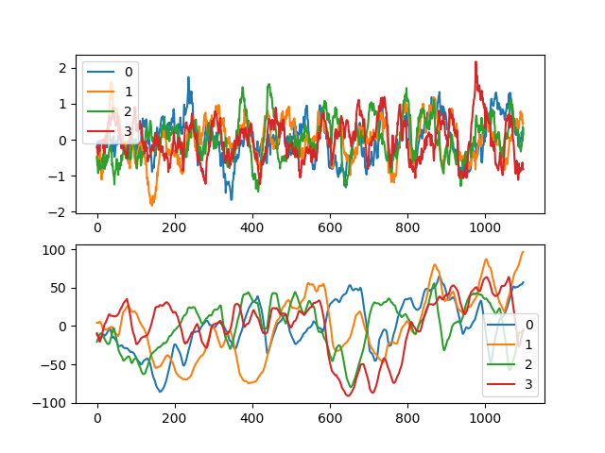

Slide 4
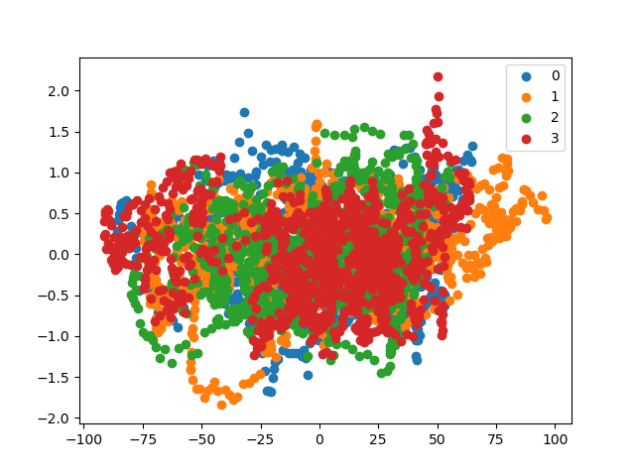

Slide 5
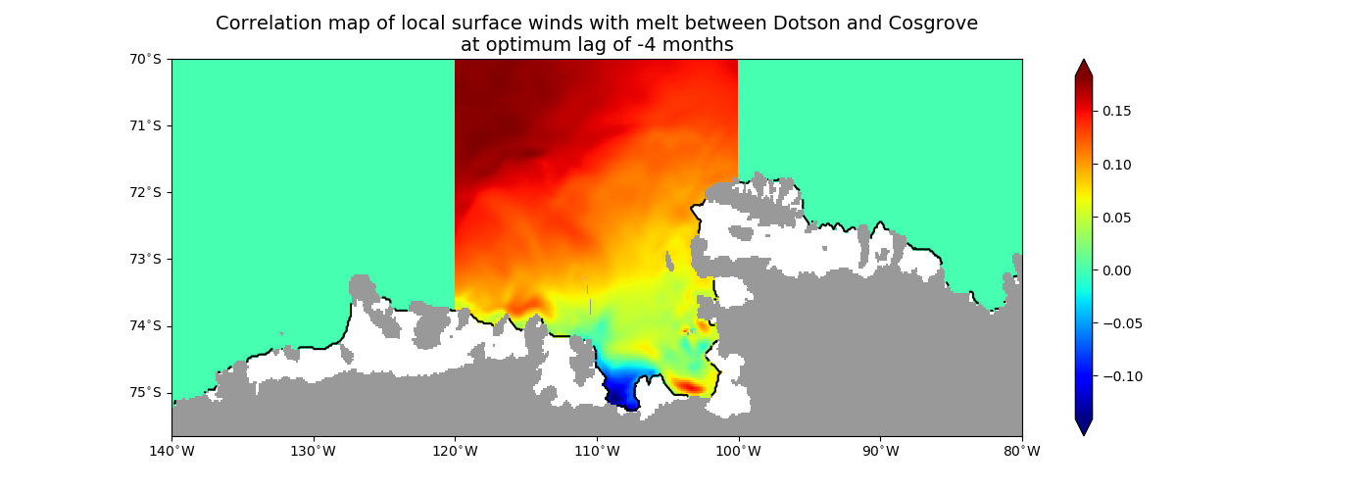
Centered

Slide 6
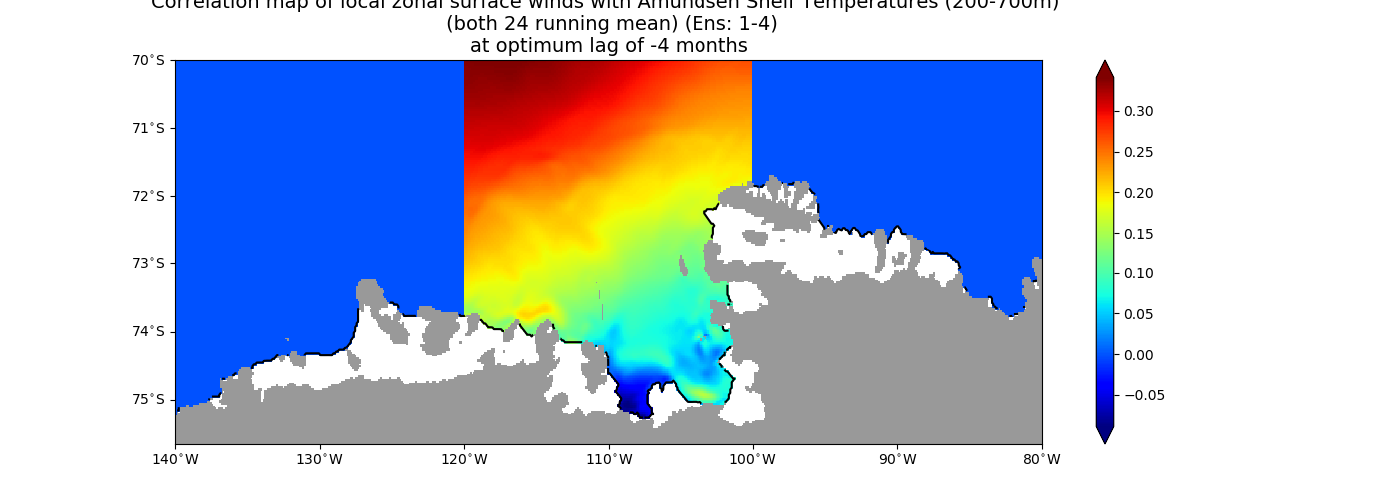
Centered

Slide 7
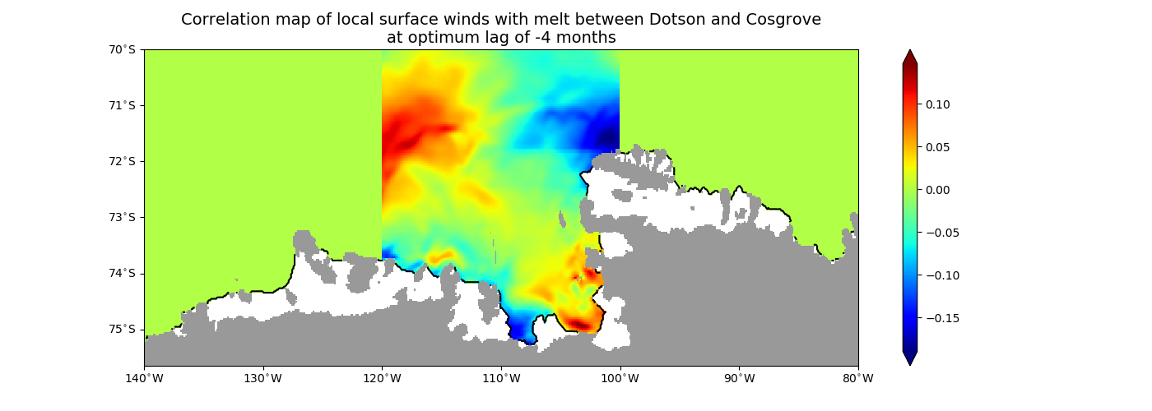
Detrended

Slide 8
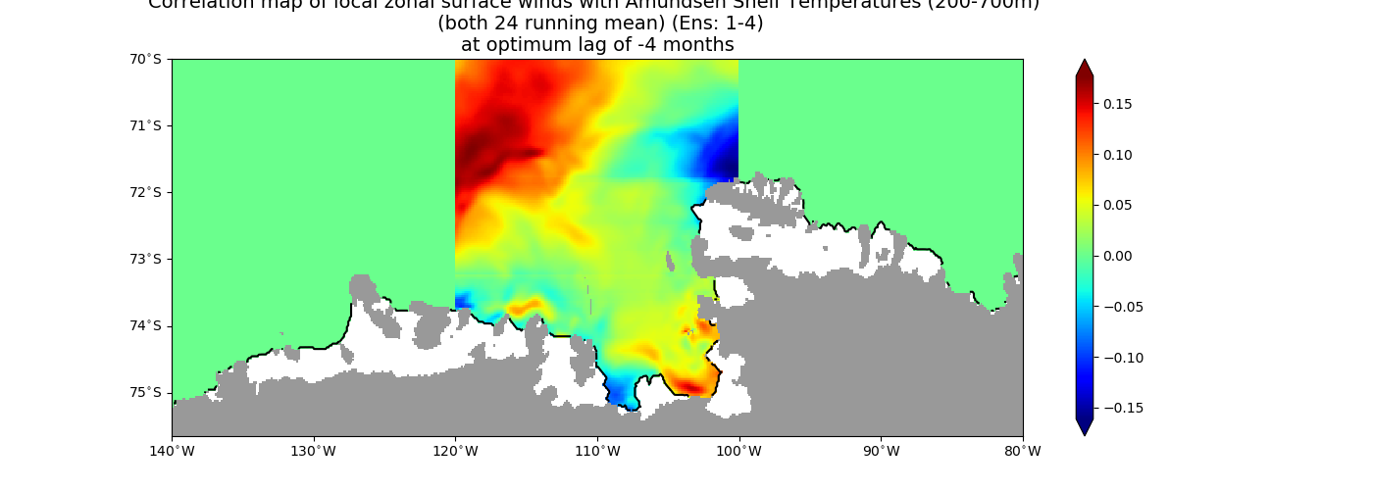
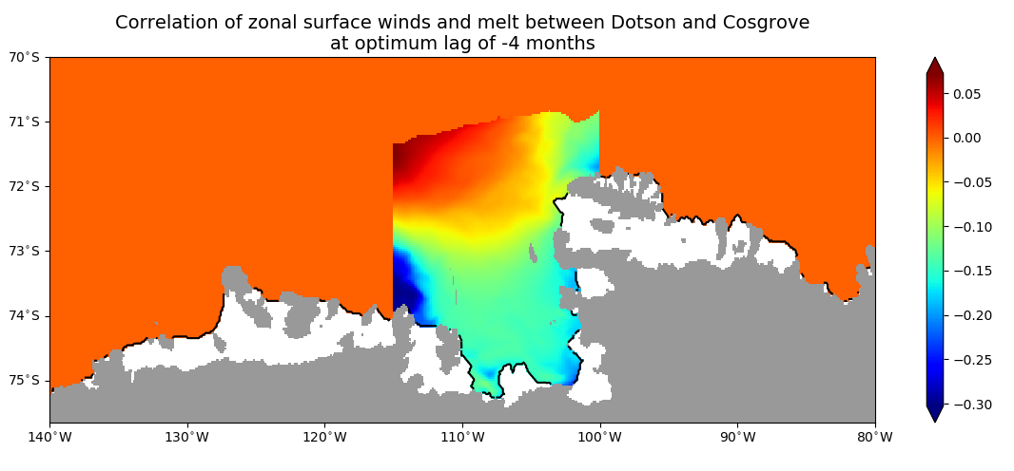
Detrended

Slide 9
Not working properly

Slide 10
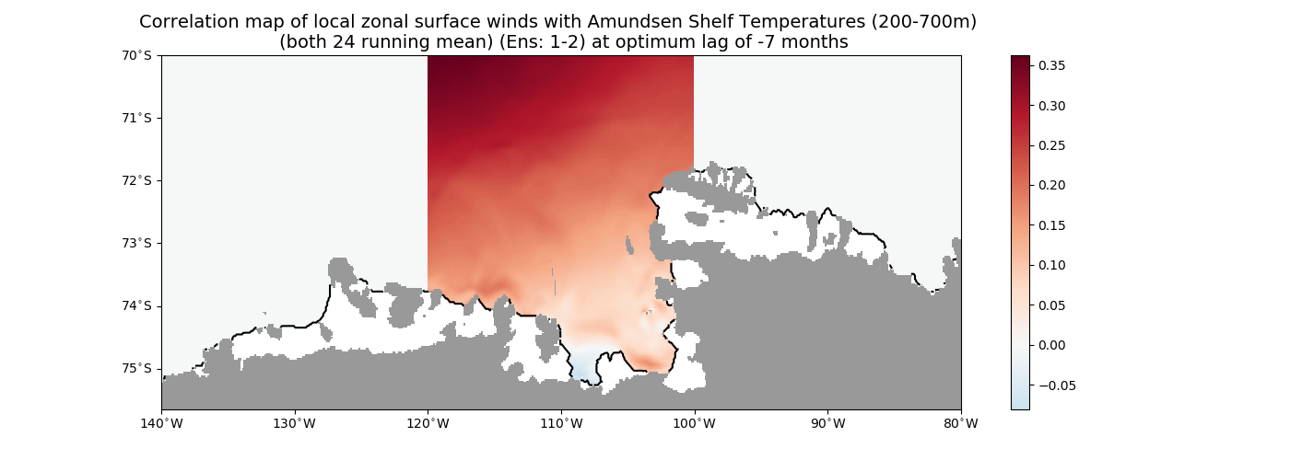

Slide 11
Planning for the coming days and weeks?
* The correlation maps

Slide 12
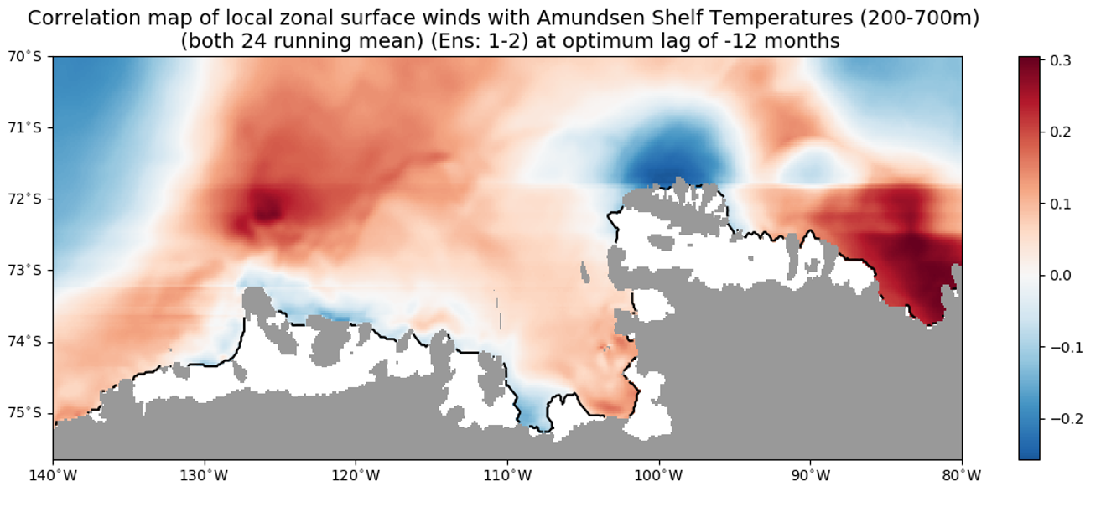
Wat is de lijn????

Slide 13
Extra

Slide 14
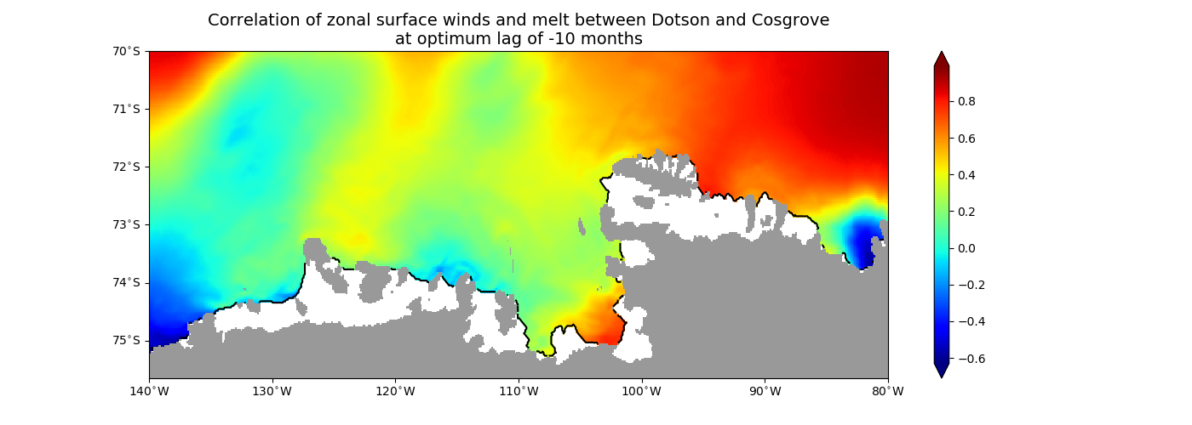
One member Amundsen Sea

Slide 15
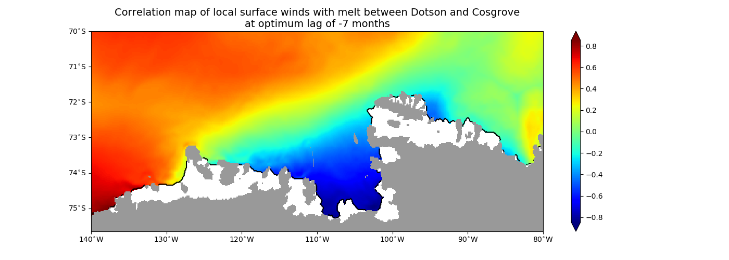
One member Amundsen Sea

Slide 16
