Slide 1
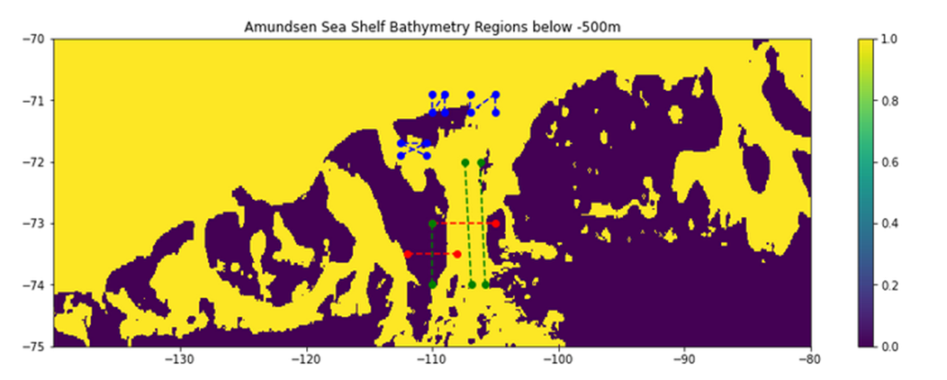
I looked mainly at the zonal flow in the blue boxes.

Slide 2
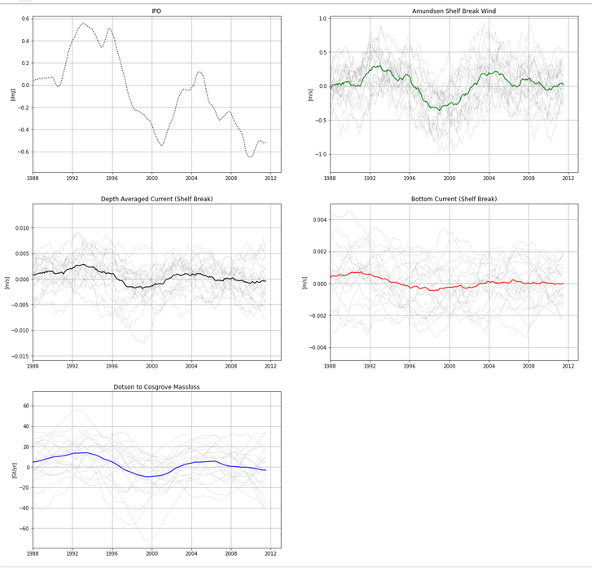
Large variability between members, but ensemble mean melt follows the IPO roughly during this period.
Note: Everything is smoothed by a 60 month running mean, after subtracting the 25 year running mean.

Slide 3
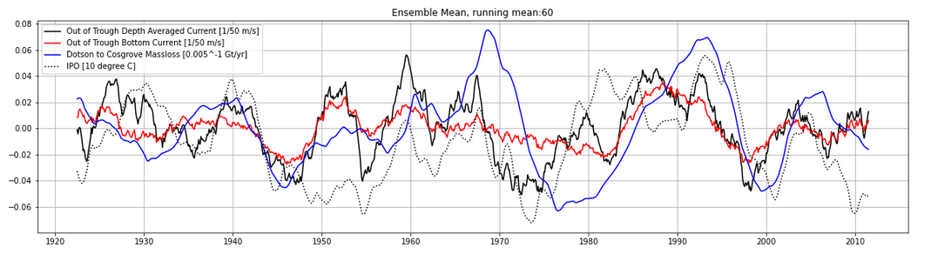
Ensemble Mean Patterns (5 year running mean). In this case, zonal flow in the upper left blue box is used. Bottom current is average over the lowest 100m above the bed.

Slide 4
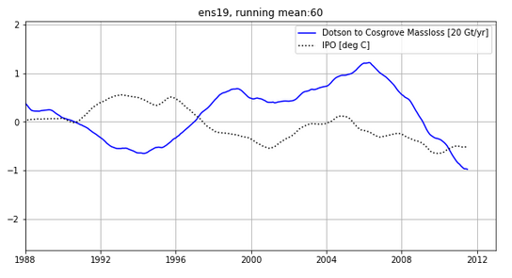
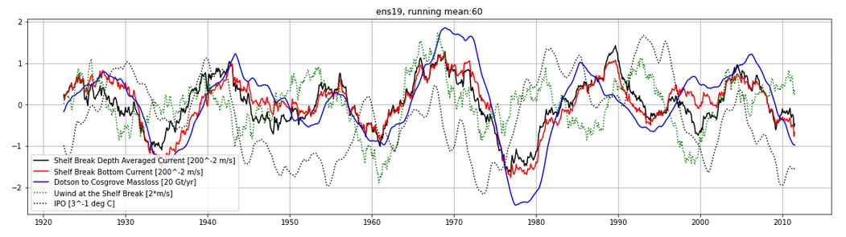
Member 19 seems to show a similar pattern in melt as what ERA5 simulation shows.;
Here zonal flow in the top right blue box is used for the bottom currents

