Slide 1
Meeting 10-8-2022
Joren Janzing

Slide 2
Content and Questions
So far, mainly writing (new geometry).
Structure of the document.
Idea for the baroclinic response? --> how to show this? and how to show in the potential internal feedback?
Meridional wind: --> katabatic or ABSL?
Alessandro: OrcID?
Memory on HPC? --> especially if I need to read Archer 2 still....
Adam. (reken even uit hoeveel vakantie je nog hebt!)

Slide 3
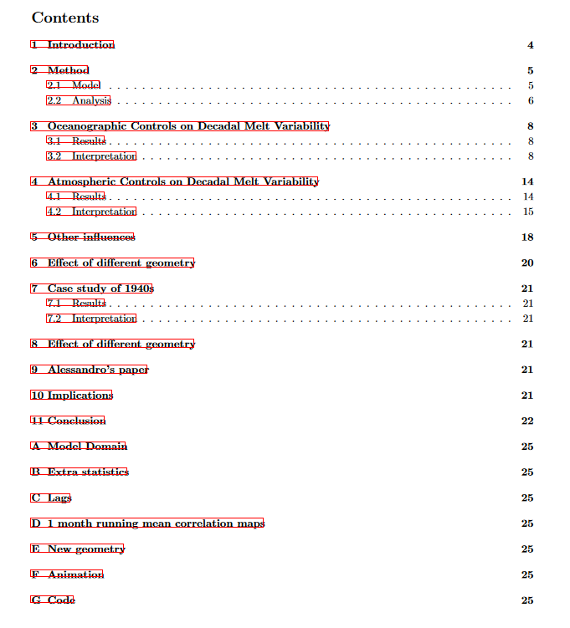
Splitting it up into an oceanic and atmospheric part?
Results and interpretation?
1940s: repetitive..
Checking with reality? Where?
- 1 month running mean (adds lag (does it?), but does not necessarily add to decadal variability?) of 5 year running mean. Double?

Slide 4
Baroclinic response

Slide 5
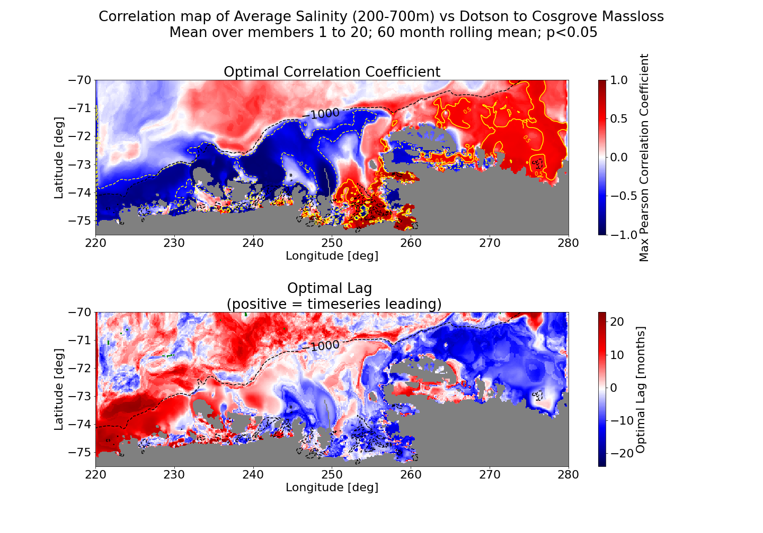
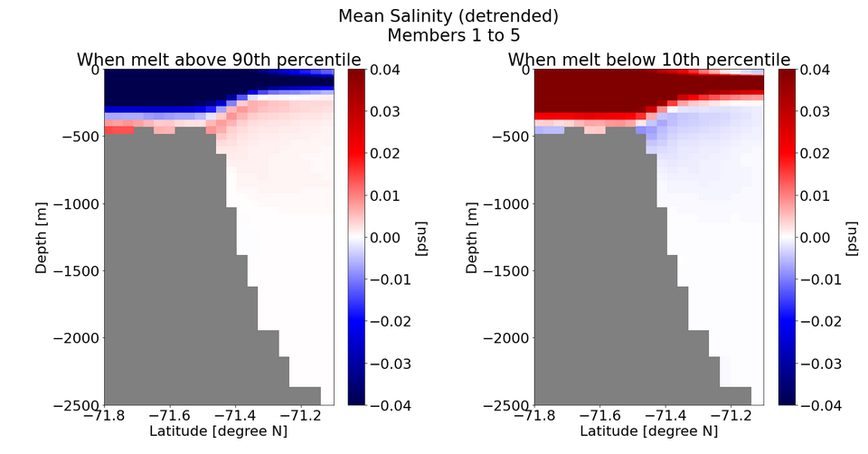
How to show baroclinic response?
There is at least some response in salinity. This includes CDW, so:
top 300m?
Or look at density as a whole (costs a lot of computing…)
Isn’t density mainly driven by salinity anyway?

Slide 6
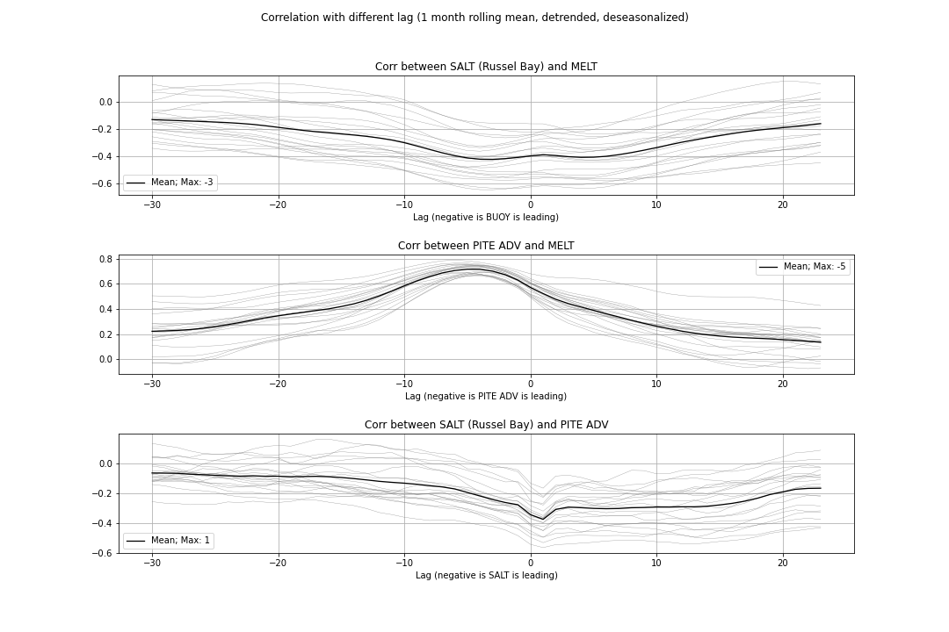
How to show baroclinic response?
Last time, the lag did not check out….
Do I like my index for heat advection?
How to select proper location for salinity forcing.
Nevertheless, I can’t imagine that it has no effect at all. How to show this?

Slide 7
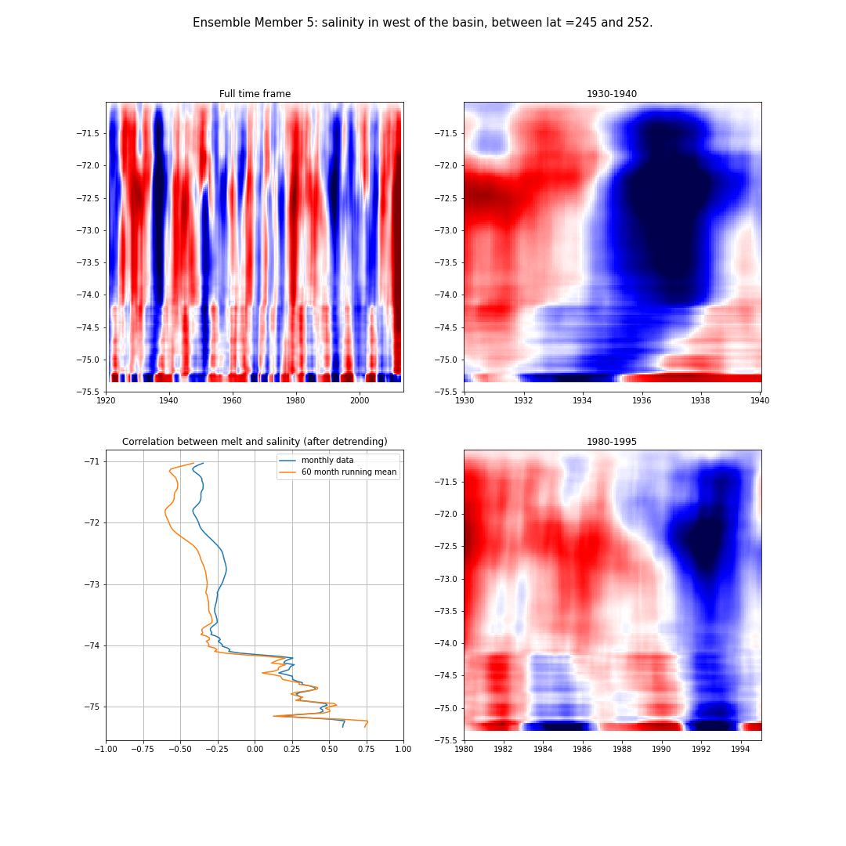
How to show this idea that it is partly self enforcing?
Latitude
Latitude

Slide 8
Cumulative wind

Slide 9
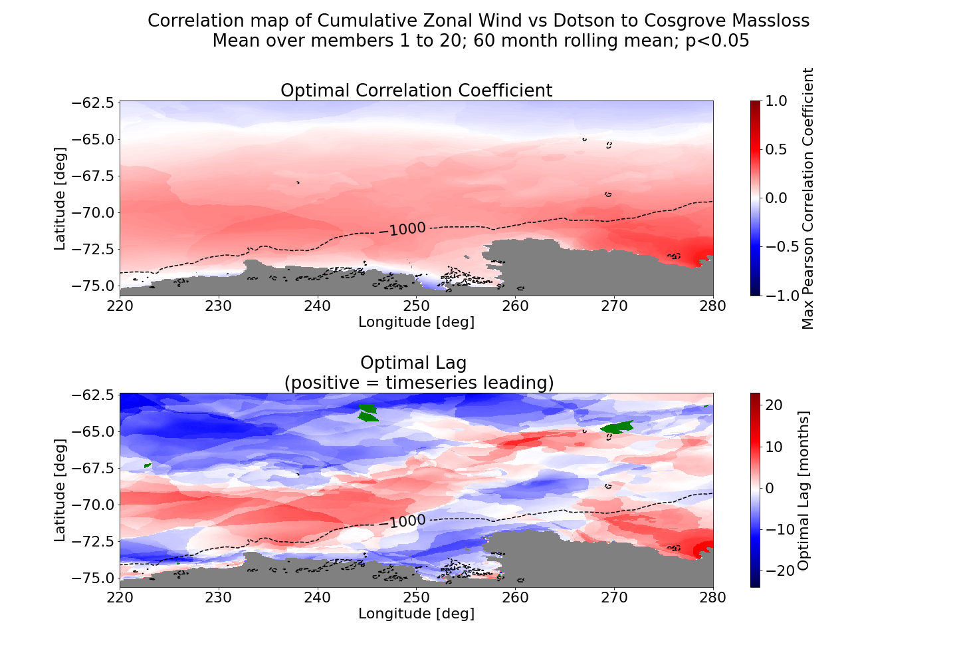
Looks a bit weird I feel… (especially optimal lag, different shades of red /blue)

Slide 10
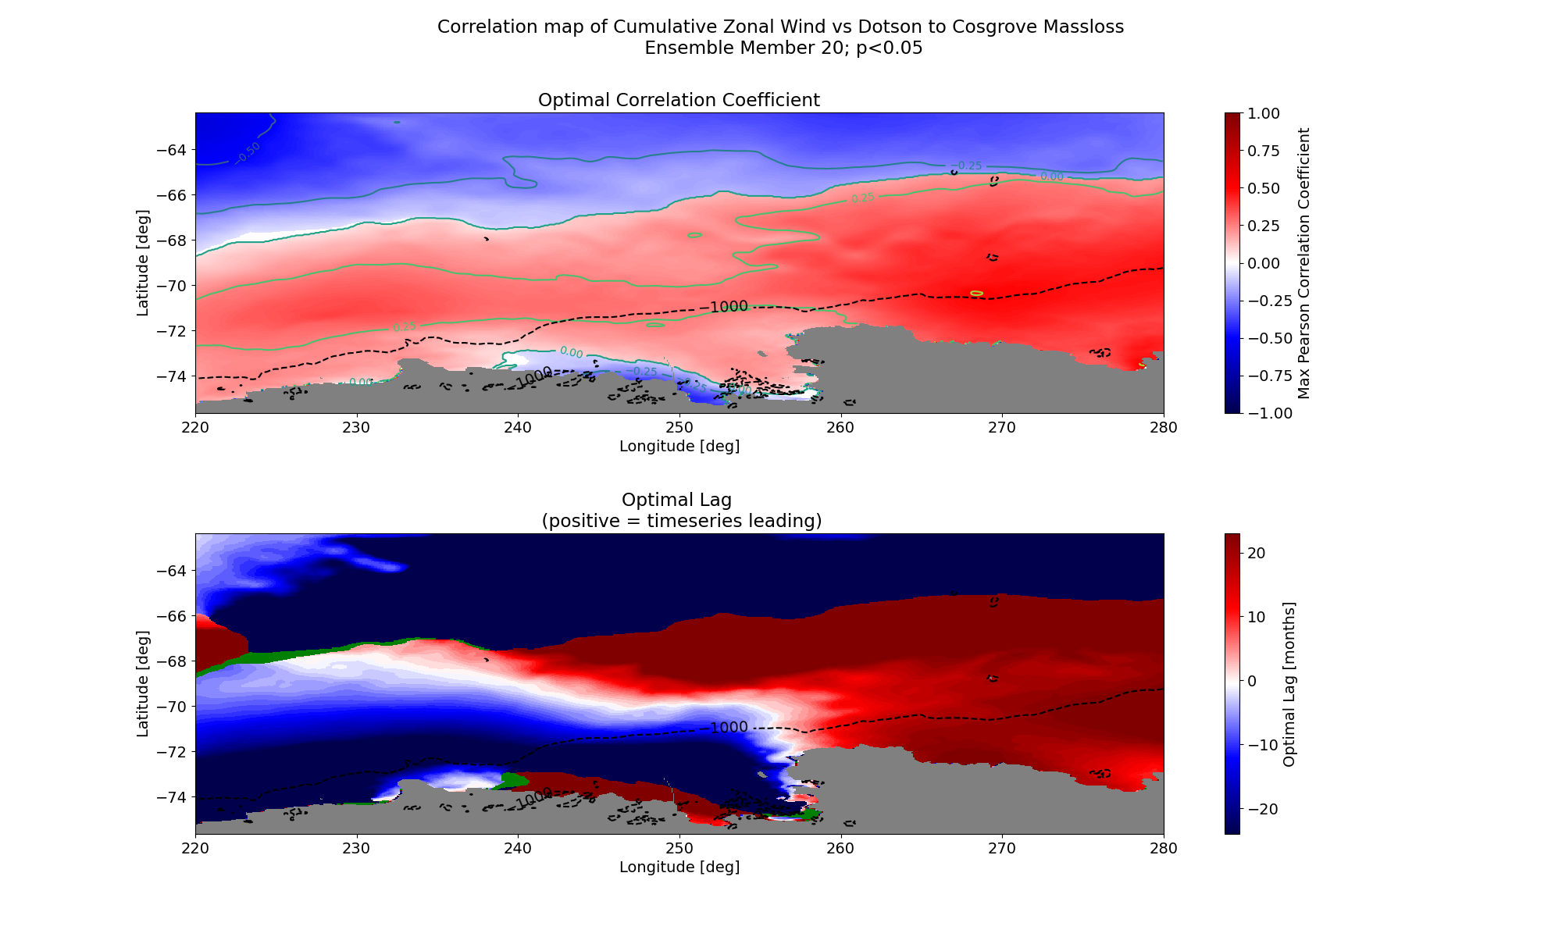
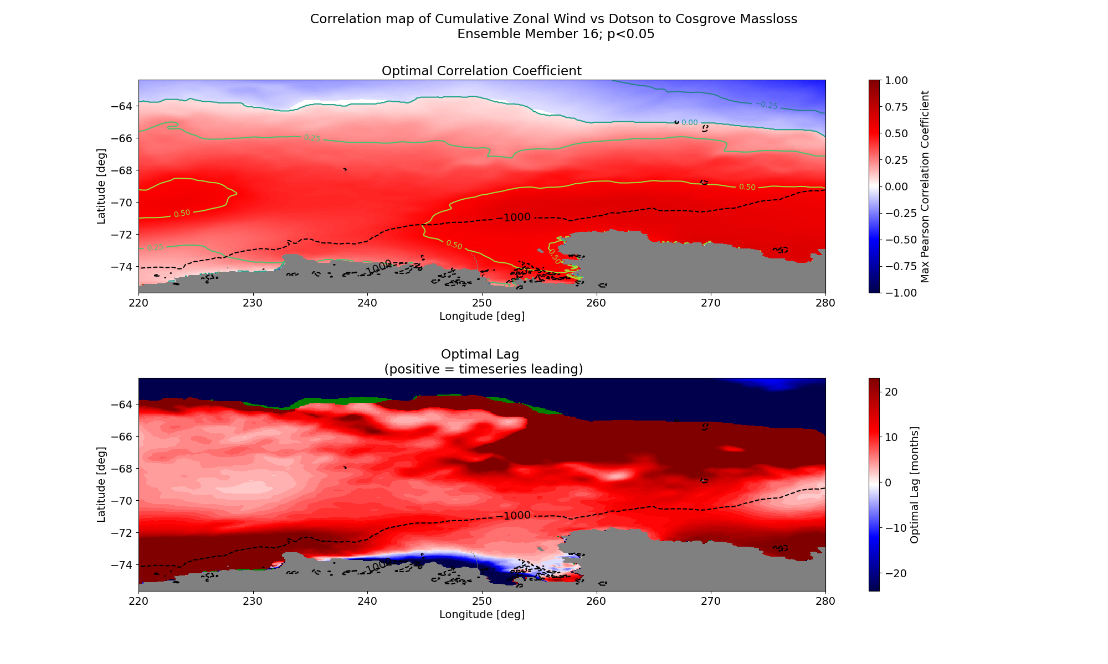

Slide 11
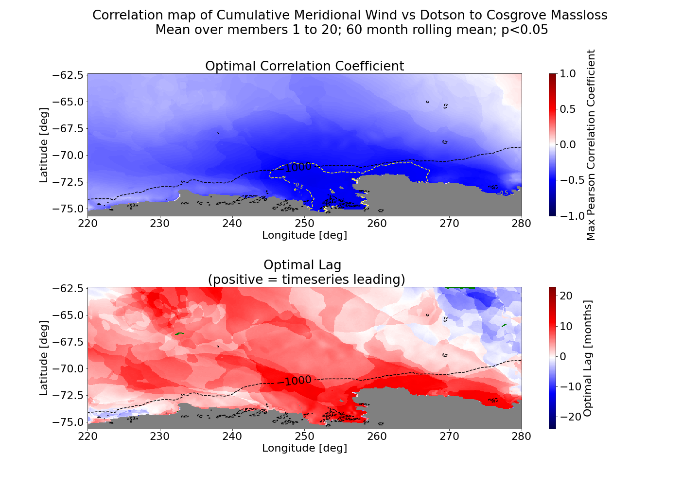

Slide 12
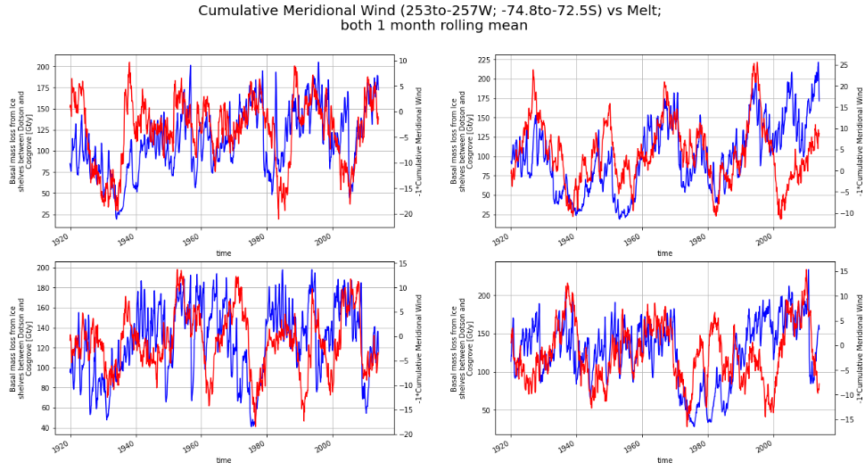

Slide 13
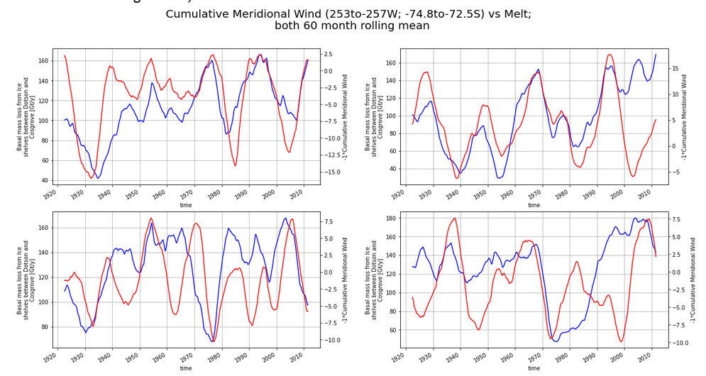

Slide 14
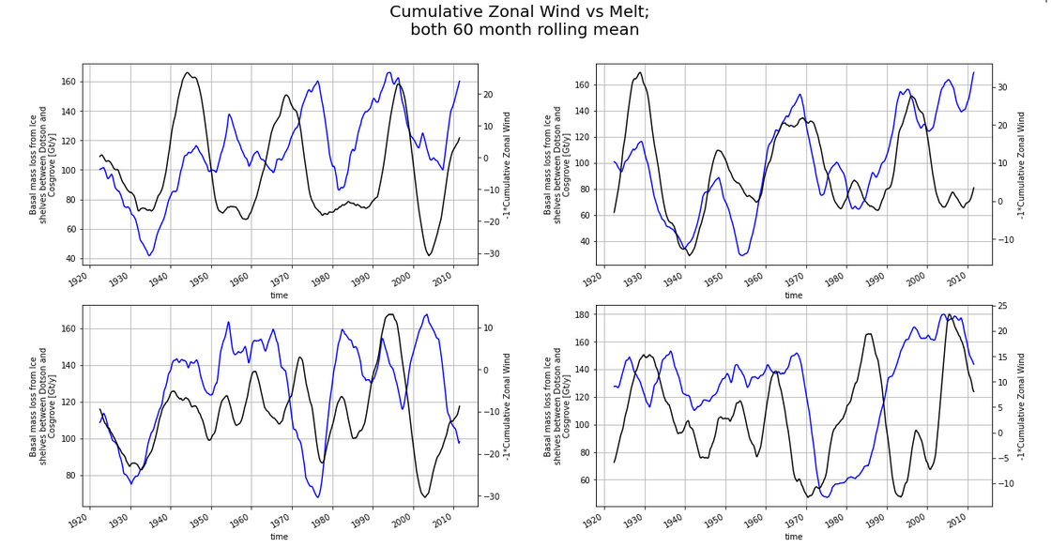

Slide 15
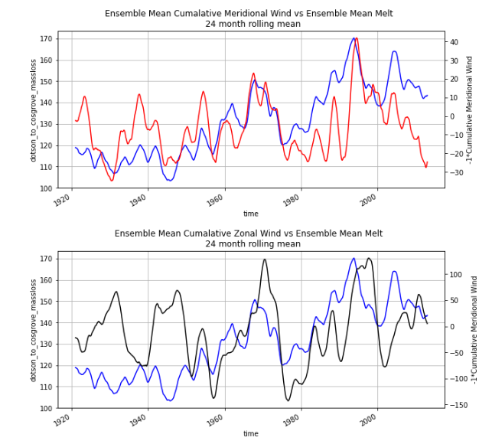
Crucial difference in ensemble mean:
first 50ish years and smaller scale features!
Possibly a changing climate??

Slide 16
Questions
Are you aware of earlier papers that suggest this?
Lag issues… probably not the correct method to do cumulative sum?
Meridional winds: katabatic or related to ABSL?
→ Thomas Bracegirdle; Scott Hosking?

Slide 17
Content and Questions
Structure of the document.
Idea for the baroclinic response? --> how to show this? and how to show in the potential internal feedback?
Meridional wind: --> katabatic or ABSL?
Alessandro: OrcID?
Memory on HPC? --> especially if I need to read Archer 2 still....
Now 866 Gb out of 1024 Gb.
Should I use different approach?
Adam (check how much holiday I still have!)

