Slide 1
Meeting 17-8
Joren Janzing

Slide 2
Content
Writing
Issue: Baroclinic feedback?
Brief update

Slide 3
Writing
Deadline first part: 26nd August!
This should contain roughly content of presentation: - Oceanic part of mechanism - Atmospheric part of mechanism - 1940s case study. - Method
Structure: 1940s?
Issues to resolve: - Baroclinic Feedback. - Meridional/Zonal wind.

Slide 4
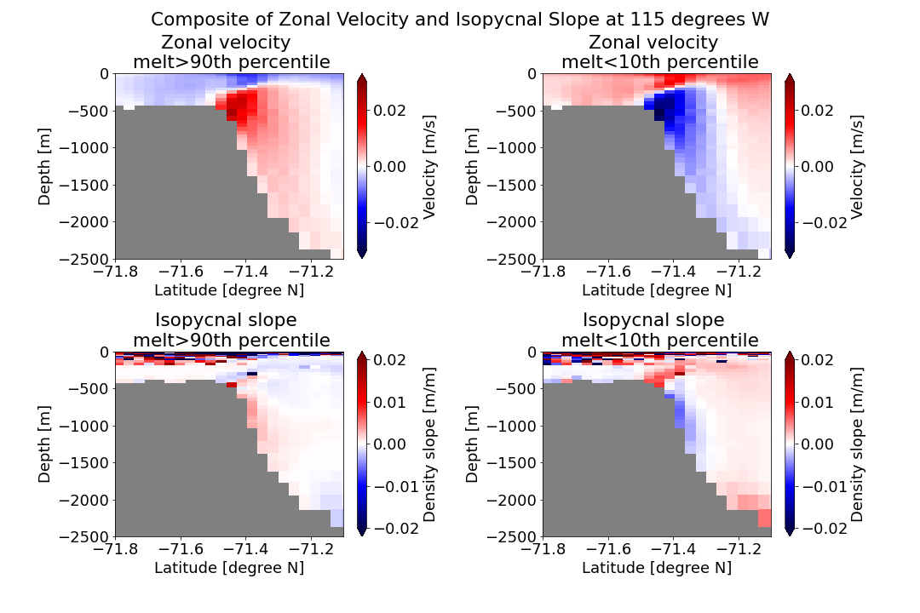
Issue 1: Baroclinic Feedback?

Slide 5
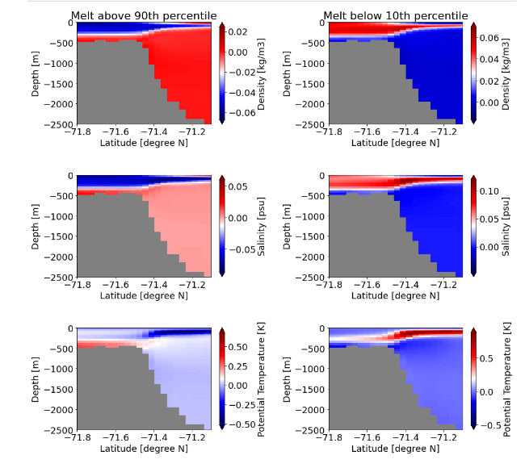
Issue 1: Baroclinic Feedback?
Density
Salinity
Potential Temperature

Slide 6
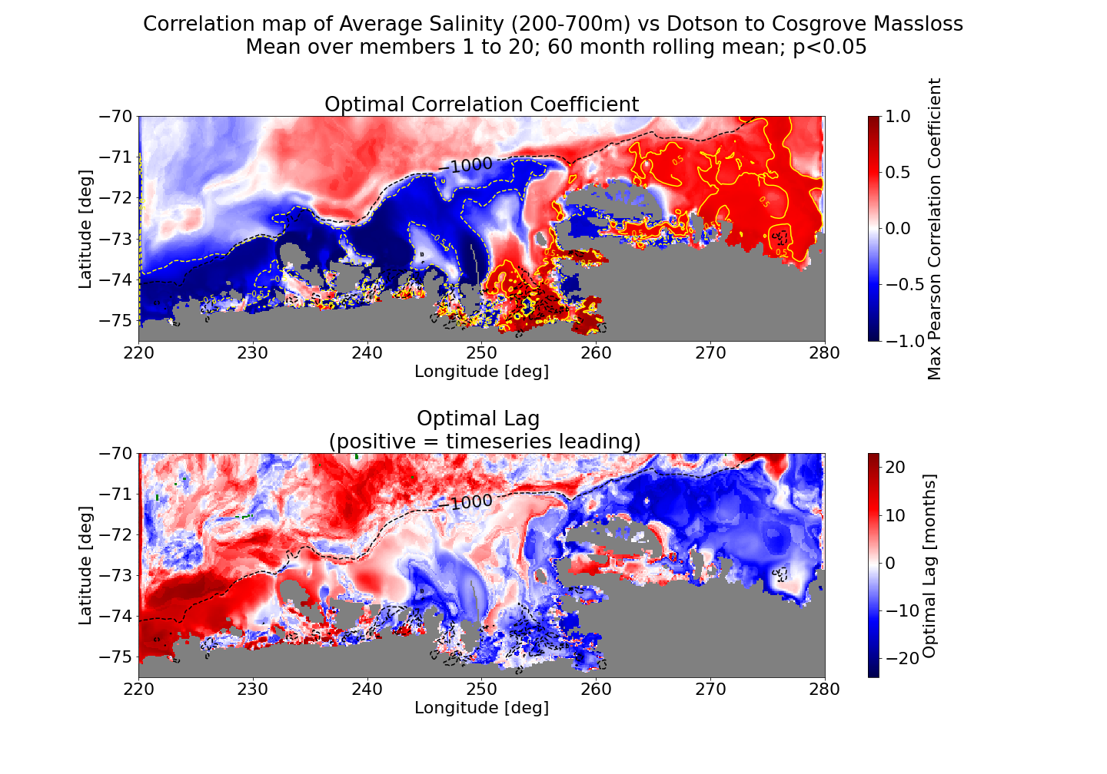
Issue 1: Baroclinic Feedback?

Slide 7
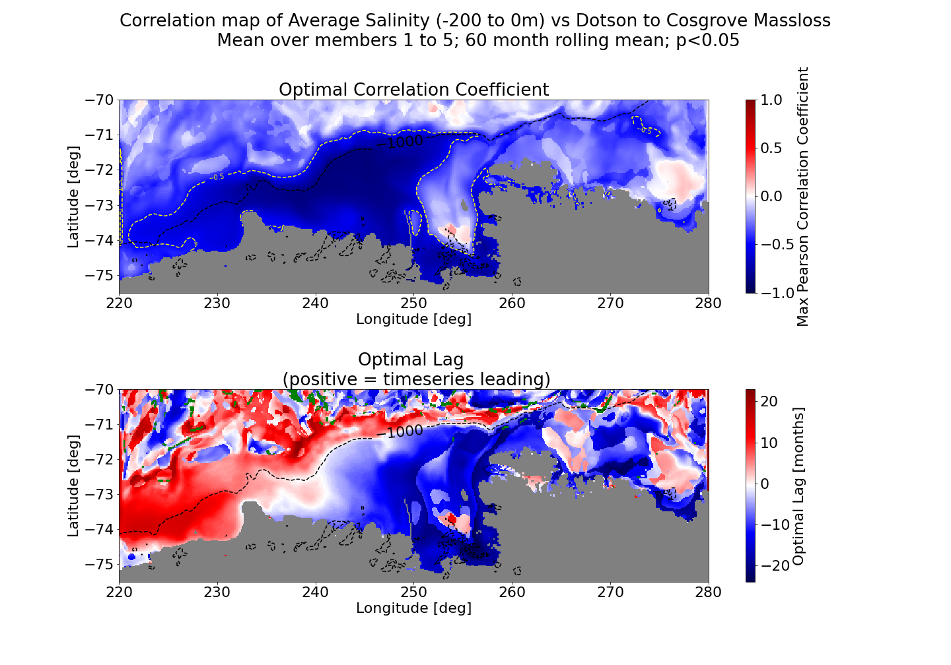
Issue 1: Baroclinic Feedback?
Note:
Follows shelfbreak almost exactly at 0 months!
In most of the basin leading melt?
Could be affected by 60 month running mean. Again for 1 month?

Slide 8
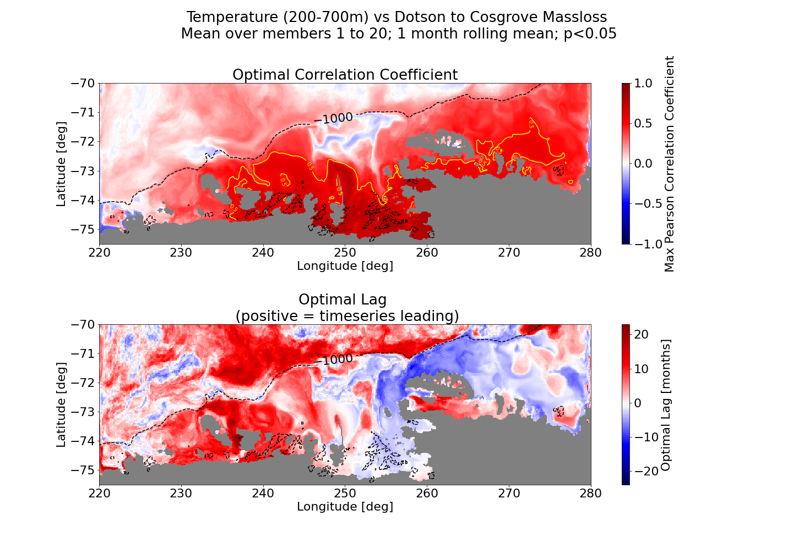
Issue 1: Baroclinic Feedback?
Very different pattern than the temperature between 200 and 700 m!

Slide 9
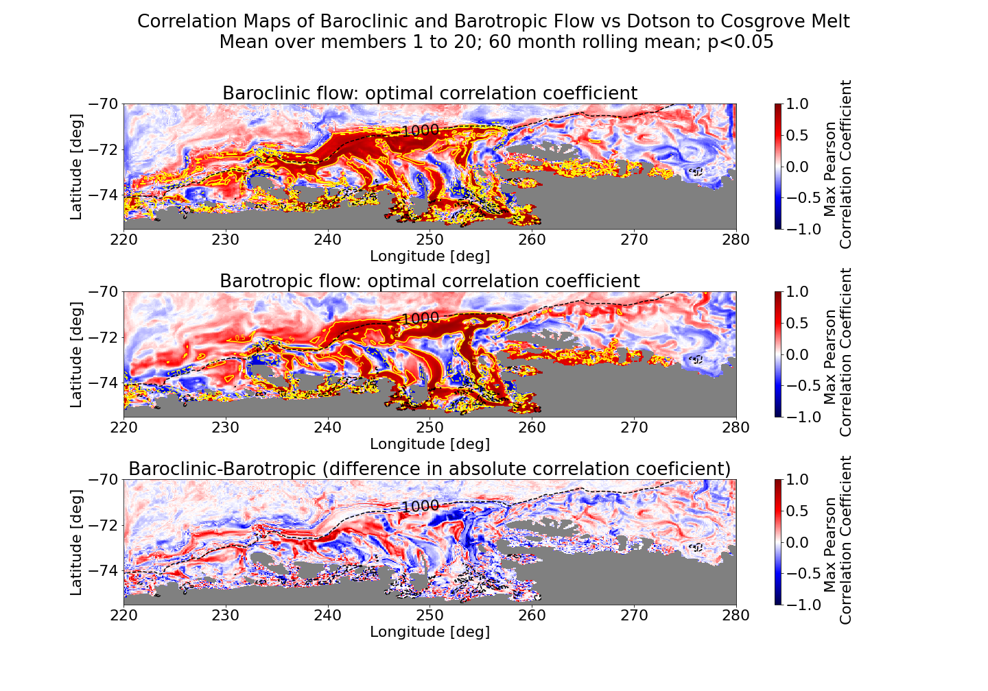
Issue 1: Baroclinic Feedback?

Slide 10
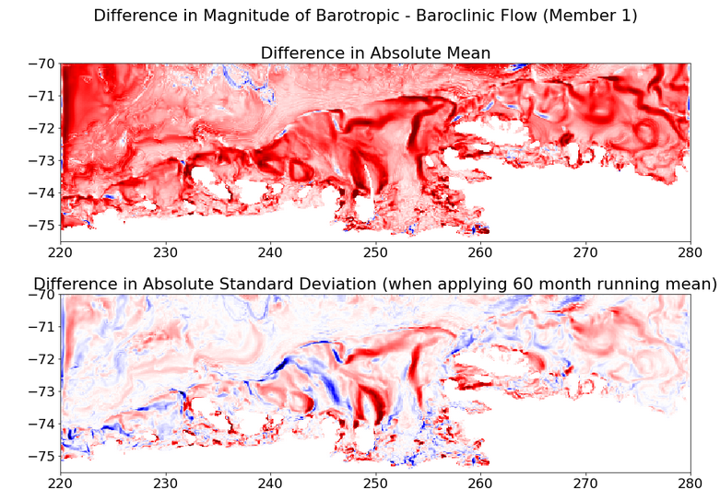
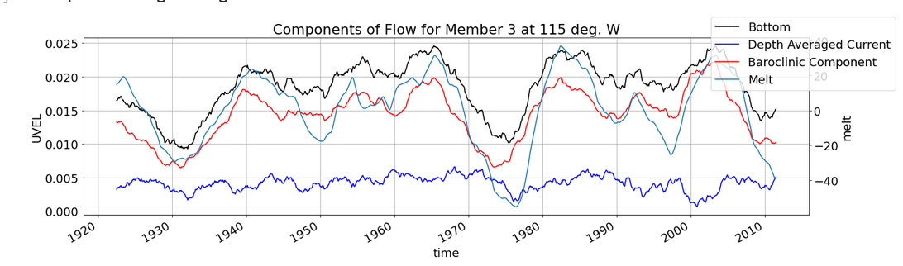
Issue 1: Baroclinic Feedback?

Slide 11
Issue 1: Baroclinic Feedback?
Causes: - Ice shelve melt? → Positive feedback? - Surface processes (i.e. sea ice formation?) → Driver? - Previous cycle of CDW input? → Negative feedback?
Feedback of driver? → Box model, over what region though? → Composite?
How to show properly that is has effect?

Slide 12
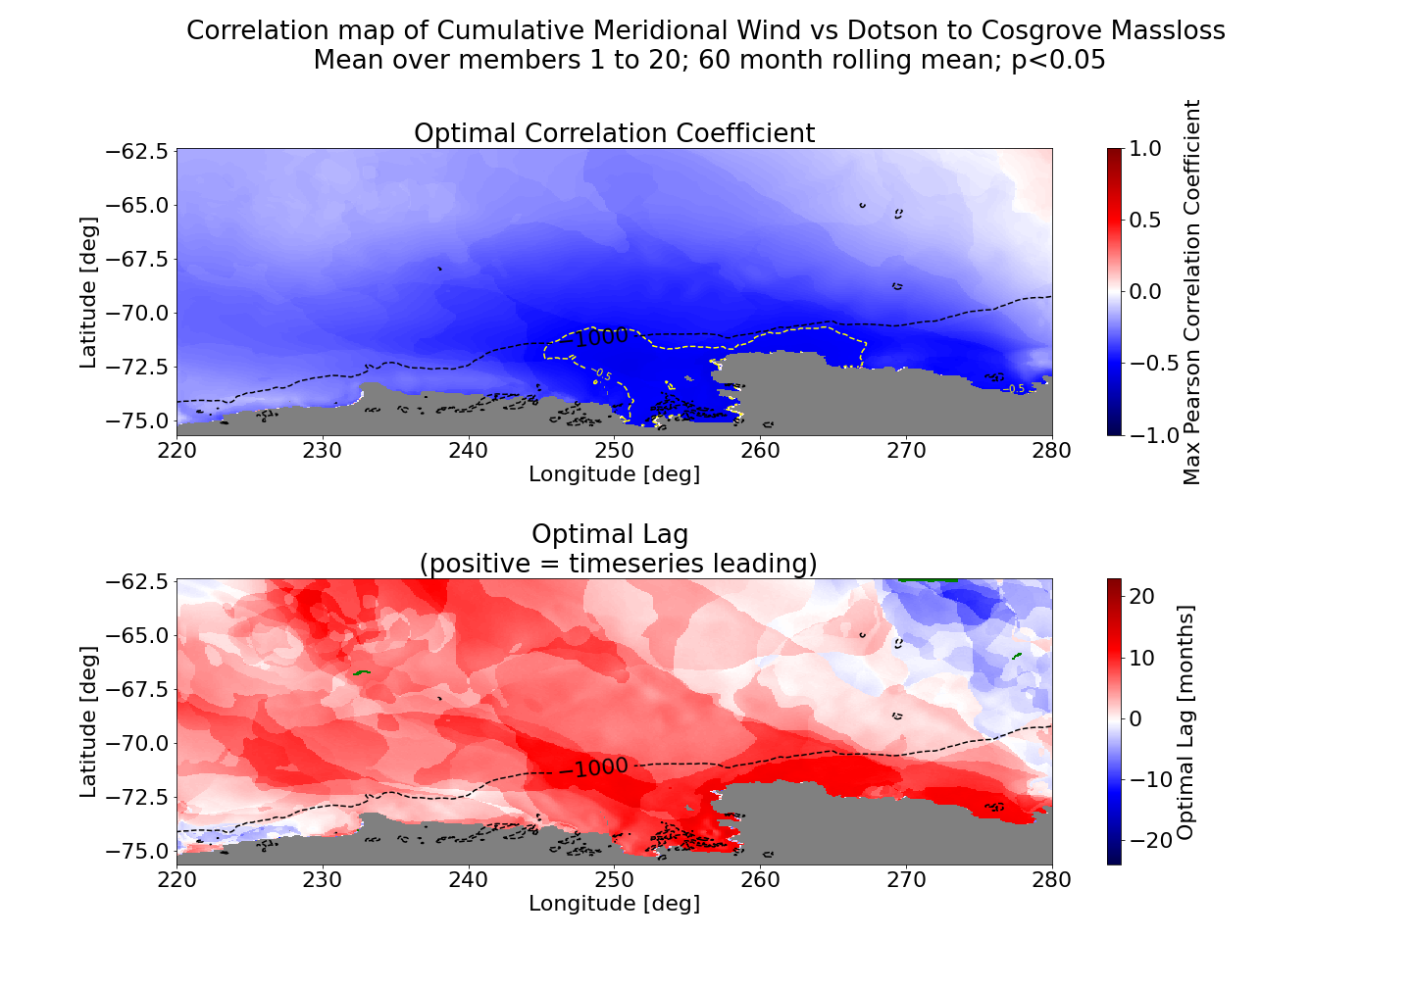
Issue 2: Cumulative meridional wind?

Slide 13
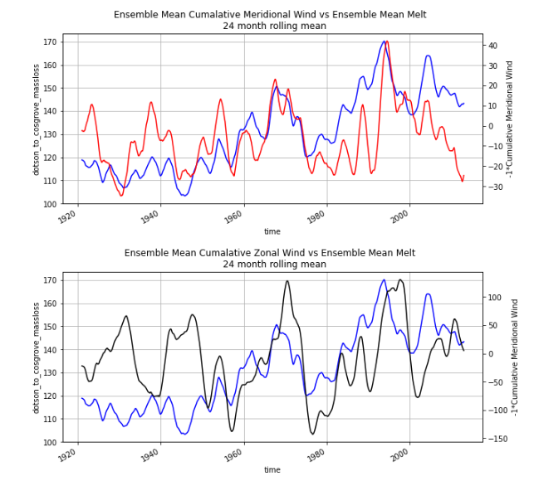
Issue 2: Cumulative meridional wind?
Crucial difference in ensemble mean:
first 50ish years and smaller scale features!
Possibly a changing climate??

Slide 14
Issue 2: Cumulative meridional wind?
Are you aware of earlier papers that suggest this?
Lag issues… probably not the correct method to do cumulative sum?
Meridional winds: katabatic or related to ABSL?
→ Thomas Bracegirdle

Slide 15
In other news:
PAS Member 6 is finished! I will try to read it next week!
Holiday after the deadline.

