Slide 1
Improved Correlation Maps

Slide 2
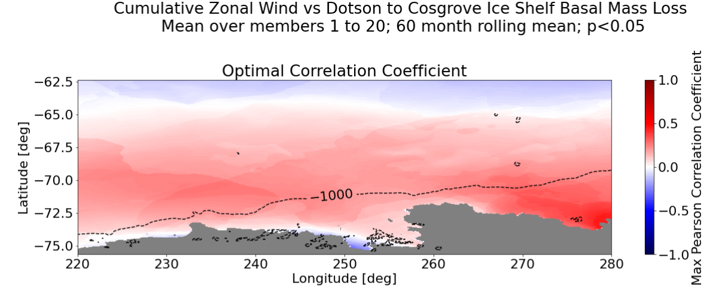

Slide 3
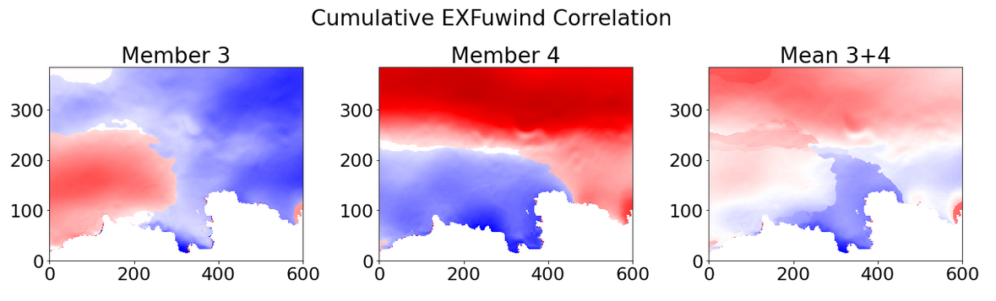
Consequence of change in sign of the optimal correlation coefficients.
Consequence of large changes in spatial patterns.

Slide 4
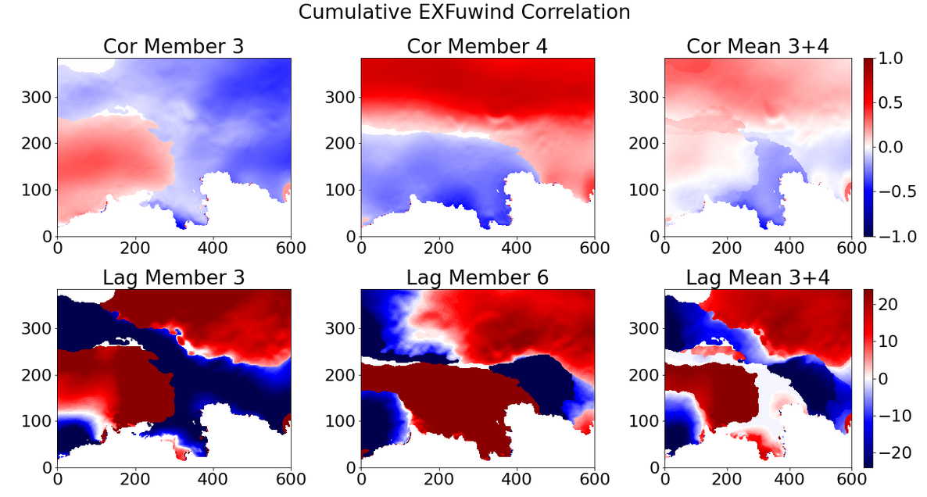
Often an effect of change from leading to lag!

Slide 5
Solution
Only correlate for cases that wind is leading melt.

