Slide 1
Proposal New Run

Slide 2
Content
Assumptions
Final Maps
Which Members to Run

Slide 3
Assumptions

Slide 4
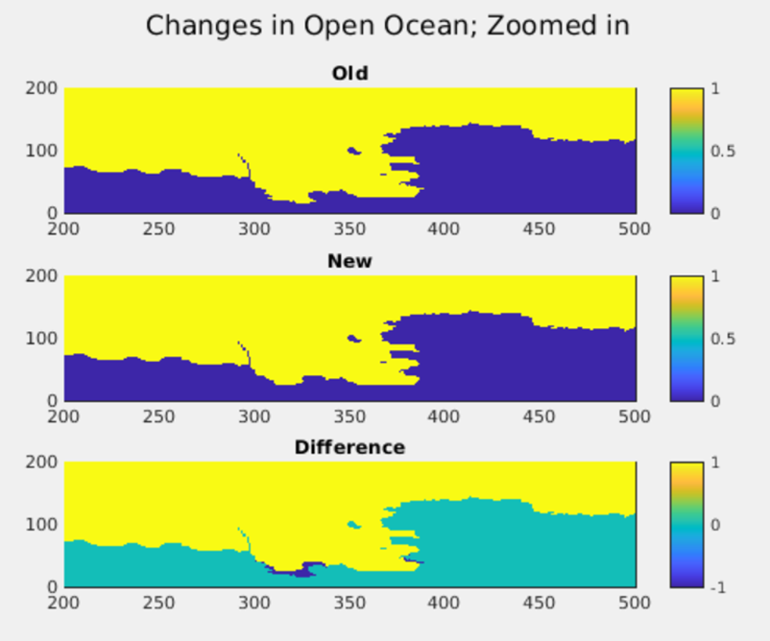
Assumptions
Using same ice front In new simulation, the ice front is extended. I cut it off to the point of the old ice front.
Difference is the dark blue areas in the bottom plot.

Slide 5
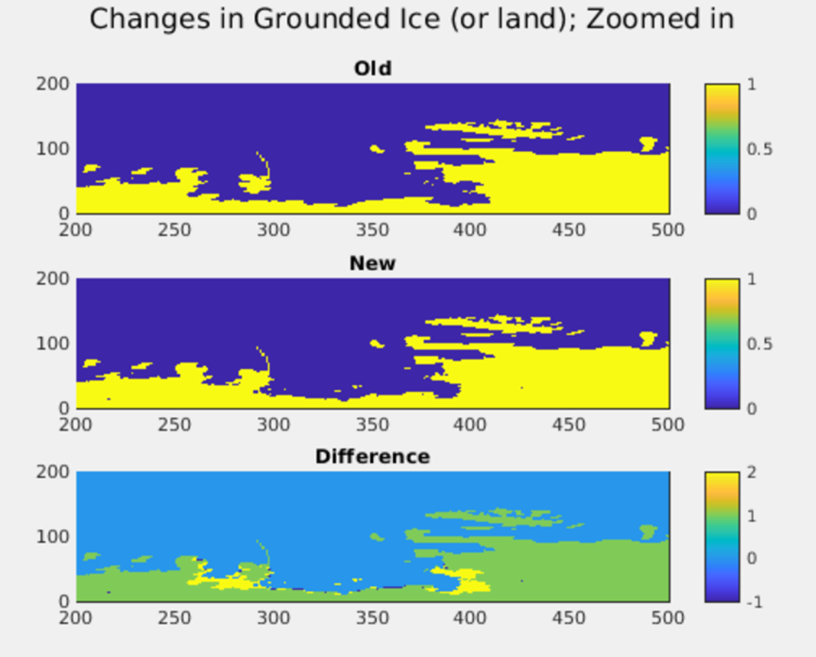
Assumptions
Remove newly ungrounded ice In the new simulation, there are a few small points where ice is ungrounded with respect to the old simulation. This is removed.
Difference is the dark blue areas in the bottom plot.

Slide 6
Final Resulting Maps

Slide 7
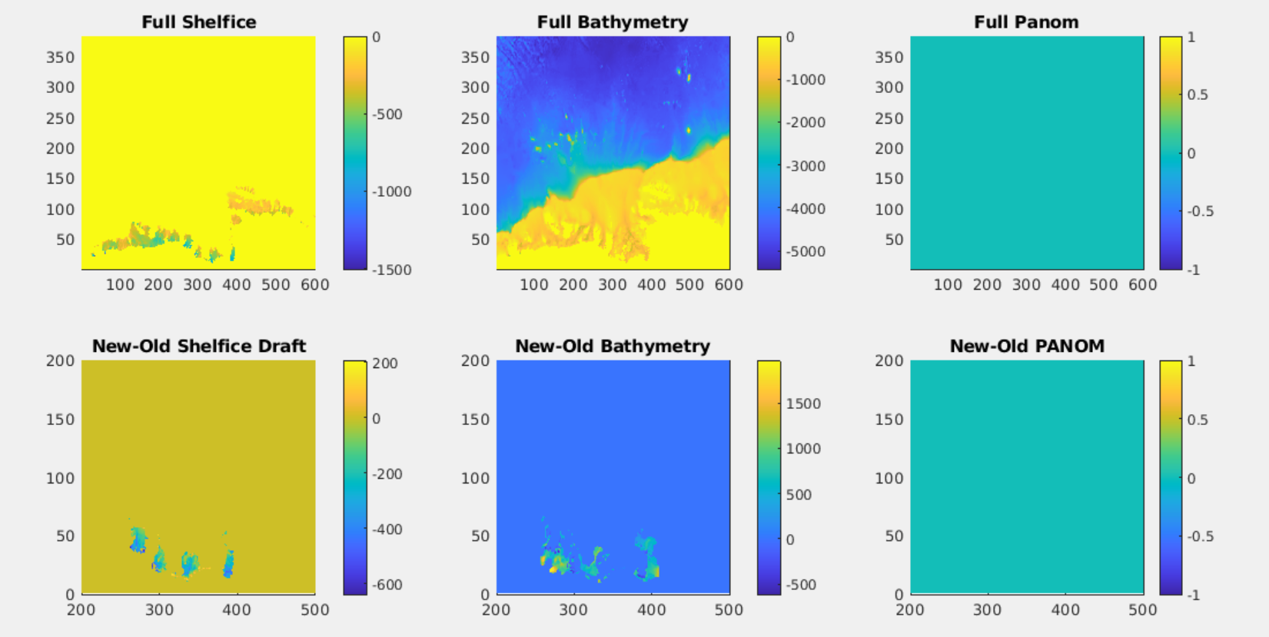
Note: there are still places where the shelfice draft is higher in the new scenario than in the old one.
Note: there are still places bathymetry is different.
Note: both PANOMs are 0 apparently.

Slide 8
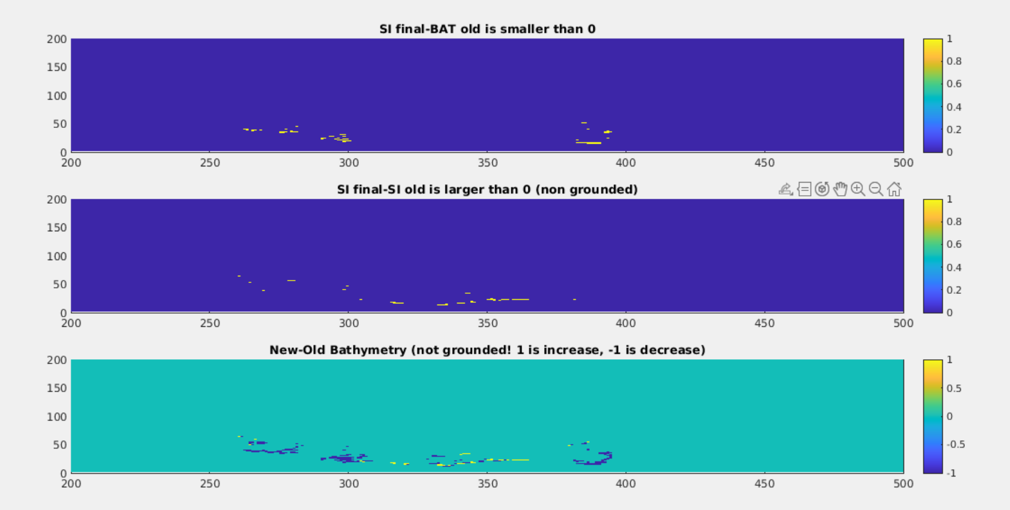

Slide 9
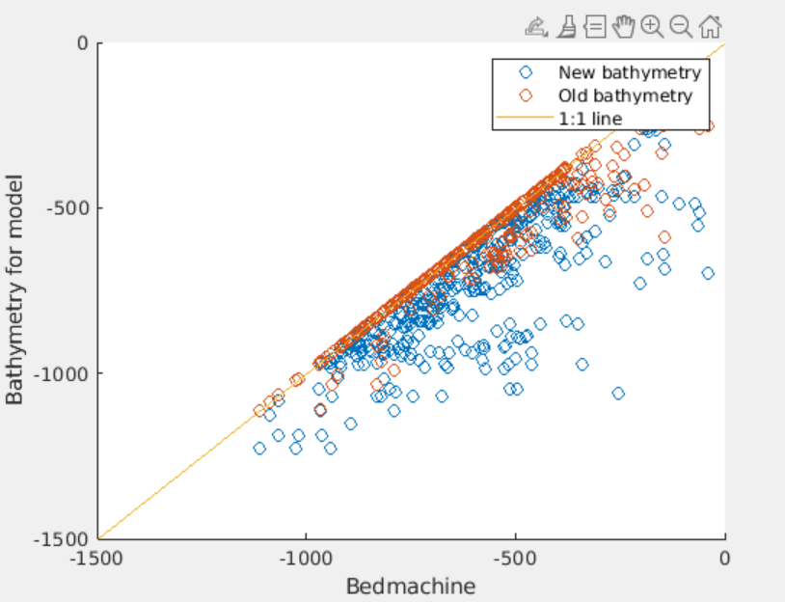

Slide 10
Which Members to Run

Slide 11
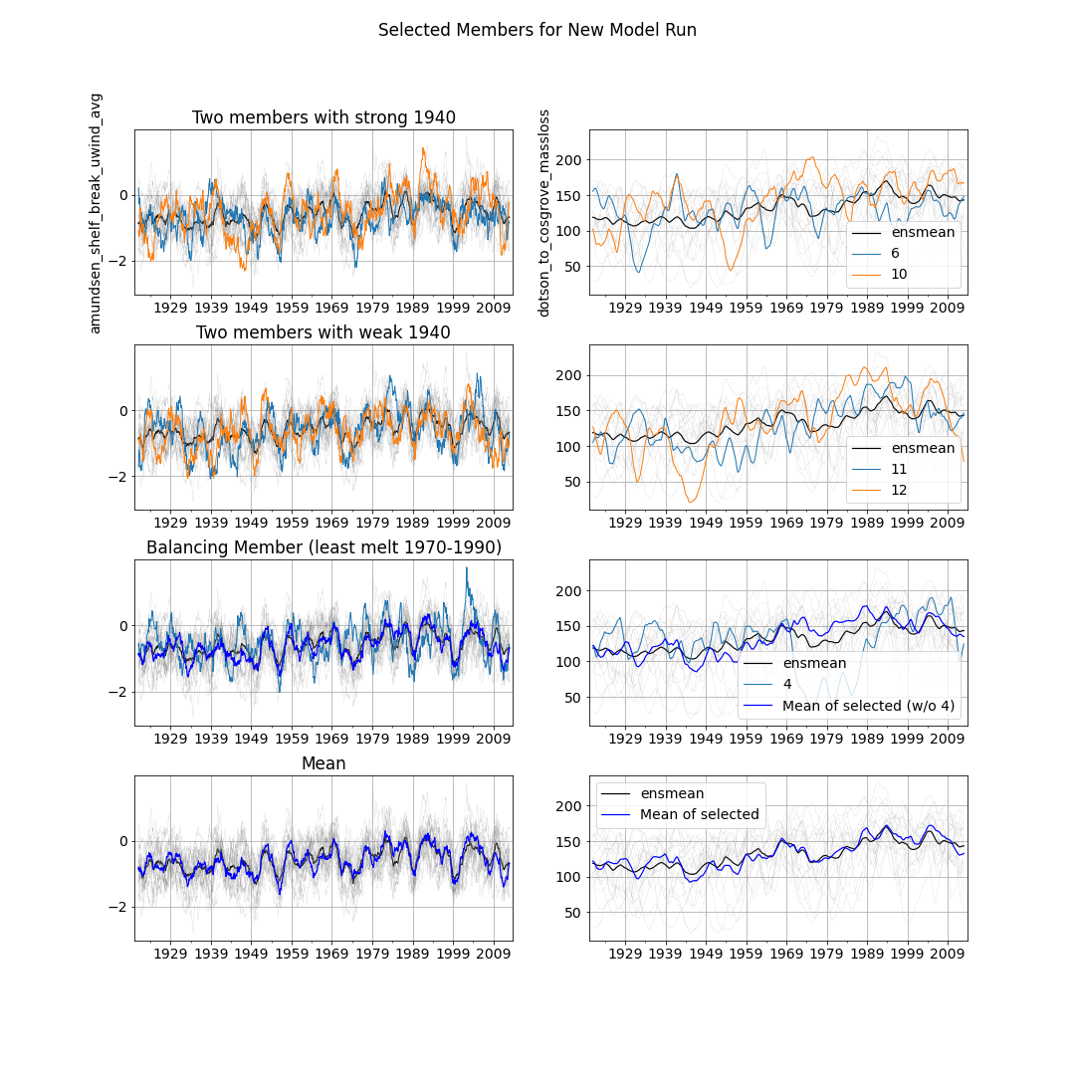
MEMBERS TO RUN:
6,10,11,12,4
2 members with strong 1940s melt anomaly: members 6 and 10
2 members with weak 1940s melt anomaly: members 11 and 12
1 member to balance the ensemble mean: member 4

