Slide 1
BEST
ASPECTS
OF
presentation for English class

Slide 2
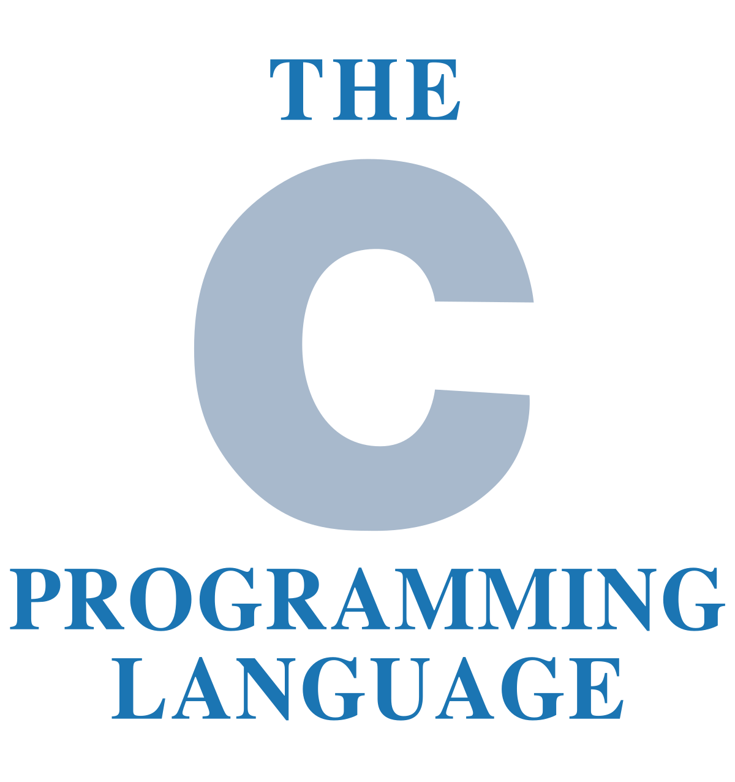
BEST
ASPECTS
OF

Slide 3
Spirit of C
The C89 Committee kept as a major goal to preserve the traditional spirit of C. There are many facets of the spirit of C, but the essence is a community sentiment of the underlying principles upon which the C language is based. Some of the facets of the spirit of C can be summarized in phrases like:
Trust the programmer.
Don’t prevent the programmer from doing what needs to be done.
Keep the language small and simple.
Provide only one way to do an operation.
Make it fast, even if it is not guaranteed to be portable.
from: C99RationaleV5.10

Slide 4
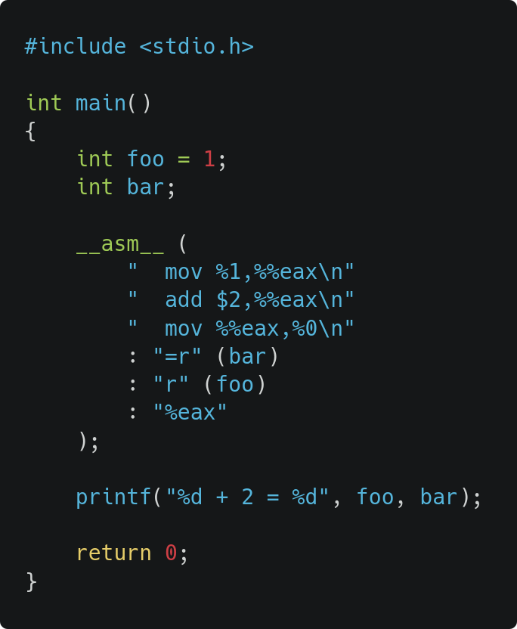
“Mid-level”
HIGH-LEVEL
LANGUAGES
Mid-level languages
Low-level languages
Assembly
Machine code
Binary

Slide 5
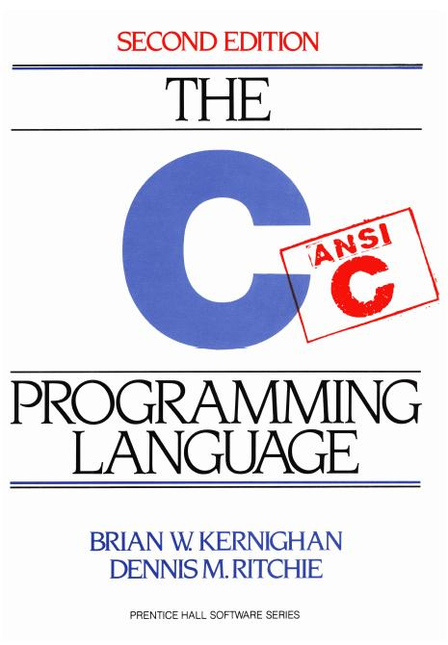
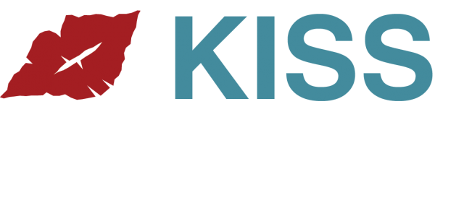
Fairly simple
No templates or fancy pitfalls
... like Java and C++!
~ Program in C song

Slide 6
Fast, lightweight and flexible
If you don't include any headers, nothing, not even simple printf() will be present.
You can replace libc with any other library of suiting your needs. You can roll your own implementation.

Slide 7

Ubiquity, portability
Architectures just GCC is available for:
You don't need to worry if you will be able to use this language somewhere as for 99% you can!*
AArch64
Alpha
AMD GCN
ARM
AVR
Blackfin
eBPF
Epiphany
H8/300
HC12
IA-32 (x86)
IA-64 (Intel Itanium)
MIPS
Motorola 68000
MSP430
Nvidia PTX
PA-RISC
PDP-11
PowerPC
R8C / M16C / M32C
RISC-V
SPARC
SPU
SuperH
System/390 / zSeries
VAX
x86-64
68HC11
A29K
CR16
C6x
D30V
DSP16xx
ETRAX CRIS
FR-30
FR-V
Intel i960
IP2000
M32R
MCORE
MIL-STD-1750A
MMIX
MN10200
MN10300
Motorola 88000
NS32K
IBM ROMP
RL78
Stormy16
V850
Xtensa
Cortus APS3
ARC
AVR32
C166 and C167
D10V
EISC
eSi-RISC
Hexagon
LatticeMico32
LatticeMico8
MeP
MicroBlaze
Motorola 6809
MSP430
NEC SX architecture
Nios II and Nios
OpenRISC
PDP-10
PIC24/dsPIC
PIC32
Propeller
RISC-V
Saturn (HP48XGCC)
System/370
TIGCC (m68k variant)
TMS9900
TriCore
Z8000
ZPU
That means, even if their code may not be 100% portable, C programmers are “portable” programmers.
* Although it doesn't mean you should…

Slide 8
The influencer
C has both directly and indirectly influenced innumerous amount of languages.
C++, Java, Go, D, Rust, Perl, even PHP and Python - those are but few examples.

Slide 9
Rich collection of libraries
Name a thing and believe me, somebody somewhere already created library for it.
You want garbage collector? Boehm GC has you covered. TUI? Nothing like timeless ncurses.
Examples can be listed almost infinitely:
GTK, libcurl, ALSA, Genann, libsoundio, SDL, SQLite, getopt, OpenGL, inih, GMP, cJSON, MuPDF, OpenSSL, libXDGdirs …
It's very universal language - you can efficiently program basically anything: web server, video game, operating system, other programming language or wrapper forcing Firefox to obey XDG Directory specification.

Slide 10
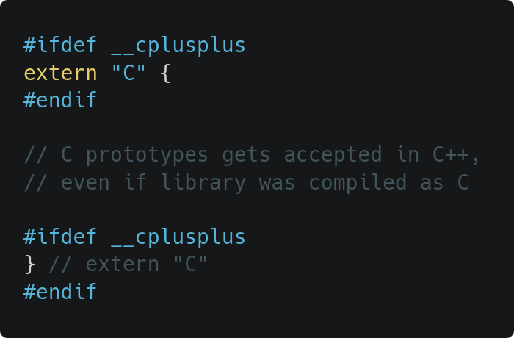
C++ is highly backward compatible

Slide 11
Safety-critical situations
C is fine choice for most of the safety-critical applications, because it does exactly what the programmer tells it to do. There's no magic going on behind the scenes which could have complex interactions with other behind the scenes magic.

Slide 12
Thank you for the attention
Further reading:
C99 with TC1, TC2, and TC3 included
comp.lang.c FAQ
History of C
My original article

