Slide 1







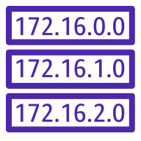










AWS Cloud
Region: Ohio
Virtual private cloud: C3E10_VPC
10.0.0.0/16
Availability Zone: US East (Ohio) / us-east-2a
Client
Public subnet: C3E10-public-a
10.0.0.0/24
Mobile client
C3E10-back
C3E10_RT
C3E0_IGW
Internet
Ubuntu Server 220.4 t2.micro
Imágenes
Front

Slide 2
main
develop
frontEnd
backEnd

Slide 3
