Slide 1


University of Sheffield, Department of Psychology
Modelling the impact of deep brain stimulation on the basal ganglia output to the thalamus
Jorge Díez García-Victoria
Supervisors: Robert Schmidt and Mohammadreza Mohagheghi Nejad
MSc Cognitive and Computational Neuroscience
July 2020

Slide 2
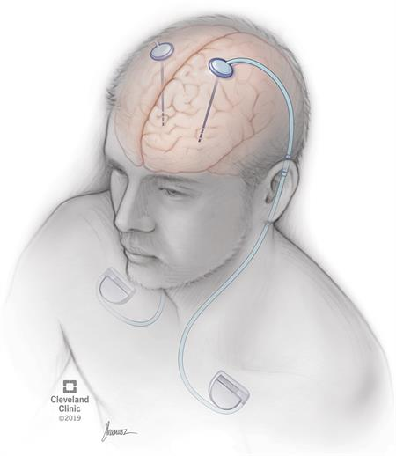
Introduction
- Deep Brain Stimulation (DBS) is used to treat parkinsonian symptoms, such as tremors and akinesia
- Various studies find changes in firing rates, bursting activity, number of neurons affected, etc.
- The impact of correlations in the basal ganglia output is not taken into account.
Source: Cleveland Clinic (2019)

Slide 3
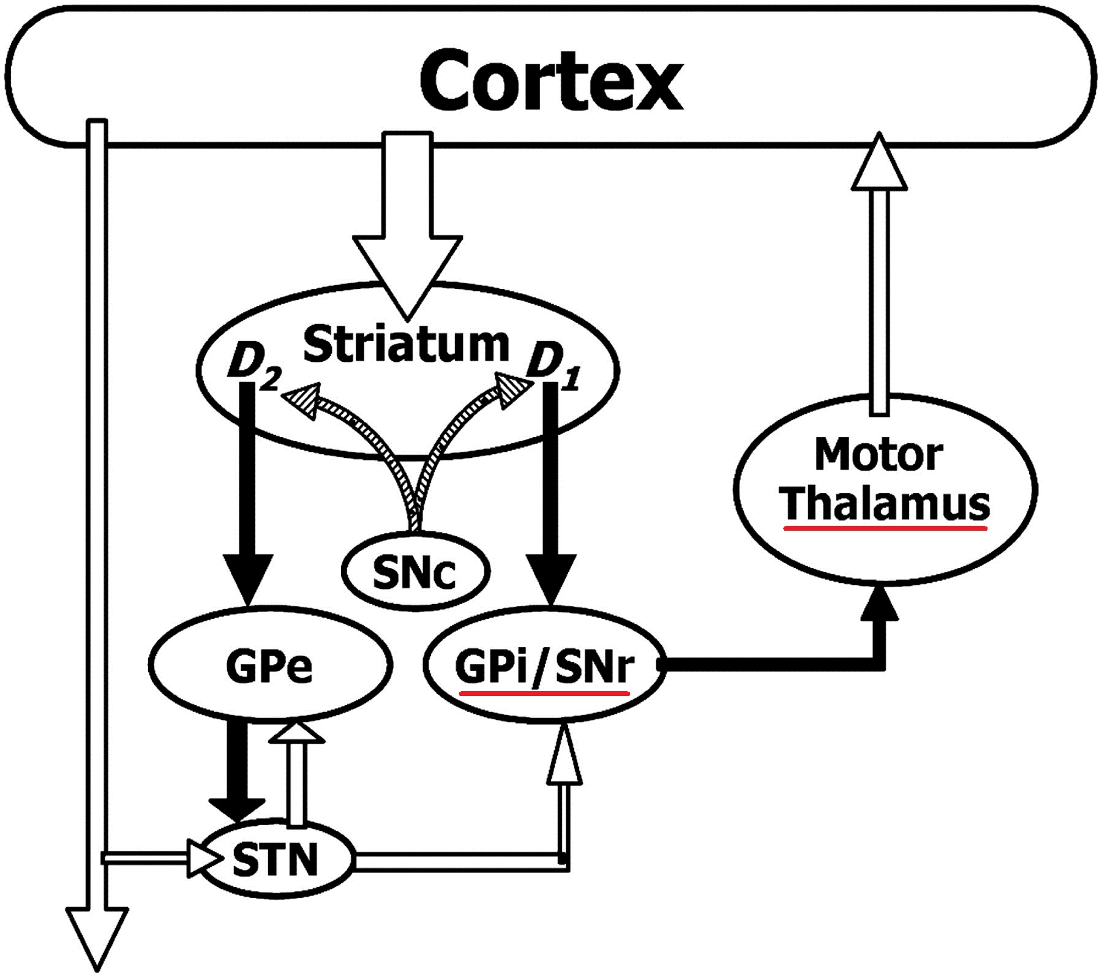
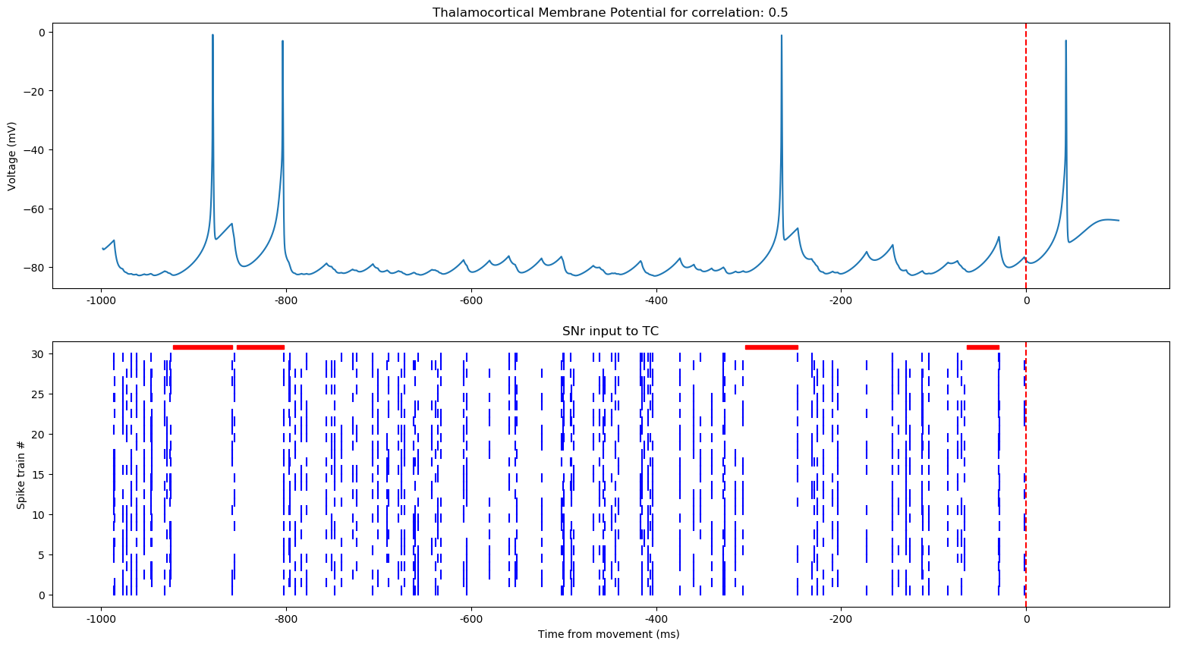
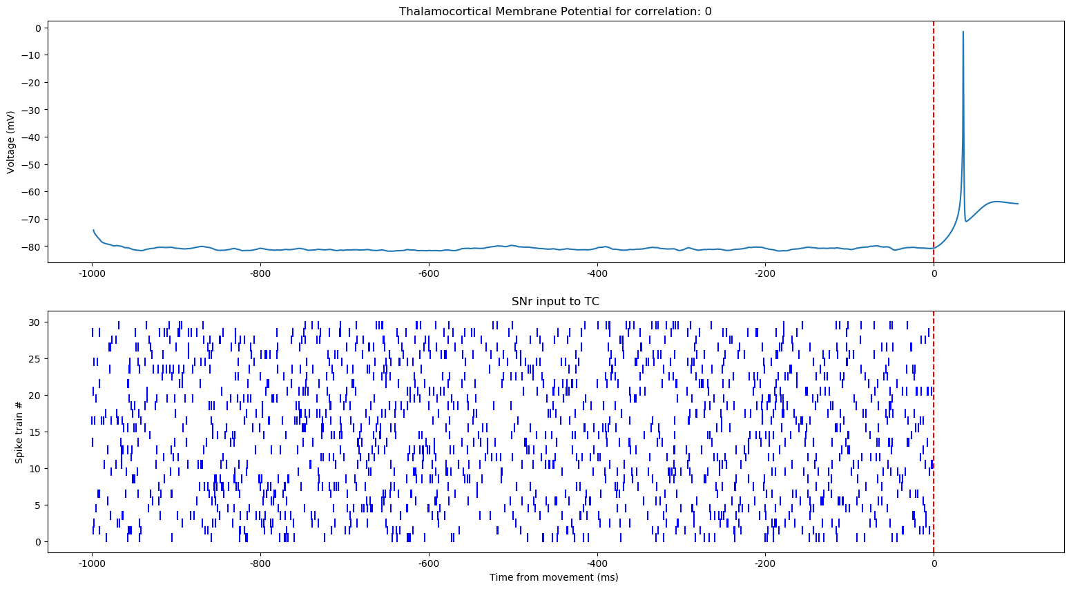
The importance of Correlation
- The basal ganglia output transmits motor signals by inducing rebound spikes in the motor thalamus
Modeling facilitation and inhibition of competing motor programs in basal ganglia subthalamic nucleus–pallidal circuits. Rubchinsky et al, 2003

Slide 4
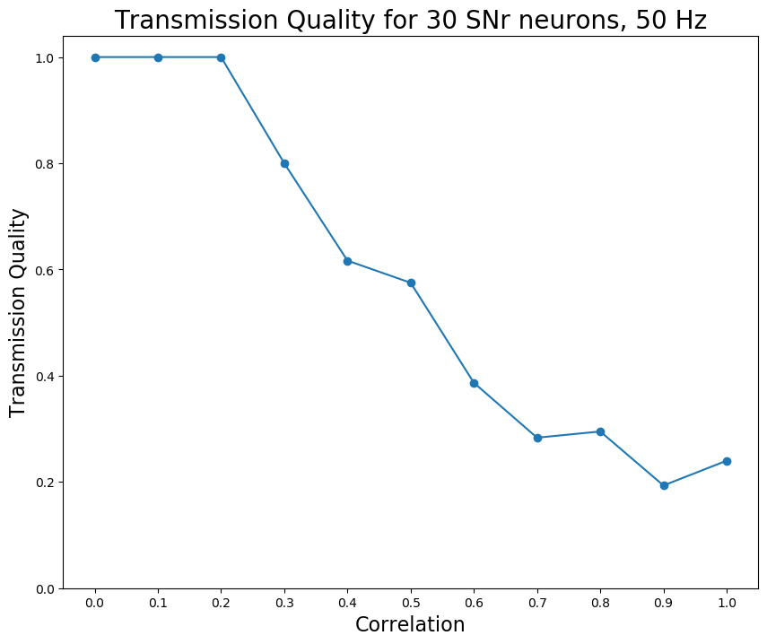
Transmission Quality
What is the impact of deep brain stimulation on the correlation of the basal ganglia output?

Slide 5
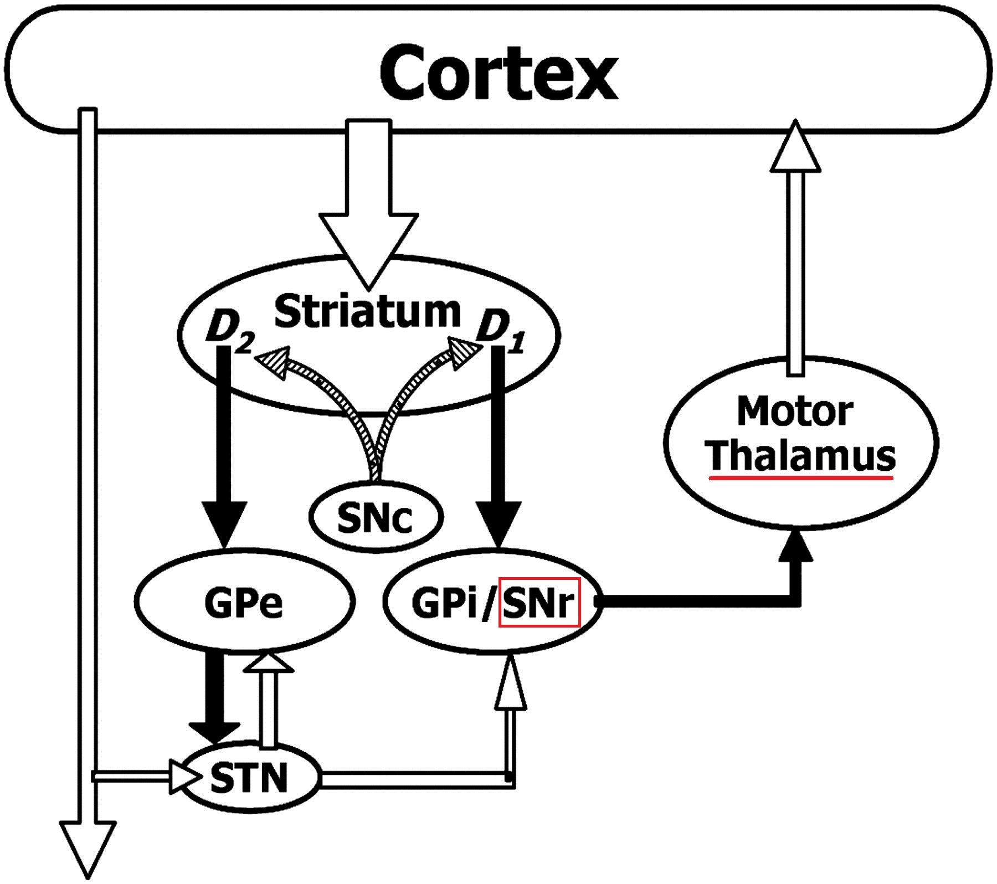
Methods
- Hodgkin-Huxley thalamocortical neuron with SNr (30) input.
- DBS simulations where parameters in simulation were number of SNr neurons affected and frequency increase from baseline of 50 Hz
- Two different methods for correlation among SNr neurons

Slide 6
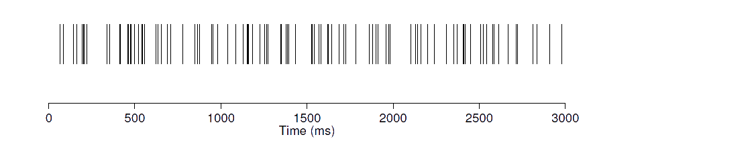



SNr Correlation
- Example: generate 30 different 50 hz spiketrains with 0.5 correlation rate
1- Create mother spike train with F = 50/0.5 Hz firing rate
Mother spike train
100 Hz
2- Choose 50 random spikes for each different spiketrain
50 Hz
50% pairwise correlation

Slide 7
SNr Correlation
Neurons can either be affected by DBS or remain at 50 Hz
20 neurons remain at 50 Hz || 10 Neurons increased to 80 Hz
Generate mother spike train for 80 Hz
Generate mother spike train for 80 Hz and create 10 neurons
Choose 80 and 50 random positions from mother spike train
Generate different mother spike train for 50 hz for other 20
Decorrelated

Slide 8
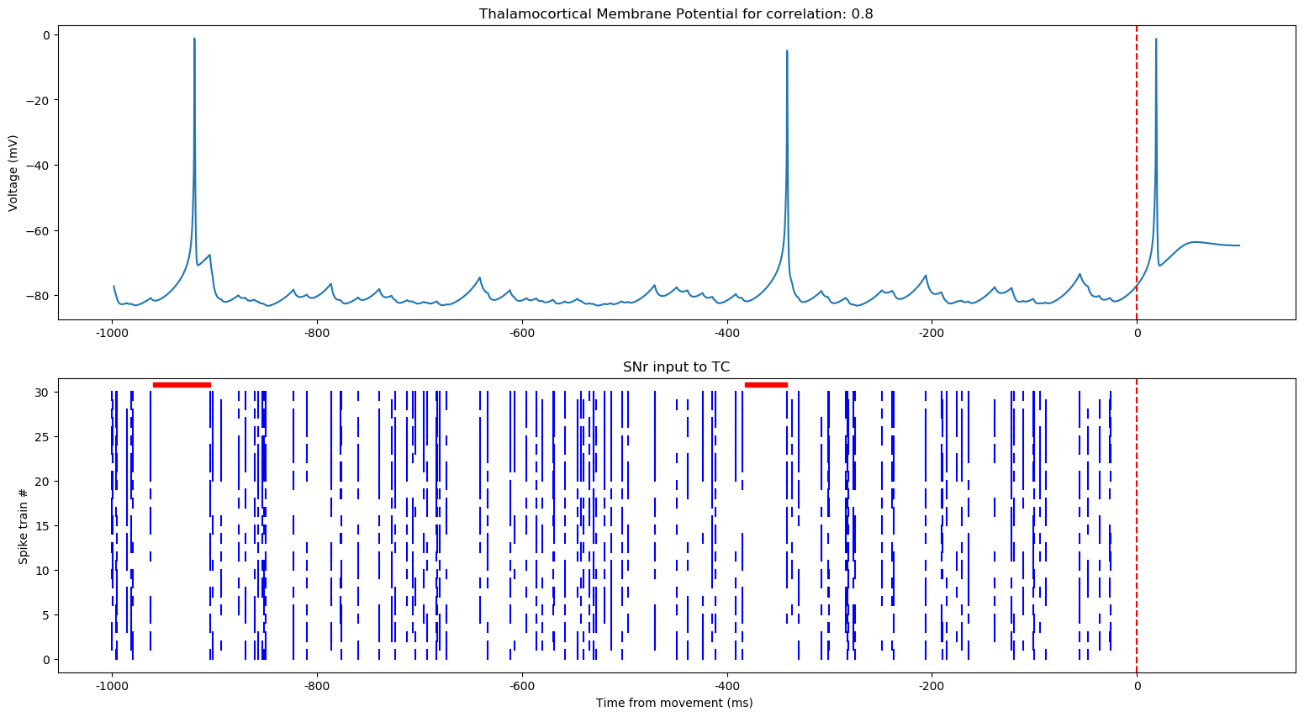
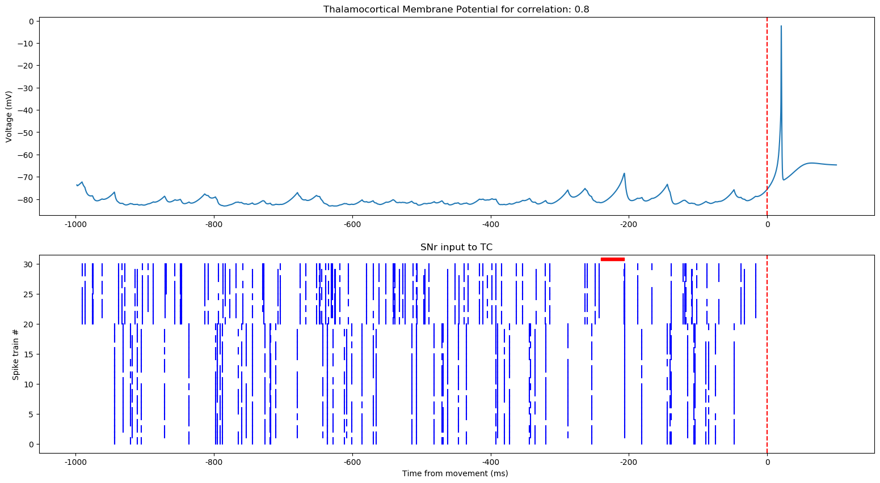
Results
Decorrelation plays a role in TQ
20 neurons remain at 50 Hz || 10 Neurons increased to 80 Hz
Spike deletion method (no decorrelation)
Spike decorrelation method

Slide 9
Discussion
- Decorrelation could explain different scenarios where DBS seems to not have any effect despite apparent changes
- Detailed spike train data from SNr should be collected and analyzed to investigate further

Slide 10
University of Sheffield, Department of Psychology
Contact
jdiezgarcia-victoria1@sheffield.ac.uk
MSc Cognitive and Computational Neuroscience
July 2020
Main sources
Mohammadreza Mohagheghi Nejad, Stefan Rotter and Robert Schmid (2019) Transmission of motor signals from the basal ganglia to the thalamus: effect of correlations, sensory responses, and excitation
Mark D. Humphries and Kevin Gurney (2012) Network effects of subthalamic deep brain stimulation drive a unique mixture of responses in basal ganglia output
Philip J. Hahn et al (2008) Pallidal burst activity during therapeutic deep brain stimulation

