Slide 1
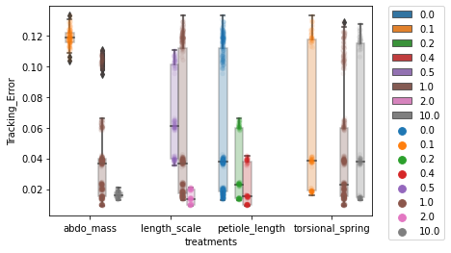
All the data put together….

Slide 2
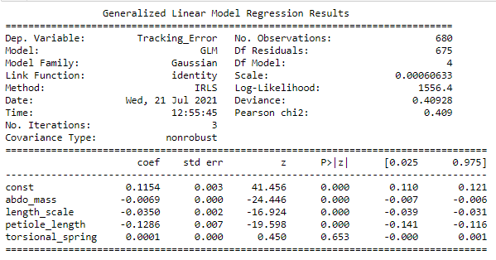

GLM formula
Tracking Error = β₀ + β₁* abdo_mass + β₂* length_scale + β₃*petiole_length + β₄* torsional spring
Summary:
abdominal mass, length scale and petiole has a negative effect on Tracking error i.e. increasing these values decreases error.
Torsional spring does not have a significant effect on the tracking error.
Fitted β
Expanded p values for fit estimates

Slide 3
GLM formula
Error = β₀ + β₁* + β₂* + β₃* + β₄*
Things I still need to figure out
Right now – I have just used gaussian model to fit these. That is, I assume that the “error” or distribution at each level is gaussian – so the purple distribution here for instance is gaussian!
Which is linked to second concern: how do I estimate interactions between variable say – petiole length and length scale?
Fitted
β

Slide 4
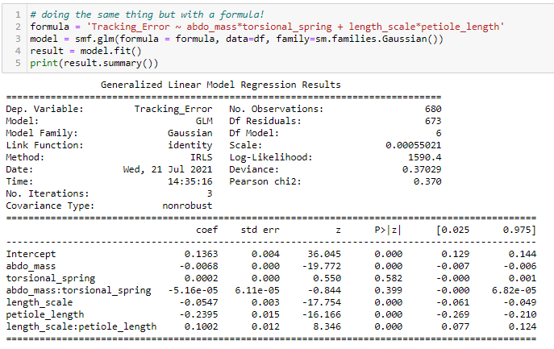
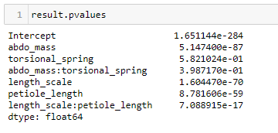
GLM formula – explicitly set up interaction terms:
Tracking Error = β₀ + β₁* length_scale + β₂* petiole_length + β₃*length_scale* petiole_length + β₄* torsional spring + β₅ * abdo_mass + β₅* length_scale * abdo_mass
Results stay mostly unchanged:
All variables except torsional spring and the joint effect of torsional spring and abdominal mass have a significant negative effect on tracking error.
Length and petiole together have a slight positive slope. So, we have to careful how we interpret the slope of these two independently.

Slide 5
Here is my attempt to visualize it…

Slide 6
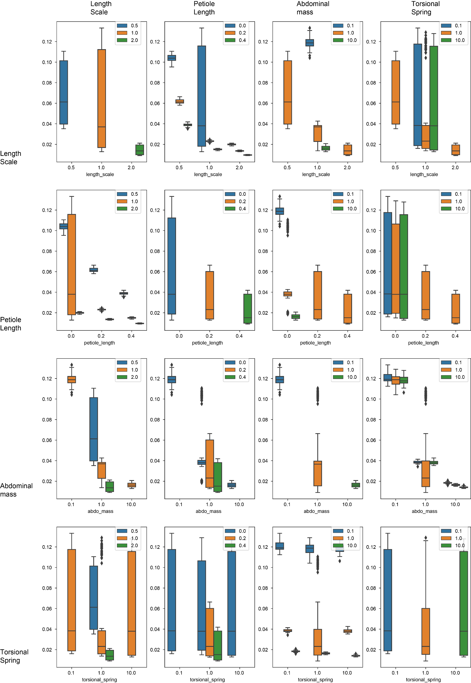
colors
Another look at the same data
For a primer on how to look at read this plot –
Let’s say we want to assess the role of
torsional spring -- so look at last row (the x axis) and the last column (the different colors represent different spring constant) – it is clear that it makes no difference to tracking error.
Now let’s look at petiole length – so second row (values increase along x axis) and second column (different colors represent different length) – has a clear negative effect – but notice the variation in the middle blue boxplot.
That is presumable coming from the other
variables that were also different in this case – mass of abdo and spring constant but I have to wrap
my head around whether we should include
those interactions in the model.
X axis

