Slide 1
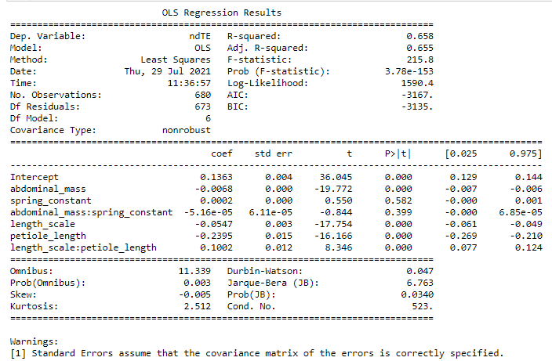
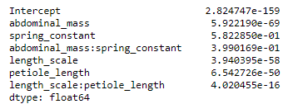
Vertically oscillating
Tracking error
Model summary
P values for fitted coefficients (slope) for all regressors

Slide 2
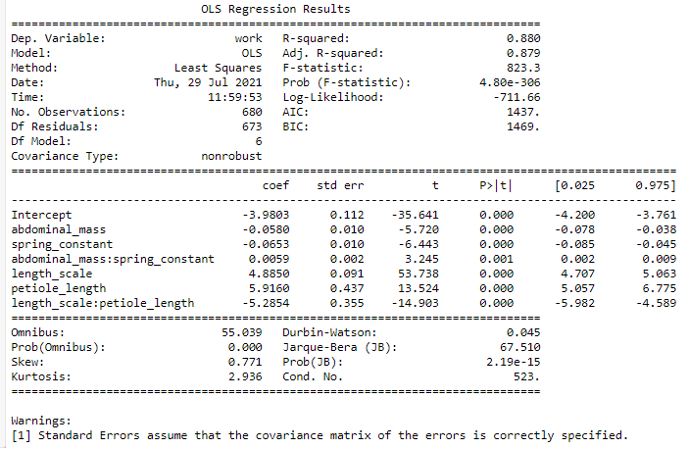
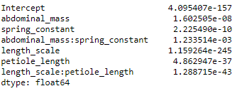
Vertically oscillating
Work
Model summary
P values for fitted coefficients (slope) for all regressors

Slide 3
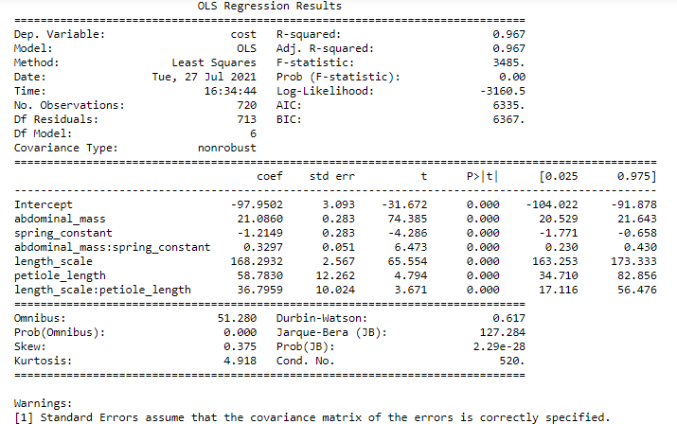
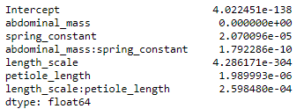
Vertically oscillating
Cost
Model summary
P values for fitted coefficients (slope) for all regressors

Slide 4
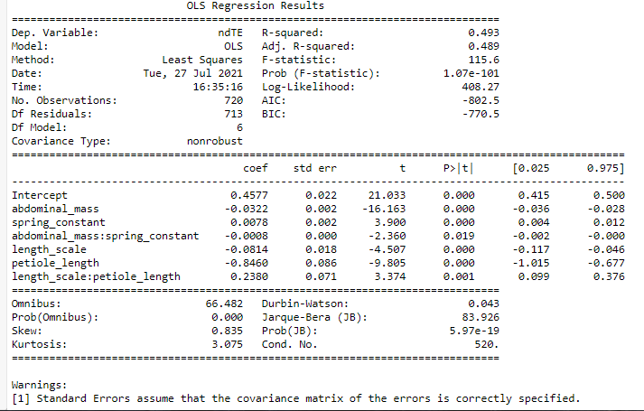
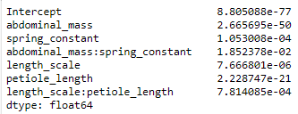
Hovering
Error
Model summary
P values for fitted coefficients (slope) for all regressors

Slide 5
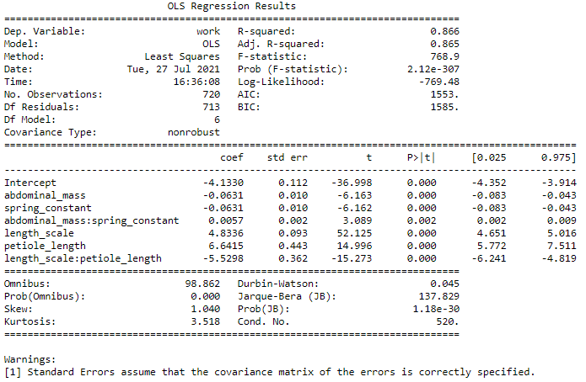
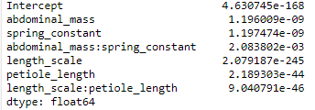
Hovering
Work
Model summary
P values for fitted coefficients (slope) for all regressors

Slide 6
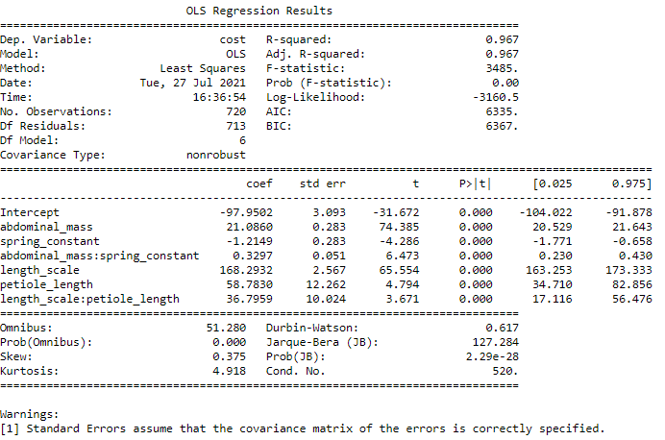
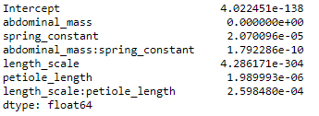
Hovering
Cost
Model summary
P values for fitted coefficients (slope) for all regressors

